Slide 1
Wild Fire (B)
Stuart Heeb Johannes Kurz Yitong Xia Yingyan Xu

Slide 2
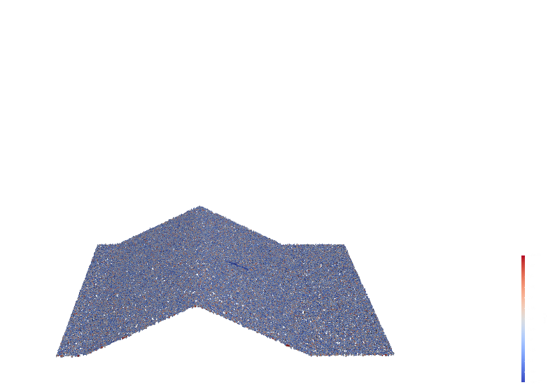
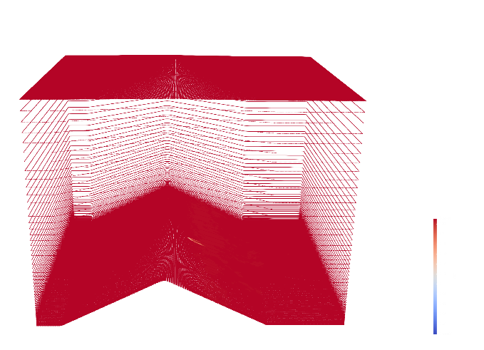
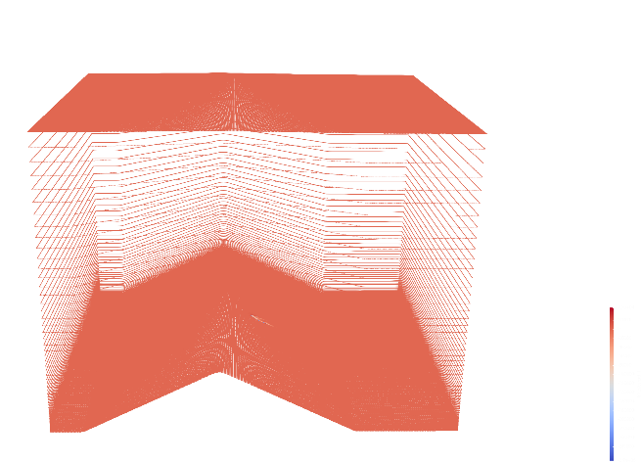
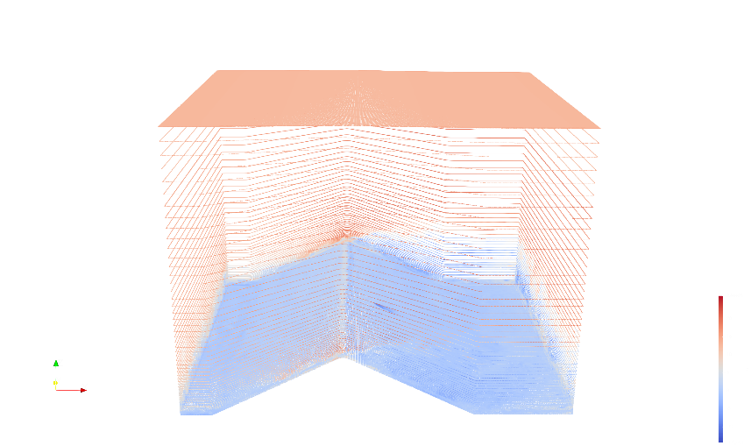
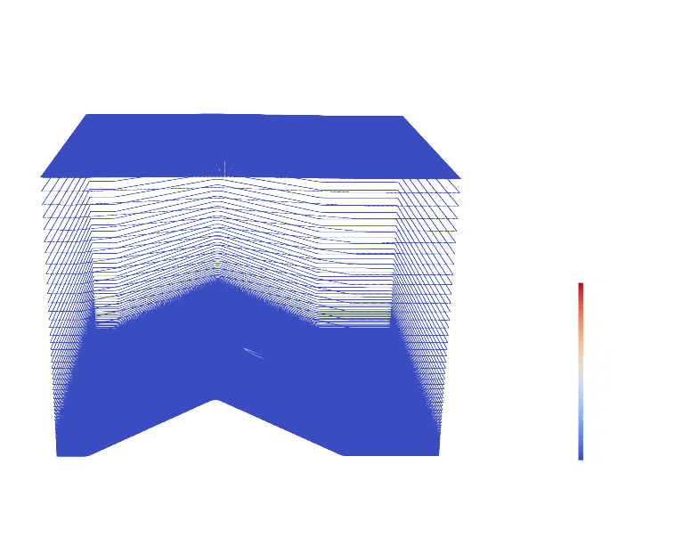
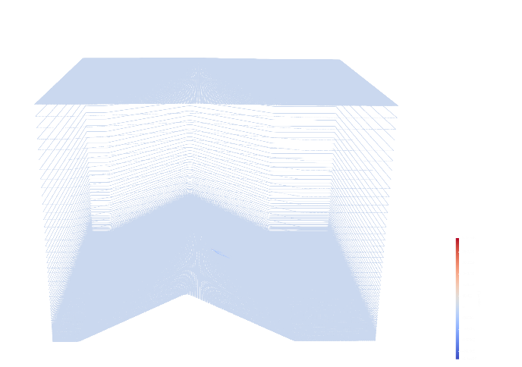
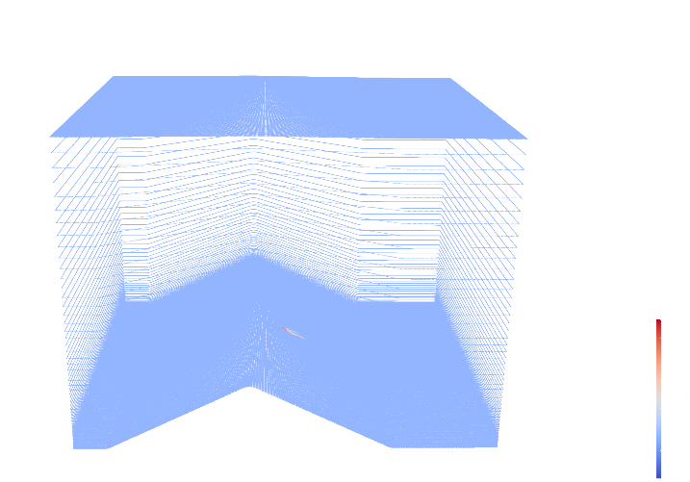
Project Start
What is the data set about?
O2: oxygen
frhosiesrad: fire-induced radiative heat transfer
rhof: bulk density of dry fuel
u, v, w: velocity field of wind
convht: convective heat transfer
rhowwatervapor: bulk density of the moisture released due to burning
theta: temperature

Slide 3
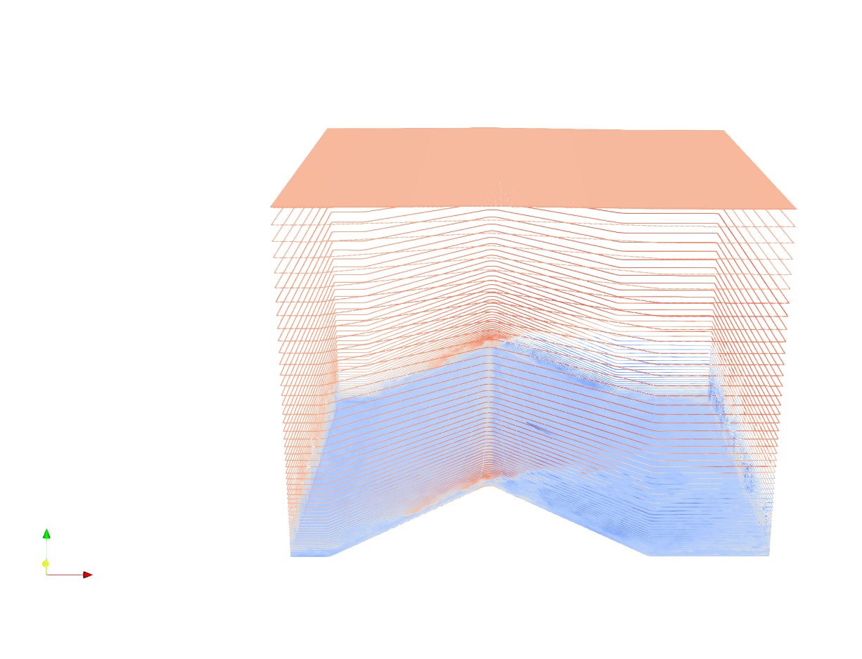
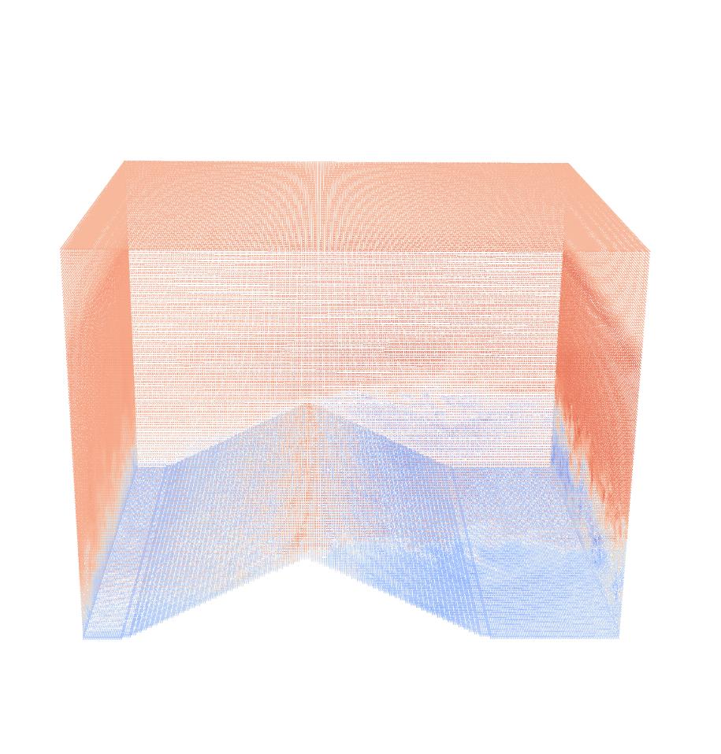
Project Start
What kind of data is given?
Time series data of necessary physical parameters for visualizing burning, stored in Curvilinear Grids that outline the terrain surface.
All quantitative data.
Convert to Uniform Rectilinear Grids.
ResampleToImage

Slide 4
Project Start
What do you want to visualize?
Which variables of the data set do you want to show?
Temperatures under burning process.
Bulk density (vegetation density) under burning process.
Wind velocity and vorticity field.
Which features or structures of the data set do you want to concentrate on?
Velocity and vorticity field of wind.
Influences of terrain, atmosphere, moisture and fire state on Vorticity-driven Lateral Spreading (VLS) behvior.
Do you derive quantitative information from features of the data set?
Spread extent of wildfire.
Vorticity from velocity field.
What is the story that you want to communicate?
Temporal evolution of wild fire burning on vegetation.
Impacts of different environmental factors on wild fire spreading.

Slide 5
Project Start
How do you visualize it?
Wind: derive wind vorticity field and streamline.
Vegetation: coloring according to the density of bulk.
Terrain: visualize in 3D surface mesh, inferred from the curvilinear grid.
Smoke & Fire: Coloring and animating smoke and fire according to the temperature. Maybe use volume rendering to improve visualization quality.

Slide 6
Project Start
Timeline
Until the milestone presentation (24.04.2023) we have finished:
Building code pipelines.
Visualizing wild fire.
Until the final presentation (22.05.2023) we have finished:
Visualizing wind, vegetation, terrain.

