Slide 1

Stuart Page - Engineering Meeting
FROZEN ACCIDENTS
Notes:
Cold open. Multiplayer game; Elixir backend ticks 20x/sec, JS client predicts. Fine on Linux, drifted on Windows. Follow that bug all the way down.

Slide 2
01
ACT 01
The bug
frozen_accidents

Slide 3

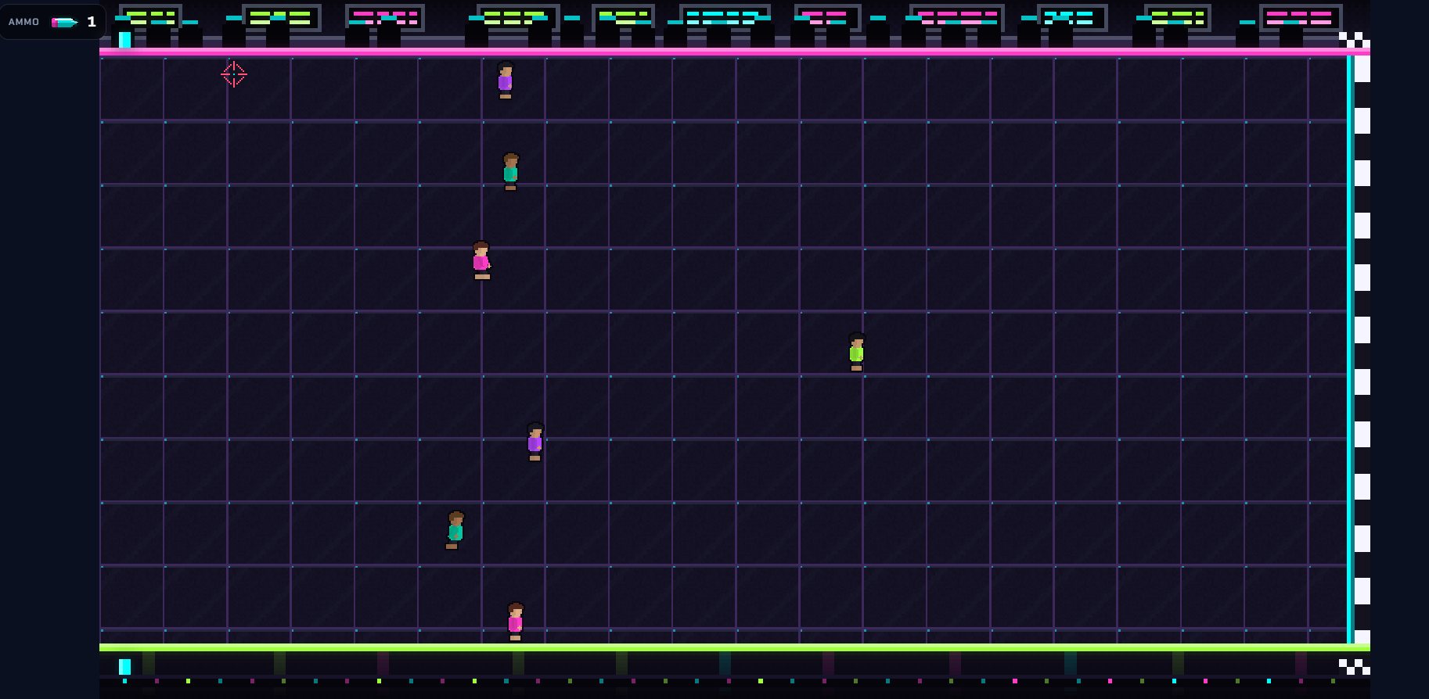
01 · THE BUG
> What I was working on
I’ve been vibe-slopping a small multiplayer game called ‘Dead Giveaway’. There’s an Elixir backend, that ticks 20 times a second. The JavaScript client fills in the motion between ticks so it looks smooth.
But I had a bug: when I was running locally, my character seems to sometimes ‘backslide’ for no reason.
This seems to get worse the further you run.
frozen_accidents
03
Notes:
20 Hz server, client predicts between ticks. Linux fine. Windows: growing desync. The growing part matters later.

Slide 4
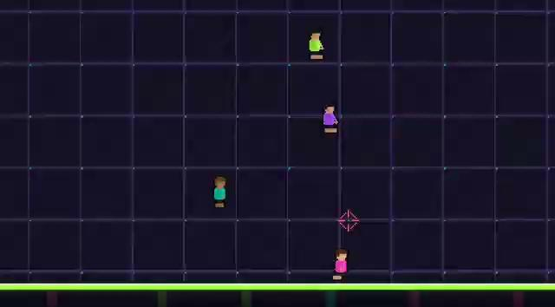
01 · THE BUG
Important note: this only happened really, really badly while I was developing locally (on my Windows machine). The deployed game (on Fly) still slid around sometimes, but it wasn’t nearly as bad. THIS WILL BE EXTREMELY RELEVANT LATER
frozen_accidents

Slide 5
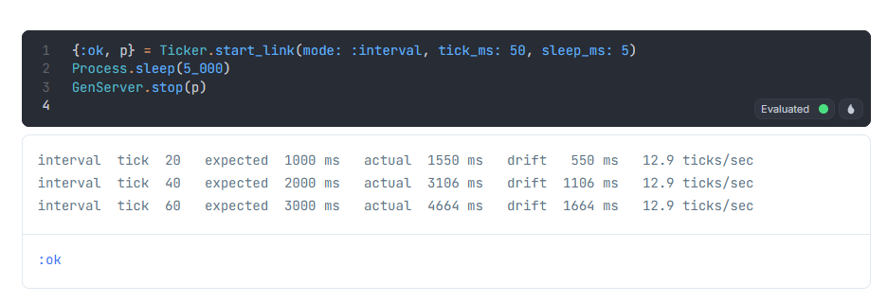
01 · THE BUG
WINDOWS
frozen_accidents

Slide 6
01 · THE BUG
> Let’s look at some code
To make matters worse…
The code schedules each tick relative to the previous one, which means the errors get worse and worse
Now…I was trying to be fancy, and had asked for client side prediction (which Flappy Phoenix does not have). In essence – the server is still the source of truth, but this allows snappy movement with reconciliation after the fact
The client is ticking along very nicely, but the compounding error means…
defp handle_info(:tick, state) do:
# adjust game state stuff
schedule_tick(state.tick_ms)
{:noreply, state}
end
defp schedule_tick(tick_ms), do: Process.send_after(self(), :tick, tick_ms)
So what’s the issue with this? Let’s say the tick is 50ms
`Process.send_after/3` calls `:erlang.send_after`
BEAM stuff: adds one entry to a BEAM scheduler "at time T, send :tick to this pid.“
These are OS threads, and if they run out of stuff to do they go sleep, and ask to be woken up in 50ms
This is where the OS matters: on Windows, FOR SOME GODFORSAKEN REASON, the wake-ups are only processed on a beat of 15.625ms
This means a timed wait can only come due on a check: so it rounds up to the next one.
asked: 50 ms
rounds up to 62.5 ms
15.625
31.25
46.875
62.5
frozen_accidents
#1
#2
#3
#4

Slide 7
01 · THE FIX
> Keep an appointment book
BEFORE
defp schedule_tick(tick_ms), do: Process.send_after(self(), :tick, tick_ms)
So why does this fix it?
Now we keep a accurate guess of where the tick should be, and correct for it
Take the time
Take the next tick prediction plus our tick rate and this time (and use max() to make sure it’s in the future
Use that to peg us to our tick rate (send_after no longer just always sends the rate
But I found this solution dissatisfying. But why? Why does Windows do this? What does Linux do? What does macOS do?
AFTER
defp schedule_tick(state) do
now = System.monotonic_time(:millisecond)
deadline = max(state.next_tick_at + state.tick_ms, now)
Process.send_after(self(), :tick, deadline - now)
%{state | next_tick_at: deadline}
end
frozen_accidents
07
Notes:
The fix isn't OS-specific. You fix what you do about being late. Late wake -> shorter next sleep.

Slide 8
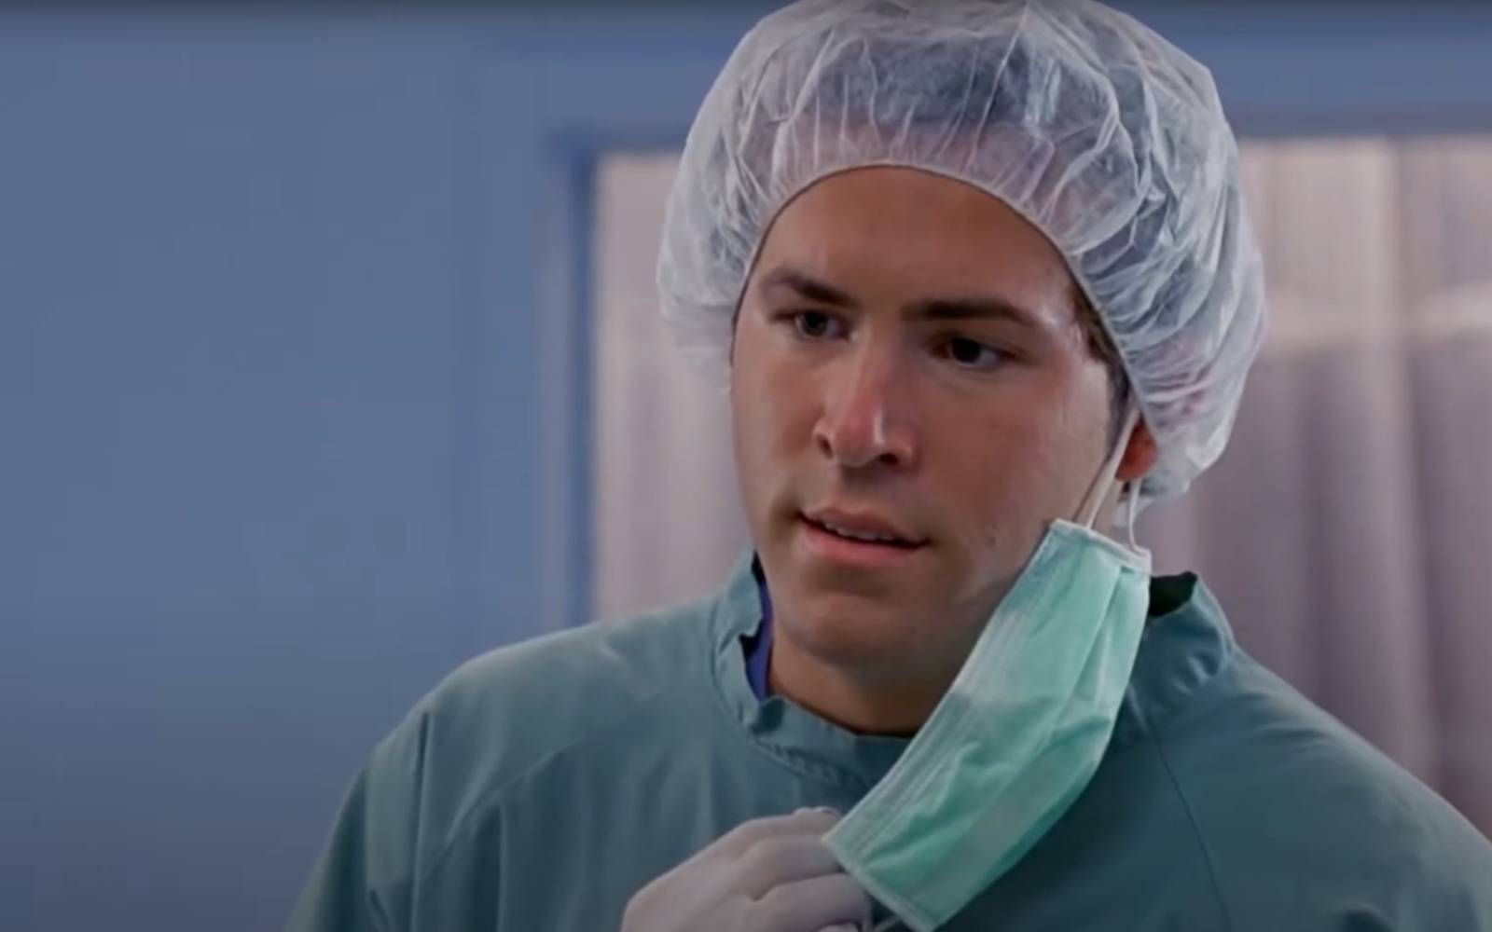
02
WHY? WHY? WHY? WHY? WHY? WHY?
WHY? WHY? WHY? WHY? WHY? WHY?
WHY? WHY? WHY? WHY? WHY? WHY?
WHY? WHY? WHY? WHY? WHY? WHY?
WHY? WHY? WHY? WHY? WHY? WHY?
WHY? WHY? WHY? WHY? WHY? WHY?
WHY? WHY? WHY? WHY? WHY? WHY?
WHY? WHY? WHY? WHY? WHY? WHY?
WHY? WHY? WHY? WHY? WHY? WHY?
WHY? WHY? WHY? WHY? WHY? WHY?
WHY? WHY? WHY? WHY? WHY? WHY?
WHY? WHY? WHY? WHY? WHY? WHY?
WHY? WHY? WHY? WHY? WHY? WHY?
WHY? WHY? WHY? WHY? WHY? WHY?
WHY? WHY? WHY? WHY? WHY? WHY?
WHY? WHY? WHY? WHY? WHY? WHY?
WHY? WHY? WHY? WHY? WHY? WHY?
WHY? WHY? WHY? WHY? WHY? WHY?
WHY? WHY? WHY? WHY? WHY? WHY?
WHY? WHY? WHY? WHY? WHY? WHY?
WHY? WHY? WHY? WHY? WHY? WHY?
WHY? WHY? WHY? WHY? WHY? WHY?
WHY? WHY? WHY? WHY? WHY? WHY?
WHY? WHY? WHY? WHY? WHY? WHY?
WHY? WHY? WHY? WHY? WHY? WHY?
WHY? WHY? WHY? WHY? WHY? WHY?
WHY? WHY? WHY? WHY? WHY? WHY?
But why?
ACT 02
frozen_accidents

Slide 9
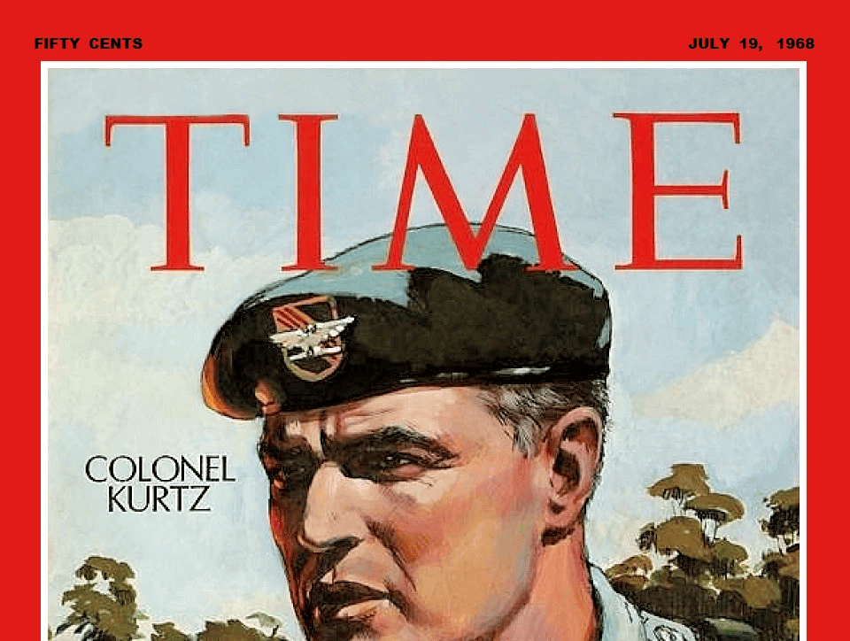
02 · DOWN THE STACK
> Two ways for a kernel to keep time
You can be ticky or tickless
The Windows default is to be ticky: Check your watch every 15 minutes, and see if anything has to be done. Do it. Go back to sleep
The Linux way (since 2007) is to be tickless. Set an alarm for when you have to do the thing, and sleep until you have to do the thing.
-
frozen_accidents
11
Notes:
Same hardware, two philosophies. The chip was always programmable; ticky vs tickless is a default.

Slide 10
02 · THE CRYSTAL
> All a CPU can do is count beats
Quartz is piezoelectric: bend it and it makes a voltage; apply a voltage and it bends. Cut to size, it vibrates at a maniacally steady rate, good to a few parts per million.
32,768 Hz
A processor has no sense of time of its own. Time of day is just those beats counted from a known start, exactly what the quartz watch on your wrist does.
= 2^15
/ 15-bit counter -> 1 Hz
the real-time clock tick - same as your quartz watch
frozen_accidents
13
Notes:
Crystal is the metronome. 32,768 = 2^15, divides to exactly 1 Hz. Same crystal as a quartz watch.

Slide 11
02 · THE PAYOFF
> Why 14.31818 MHz?
14.31818 MHz
the original IBM PC's master crystal
Because it's exactly 4x the colour frequency of NTSC television - and TV crystals were mass-produced and dirt cheap. The PC's video had to look like a TV anyway, so IBM grabbed the cheapest oscillator already in every factory.
/ 4 3.579545 MHz
/ 3 4.772766 MHz
/ 12 1.193182 MHz
NTSC subcarrier - still in the ACPI timer spec today
the famous 4.77 MHz CPU clock
the PIT timer chip
NTSC went off the air in the US in 2009. The frequency stayed - emulating it costs nothing, and removing it would break the past.
frozen_accidents
14
Notes:
The why: TV crystals were mass-produced and cheap; PC video had to be TV-compatible. 14.31818 = 4x NTSC subcarrier. ACPI timer still spec'd at 3.579545 today.

Slide 12
02 · THE IDEA
FROZEN ACCIDENT
A decision whose original reason is gone, kept because removing it would break something old and emulating it costs nothing.
They stick around because removing them never quite feels worth the trouble.
frozen_accidents
15
Notes:
Land the thesis as a definition. Once you can name one, you see them everywhere -> Act 3.

Slide 13
03
ACT 03
The same shape, everywhere
Once you can name one frozen accident, you start seeing them in everyday code.
frozen_accidents

Slide 14
03 · FOSSILS
> Why your editor's ruler sits at 80
the US dollar bill
Fortran: columns 73-80 for sequence numbers
PEP 8, your linter, the ruler line
1860s
1950s
today
1928
1978
IBM's 80-column card, cut to fit a cash drawer
DEC VT100 fixes the screen at 80x24
Five dead technologies, each handing the number to the next like a surname. (Guess the year on the slide: 1928.)
frozen_accidents
17
Notes:
Currency -> card -> Fortran -> VT100 -> your editor. Terminal emulators still boot imitating a VT100.

Slide 15
03 · FOSSILS
> Three you touch every day
The C drive
\r\n
Referer
A: and B: were the floppy drives. They're long gone; the gap stayed behind.
A teletype did two physical things: returned the carriage, then fed the line. Unix kept only the feed. It still breaks your Git diffs.
The header that tells a site which page you came from. Its name is a 1995 typo for "referrer," caught too late - so it's now, forever, the referer we all keep referring to.
frozen_accidents
18
Notes:
Fact -> why -> you-touch-this. The Referer pun: the referer we keep referring to.

Slide 16
03 · FOSSILS
> From two horses' rears to a rocket
two horses
side by side
>
horse-drawn
mine wagons
>
Stephenson's
railways, 1820s
>
standard gauge
4 ft 8.5 in
>
Shuttle boosters
shipped by rail
A Space Shuttle booster had to fit the rail tunnels on the way to the launch pad - so its width traces back to the back end of a horse.
Mostly a tall tale - but the railway gauge really does descend from horse-drawn wagons. The frozen accident is real; the Roman chariots and the rocket are decoration.
frozen_accidents
19
Notes:
Honest version: standard gauge descends from horse-drawn mine wagons via Stephenson; Roman chariots and the Shuttle punchline are embellishment (Snopes: false, partly true for trivial reasons).

Slide 17
03 · FOSSILS
> A two-week stopgap you'll use forever
2005. The Linux kernel loses access to the proprietary tool it relied on. Linus Torvalds writes the first version of git in about ten days.
"I'm an egotistical bastard, and I name all my projects after myself.
First Linux, now git."
- Linus Torvalds · "git" is British slang for an unpleasant person
frozen_accidents
20
Notes:
Two-week rage project, named as a self-deprecating joke. Man page: the stupid content tracker.

Slide 18
03 · MYTH
MYTH
> QWERTY didn't slow you down
The story everyone repeats: the layout was designed to keep typists slow so the typebars wouldn't jam.
But "e" and "r" sit right next to each other - one of the most common pairs in English. A layout built to separate frequent pairs would never do that.
Nobody is sure why the keys ended up here. What we do know is why they stayed: everyone had already learned it. That lock-in is the whole point of this talk.
frozen_accidents
21
Notes:
Present as a myth. The anti-jam claim fails the er-adjacency test. It survived through training and lock-in.

Slide 19
04 · OUR TURN
> What will they laugh at us for?
We smile at a television frequency and a missing drive letter. So what are we shipping right now that reads the same way in forty years?
03:14:07 UTC · 19 Jan 2038
signed 32-bit Unix time runs out, and we're still writing it into new systems
on the same bench: money kept in floating point · code that assumes the clock only moves forward
frozen_accidents
22
Notes:
2038 is on the calendar; we're minting the fossil now. Floats for money, monotonic assumptions.

Slide 20
04 · TAKEAWAY
The crystal is good to parts per million; the trouble is always the policy we stack on top of it.
Chesterton's fence. When you meet a strange constant or a baffling default, find out why it's there before you tear it out. The reason is usually real, just very old.
The one part of the machine that never lies to you, counting 32,768 times a second.
frozen_accidents
23
Notes:
Close on the lesson, then the crystal callback.

Slide 21
Thanks.
Questions - and your most-cursed "why is it like this?"
the bug & the fix: github.com/stuartjohnpage/dead_giveaway/pull/58
frozen_accidents
Notes:
Open the floor and crowd-source a frozen-accident hall of fame.

