Slide 1
Master project
Jian Sun

Slide 2
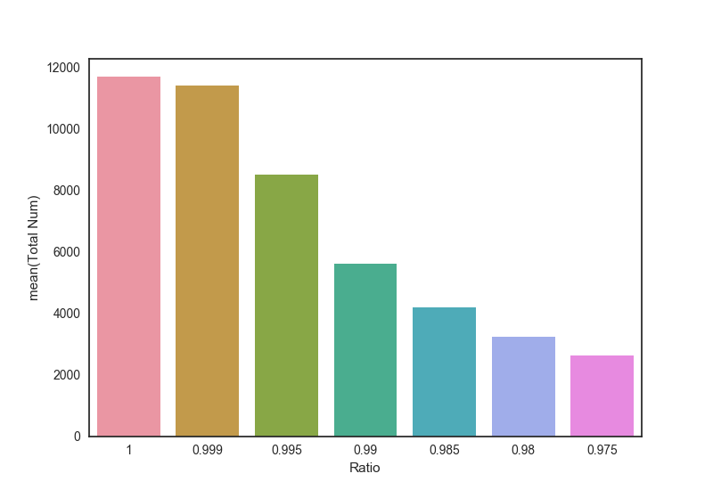
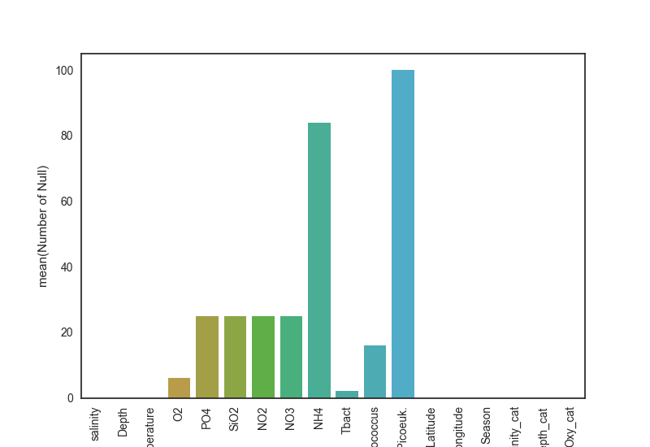
Data cleaning
Percentage of Zero
Number of Null

Slide 3
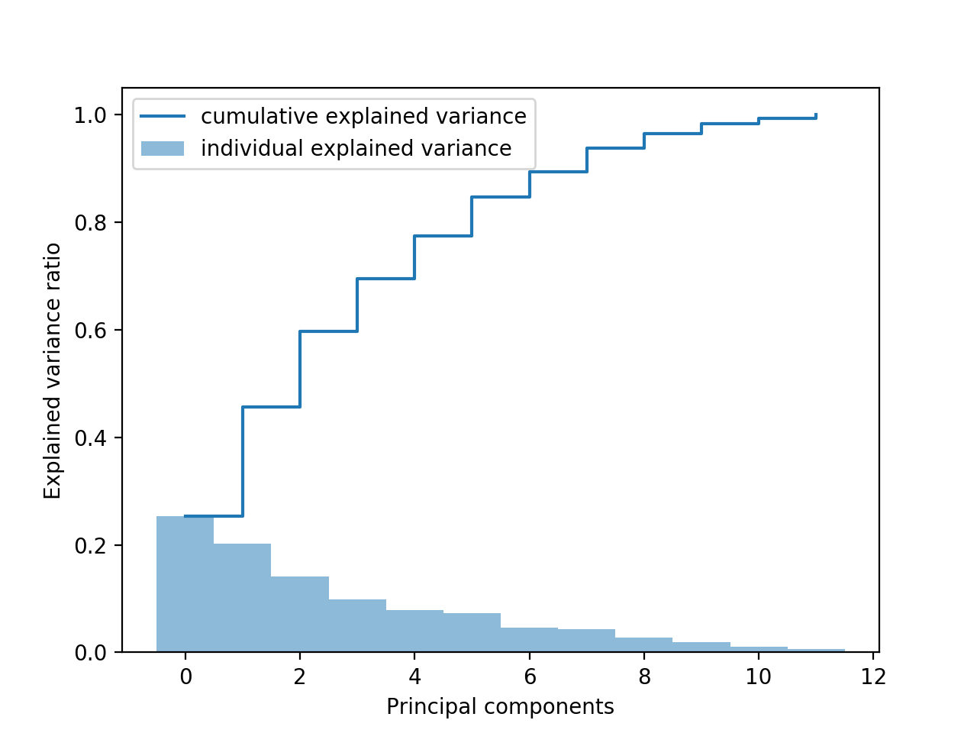
Curse of dimensionality
PCA

Slide 4
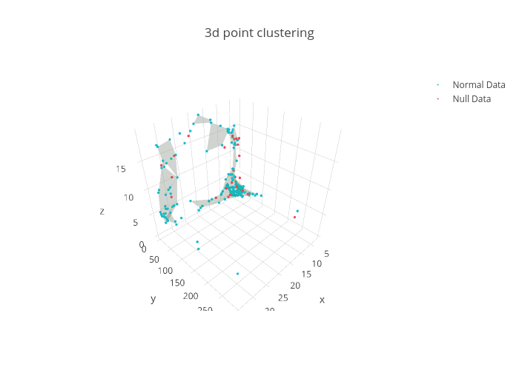
Data mending
1-Nearest Neighbor
3D-clustering

Slide 5
Training model
1. Multi factor line regression method
2. ANN-BP
3. ANN-ELM
4. Random Forest

Slide 6
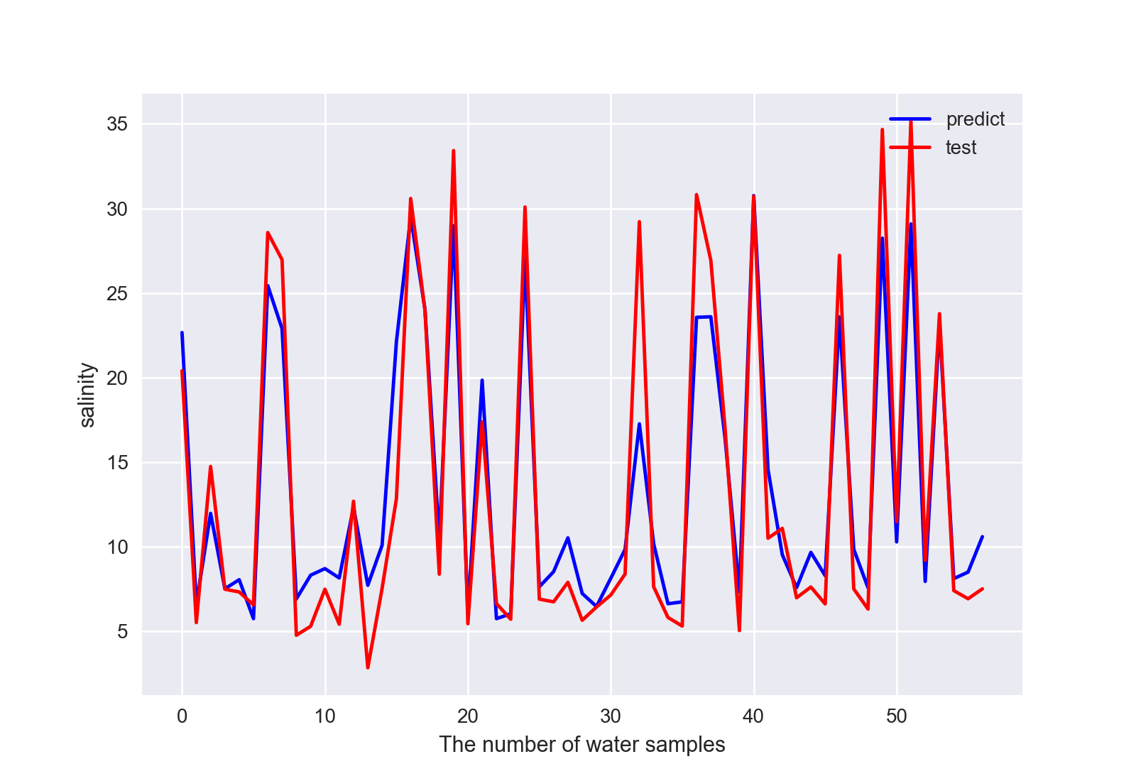
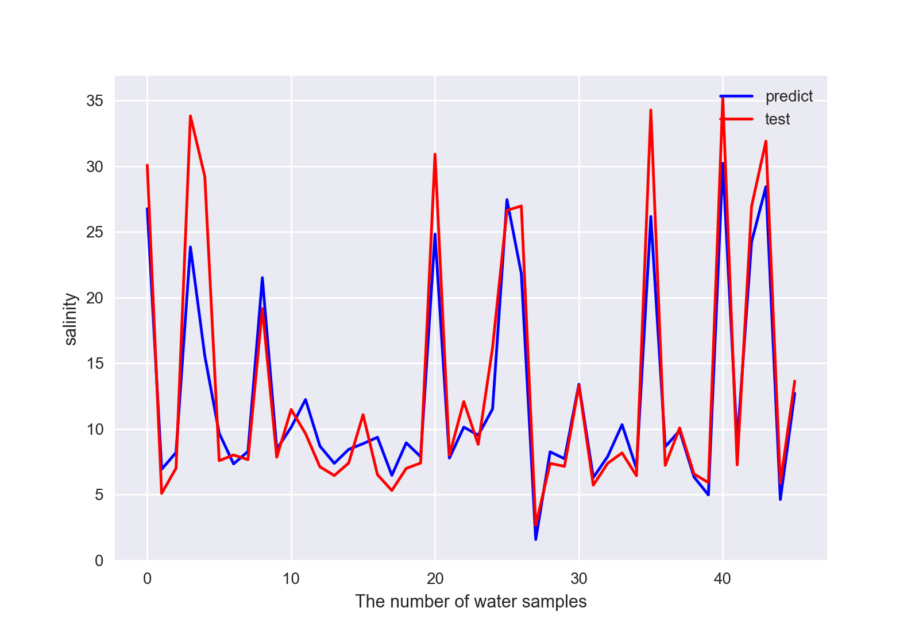
Multi factor line regression method
Ca 15 seconds

Slide 7
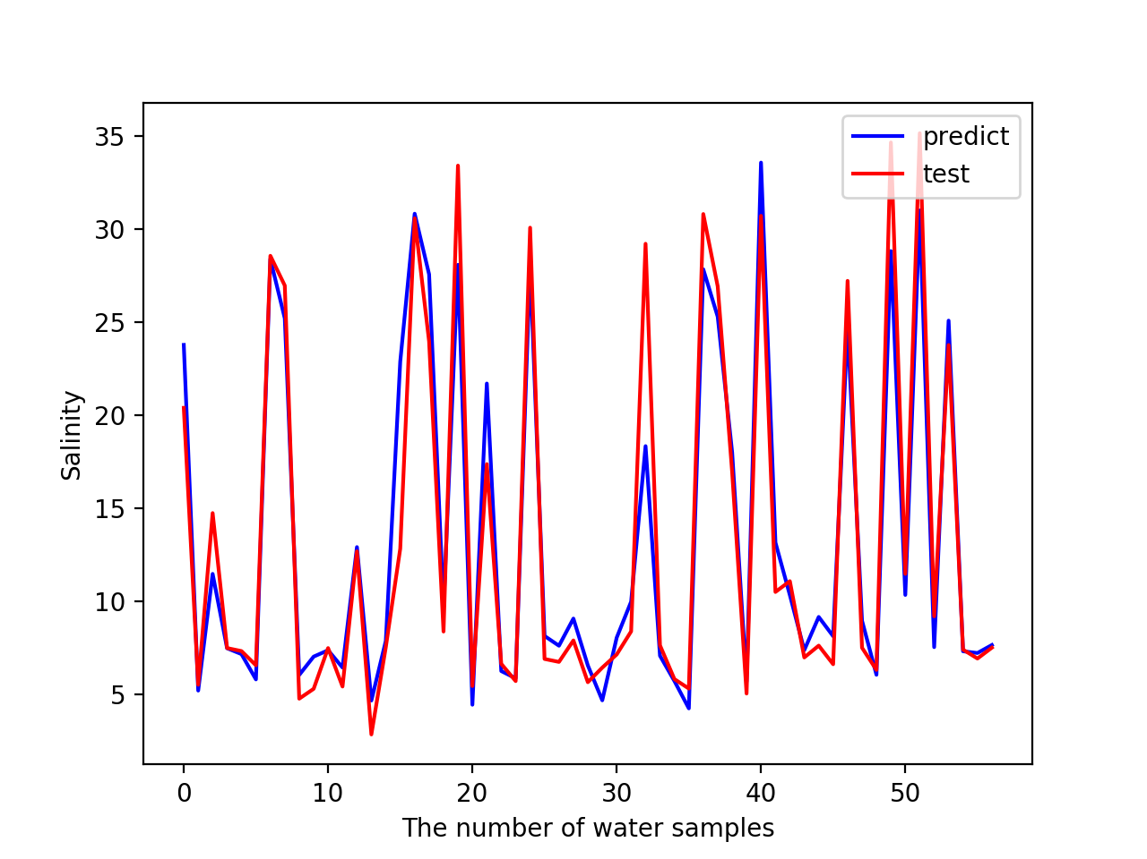
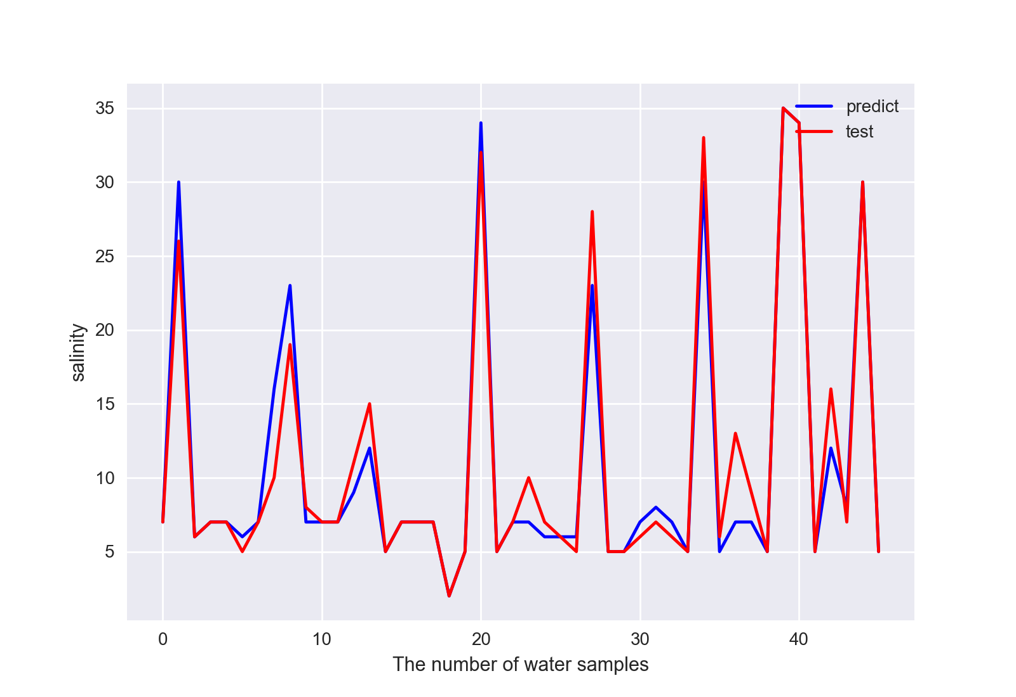
Back propagation
ELM
Ca 200 seconds
Ca 20 seconds

Slide 8
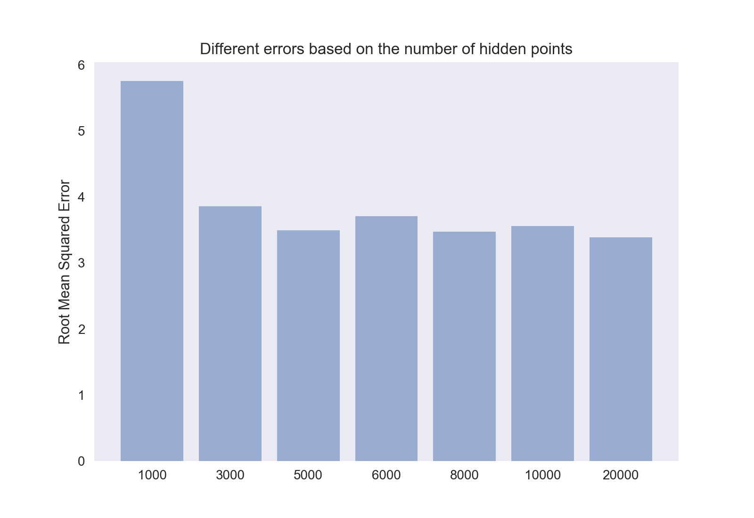
Influence of hidden points
Number of hidden points

Slide 9
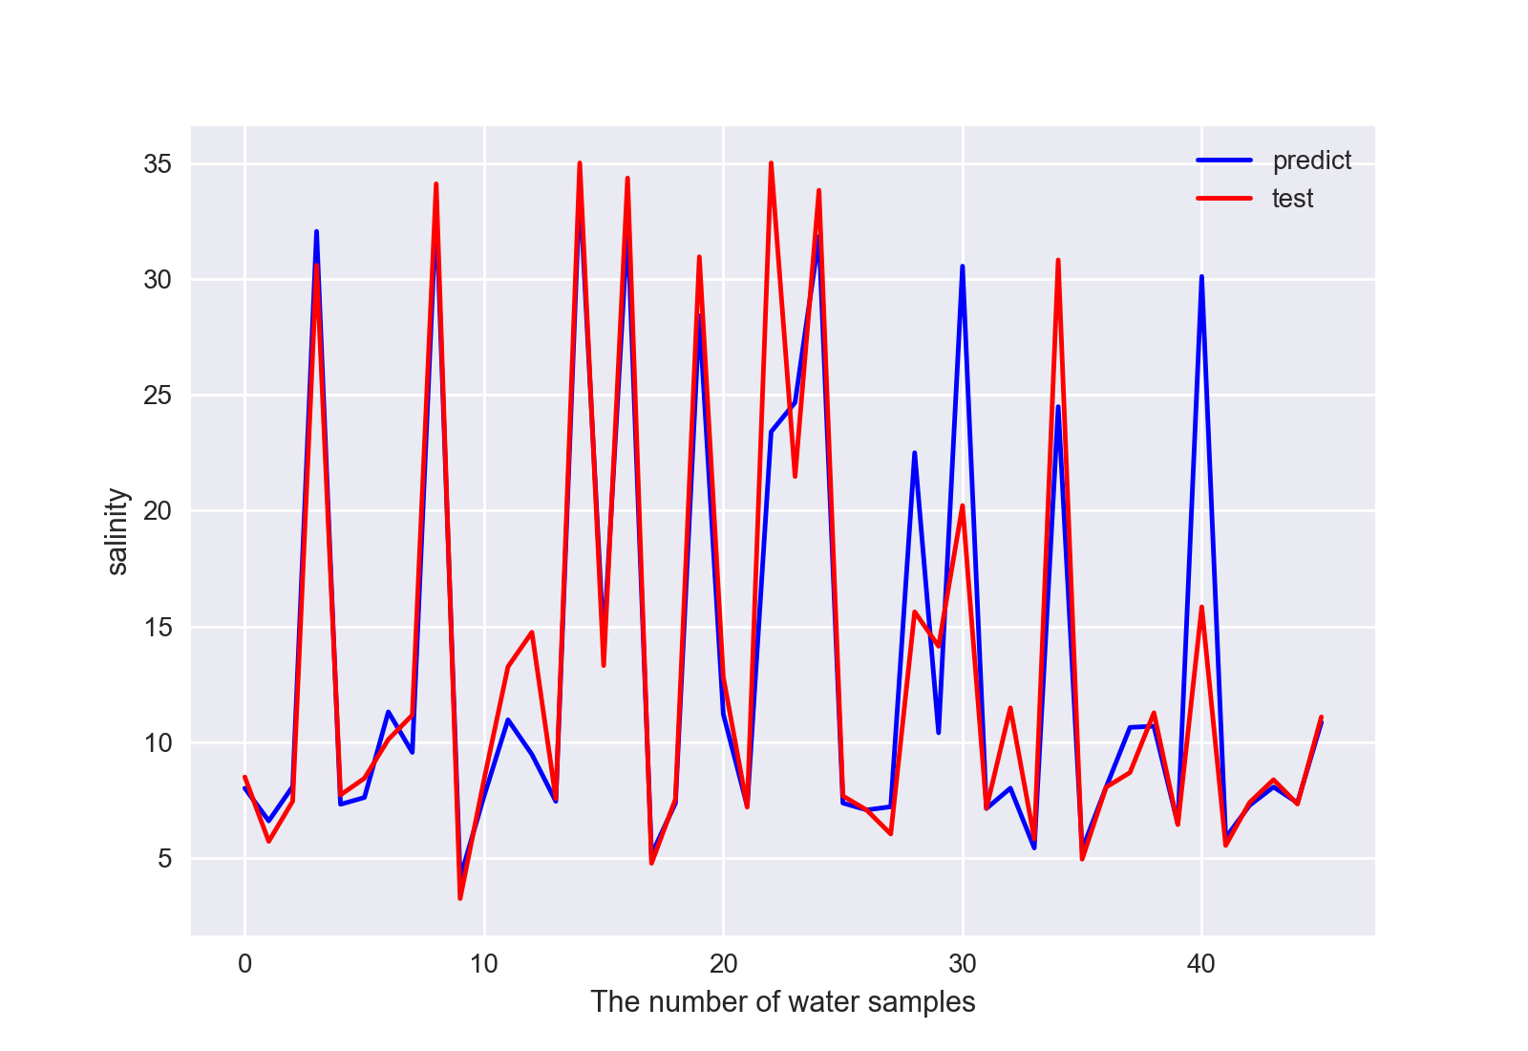
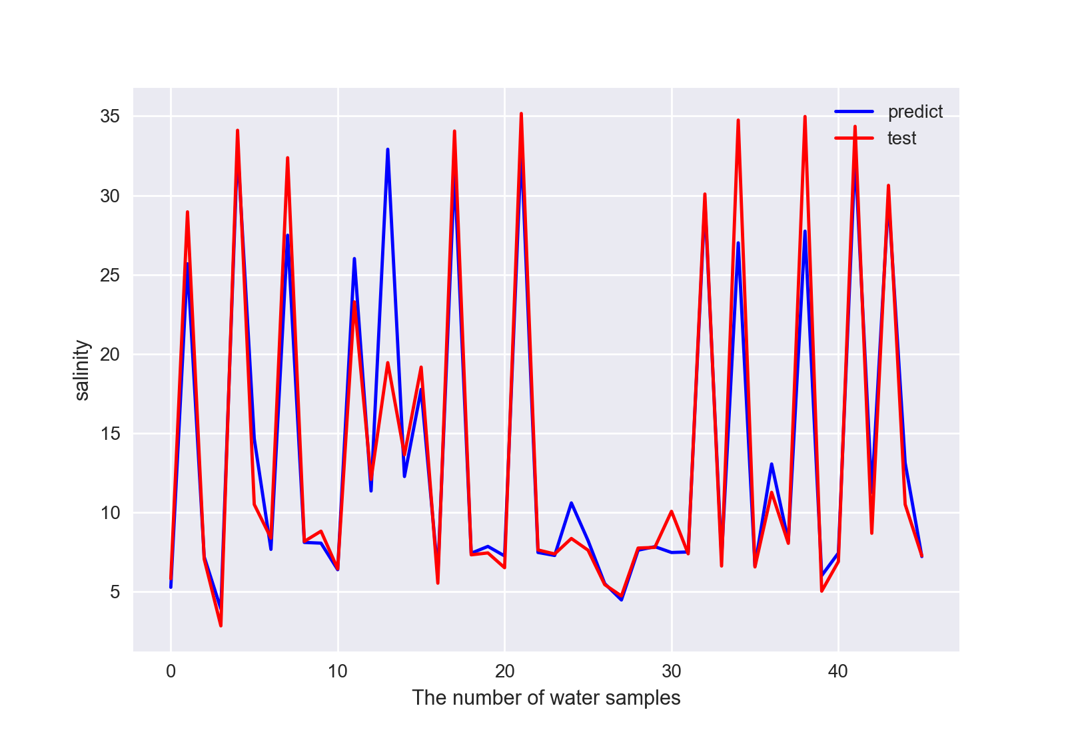
Random Forest
Ca 15 seconds

