Slide 1
Wildfly Swarm Booker Demo
Example Wildfly Swarm application
Stuart Douglas
Principal Software Engineer

Slide 2
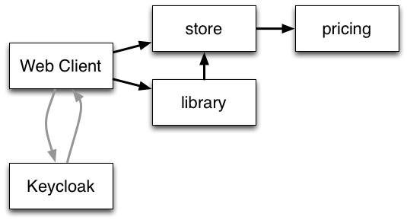
Booker Demo
Simple micro services book store example
Booker is a book store that is comprised of the following services:

Slide 3

Keycloak
Identity management server
Swarm provides a Keycloak fraction to make integration easy
Booker uses OAuth to authenticate users against Keycloak

Slide 4
Pricing Service
JAX-RS endpoint that provides pricing for books
Secured via Keycloak
Discovered via the topology fraction

Slide 5
Pricing Service
Standard JAX-RS endpoint, charges logged in users $9 and other users $10
@Path("/")
public class PricingResource {
@GET
@Path("/book/{id}")
@Produces(MediaType.APPLICATION_JSON)
public Integer search(@PathParam("id") String id,
@Context SecurityContext c) {
KeycloakPrincipal p = (KeycloakPrincipal) c.getUserPrincipal();
if ( p != null && p.getKeycloakSecurityContext() != null ) {
return 9;
}
return 10;
}
}

Slide 6
Pricing Service
Main method that sets up the service, and advertises it under “pricing”
public static void main(String... args) throws Exception {
Container container = new Container();
container.fraction(ContainerUtils.loggingFraction());
JAXRSArchive deployment = ShrinkWrap.create(JAXRSArchive.class);
deployment.addPackage(Main.class.getPackage());
deployment.as(RibbonArchive.class).advertise("pricing");
deployment.as(Secured.class);
ContainerUtils.addExternalKeycloakJson(deployment);
container.start();
container.deploy(deployment);
}

Slide 7
Store Service
In memory store of Project Gutenburg books
Pricing service is invoked via Ribbon
Uses JAX-RS async processing to efficiently handle pricing requests

Slide 8
Store Service
Using Ribbon to access the pricing service and expose it over CDI
@ResourceGroup(name="pricing")
public interface PricingService {
@TemplateName("get")
@Http(
method = Http.HttpMethod.GET,
uri = "/book/{id}"
)
RibbonRequest<ByteBuf> get(@Var("id") String id);
}
public class ServicesFactory {
@Produces
@ApplicationScoped
public static PricingService getInstance() {
return SecuredRibbon.from(PricingService.class);
}
}

Slide 9
Store Service
Use JAX-RS async processing to service request
@Inject
private PricingService pricingService;
@GET
@Path("/book")
@Produces(MediaType.APPLICATION_JSON)
public void get(@Suspended final AsyncResponse asyncResponse,
@QueryParam("id") String id) {
Book book = this.store.get(id);
Observable<ByteBuf> obs = pricingService.get(id).observe();
obs.subscribe(
(result) -> {
int price = Integer.parseInt(result.toString(Charset.defaultCharset()));
book.setPrice(price);
asyncResponse.resume(book);
},
...

Slide 10
Library Service
Uses JPA to store a record of purchased books
Uses the store service to retrieve book details

Slide 11
Library Service
JPA and Datasources are configured when creating the Container
public static void main(String... args) throws Exception {
Container container = new Container();
container.fraction(new JPAFraction()
.inhibitDefaultDatasource()
.defaultDatasource("LibraryDS"));
container.fraction(new DatasourcesFraction()
...
.dataSource(new DataSource("LibraryDS") .connectionUrl("jdbc:h2:./library;DB_CLOSE_ON_EXIT=TRUE")
.driverName("h2")
.jndiName("java:/LibraryDS")
.userName("sa")
.password( "sa" )));

Slide 12
Web Front End
Mostly static deployment (react.js based)
Uses the topology fraction to proxy backend services
Topology information is provided to the front end by the topology webapp

Slide 13
Web Front End
Proxies backend services using the topology fraction
public static void main(String... args) throws Exception {
Container container = new Container();
container.fraction(ContainerUtils.loggingFraction());
System.setProperty(TopologyProperties.CONTEXT_PATH, "/topology-webapp");
TopologyWebAppFraction topologyWebAppFraction = new TopologyWebAppFraction();
topologyWebAppFraction.proxyService("store", "/store-proxy");
topologyWebAppFraction.proxyService("pricing", "/pricing-proxy");
topologyWebAppFraction.proxyService("library", "/library-proxy");
container.fraction(topologyWebAppFraction);
container.start();
WARArchive war = ShrinkWrap.create(WARArchive.class);
war.staticContent();
war.addAllDependencies();
war.addModule("org.wildfly.swarm.container");
container.deploy(war);

Slide 14
Questions?

