Slide 1


GPU-accelerated Hall MHD
John C. Dorelli (1)
Christopher M. Bard (2)
Melvyn L. Goldstein (1)
NASA-GSFC
(2) University of Wisconsin, Madison

Slide 2
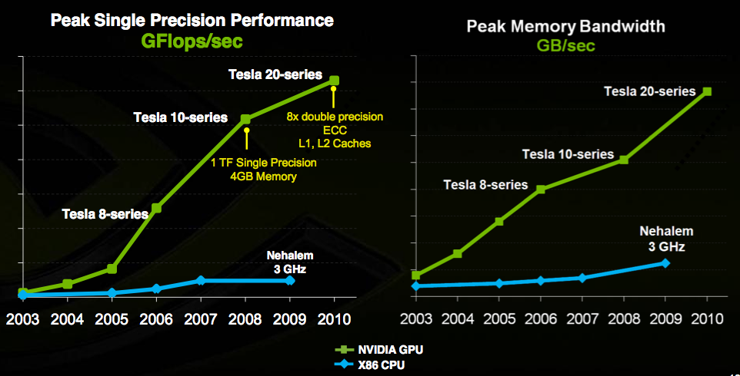
Why GPUs?
from www.nvidia.com
GPU-CPU performance gap has been steadily increasing for the last 5 years: The latest Tesla 20-series cards (“Fermi” architecture, with up to 6GB GDDR5) are designed with large scale HPC apps in mind.

Slide 3
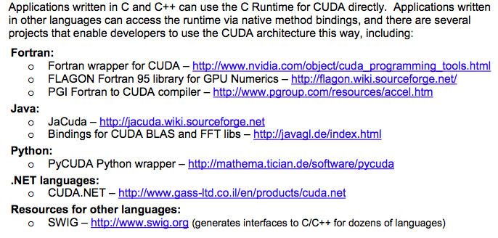
Why GPUs?
from www.nvidia.com
NVIDIA’s Compute Unified Device Architecture (CUDA) supports application development using familiar high-level programming languages.

Slide 4
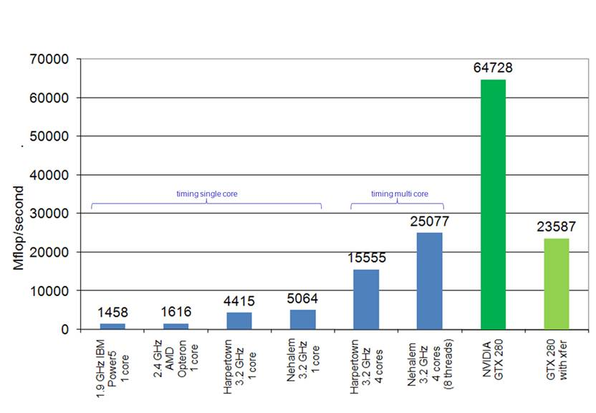
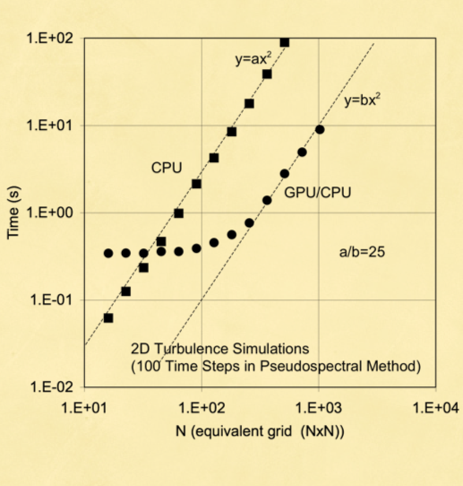
Why GPUs?
WRF (Weather Research and Forecasting Model)
Plasma Turbulence (Orszag-Tang vortex)
Michalakes, J. and M. Vachharajani, “GPU Acceleration of Numerical
Weather Prediction”, Parallel Processing Letters Vol. 18 No. 4. World
Scientific. Dec. 2008. pp. 531—548,
Dorland, W., NVision08, Aug. 2008
Real world applications (e.g., weather simulation, plasma astrophysics) have achieved significant performance gains -- factors of 50 speedups are typical.

Slide 5
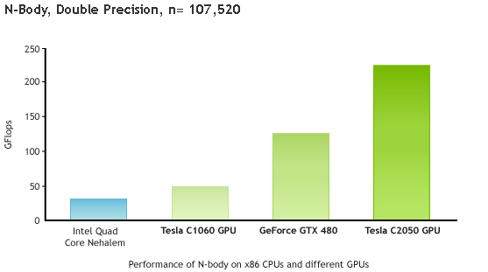
New Fermi Architecture
from nvidia.com
Fermi
Tesla C2050 (3 GB GDDR5): ~$2.5K
Tesla C2070 (6 GB GDDR5): ~$4K
0.25 Tflops double precision on a single desktop -- however, memory still severely limits problem size for “single desktop” apps.

Slide 6
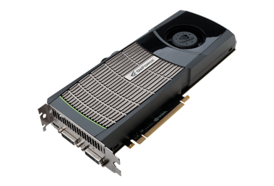
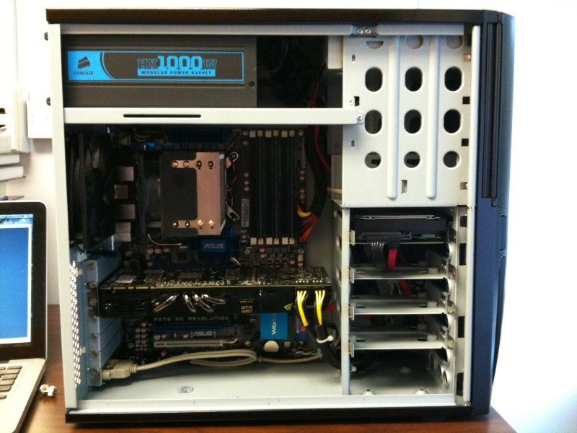
Our (much cheaper) Approach
GeForce GTX 480
1.5 GB GDDR5
Fermi architecture
15 multiprocessors
(480 cores)
~$400
The GTX 480 provides the same Fermi architecture (albeit with 0.25-0.5 the memory and 0.5 the double precision performance) but at a tenth of the cost of the Tesla C2070 -- Total cost of our workstation: ~$3K!

Slide 7




Hall MHD Equations
Godunov Solver
2nd order MUSCL-Hancock scheme on a uniform grid -- van Leer, 1985.
Strang dimensional splitting for 2nd order time stepping (currently 2D) -- Strang, 1968.
HLL approximate Riemann solver -- Toro, 1999
Hyperbolic divergence cleaning to control magnetic field divergence errors -- Dedner et al., 2002.
Second order differencing of current density for Hall term + MC slope limiter to reconstruct all conservative variables (acts like hyper-resistivity) -- Toth et al., J. Comp. Phys., 2008.
This scheme robustly captures MHD discontinuities -- the addition of the Hall effect tends to smear these out due to the physical dispersion introduced by whistler waves.

Slide 8



MUSCL-Hancock Scheme
i+1/2
Linearly extrapolate cell centered variables to cell interfaces
(U_{L}, U_{R})
i-1
i
i+1
Advance cell interfaces by 1/2 time step (conservative differencing)
Apply Riemann solver (HLL) to compute numerical flux at interface
(“Numerical Flux”)
Riemann Problem: Given a 1D interface with constant left and right states, compute the time evolution of the interface state (U*).
S_{L}
t
S_{R}
U*
U_{L}
U_{R}
x

Slide 9
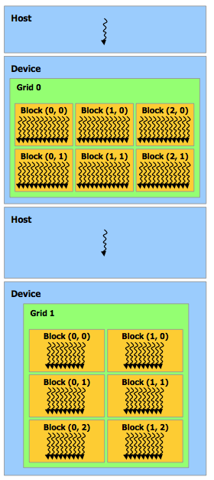
GPU Implementation
Heterogeneous CPU-GPU programming model
void evolvex(double* p_cons, double dt){
dim3 dimGrid(NX/TILE_WIDTH, NZ/TILE_WIDTH);
dim3 dimBlock(TILE_WIDTH, TILE_WIDTH);
size3 = NX*NZ*NVAR*sizeof(double);
cudaMalloc((void**)&p_xslope, size3);
xslope_ker<<<dimGrid, dimBlock>>>(p_cons,p_xslope);
cudaMalloc((void**)&p_dright, size3);
cudaMalloc((void**)&p_dleft, size3);
d_from_slope_ker<<<dimGrid, dimBlock>>>(p_dright, \
p_dleft, p_cons, p_xslope);
cudaMalloc((void**)&p_fleft);
cudaMalloc((void**)&p_fright);
physical_flux_f_ker<<<dimGrid, dimBlock>>>(p_dright, \
p_fright);
physical_flux_f_ker<<<dimGrid, dimBlock>>>(p_dleft, \
p_dleft);
*
*
*
CPU
(single thread)
GPU
(thousands of
threads)
CPU
(single thread)
GPU
(thousands of
threads)
CPU sequentially launches GPU “kernels”, each
of which consists of thousands of simultaneously active threads; each thread is responsible for a single computational cell.
Time
from the NVIDIA C Programming Guide v3.1.1

Slide 10
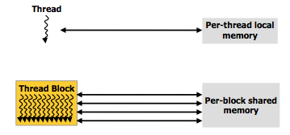
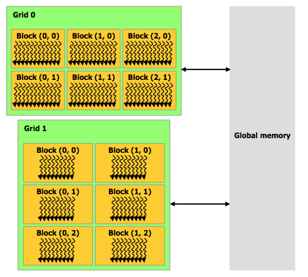
GPU Implementation
Single Instruction Multiple Data Architecture
__global__ void cons_diff_ker(double* p_cons,double* p_fvec,double,dt){
int b = blockIdx.y*TILE_WIDTH + threadIdx.y;
int a = blockIdx.x*TILE_WIDTH + threadIdx.x;
double dt_dx = dt/(LX/(NX-1));
if(a==0 || a=(NX-1) || b==0 || b==(NZ-1){
//do nothing
}
else{
for(int c = 0; c<NVAR; c++){
p_cons[index3(a,b,c)] = p_cons[index3(a,b,c) - dt_dx* \
(p_fvec[index3((a+1),b,c)] - p_fvec[index3(a,b,c)]);
}
}
}
* p_cons -- pointer to global memory address
* “local” variables stored in fast thread registers
* per-block shared memory is not used
* threads in a block organized into SIMD “warps” (multiple
threads in a warp simultaneously execute the same instruction on
data in different global memory locations).
* typically, NX*NZ/256 blocks/kernel invocation, 256 threads/block.
from the NVIDIA C Programming Guide v3.1.1
In practice, register memory constrains the number of simultaneously active threads on each multiprocessor. In our case: (4 blocks/multiprocessor)*(256 threads/block) = 1024 threads/multiprocessor. GTX 480 has 15 multiprocessors, so we typically have 1024*15 = 15,360 simultaneously active threads.

Slide 11
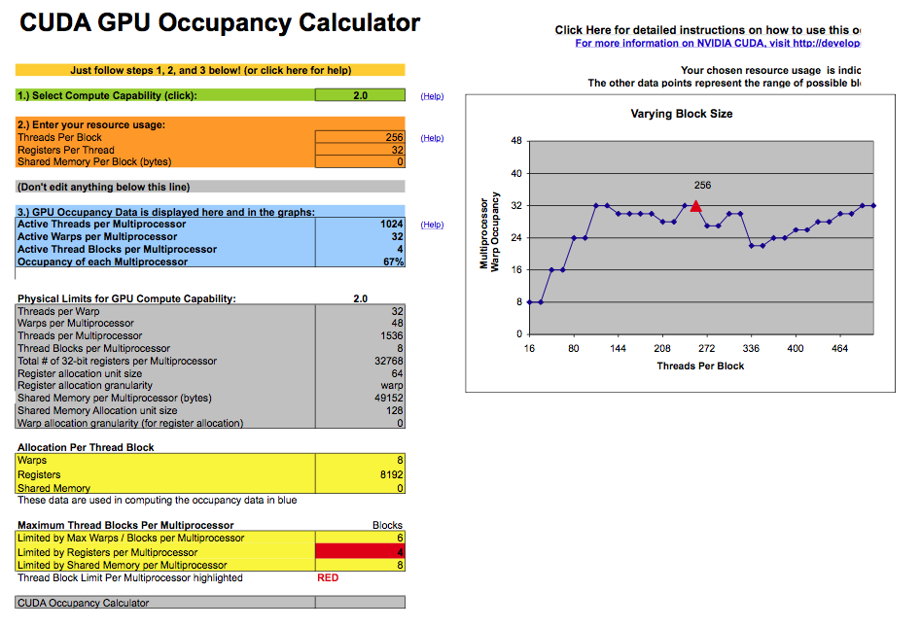
GPU Implementation
Maximizing the Number of Threads/Multiprocessor
Excel spreadsheet provided by NVIDIA -- This could be automated

Slide 12
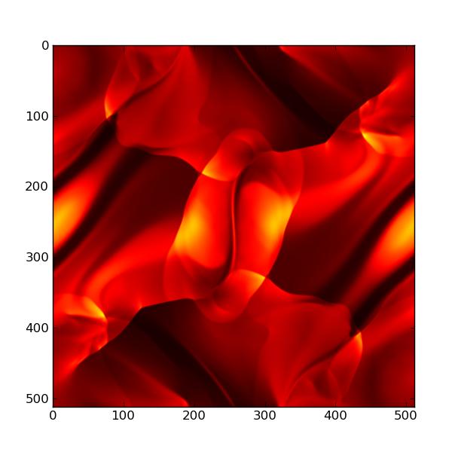
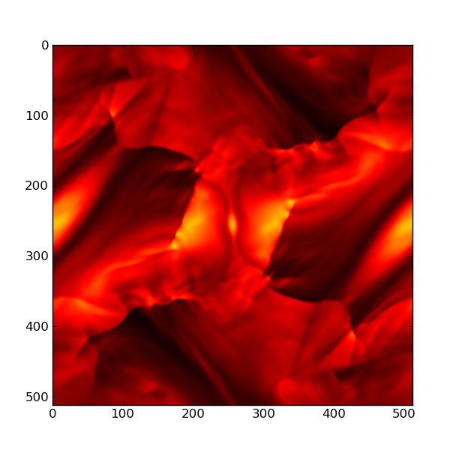
Orszag-Tang Test
(pressure)
512x512 MHD
512x512 Hall MHD
Hall MHD simulation of Orszag-Tang [1979] Vortex: “Physical” convergence requires moving beyond the MHD approximation -- e.g., including the Hall effect is about an order of magnitude more computationally expensive….

Slide 13
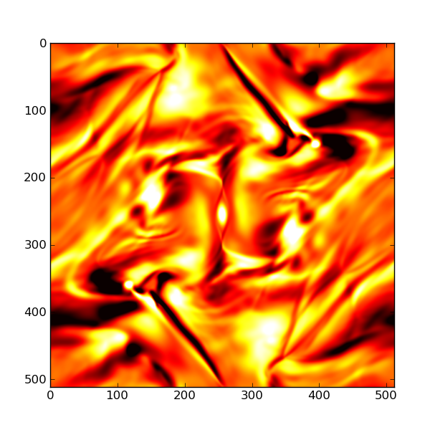
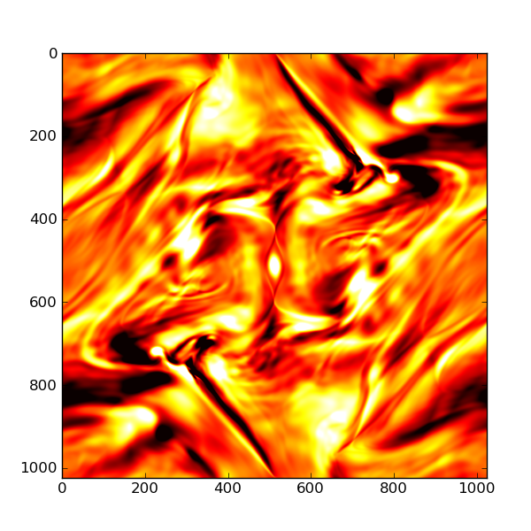
Orszag-Tang Test
(out-of-plane magnetic field)
512x512 Hall MHD
1024x1024 Hall MHD
Hall MHD simulation of Orszag-Tang [1979] Vortex: The simulation on the right would have taken nearly half a year on a single Intel core (which is why we require thousands of cores to do anything interesting).

Slide 14
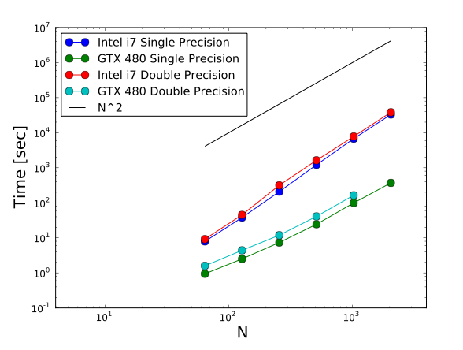
Timing Results
NX = NZ = N: For N = 1024, we achieve a single (double) precision speedup of 87x (58x).

Slide 15
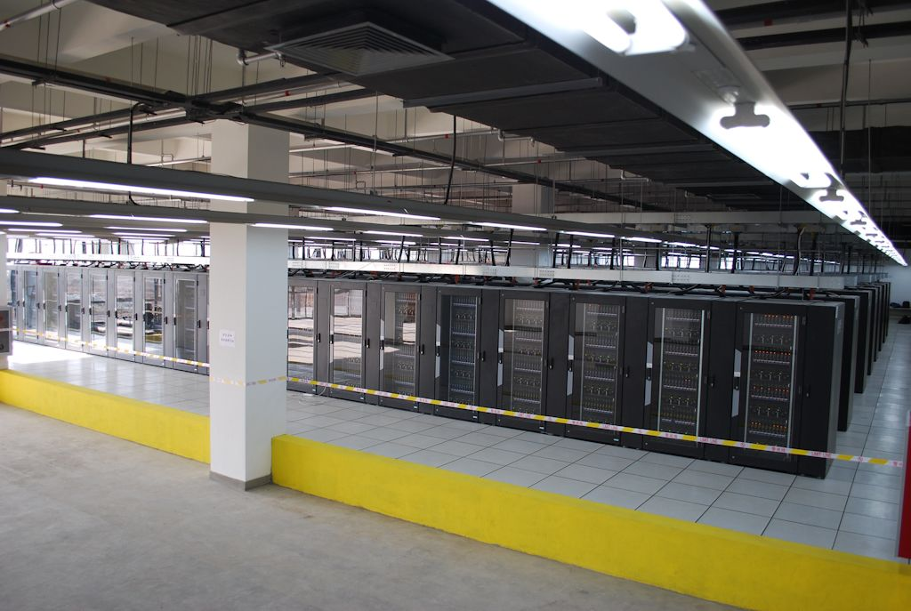
Conclusions
We have ported a new Hall MHD solve to an NVIDIA GTX 480 (Fermi architecture) GPU.
For a problem size of 1024x1024, we achieve a speedup (relative to a single Intel i7 core) of 87x for single precision and 58x for double precision; this gives us the power of a small cluster on our desktop for under $3K.
The CUDA programming model is straightforward (we ported a fortran version of the Hall MHD solver to CUDA C in less than a month); however, this required essentially rewriting the code.
The future….
Nebulae CPU-GPU cluster at the National Supercomputing Center in Shenzhen, China
#2 in the TOP500 (behind ORNL’s Jaguar)
4640 Tesla C2050 GPU’s
1.271 PFLops/sec Linpack

