Slide 1
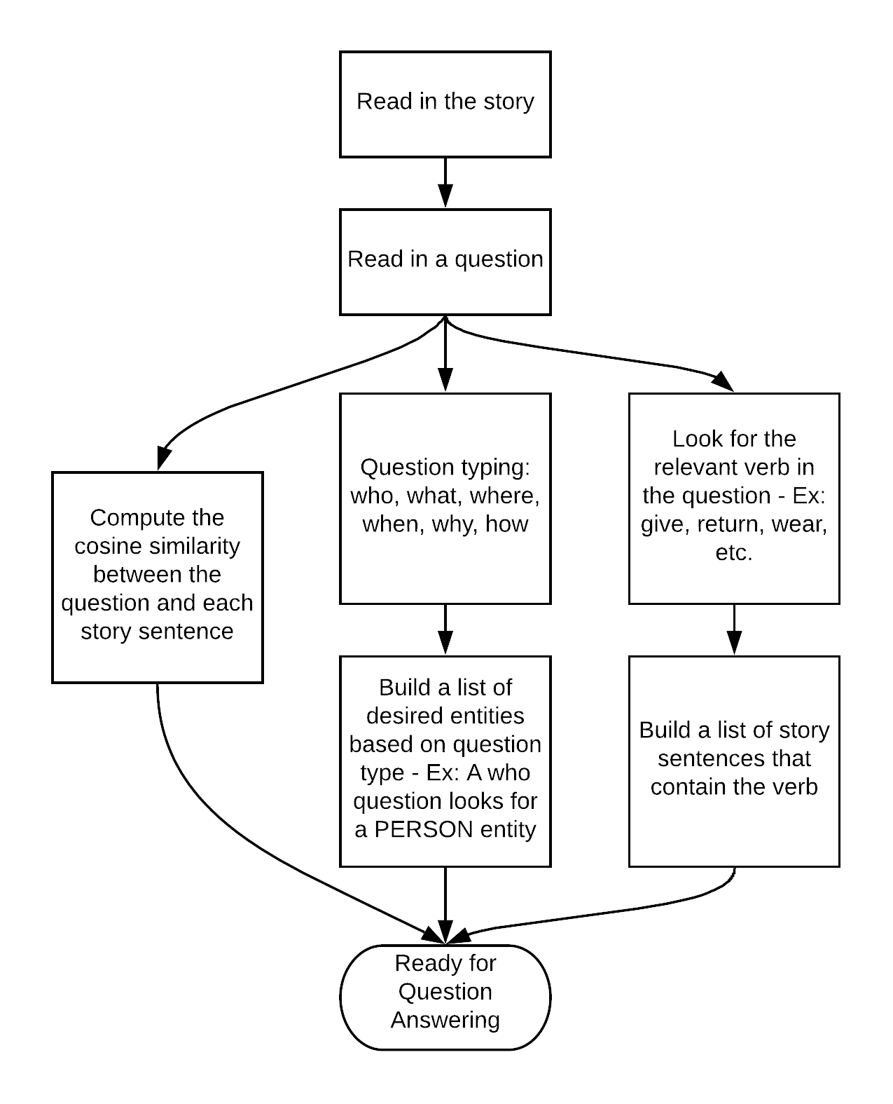



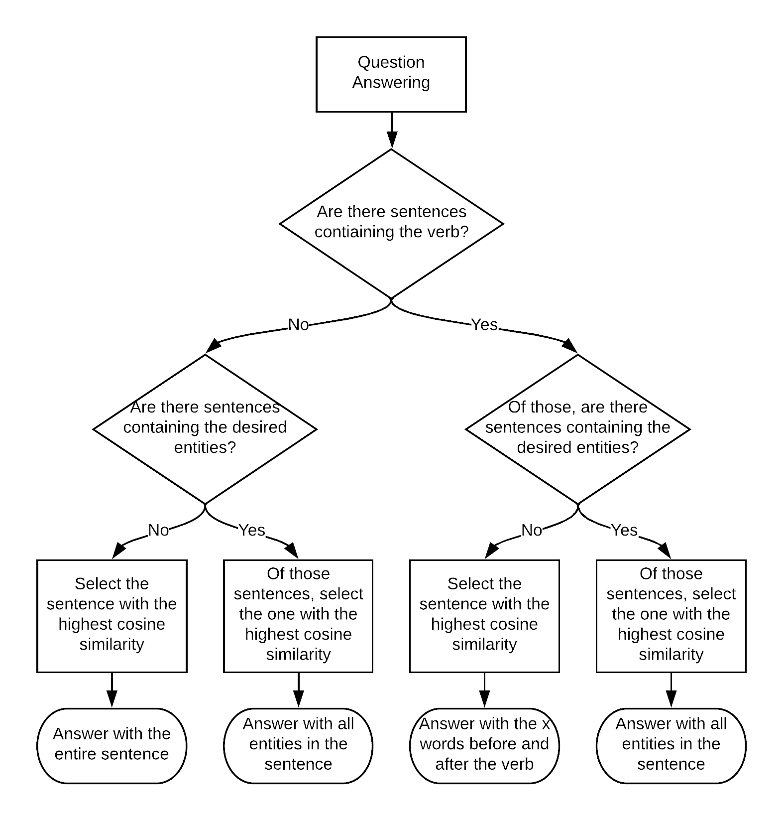
Kung Fu Panda
Eric Stubbs Jonathan Call
Algorithms: POS tagging, NER, word stemming, Cosine Similarity
Contributions: Spacy – Eric
Question typing – Eric, Jonathan
Verb typing – Jonathan, Eric
Cosine Similarity – Jonathan
External Resources: Spacy library – https://spacy.io
Emphasis: The cornerstone of our system was originally question typing; we later added cosine similarity and what we call ‘verb typing’ – matching a verb in the question with verbs in the story.
To handle “what” questions, our system performs cosine similarity on the portion of the question after the relevant verb.
Performance: We achieved an F-score of 0.32, with .38 recall and .28 precision. Our system did well with ‘who’ questions and questions asking for numbers.
Your poster size will be 24” X 36” when printed
How does your system work?
What tools did you use?
Think about using flowcharts and figures.
What worked well and what didn’t? Examples are great!
Do NOT use a colored background for the poster! It greatly taxes the printer.
A white background is much more printer-friendly. The printer thanks you!!!
Pictures are nice!
This is 36 point font, which is easy to read on the poster
This is 32 point font, which is also readable on the poster, but you probably shouldn’t use any smaller fonts .
Regrets: Limiting the response to 7 words before and after a verb didn’t work well. It returned the correct answer in some cases, but hurt recall more than it helped precision.
Successes: Using question typing and NER in combination with cosine similarity was very successful, helping the system find likely answers depending on the question text.
Lessons Learned: It’s hard to build a system that can understand language and answer even the simplest of questions.

