Slide 1
Final Project
Stuart Lai

Slide 2
Agenda
Research Question
Data preparation
Data Cleaning and wrangling
Exploratory analysis
Model

Slide 3
Research Question
How much does green taxi demand fluctuate according to season and can we predict demand?
Based on the time of year do people hail rides more or less?
Notes:
46K to 37K

Slide 4
What data have you gathered, and how did you gather it?
Downloaded 2016 Green Taxi data from the NYC Open data website.
Data is published by the New York Taxi and Limousine Commission
Source: https://data.cityofnewyork.us/Transportation/2016-Green-Taxi-Trip-Data/hvrh-b6nb
Green Taxi’s service the Borough's and not Manhattan (yellow taxi’s).
Uploaded as a CSV into Spyder

Slide 5
Cleaning the data
Parse date from datetime field
Create a response variable, which is where a pickup and dropoff datetime are present.
Check for a discrepancy between column values.
Parse the day and month from the datetime field.
Convert passenger count, trip distance, revenue, and response variable to numeric.
Aggregate data by day, which reduces the row count from 16.3M to 355 rows.
Convert ‘pickup_timestamp’ to datetime and set it as the index

Slide 6
What steps have you taken to explore the data?
Check null values for response variable
Check row counts for all columns
Applied counter logic.
i.e. where is Longitude positive?
Check for stationarity

Slide 7
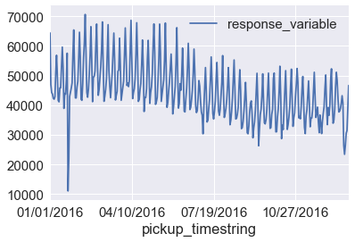
Trends in the raw data

Slide 8
How appropriate is the data?
Yes, the dataset appears to be suitable

Slide 9
What insights have you gained from your exploration?
The dataset is fairly clean
Missing 7M pickup & dropoff Lat and Longs when compared to the response variable
The latitude and longitude fields all move in-sync.
The rest of the columns move in sync with pickup and dropoff times.

Slide 10
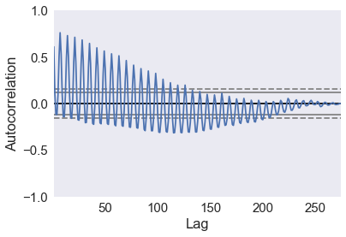
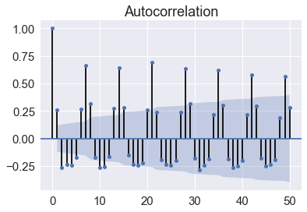
Is an ARIMA model an ideal estimator?
Notes:
#Decreasing lag suggests highly autocorrelated dataset
plot_acf = autocorrelation_plot(train)
#find ideal lag. Cyclical spikes means we have a cycle
AR(1) model matches the autocorrelation of a lag of 1. Therefore stationary.

Slide 11
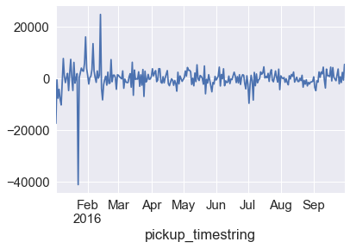
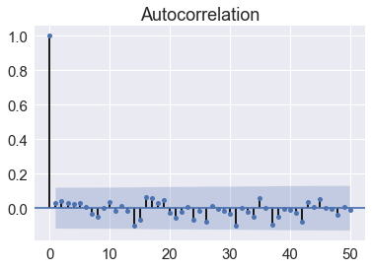
Results and Error of ARIMA model
Notes:
(21,1,1)

Slide 12
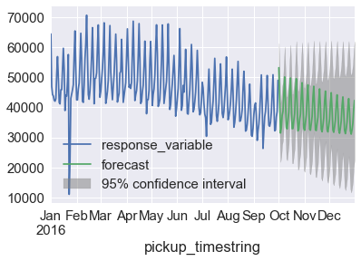
Forecast and Looking forward - Yes, demand does fluctuate by season. It decreases near the end of the year.

Slide 13
Next Steps
VAR
Predict using different features
E.g. Does the number of passengers follow a season trend?
E.g. Does the average trip distance follow a seasonal trend?

