Slide 1
Supercompensation

Slide 2
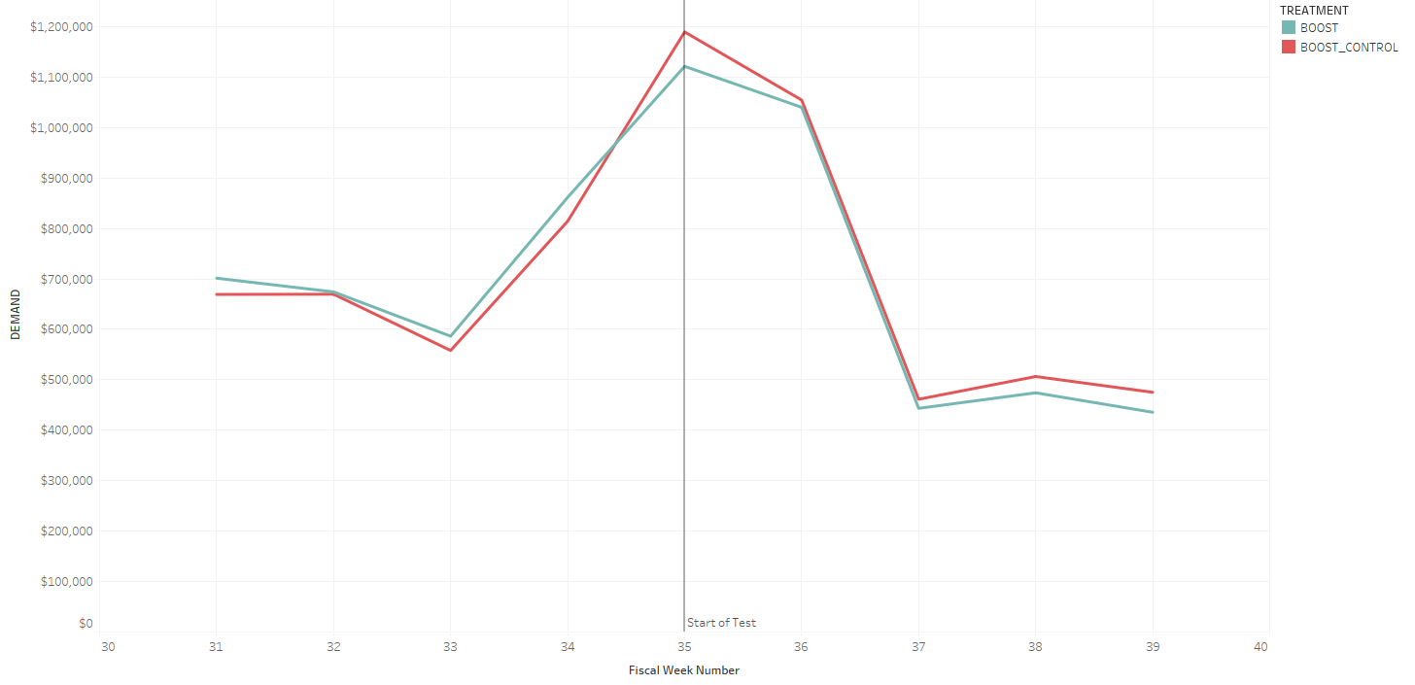
Boost Test
When looking at total demand, control is outperforming treatment.
How can we explain this? This is the polar opposite of our hypothesis.

Slide 3
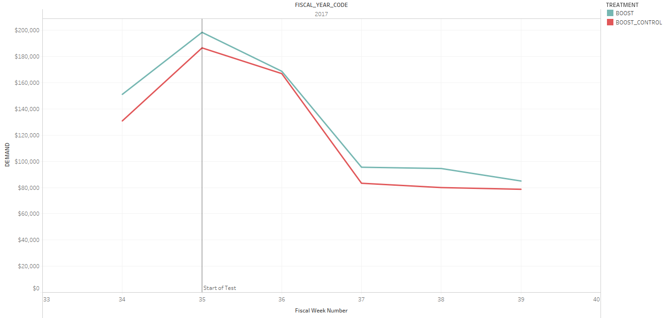
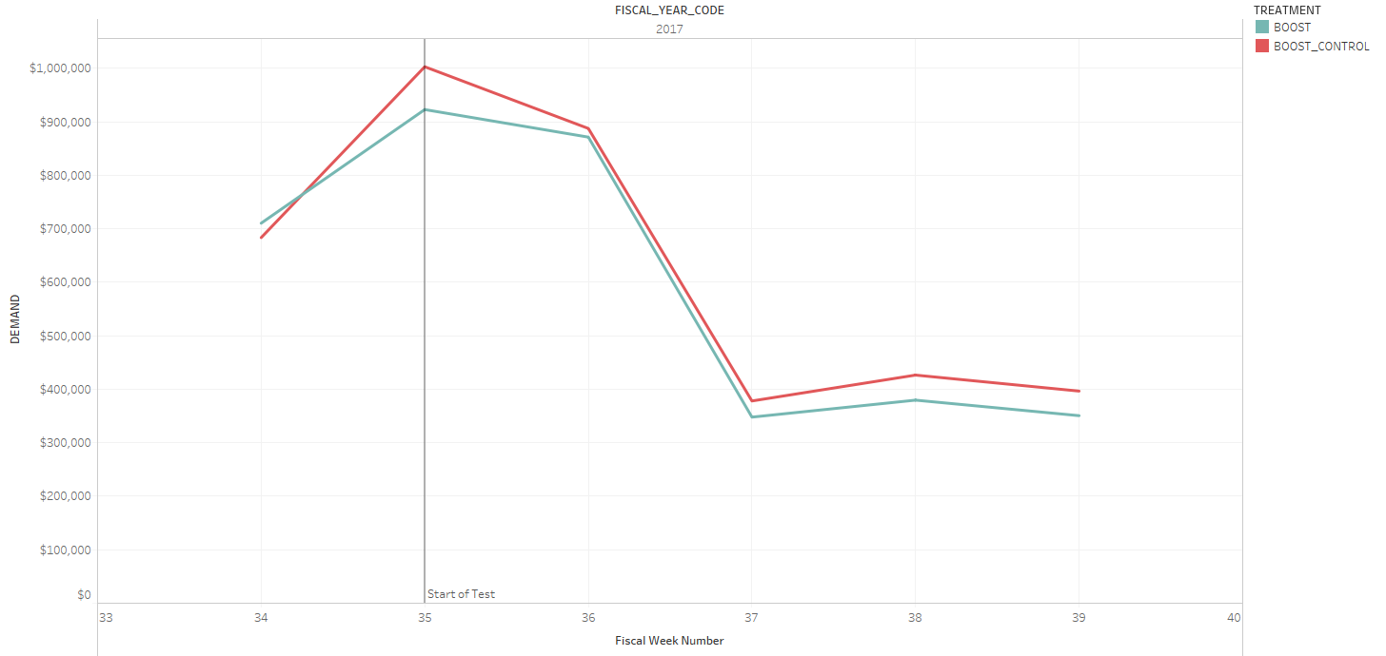
Does this trend hold true at a state level?
Yes, the trend holds true.
We can isolate the problem to IL and MN, which are both states we have stores in
IL and MN cause the flip!

Slide 4
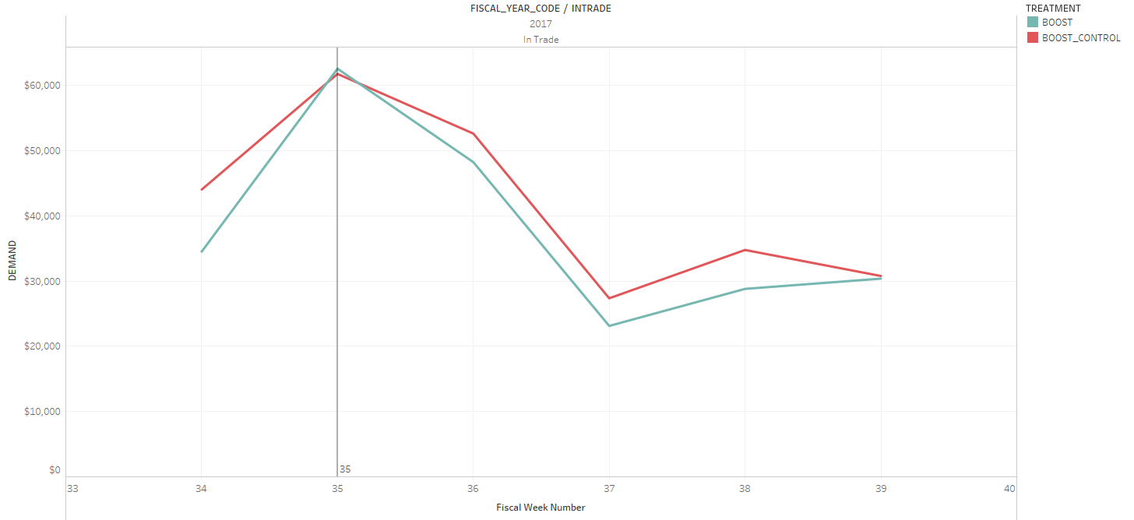
MN and IL are unique because they have a store.
In-trade, PLA/PS selected, for MN and IL and control still beats treatment!
The boosted treatment isn’t even showing an effect in PLA and PS.

Slide 5
Is data clarity a factor?
We ran a simplified query, solely focusing on the boost markets.
We tested random zip codes and all were assigned correctly.
Off test is working fine, and shares the base data.
To the best of our knowledge, YES! The query is fine.

Slide 6
Supercompensation hypothesis
Given that control really is beating treatment, we are left wondering why.
To explain why, we are introducing the Supercompensation hypothesis.

