Slide 1
Creating Filesystems in Linux with FUSE
Chris Stucchio
www.styloot.com

Slide 2

Goal of the talk
When we are finished, you should be able to write code that will do this:
$ mkdir test
$ python twitfs.py test
$ ls test
177828419223027712 177861882391166976 177887531948453888 177907401553494017 177940377339314177 178020021065359360 178044456589721600
177829712612167681 177876272691691520 177906425224380417 177907654595837952 177949719090307072 178020400033312768 178067246780911617
177861220089593856 177876606512144385 177907223220060160 177939904083410944 177989623283331072 178042052003643392
$ cat test/177939904083410944
GulPanag
Another look at the matter. http://t.co/jYasOWWs %

Slide 3
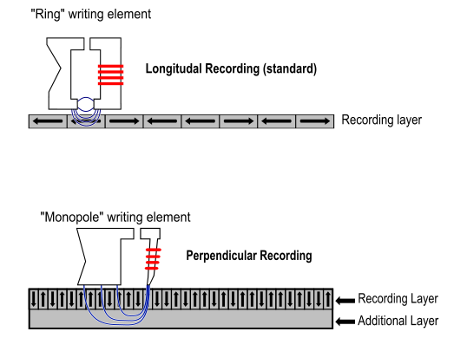
Hard Drives
Unstructured array of bytes
Three operations: read, write, seek
Seek moves disk head, read/write manipulate it

Slide 4
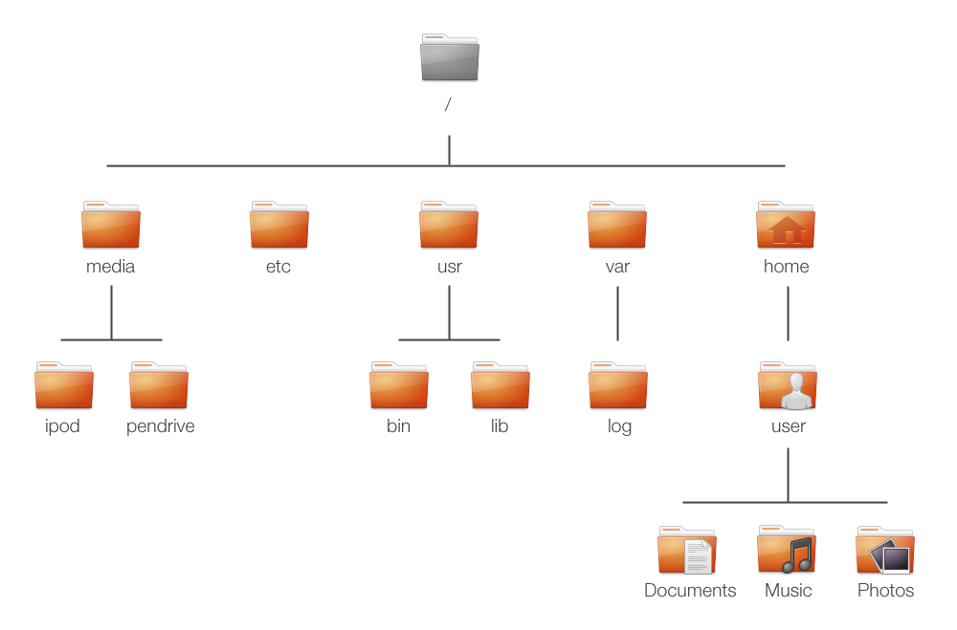
Filesystems (*NIX, Win)
Heirerarchical store of objects
Objects are Binary Blobs (no internal structure)
Support limited set of operations: listDir, getFileStat, open, read, write, seek, delete

Slide 5
Alternatives to Filesystems
IBM OS/360
Files based on records – similar to database tables
Programs stored in separate namespace
Apple Newton
Data stored in “soups” - collections of dict's
Access via queries returning cursors
Programs stored in separate namespace

Slide 6
Filesystem Layouts
struct inode {
int[3] permissions;
int owner;
int firstDataBlockPosition;
int size;
boolean isDirectory;
...
};
struct DataBlock
{
int dataLength;
int nextBlockPosition;
char[BLOCK_SIZE] data;
};
inode
datablock
datablock
datablock

Slide 7
Filesystem Layouts
int readDataToBuffer(inode* node, int startPosition,
int endPosition, void* buffer)
{
int bytesRead = 0;
int filePosition = 0;
disk.seek(node.dataBlockPosition);
int dataLength = disk.readInt();
int nextBlockPosition = disk.readInt();
while (bytesRead < (endPosition - startPosition))
{
if (dataLength < BLOCK_SIZE)
{
disk.read(dataLength, buffer+bytesRead);
bytesRead += dataLength;
return bytesRead;
}
else
{
disk.read(BLOCK_SIZE, buffer+bytesRead);
bytesRead += BLOCK_SIZE;
disk.seek(nextBlockPosition);
dataLength = (int)disk.read(sizeof(int));
nextBlockPosition = (int)disk.read(sizeof(int));
}
}
return bytesRead;
}
inode
datablock
datablock
datablock

Slide 8
Filesystem Layouts
struct dentry {
boolean isDirectory;
int inodePosition;
char[256] filename;
int parentDirectory;
int childListPosition;
int numChildren;
...
};
Child entry
inodePosition
parentDirectory
dentry
dentry
/foo childlist
inode
/foo
/foo/bar
childListPosition

Slide 9
Free Space Map
struct superBlock {
...assorted filesystem headers
int firstFreeBlock;
};
struct freeBlock {
int nextFreeBlockPosition;
char[1024-sizeof(int)] arbitraryData;
};
superblock
dentry
free
inode
free
free
inode

Slide 10
Free Space Map
createNewFile(filename, ... )
superblock
dentry
free
inode
free
free
inode

Slide 11
Free Space Map
createNewFile(filename, ... )
superblock
dentry
dentry
inode
free
free
inode

Slide 12
Free Space Map
createNewFile(filename, ... )
superblock
dentry
dentry
inode
inode
free
inode

Slide 13
Free Space Map
createNewFile(filename, ... )
superblock
dentry
dentry
inode
inode
datablock
inode

Slide 14
Journaling
superblock
dentry
dentry
inode
free
free
inode
What if the disk crashes before inode is allocated?
superblock
dentry
free
inode
free
free
inode
Even worse case – memory leak

Slide 15
Journaling
Write operations to journal first, then to disk.
superblock
Journal
free
inode
free
free
inode
Update free pointer to fourth free block

Slide 16
Journaling
Write operations to journal first, then to disk.
superblock
Journal
free
inode
free
free
inode
Update free pointer to fourth free block
Create dentry in first block

Slide 17
Journaling
Write operations to journal first, then to disk.
superblock
Journal
free
inode
free
free
inode
Update free pointer to fourth free block
Create dentry in first block
Create inode in second block

Slide 18
Journaling
Write operations to journal first, then to disk.
superblock
Journal
free
inode
free
free
inode
Update free pointer to fourth free block
Create dentry in first block
Create inode in second block
Create data block in third block

Slide 19
Journaling
Write operations to journal first, then to disk.
superblock
Journal
free
inode
free
free
inode
Update free pointer to fourth free block
Create dentry in first block
Create inode in second block
Create data block in third block
COMMIT

Slide 20
Journaling
Write operations to journal first, then to disk.
superblock
Journal
free
inode
free
free
inode
After Journal is fully written, start updating actual filesystem.
If disk crashes, we can redo the disk operation based
on the journal.

Slide 21
Journaling
Write operations to journal first, then to disk.
superblock
Journal
free
inode
free
free
inode
Update free pointer to fourth free block
Create dentry in first block
Create inode in second block

Slide 22
Journaling
Write operations to journal first, then to disk.
superblock
Journal
free
inode
free
free
inode
Update free pointer to fourth free block
Create dentry in first block
Create inode in second block
CRASH

Slide 23
Journaling
Write operations to journal first, then to disk.
superblock
Journal
free
inode
free
free
inode
Update free pointer to fourth free block
Create dentry in first block
Create inode in second block
CRASH
Since Journal has no COMMIT entry, we do not retry ANY
operations on restart. I.e., createNewFile call simply failed.
Disk is consistent.

Slide 24
Abstractions
User level code can ignore disk layout.
OS provides security – prevents illegal disk accesses
Reliability – partial data recovery on power crash
Portability – UNIX code can run unmodified on HP/UX as long as HP/UX and UNIX provide same system calls.

Slide 25
Disk-less filesystems
NFS (Network File System)/Windows Shared Folders – disk lives in a separate computer
/proc – linux filesystem that provides data on running processes
Plan 9 from Bell Labs – Most OS/User interfaces implemented using filesystems.
Unix Sockets/Pipes – Look like files, but not backed by disk.

Slide 26

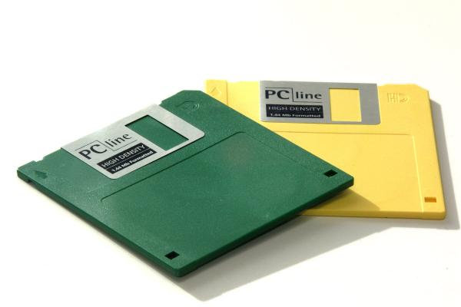
Architecture of simpler OS's
Userspace
Kernel
Filesystem 1
Filesystem 2
#include <fs1.h>
int fd = fs1Open(“/tmp/file”);
#include <fs2.h>
int fd = fs2Open(“/tmp/file”);

Slide 27
Modern Filesystems
Userspace
Kernel
Virtual File System (VFS)
Filesystem 1
Filesystem 2
#include <stdio.h>
int fd = open(“/tmp/file”);

Slide 28
Virtual File System interface
interface Filesystem {
Open (...),
Read (...),
Write (...),
GetFileStat (...),
CreateDirectory (...),
Flush (...),
ReadDirectory (...),
RemoveLink (...),
RemoveDirectory (...),
Rename (...),
ReadSymbolicLink (...),
CreateDevice (...),
CreateSymbolicLink (...),
...
}

Slide 29
VFS
Public interface to all filesystems
Users no longer care which filesystem their files are located on.
Introduced in SunOS 2.0 (1985), allowed the same system calls to access both UFS (Unix File System) and NFS (Network File System).

Slide 30
Plan 9 from Bell Labs
Experimental successor to UNIX
Everything is a file
/net – Network access handled via opening files in /net folder
/proc – Access to processes handled (copied by Linux/Solaris/etc)
/rio – Access the Rio window manager via filesystem
User level programs can create filesystems

Slide 31
FUSE (Filesystem in USErspace)
User Program
User Filesystem
Libfuse
Kernel
Virtual File System (VFS)
FUSE

Slide 32
Writing FUSE daemons
Implement the FUSE interface (same as VFS interface)
Pass function pointers to libfuse.h.
libfuse then calls the functions based on filesystem activity.

Slide 33
Fuse Operations
int(* getattr )(const char *, struct stat *)
int(* readlink )(const char *, char *, size_t)
int(* mknod )(const char *, mode_t, dev_t)
int(* mkdir )(const char *, mode_t)
int(* unlink )(const char *)
int(* rmdir )(const char *)
int(* symlink )(const char *, const char *)
int(* rename )(const char *, const char *)
int(* link )(const char *, const char *)
int(* chmod )(const char *, mode_t)
int(* chown )(const char *, uid_t, gid_t)
int(* truncate )(const char *, off_t)
int(* utime )(const char *, struct utimbuf *)
int(* open )(const char *, struct fuse_file_info *)
int(* read )(const char *, char *, size_t, off_t, struct fuse_file_info *)
int(* write )(const char *, const char *, size_t, off_t, struct fuse_file_info *)
int(* statfs )(const char *, struct statvfs *)
int(* flush )(const char *, struct fuse_file_info *)
int(* release )(const char *, struct fuse_file_info *)
...

