Slide 1
Drone Imagery Analysis
Susmit Mahato
Supervisor: Prof. Aaditeshwar Seth
IIT Delhi
11th October 2026

Slide 2
Contents
1
What it does
2
How it works
3
The crown detector: Detectree2
4
Detector engineering
5
Which orthomosaics work
6
Walkthrough video
7
Reading the charts and the crown map
8
Checking the detections
9
Poor results? Use the Guide
10
Better settings, far more trees
11
What you get
12
Your files in FileBrowser

Slide 3
What it does
1
Upload a drone orthomosaic
One big stitched aerial photo of your site.
2
Our model finds the tree crowns
It outlines every crown it can see in the image.
3
Similar crowns are grouped
You get sample pictures of each group to look at.
4
You name each group once
Every tree in that group gets the species you typed.
5
Download your results
A species map, csv table summary and a stack item.

Slide 4
How it works
1
2
3
4
5
Upload
Detect
Group
Name
Export
A GeoTIFF orthomosaic of your site.
Our model outlines every tree crown.
Look-alike crowns are grouped together.
You type a species for each group.
Map, tables and metadata to download.
Everything is saved per run, so you can change the settings and try again whenever you like.

Slide 5
Detectree2
We run Detectree2, an open-source tree-crown detector.
What it is
Weights you can pick per project
• Mask R-CNN instance segmentation, built on Meta’s detectron2.
• Each tile returns crown outlines, each with a confidence score.
• Published weights are used as they are.
urban_cambridge Urban trees, Cambridge UK. Default.
paracou Tropical canopy, Paracou UAV.
randresize Random-resize full model.
flexi Generalist: urban and closed canopy.
tropical_closed Dense tropical forest only.
The detector only finds crowns. The crowns are then grouped, the user names the species of each group, and the final species map is generated.

Slide 6
Detector Engineering
The detector was trained at one ground resolution, so every survey is brought to it first.
One resolution for every survey
Tiles the network can read
• Surveys finer than 6.7 cm/px are downsampled to it, the resolution the model works best at. Coarser surveys are left as they are.
• Native GSD is read from the GeoTIFF’s metadata.
• The ortho is cut into tile_size metre tiles with a buffer metre overlap.
• detections_per_image = 6 caps crowns per tile and extras are dropped.
• conf_threshold is 0.85 by default.
Back to one map
• Tile results are stitched into one crown layer in the orthomosaic’s own coordinates.
• Duplicates from the tile overlap are removed (IoU 0.9).
• Crowns are filtered by confidence and by area (4 to 2000 m²).

Slide 7
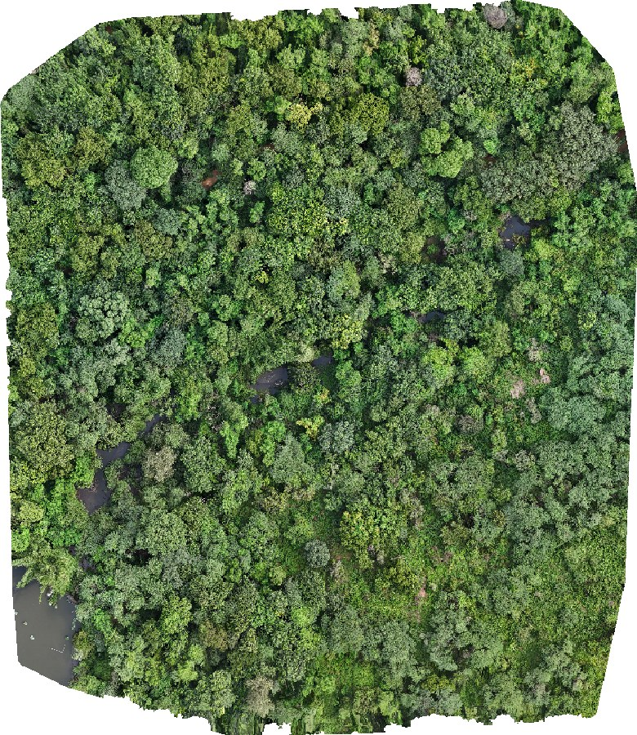
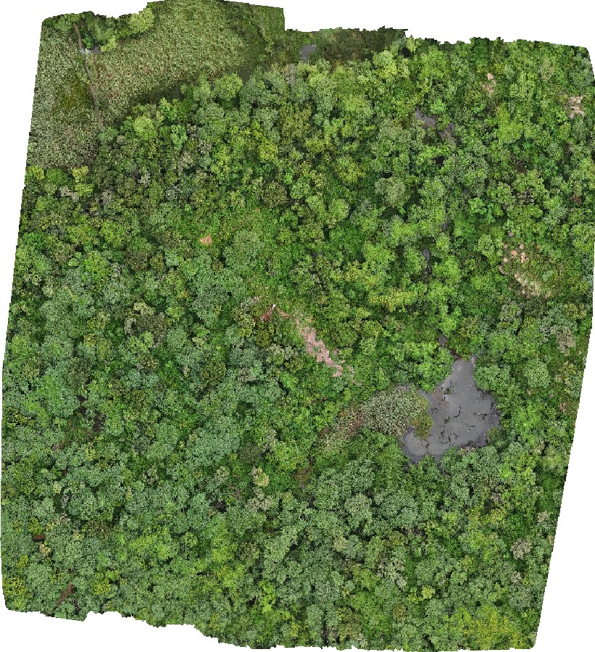
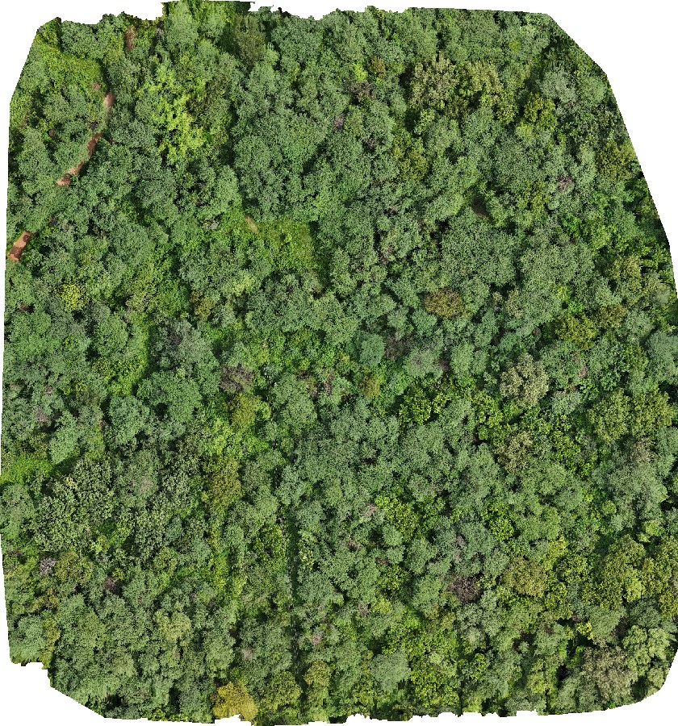
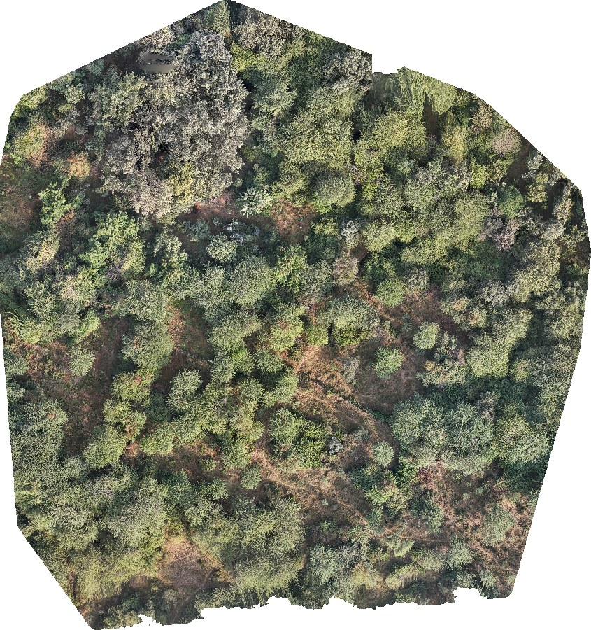
Which orthomosaics work
What the app accepts
• GeoTIFF file (.tif or .tiff) with its map coordinates built in.
• Best results with a ground resolution finer than 8 cm per pixel.
• Up to 10 orthomosaics and 5 GB in one project.
• Upload from your computer, or paste a Google Drive link shared as "Anyone with the link".
s1_tree.tif
2.0 cm/px · 228×263 m
s2_tree.tif
2.14 cm/px · 250×275 m
Tip: no coordinates in the file? The app asks you for the EPSG code, so the map still lands in the right place.
s3_tree.tif
2.04 cm/px · 212×227 m
s4_tree.tif
2.0 cm/px · 152×162 m

Slide 8
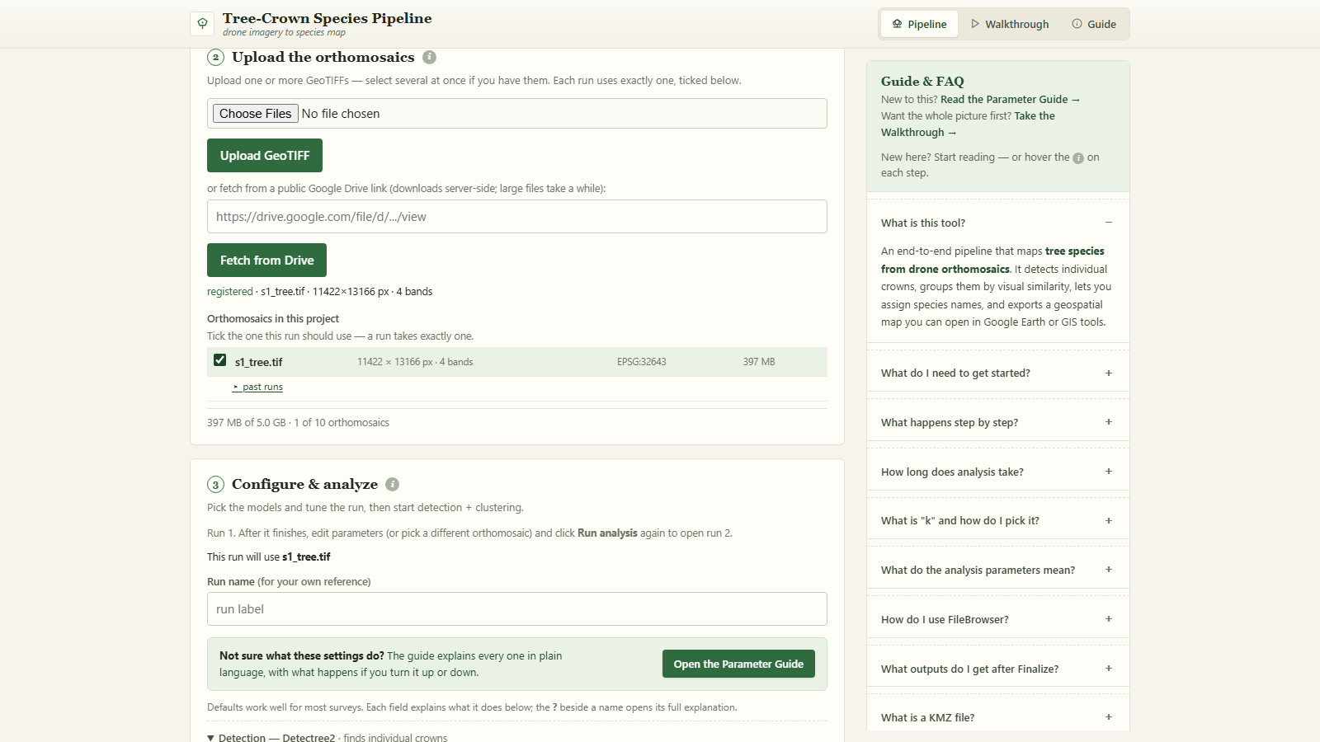
Watch the walkthrough
Chapters
0:00 Intro & sign in
0:12 Create a project
0:23 Upload an orthomosaic
0:51 Choose the settings
2:11 Run the analysis
2:22 Check the detections
2:45 Parameter Guide
3:11 Tune and run again
4:07 Review the groups
4:39 Name the species
5:24 Export the results
6:23 Run history
6:36 Come back later
6:58 Your files in FileBrowser
7:45 Wrap-up
8 min · click the video to play · subtitles on screen

Slide 9
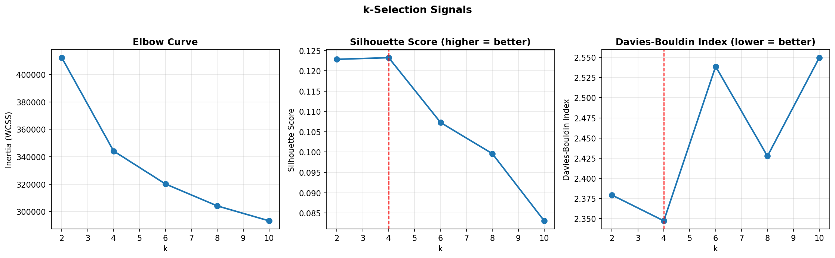
Reading the group-count charts
These three charts suggest how many groups (k) your crowns fall into.
Elbow curve
Silhouette score
Davies-Bouldin index
Pick the k where the line stops dropping steeply.
Higher is better: groups are tight and separate.
Lower is better: groups overlap less.
The red dashed line is the app's suggestion. Use it unless the sample crowns of a group look mixed — then try the next k.

Slide 10
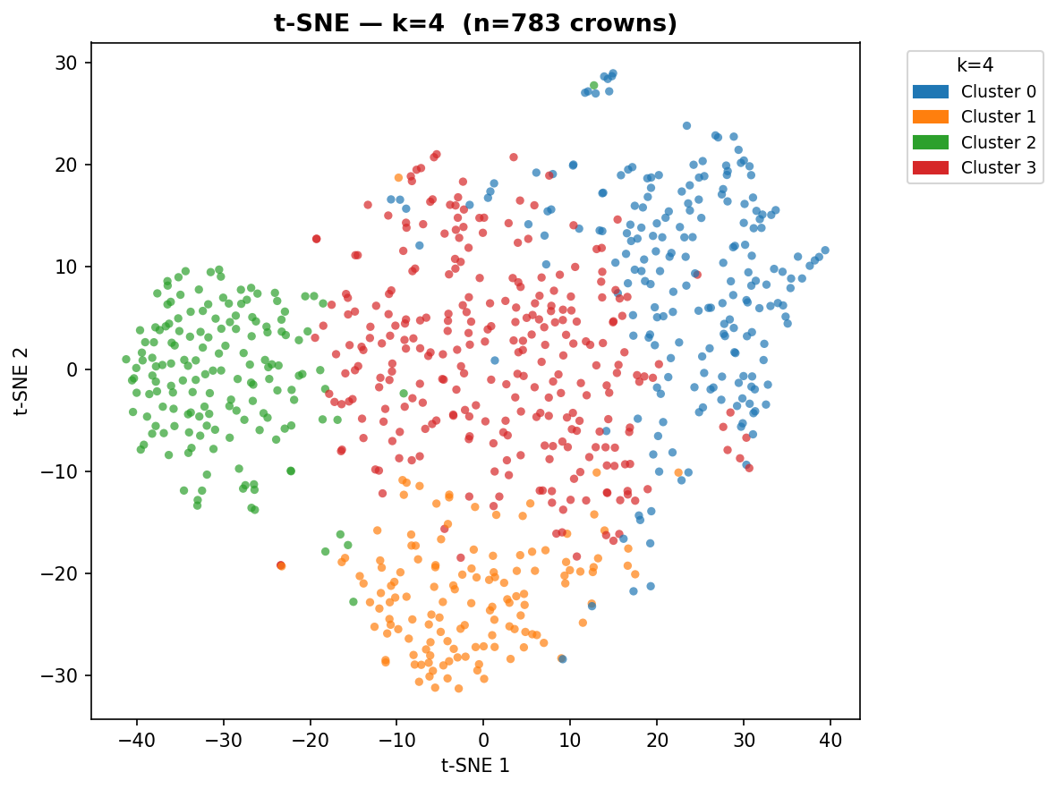
Reading the crown map (t-SNE)
What you are looking at
• Every dot is one tree crown that was detected.
• Dots with the same colour are in the same group.
• Dots close together look alike to the model.
• Tight, separate patches of colour mean clean groups.
• Colours mixed all through each other mean the groups overlap — try another k.

Slide 11
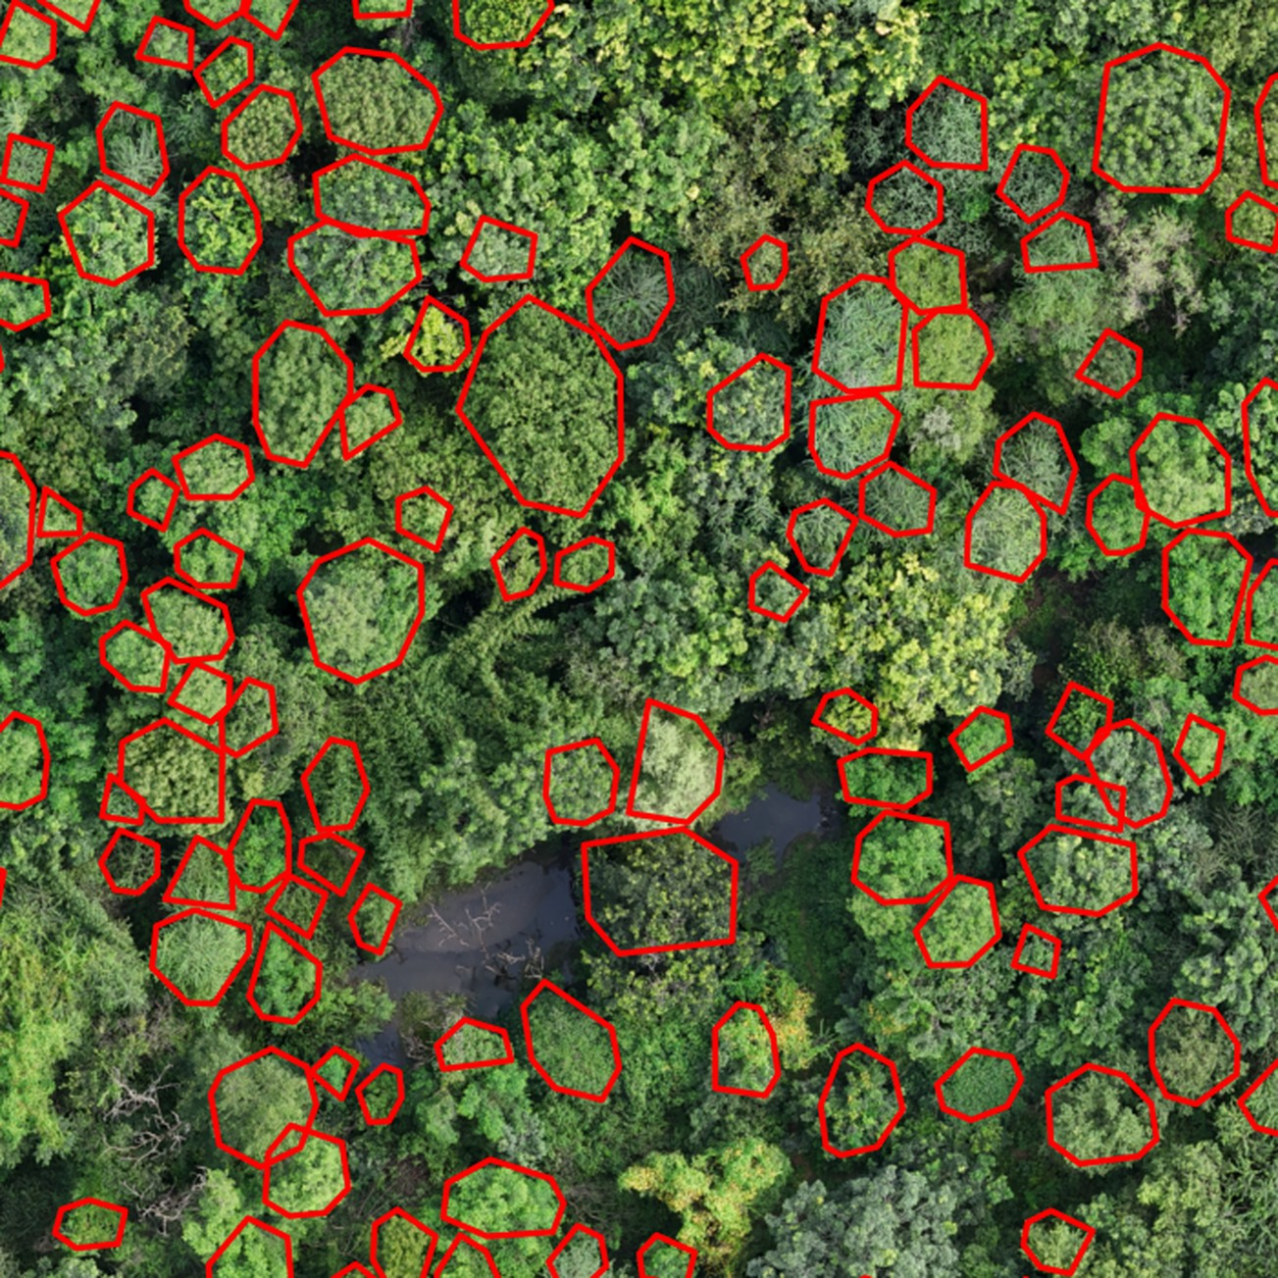
The detection overlay
Check what our model found
• Every red outline is one tree crown the model detected.
• Compare the outlines against the trees you can see.
• Trees with no outline were missed.
• One outline around several trees means they were merged.
• It sits at the top of the review. Click it to see it full size.

Slide 12
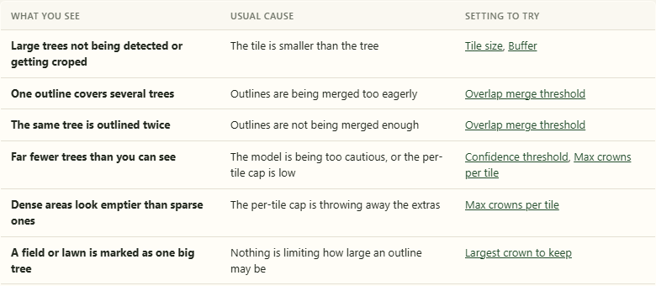
Poor results? Use the Guide
The Guide tab lists what you see, why it happens and the setting to change.
Big crowns missed or cut
Raise tile_size
Far fewer trees than you see
Lower conf_threshold
Nothing found along an edge
Turn on full coverage
A lawn marked as one tree
Lower area_max

Slide 13
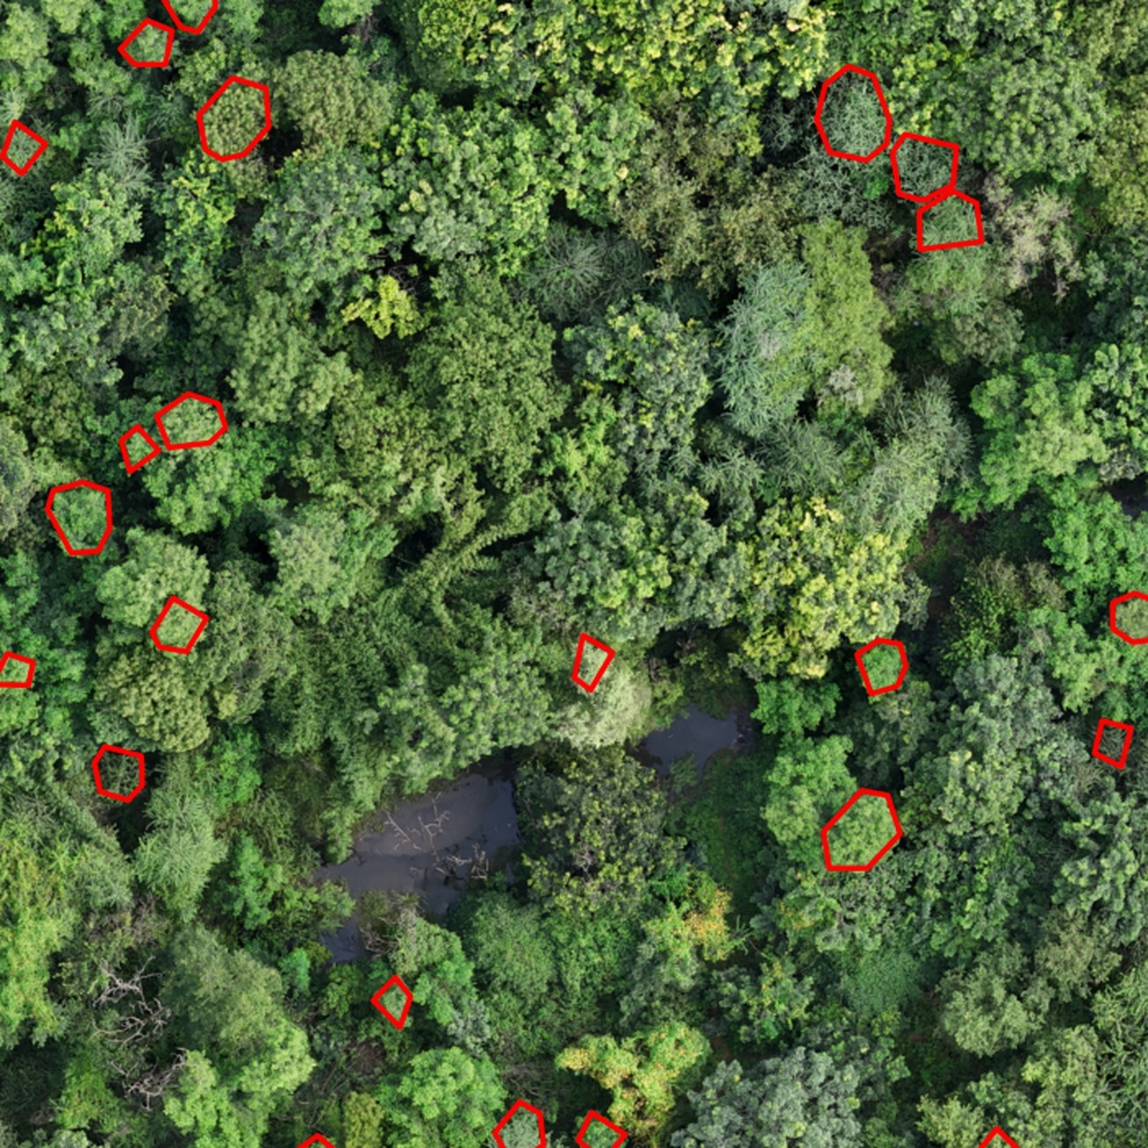
Better settings, far more trees
Run 1 · default settings
Run 2 · tuned settings
tile_size 10 · conf_threshold 0.85 · area_max 2000
tile_size 20 · buffer 15 · conf_threshold 0.5
area_max 200 · full_coverage on
173 crowns detected
783 crowns detected

Slide 14
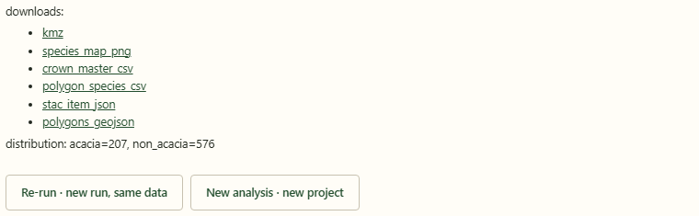
What you get as Final Output
Species map (KMZ)
CSV tables
STAC record
Opens in Google Earth or any GIS tool.
Every crown with its species, ready for Excel.
So the dataset can be catalogued and found later.
FileBrowser folder
Every run is kept
A shareable link to every file of the run.
Compare settings and finish any run later.

Slide 15
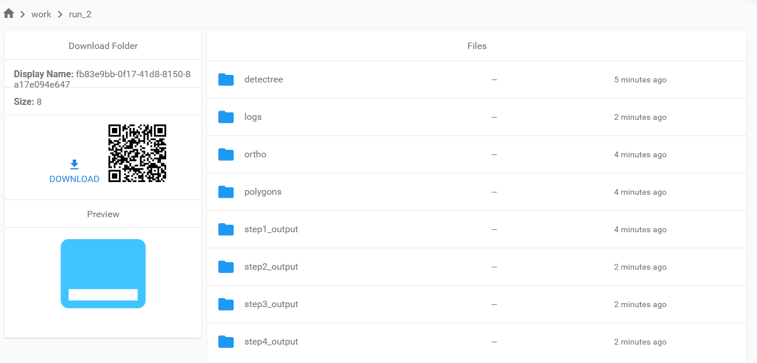
Your files in FileBrowser
Every run gets its own read-only folder link. Open it in a browser, nothing to install.
What is in a run folder
ortho the orthomosaic this run used
detectree raw output from the detector
polygons crown outlines as map shapes
step1_output crown pictures and the plots
step2_output crowns with their group
step3_output per-run summary tables
The link opens straight at the run folder, with a download button for the whole run.
step4_output species_map.kmz, CSV, GeoJSON
logs what the run did, step by step

Slide 16
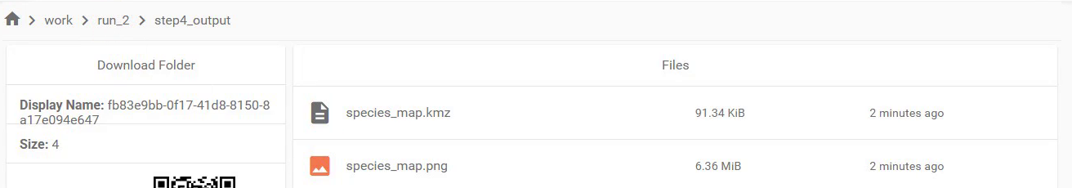
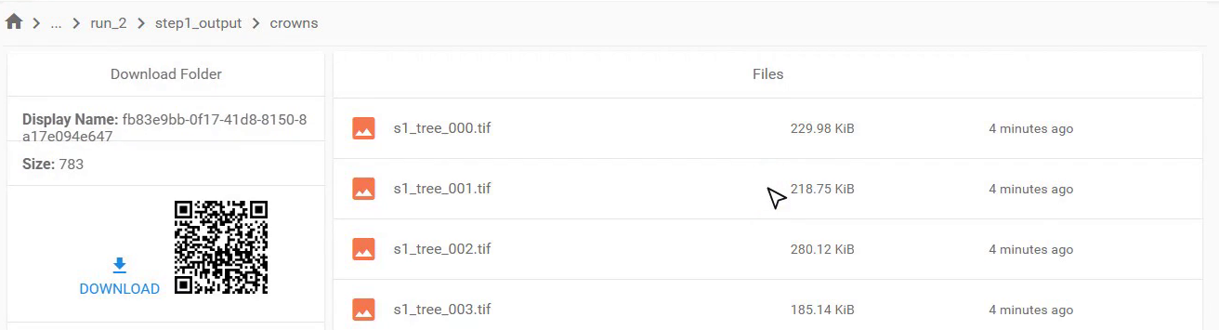
Inside a run folder
The two folders you will open most often.
step4_output: the finished map
Working with the folder
The link is read-only, so nothing can be changed or deleted by mistake.
The download button takes the whole run as one zip; the QR code carries the same link.
Click any picture to preview it
Each run keeps its own folder, so run_1 and run_2 never mix.
Share the link with anyone who needs the outputs.
species_map.kmz opens in Google Earth. The CSV and GeoJSON sit beside it, with the STAC record.
step1_output: the crown pictures
clustering/k2/thumbs holds the sample crowns you named.

Slide 17
Thank you

