Slide 1
Habitat Characterization using
Remote Image Sensory
Susmit Mahato
Supervisor: Prof. Aaditeshwar Seth
IIT Delhi
9th October 2026

Slide 2
What it does
1
Upload a drone orthomosaic
One big stitched drone image of any site.
2
Our model finds the tree crowns
It outlines every crown it can detect in the image.
3
Similar crowns are grouped
User get sample pictures of each group to review at on frontend, rest can be viewed and downloaded from shareable URL.
4
You name each group once
Every tree in that group get labelled the species user inputted.
5
Download your results
A species map, csv table summary and a stack item.

Slide 3
The Pipeline :
Orthomosaic goes in. A species map comes out. Eight steps, one of them which is labelling requires user inputs.
Stage 1 · Find the crowns (automatic)
1 · Orthomosaic
2 · Rescale and tile
3 · Detectree2
4 · Crown layer
GeoTIFF from a drone survey, ideally finer than 8 cm/px.
Brought to GSD best suited for the model, then cut into overlapping tiles.
Mask R-CNN outlines the crowns in each tile, with a confidence score for each crown.
Tiles stitched; weak, tiny, huge and duplicate crowns are removed.
Stage 2 · Group and name (automatic, then labelling )
5 · Crown crops
6 · DINOv2 + PCA
7 · KMeans
8 · User labels
Each polygon is cut from the full-resolution image.
One embedding per crown, reduced to 50 dimensions.
Crowns grouped for every k; three scores suggest a k.
The user after reviewing the crowns names each group and each tree crown in that group gets labelled.
Exports species map (KMZ) · per-crown CSV · crown polygons (GeoJSON) · STAC item

Slide 4
System architecture
The backend owns state, the worker computes, and the orchestrator only schedules.
User's browser
HTTPS
Web frontend
REST
FastAPI backend
run job
GPU worker
Signs in with Google.
Webpage served by nginx hosted on the link below.
REST API
Owns project and run state.
Runs Detectree2 and DINOv2, one process per run.
share link
trigger a run
callback /compute/*
FileBrowser
Airflow / STACD
Read-only share link to a run's folder. User can view and download generated files
state,
labels
image in,
outputs out
Schedule runs
read-only
Storage Database for state, and one folder per run: orthomosaic, crown polygons, crown crops, clusters, exports, STAC item.
Deployed at www.cse.iitd.ernet.in/act4dws5/drone

Slide 5
The Crown Detector
We run Detectree2, an open-source tree-crown detector.
What it is
Weights you can pick per project
• Mask R-CNN instance segmentation, built on Meta’s detectron2.
• Each tile returns a crown outline and a confidence score
• Published weights are used as they are
urban_cambridge Urban trees, Cambridge UK. Default.
paracou Tropical canopy, Paracou UAV.
randresize Random-resize full model.
flexi Generalist: urban and closed canopy.
tropical_closed Dense tropical forest only.
The detector only finds crowns. User has to label the clusters according to their chosen value of k and final species map is generated as output.

Slide 6
Crown embedding: DINOv2
From crown to vector
Backbones you can pick per run
• Each crown polygon is cut from the full-resolution orthomosaic.
• Then DINOv2 vision transformer returns one embedding per crown.
• Embeddings are L2-normalised, standardised, then reduced with PCA to 50 components(configurable).
ViT-S/14 Fastest, smallest embeddings.
ViT-B/14 Balanced. Default.
ViT-L/14 Highest quality, slowest.

Slide 7
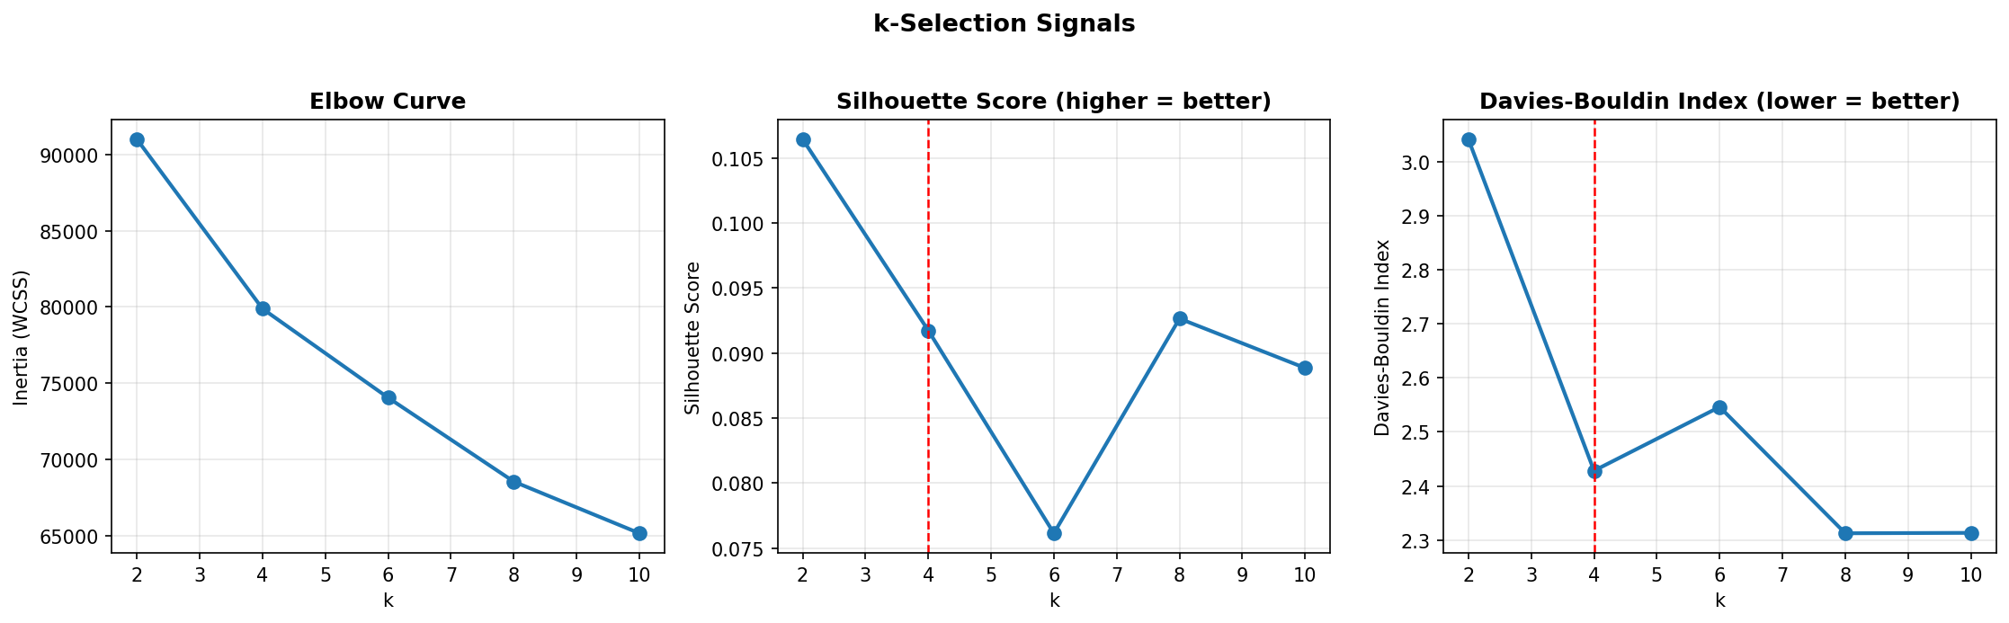
Clustering and choosing k
Look-alike crowns are grouped with KMeans, once for every k in the list.
KMeans for every k
Default k list is 2, 4, 6, 8, 10.
Three scores
The elbow, silhouette and Davies-Bouldin are computed for every k.
The k-selection plot from a run. The red dashed line marks the suggested k.
Suggested k
The best k is suggested; the user can choose any k of their choice after reviewing.
For review, the app also shows the crowns nearest each group's centre and a t-SNE map of all crowns.

Slide 8
Naming species
Clustering only groups crowns. User supplies the species names after reviewing the cropped crowns.
User names each group
• The review page shows sample crowns for every group at the chosen k.
• The user types one species per group; every crown in the group inherits it.
• Two groups can be given the same species.
• Labels are stored per run, so an older run can still be finished later.

Slide 9
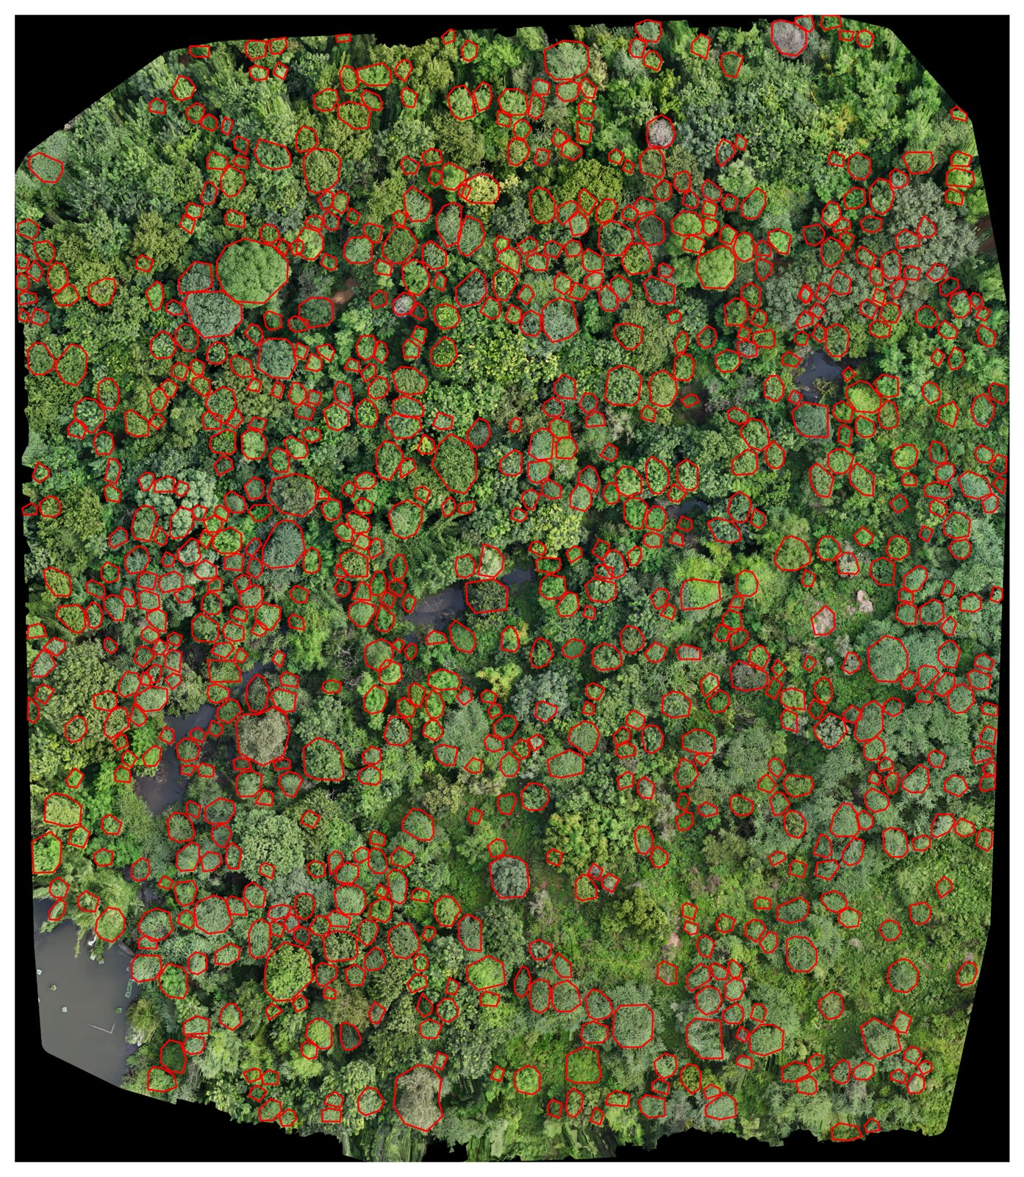
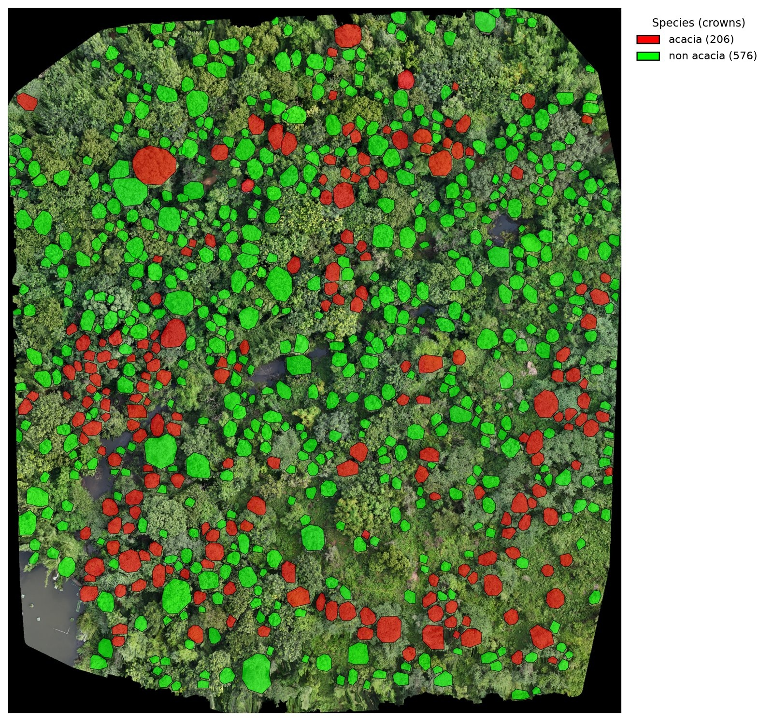
Result
782
tree crowns detected
206
labelled acacia (26%)
576
labelled non-acacia (74%)
One orthomosaic
2 cm/px, k = 2
1 · Detected crowns
2 · Species map after labelling
Detectree2 (urban_cambridge) and DINOv2 ViT-B/14. Species come from user-named clusters and are not yet checked against ground truth.

Slide 10
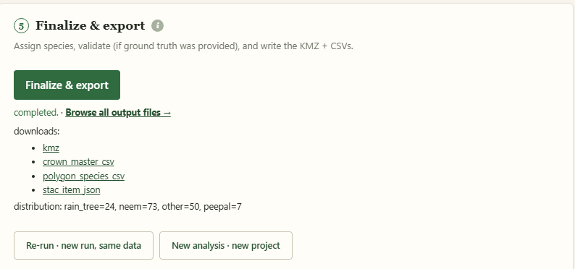
What you get as Final Output
Species map (KMZ)
CSV tables
STAC record
Opens in Google Earth or any GIS tool.
Every crown with its species, ready for Excel.
So the dataset can be catalogued and found later.
FileBrowser folder
Every run is kept
A shareable link to every file of the run.
Compare settings and finish any run later.

