Slide 1

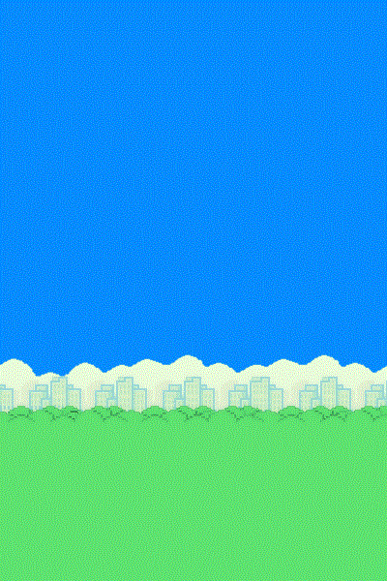

TEAM “CORELLIA” Project “FlappyBird”
Dragomir Nedelchev
Darin Georgiev
Vania Boncheva
Aleksandar Stefanov
Tihomir Pelev
Stoyan Kirkov

Slide 2
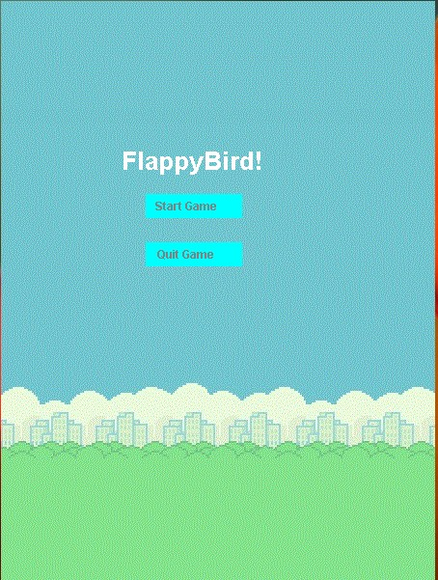
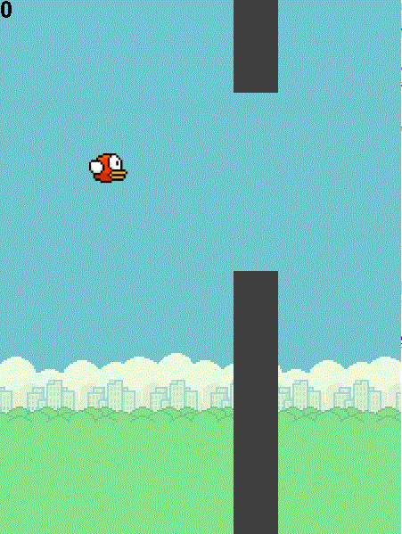
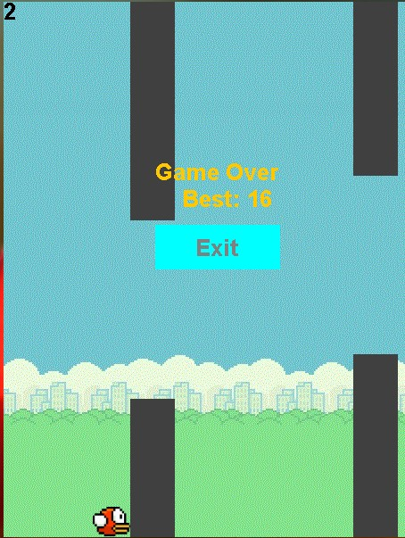
Time to jump through some columns
Short Demonstration of FlappyBird Game

Slide 3
FlappyBird Game
GUI – AWT (Abstract Window Toolkit)
Classes
Bird – represents the Bird Object and it’s movement
Column – represents a Column Object with a random gap
Window – the Main Class, starts the game, adds menu buttons etc.
Resources
background image
sound
best_score.txt – stores the best score

Slide 4
The “CORELLIA” TEAM
Dragomir Nedelchev (The Mastermind) - Main project structure, Bird movement, etc.
Darin Georgiev – Menus, Columns and their movement
Vania Boncheva – Sound and Presentation
Aleksandar Stefanov - Counter, Column freeze
Tihomir Pelev - Best Score, Exit
Stoyan Kirkov - Collision and Repository (Google Project Hosting – SVN Repository)

Slide 5
The END
Thank you!

