Slide 1
Commodity Price and Machine Learning
Daniel Brickman, Chris Nash, Sawyer Tucker, Greg Wagner

Slide 2
Presenter Introduction
Daniel Brickman
BA Statistics from University of Minnesota Twin Cities 2021
Located in Minneapolis, Minnesota
LinkedIn
Greg Wagner
BS in Mathematics from Davidson College, 2018
Located in Fort Myers, Florida (part of the Washington, DC cohort)
LinkedIn
Sawyer Tucker
BBA in Computer Information Systems Western Michigan University, 2021
Located in Minneapolis, Minnesota
LinkedIn
Christopher Nash
BBA of Computer Information Systems from Western Michigan University, 2021
Located in Milwaukee, Wisconsin
LinkedIn

Slide 3
Project Introduction
Commodities are raw materials or agricultural products
Traded in Chicago Mercantile Exchange Group and the New York Mercantile Exchange
Like stocks, prices fluctuate minute-to-minute
Unlike stocks, commodities are an asset that can be used or consumed
Value in being able to predict future prices of commodities
Half our group is entering an agriculturally-focused field, so we examined three crops: corn, wheat, and soybeans

Slide 4
Initial Questions
How have the prices of commodities like wheat, corn, and soybeans changed over time?
What affects the prices of these commodities?
Can we predict the price of these commodities in the future?
Does our model change as we receive incoming data from the API?
Which states are the top producers and consumers of these commodities?
Which nations are the top producers and consumers of these commodities?

Slide 5
Data Sources
Commodities API - updates every two minutes
Corn, wheat, soy, gold, relevant foreign currencies
Used in ML model
Economic Research Service API - US Department of Agriculture
Reports how much and what type of commodity is produced in USD
Foreign Agricultural Service Data API - National Agriculture Stats Service
What is being exported and to whom in USD

Slide 6
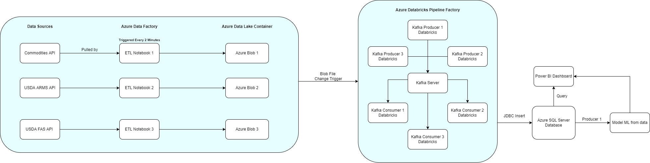
Data Platform Overview

Slide 7

Visualizations

Slide 8
Machine Learning
Using ARIMA forecasting model for Wheat/Corn/Soybeans
AutoRegressive Integrated Moving Average
Training with 90% commodity data, testing with last 10%
Using autoARIMA python package to select best hyperparameters for each commodity
Corn: {1, 0, 3} p, d, q values respectively
MAPE = 0.00235 ~ 99.765% accurate
Limitation - modeling must be graphed on a separate Power BI report

Slide 9
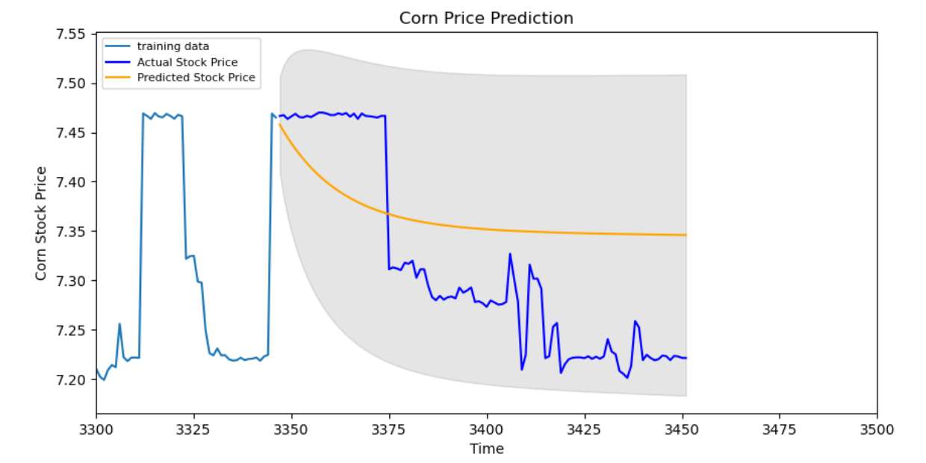
ARIMA Testing
Corn Stock Price (USD)
API Calls

Slide 10
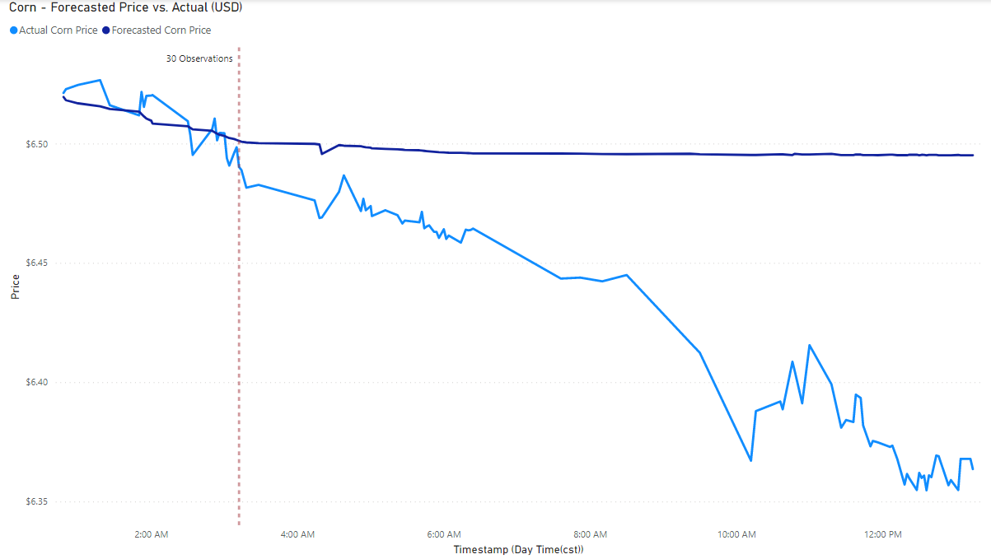
30 Observations

Slide 11
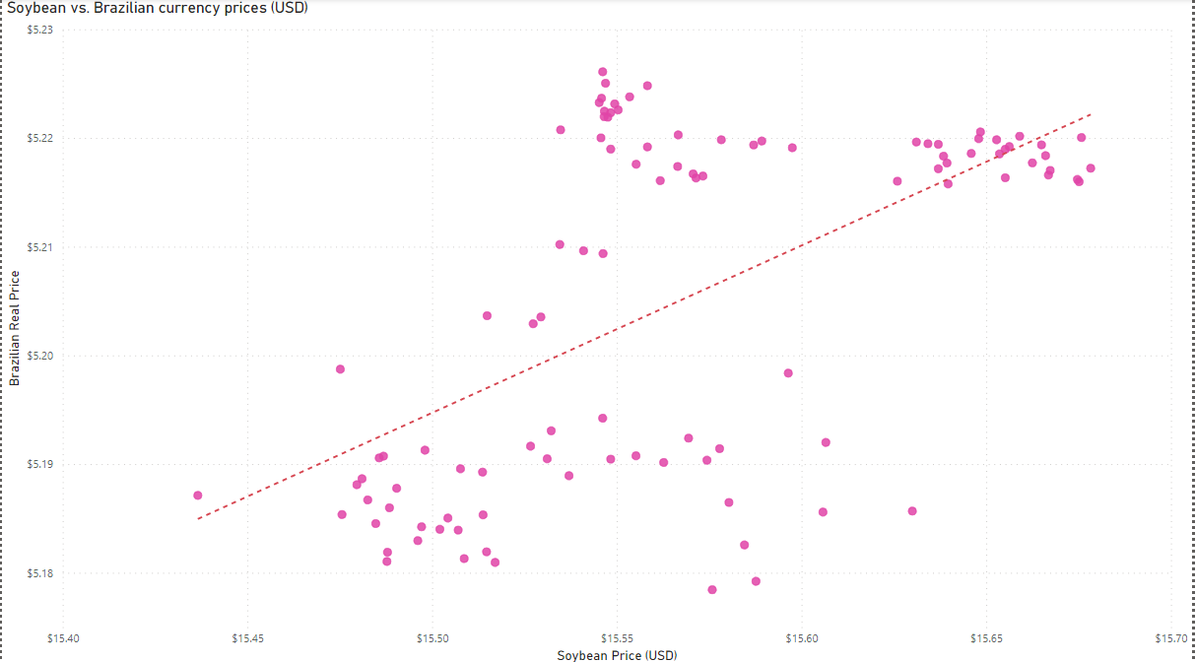
Recommendations
Predicting time series data is tricky and needs to be updated frequently to retain accuracy
Real world events and weather patterns change our model
Example: The Russia-Ukraine (global), Canada Truckers (more local)
Minnesota is a top producer of Corn and Soybean in the US
Possible Commodity-Currency Link

Slide 12

THANK YOU
Any QUESTIONS?

