Slide 1

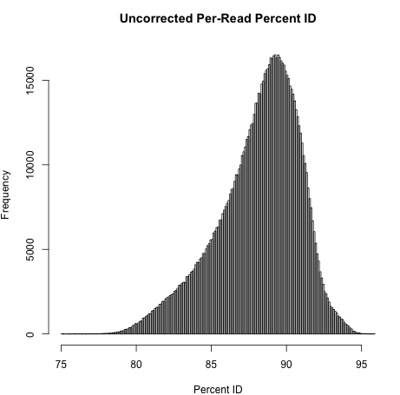
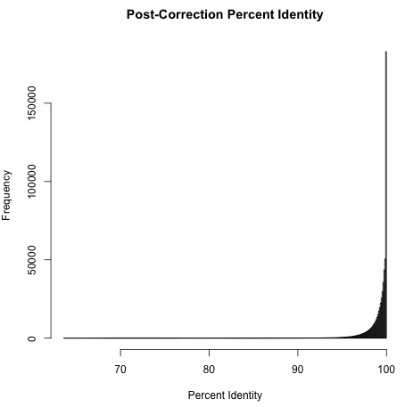
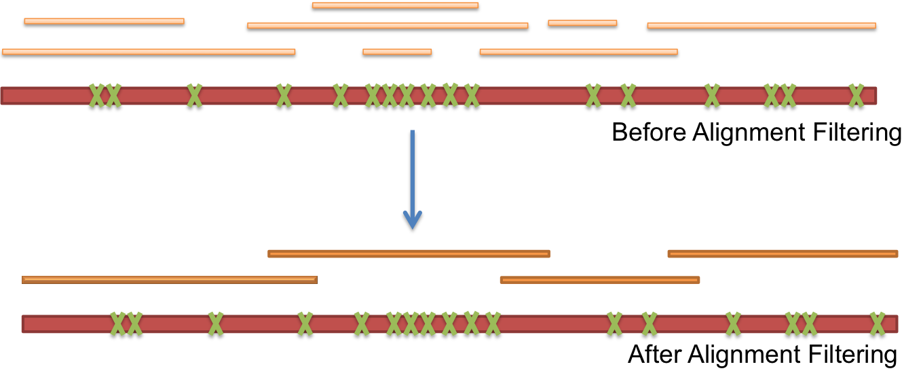
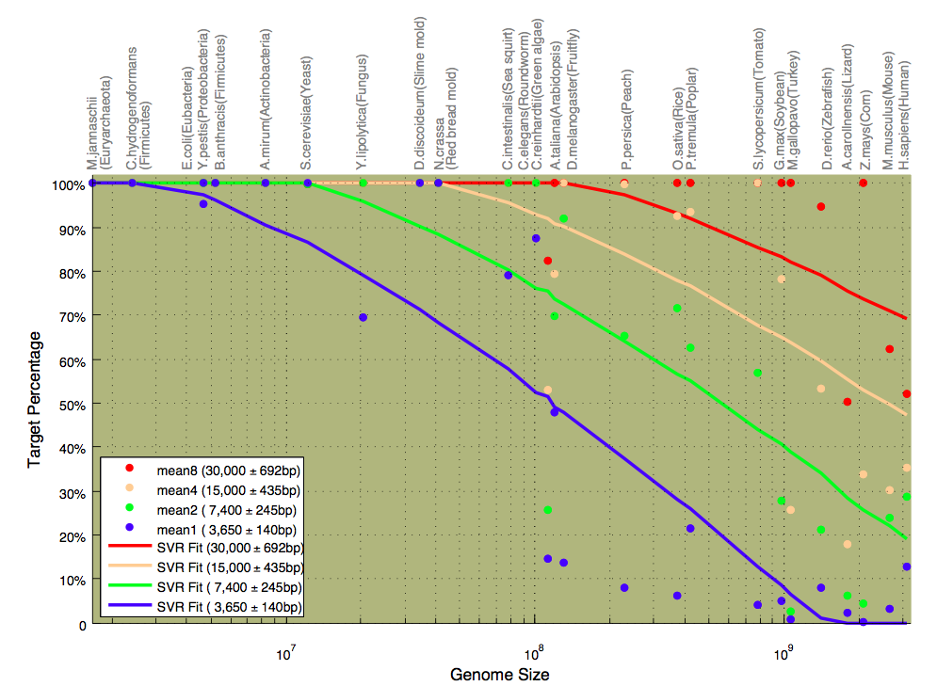
iGenomics: Mobile DNA Sequence Analysis
Aspyn Palatnick
https://github.com/stuckinaboot/iGenomics
Abstract
Methods
Results
In the same way that a technological transformation occurred where computers the size of entire rooms evolved into mobile devices that can into our pockets, a genomics revolution is currently ongoing as DNA sequencing technology shifts from million dollar instruments to inexpensive mobile sensors. The potential uses of these sensors range from diagnosing genetic conditions in doctors’ offices, to analyzing the DNA of pathogens discovered in the Amazon rainforest, to improving the overall yield of crops that are grown.
iGenomics is my new mobile DNA sequence analysis application that is optimized to run as efficiently as possible on iPads and other mobile devices. This is the first application ever to be able to screen genomes and identify variants on a mobile device through an implementation in Objective-C. The long-term prediction is that iGenomics will become the main platform for DNA sequence analysis in a remote setting.
The significantly lower amount of processing power contained within an iPad limits the data processing power available compared to super-computers that have been traditionally used to process genomes. That being stated, iGenomics uses the multiple cores of the iPad and advanced algorithms such as the Burrows-Wheeler Transform to rapidly analyze DNA sequences. Viral genomes such as the influenza virus can be analyzed in a matter of seconds while microbial genomes including many disease-causing pathogens can be analyzed in a matter of minutes.
iGenomics is available as a free-to-download application on Apple’s App Store and its source code can be obtained from https://github.com/stuckinaboot/iGenomics.
In all aspects of assembly long reads are preferred over short reads because they contain more contiguous information about the nucleotide sequence. Error correction is no exception. Rather than align raw short reads to a long-read backbone, the short reads are first preassembled into unitigs. These unitigs give more contiguous information and can span regions of high error rate. In order to align unitigs a very sensitive aligner is needed. Nucmer from the Mummer suite was chosen for its sensitivity and flexibility.
Short Reads
Short-Read Unitig
Uncorrected Long Read
Above, unitigs composed of short reads are aligned to a raw long read. Because the short-read unitigs are the assembler’s attempt at creating a unique representation of the genome, it is no longer appropriate to try to make a consensus sequence. Instead, we want to find the layout of the unitigs along the long read scaffold that maximizes long read coverage while minimizing short-read unitig overlap. This functionality is implemented in the delta-filter program which is also a part of the Mummer suite of tools. The functionality of delta-filter is depicted below where a large set of alignments are filtered down to a candidate set of unitigs that most likely come from the same region as the long read.
Error correction significantly improves the per-base identity. Most reads are corrected to within 1% error rate. These plots were made by aligning pre and post correction reads to the rice reference genome.
Background
Assembly | Contig NG50
HiSeq Fragments 50x 2x100bp @ 180 | 3,925
MiSeq Fragments 23x 459bp 8x 2x251bp @ 450 | 6,332
“ALLPATHS-recipe” 50x 2x100bp @ 180 36x 2x50bp @ 2100 51x 2x50bp @ 4800 | 18,248
PBeCR Reads 7x @ 3500 ** MiSeq for correction | 50,995
Enchanced PBeCR 15x @ 3500 ** MiSeq for correction | 155,695
Prior to the aligning and analyzing of DNA strands, these samples of DNA must be sequenced using a bench-top sequencing apparatus. This type of machine requires special preparation for the DNA to be read in. The DNA must first be extracted from the cells of the sample biological substance/organism and split into smaller random pieces using sound waves at a specific frequency. These newly split strands of DNA are color-coded in a specific manner so that the sequencing machines can read in the DNA and categorize each base-pair as an A, C, G, or T. Once all of the DNA has been read in by the sequencing device, the DNA data, called reads, is saved in a file on the connected computer or server network. This file solely consists of the raw read data, the quality of each read, and the name of each read.
The DNA sequencing device provides no way to align the reads to a reference genome, so that is done on a computer or linked set of servers. The software used for the aligning requires both a reads file and and a reference genome (the DNA sequence the reads will aligned to) file. The DNA analyzing takes place and an export file containing alignment data and mutation information is generated. Until iGenomics, there has been no mobile version of any of this alignment software.
Short-Read Unitigs
Using a variation of the longest increasing subsequence dynamic programming algorithm, delta-filter is able to filter unitig alignments to find the subset that are most likely to be from the same region as the long read. Once the set of unitigs is determined, the show-snps program is used to determine the difference between the unitig set and the raw long read. A simple python script uses this information to “correct” the long read, incorporating all of the information provided by the scaffold of unitigs.
** Minimum read length
The table above shows the results of various rice assemblies. Assemblies using the long read data produced the best results. Our enhanced error correction pipeline was able to boost the n50 metric by nearly 3 fold over the correction with the existing pacbioToCA pipeline bundled with the Celera assembler.
Once the layout is determined and bases are corrected, and a conservative trimming algorithm removes regions of the long reads that did not have short-read unitig alignments. Depending on the context, the user may want to choose between shorter, well corrected reads and longer, lower identity reads. The user can specify a minimum identity and the splitting algorithm will make an effort to only output reads with a per-base identity greater than this number. It assumes all bases with a short-read unitig alignment can be corrected to within 99% identity while regions without coverage remain at the uncorrected 85% identity. Taking the average identity along the read and recursively splitting out sections without coverage eventually produces subreads with an identity that meets the user’s requirements.
A
R
B
R
C
R
A
R
B
R
C
R
Once corrected, the long reads help to span repeats and conclusively determine the order of contigs in the assembly graph. The twisted assembly graph seen with shorter reads becomes a straight forward linear representation of the genomic sequence. It is for this reason that longer reads are so coveted, because they contain more information about the relative position of contiguous sequences.
Sequencing technology is improving rapidly. Over the past few years read length from the leading single molecule sequencing technology has increased at an exponential rate. Using simulation we are able to see how this exponential increase in throughput and read length will affect de novo assembly in the near future. The above graph has a selection of organisms from across the tree of life for which a reference genome exists. Various assemblies with different read lengths were conducted at 20x coverage to find how well different genomes assemble. The blue line shows what is possible with today’s technology. The successive colors, green, peach and red are the predictions for next year, the year after and so on. This chart can be a great tool for planning future assembly projects.
References:
Hybrid error correction and de novo assembly of single-molecule sequencing reads. Koren,S, Schatz, MC, et all. (2012) Nature Biotechnology. Doi:10.1038/nbt.2280
Nonhybrid, finished microbial genome assemblies from long-read SMRT sequencing data. Chin, CS et al. (2013) Nature Methods. 10:563-569
Fast algorithms for large-scale genome alignment and comparison.
Delcher AL, Phillippy A, Carlton J, Salzberg SL, Nucleic Acids Res. 2002 Jun 1;30(11):2478-83.

