Slide 1
IPL Auctioning System
Group 26
Manav Kedia
Sudhanshu Bahety
Vatsalya Chauhan
Swapnil Agarwal

Slide 2
Crawling
We crawled the data from Wikipedia, IPL official web page
Python was used for populating the database

Slide 3
Content
All the bids of every IPL season of every player from every owner owing any team
Player statistics of every IPL player that ever played in each individual seasons
Sold/Unsold players in the IPL Auction
Retained players
Trades between teams
Replacements in the IPL Season

Slide 4
Content
Retirements, if any
Capped/ Uncapped players
Team owners and their details like initial cash
Teams and their details like homeground, number of foreign and Indian players

Slide 5
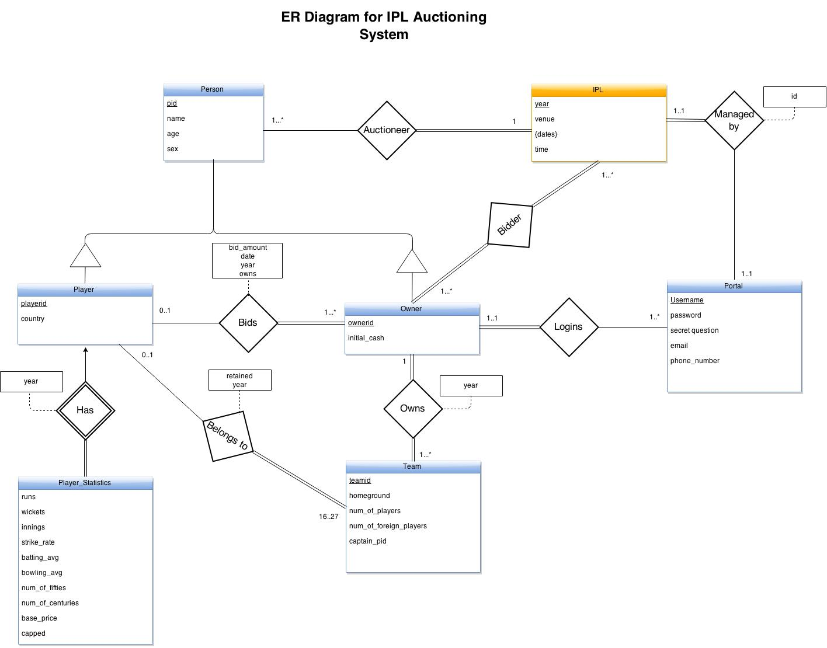
ER Diagram

Slide 6
Functional Dependency
pid->name, sex,nationality, teamname
pid,year->runs,wickets,num_of_innings,bat_strike_rate,bowl_strike_rate,batting_avg, bowling_avg,economy, num_of_fifties, num_of_centuries, base_price
pid, teamname,year -> bid_amount,date, initial_cash, retained
year, teamname -> homeground, num_of_players, num_of_foreign_players, captain_name
year, dates -> time
year -> venue

Slide 7
Table Schemas
Person(pid, name, sex) ;
Player(pid, nationality);
Player_statistics(pid,year,runs,wickets,num_of_innings,bat_strike_rate,bowl_strike_rate,batting_avg, bowling_avg,economy, num_of_fifties, num_of_centuries, base_price);
Owner(pid);
Bids(pid, teamname,year,bid_amount,date);
Team(year, teamname, homeground, num_of_players, num_of_foreign_players, captain_name);
TeamOwner(pid,teamname,year , initial_cash);
TeamPlayer(pid, teamname, retained, year);
IPL(year, venue);
IPLDates(year, dates, time);
Auctioneer(pid, year);
Trades(pid1,pid2, teamname1 ,teamname2 );
create table Retirement(pid,year);
create table Replacement(pid1,pid2,year,teamname );

Slide 8
Use Cases
Query a player. Search the player by name, team-name, team-owner. This query can be made for each individual year of the IPL
Query player statistics. Get the runs, wickets, centuries,half-centuries, batting and bowling averages, batting and bowling strike rates, economy for a player. This can also be done seasonwise
Query teams. Search a team by team name, team-owner, player name seasonwise
Query bid amounts for any player any year
Query team-owner bids seasonwise
Query player base price, season wise.
Query trades for any year

Slide 9
Use Cases
Query if a player was retained in the team from last season or not
Query average bids/ total sum of bids for any team yearwise
Query the number of Indian/Foreign players in a team yearwise
Query the captain of a team seasonwise
Query the homeground of a team
Query year of joining of a player in the IPL
Sort the players by highest/lowest runs, wickets, batting and bowling averages, batting and bowling strike rate, half-centuries, centuries, economy yearwise as well as teamwise
Sort the players by highest/lowest bids yearwise as well as teamwise

Slide 10
Use Cases
Query retirements for any year
Query replacements for any year
Query IPL Venue season
Query players that have played in n number of teams (n>=2)
Query unsold players for any team, seasonwise
Players whose bid amounts have increased always
Players whose bid amount has ever decreased

