Slide 1
Boosting for tumor classification
with gene expression data
Kfir Barhum

Slide 2
Overview – Today:
Review the Classification Problem
Features (genes) Preselection
Weak Learners & Boosting
LogitBoost Algorithm
Reduction to the Binary Case
Errors & ROC Curves
Simulation
Results

Slide 3
Classification Problem
Given n training data pairs:
With : and
Corresponds to: X – features vector, p features
    Y – class label
Typically: n between 20-80 samples
p varies from 2,000 to 20,000

Slide 4
Our Goal:
Construct a classifier C:
From which a new tissue sample is classified based on it’s expression vector X. For the optimal C holds:
  is minimal
We first handle only binary problems, for which:
Problem: p>>n
  we use boosting in conjunction with decision trees !

Slide 5
Features (genes) Preselection
Problem: p>>n: sample size is much smaller than the features dimension (number of genes – p).
Many genes are irrelevant for discrimination.
Optional solution:
    Dimensionality Reduction – was discussed earlier
We score each individual gene g, with g {1,…,p}, according to it’s strength for phenotype discrimination.

Slide 6
Features (genes) Preselection
We denote:
the expression value of gene g for individual I
Define:
Which counts, for each input s.t. Y(x) = 0, the number of inputs of the form Y(x)=1, such that their expression difference is negative.
Corresponding to set of indices having response Y( )=0, Y( )=1

Slide 7
Features (genes) Preselection
A gene does not discrimintate, if it’s score is about
It discriminates best when or even s(g) = 0 !
Therefore define
We then simply take the genes with the highest values of q(g) as our top features.
Formal choice of can be done via cross-validation

Slide 8
Weak Learners & Boosting
Suppose…
Suppose we had a “weak” learner, which can learn the data, and make a good estimation.
Problem: Our learner has an error rate which is too high for us.
We search for a method to “boost” those weak classifiers.

Slide 9
Weak Learners & Boosting
…… Boosting !!!
Introduce:
create an accurate combined classifier from a sequence of weak classifiers
Weak classifiers are fitted to iteratively reweighed versions of the data.
In each boosting iteration m, with m = 1…M:
  Weight of data observations that have been misclassified at the previous step, have their weights increased
  The weight of data that has been classified correctly is decreased

Slide 10
Weak Learners & Boosting
The m th weak classifier - - is forced to concentrate on the individual inputs that were classified wrong at earlier iterations.
Now, suppose we have remapped the output classes Y(x) into {-1, 1} instead of {0,1}.
We have M different classifiers. How shall we combine them into a stronger one ?

Slide 11
Weak Learners & Boosting
“The Committee”
Define the combined classifier to a weighted majority vote of the “weak” classifiers:
Points which need to be clarified, and specify the alg. :
  i) Which weak learners shall we use ?
  ii) reweighing the data, and the aggregation weights
  iii) How many iterations (choosing M) ?

Slide 12
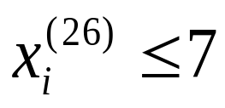
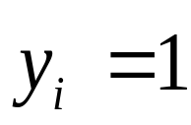
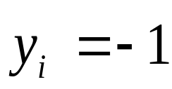
Weak Learners & Boosting
Which type of “weak” learners:
  Our case, we use a special kind of decision trees, called stumps - trees with two terminal nodes.
  Stumps are simple “rule of thumb”, which test on a single attribute.
Our example:
yes
no

Slide 13
Weak Learners & Boosting
The Additive Logistic Regression Model
Examine the logistic regression:
The logit transformation, gurantees that for any F(x), p(x) is a probability in [0,1].
inverting, we get:

Slide 14
LogitBoost Algorithm
So.. How to update the weights ?
We define a loss function, and follow gradient decent principle.
AdaBoost uses the exponential loss function:
LogitBoost uses the binomial log-likelihood:
  Let
  Define

Slide 15
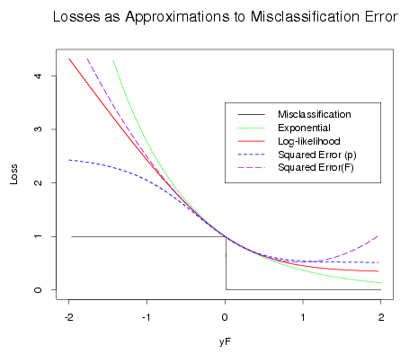
LogitBoost Algorithm

Slide 16
LogitBoost Algorithm
Step 1: Initialization
committee function:
initial probabilities:
Step 2: LogitBoost iterations
for m=1,2,...,M repeat:

Slide 17
LogitBoost Algorithm
A. Fitting the weak learner
  Compute working response and weights for i=1,...,n
  Fit a regression stump by weighted least squares

Slide 18
LogitBoost Algorithm
B. Updating and classifier output

Slide 19
LogitBoost Algorithm
Choosing the stop parameter M:
  overfitting: when the model no longer concentrates on the general aspects of the problem, but on specific it’s specific learnning set
  In general: Boosting is quite resistant to overfitting, so picking M higher as 100 will be good enough
  Alternatively one can compute the binomial log-likelihood for each iteration and choose to stop on maximal approximation

Slide 20
Reduction to the Binary Case
Our Algorithm discusses only 2-Classifications.
For J>2 Classes, we simply reduce to J Binary problems as follows:
Define the j th problem as:

Slide 21
Reduction to the Binary Case
Now we run J times the entire procedure, including features preselection, and estimating stopping parameter on new data.
  different classes may preselect different features (genes)
  This yields estimation probabilities:
  for j = 1,...,J

Slide 22
Reduction to the Binary Case
These can be converted into probability estimates for J=j via normalization:
Note that there exists a LogitBoost Algorithm for J>2 classes, which treats the multiclass problem simultaneously. It yielded >1.5 times error rate.

Slide 23
Errors & ROC Curves
We measure errors by leave-one-out cross validation :
For i=1 to n:
  Set aside the i th observation
  Carry out the whole process (i.e. feature selection, classifier fitting) on the remaining (n-1) data points.
  Predict the class label for the i th observation
Now define:

Slide 24
Errors & ROC Curves
False Positive Error -
  when we classify a positive result as a negative one
False Negative Error –
  when we classify a negative result as a positive one
Our Algorithm uses Equal misclassification Costs.
  (i.e. punish false-positive and false-negative errors equally)
Question: Should this be the situation ?

Slide 25
Recall Our Problem…
NO !
In our case:
  false positive - means we diagnosed a normal tissue as a tumorous one. Probably further tests will be carried out.
  false negative – We just classified a tumorous tissue as a healthy one. Outcome might be deadly.

Slide 26
Errors & ROC Curves
ROC Curves illustrate how accurate classifiers are under asymmetric losses
Each point corresponds to a specific probability which was chosen as a threshold for positive classification.
Tradeoff between false positive and false negative errors.
The closer the curve is to (0,1) on graph, the better the test.
ROC is: Reciever Operating Characteristic – comes from field called “Signal Detection Theory”, developed in WW-II, when radar had to decide whether a ship is friendly, enemy or just a backgroud noise.

Slide 27
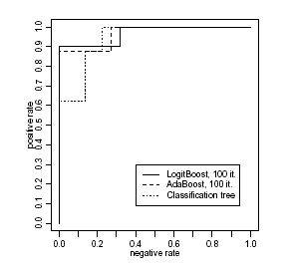
Errors & ROC Curves
Colon data w/o features preselection
X-axis: negative examples classified as positive (tumorous ones)
Y-axis positive classified correctly
Each point on graph, represents a Beta chosen from [0,1] – as a threshold for positive classification

Slide 28
Simulation
The algorithm worked better than benchmark methods for our real examination.
Real datasets are hard / expensive to get
Relevant differences between discrimination methods might be difficult to detect
Let’s try to simulate gene expression data, with large dataset

Slide 29
Simulation
Produce gene expression profiles from a multivariate normal distribution
where the covariance structure is from the colon dataset
we took p = 2000 genes
Now assign one of two respond classes, with probabilities:

Slide 30
Simulation
The conditional probabilities are take as follows:
  For j=1,...,10:
    Pick Cj of of size uniformly random from {1,...,10}
    - Mean values across random gene
    The expected number of relevant genes is therefore 10*5.5=55
    Pick from normal distrubtion with stddev 2,1,0.5
    respectively

Slide 31
Simulation
The trainning size was set to n=200 samples, and tested on 1000 new observations test
The whole process was repeated 20 times, and was tested against 2 well-known benchmarks: 1-Nearest-Neighbor and Classification Tree.
LogitBoost did better than both, even on arbitrary fixed number of iterations (150)

Slide 32
Results
Boosting method was tried on 6 publicly avilable datasets (Lukemia, Colon, Estrogen, Nodal, Lymphoma, NCI).
Data was processed and tested against other benchmarks: AdaBoost, 1-Nearest-Neighbor, Classification Tree.
On all 6 datasets the choice of the actual stopping parameter did not matter, and the choice of 100 iterations, did fairly well.

Slide 33
Results
Tests were made for several numbers of preselected features, and all of them.
Using all genes, the classical method of 1-nearest-neighbor is interrupted by noise variables, and the boosting methods outperforms it.

Slide 34
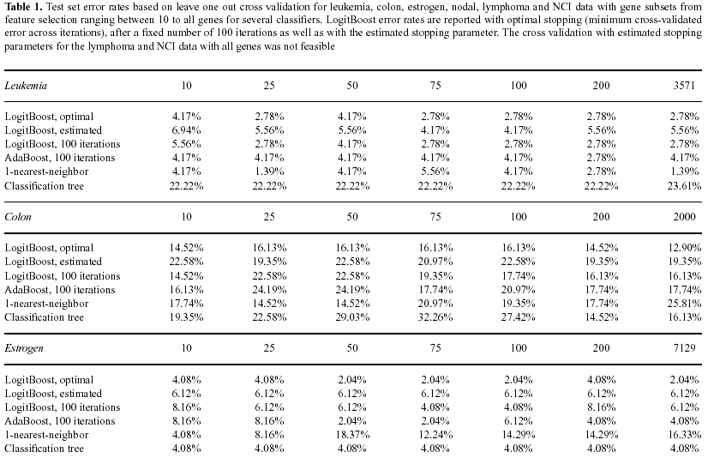
Results

Slide 35
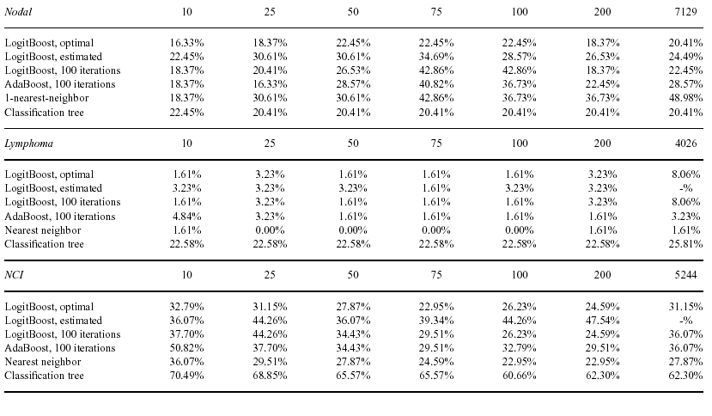

Slide 36
-fin-

