Slide 1
Decision Tree
By Wang Rui
State Key Lab of CAD&CG
2004-03-17

Slide 2
Review
Concept learning
  Induce Boolean function from a sample of positive/negative training examples.
  Concept learning can be cast as Searching through predefined hypotheses space
Searching Algorithm:
  FIND-S
  LIST-THEN-ELIMINATE
  CANDIDATE-ELIMINATION

Slide 3
Decision Tree
Decision tree learning is a method for approximating discrete-valued target functions (Classifier), in which the learned function is represented by a decision tree.
Decision tree algorithm induces
concepts from examples.
Decision tree algorithm is a
general-to-specific
searching strategy
Examples
Decision tree algorithm
Decision Tree
concept
New example
classification

Slide 4
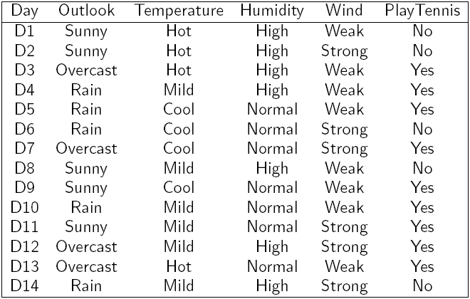
A Demo Task – Play Tennis

Slide 5
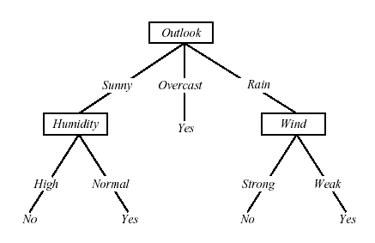
Decision Tree Representation
Classify instances by sorting them down the tree from the root to some leaf node
Each branch corresponds to attribute value
Each leaf node assigns a classification

Slide 6
Each path from the tree root to a leaf corresponds to a conjunction of attribute tests
  (Overlook = Sunny) ^ (Humidity = Normal)
The tree itself corresponds to a disjunction of these conjunctions
  (Overlook = Sunny ^ Humidity = Normal)
  V (Outlook = Overcast)
  V (Outlook = Rain ^Wind = Weak)

Slide 7
Top-Down Induction of Decision Trees
Main loop:
1. A the “best” decision attribute for next node
2. Assign A as decision attribute for node
3. For each value of A, create new descendant of node
4. Sort training examples to leaf nodes
5. If training examples perfectly classified, Then STOP, Else iterate over new leaf nodes

Slide 8
{ Outlook = Sunny, Temperature = Hot, Humidity = High, Wind = Strong }
Tests attributes along the tree
  typically, equality test (e.g., “Wind=Strong”)
  other tests (such as inequality) are possible

Slide 9
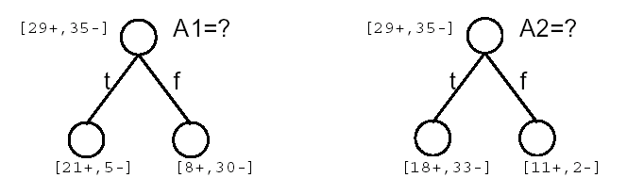
Which Attribute is Best?
Occam’s razor: (year 1320)
  Prefer the simplest hypothesis that fits the data.
Why?
  It’s a philosophical problem.
    Philosophers and others have debated this question for centuries, and the debate remains unresolved to this day.

Slide 10
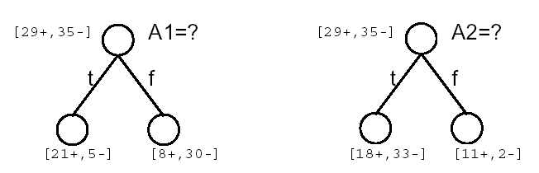
Simple is beauty
Shorter trees are preferred over lager Trees
Idea: want attributes that classifies examples well. The best attribute is selected.
How well an attribute alone classifies the training data?
  information theory

Slide 11
Information theory
A branch of mathematics founded by Claude Shannon in the 1940s.
What is it?
  A method for quantifying the flow of information across tasks of varying complexity
What is information?
  The amount our uncertainty is reduced given new knowledge

Slide 12
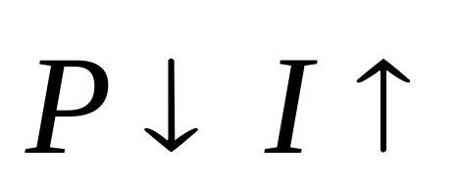
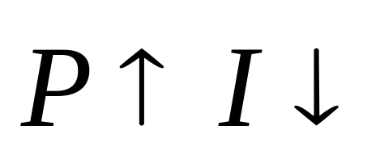
Information Measurement
Information Measurement
  The amount of information about an event is closely related to its probability of occurrence.
Units of information: bits
Messages containing knowledge of a low probability of occurrence convey relatively large amount of information.
Messages containing knowledge of high probability of occurrence convey relatively little information.

Slide 13
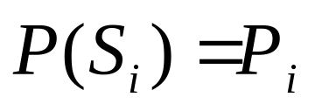
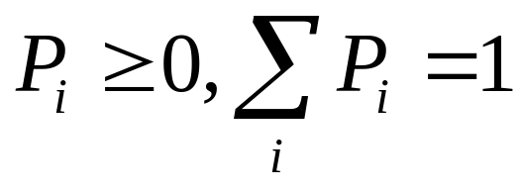

Source alphabet of n symbols {S1, S2,S3,…Sn}
Information
Source
Let the probability of producing be
for
Question
  A. If a receiver receives the symbol in a message, how much information is received?
  B. If a receiver receives in a M - symbols message, how much information is received on average?

Slide 14


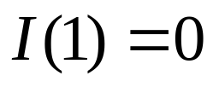



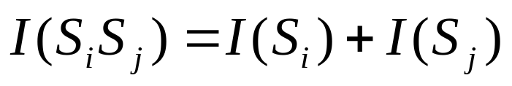

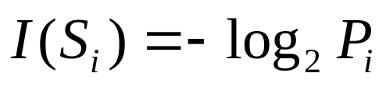
Question A
The information of a single symbol in a n symbols message
  Case I:
  Answer: is transmitted for sure. Therefore, no information.
  Case II:
  Answer: Consider a symbol ,then the received information is
  So the amount of information or information content in the symbols is

Slide 15
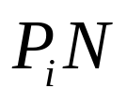

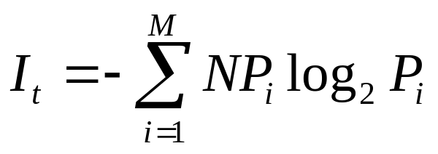
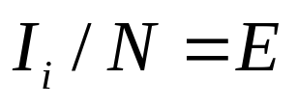
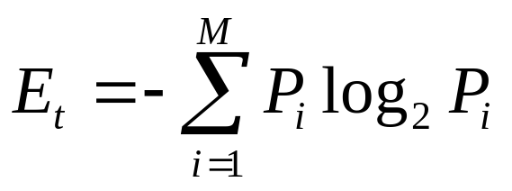
Question B
The information is received on average Message
  will occur, on average, times for
  Therefore, total information of the M-symbol message is
  The average information per symbol is and
Entropy

Slide 16
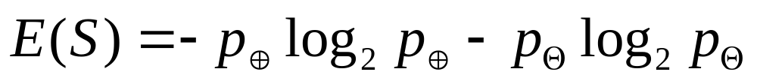
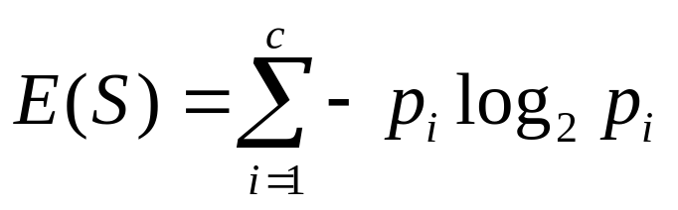
Entropy in Classification
A collection S, containing positive and negative examples, the entropy to this boolean classification is
Generally

Slide 17

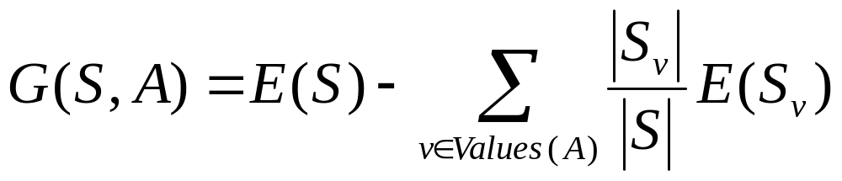
Information Gain
What is the uncertainty removed by splitting on the value of A?
The information gain of S relative to attribute A is the expected reduction in entropy caused by knowing the value of A
  : the set of examples in S where attribute A has value v

Slide 18
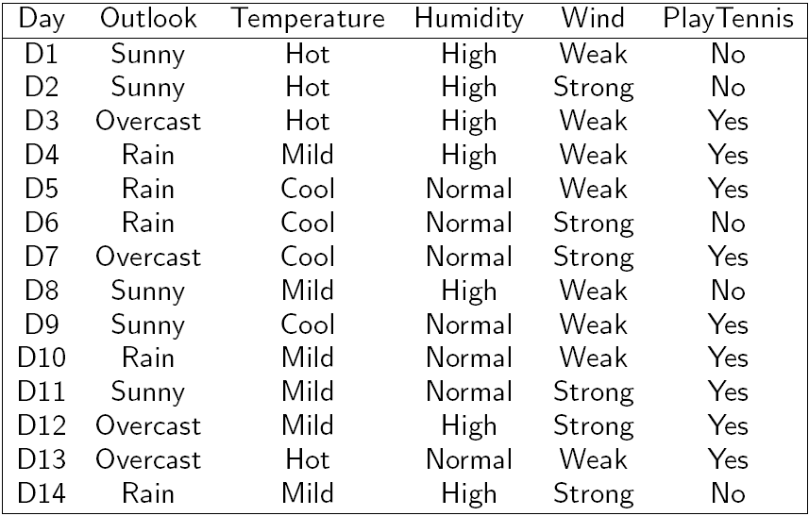
PlayTennis

Slide 19
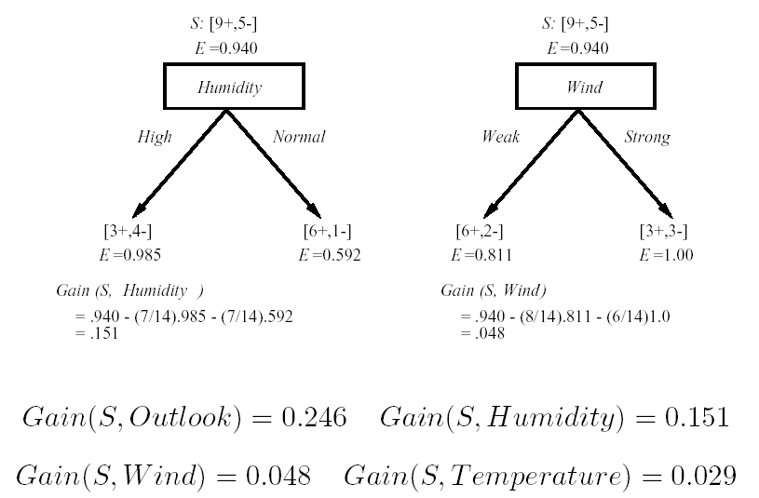
Which attribute is the best classifier?

Slide 20
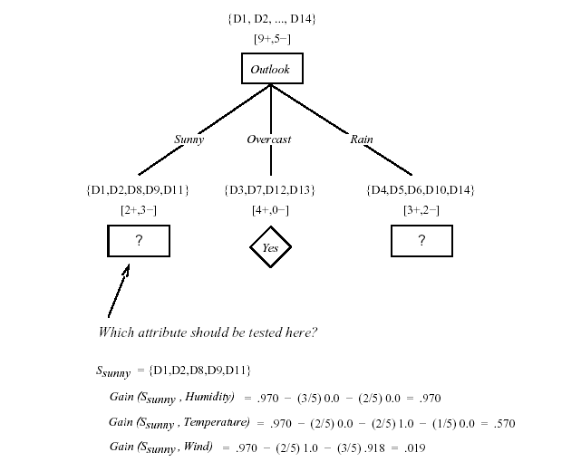

Slide 21
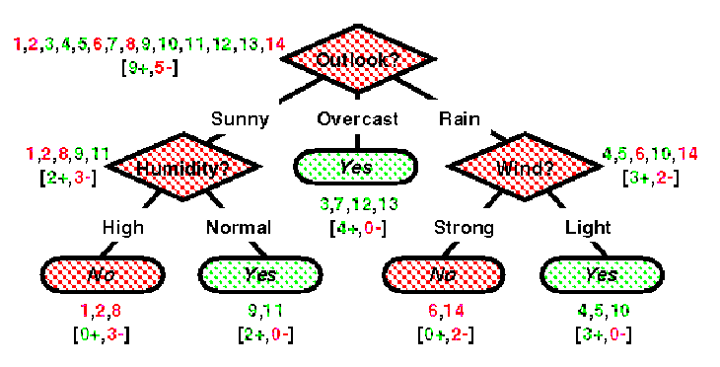
A1 = overcast: + (4.0)
A1 = sunny:
| A3 = high: - (3.0)
| A3 = normal: + (2.0)
A1 = rain:
| A4 = weak: + (3.0)
| A4 = strong: - (2.0)
See/C 5.0

Slide 22

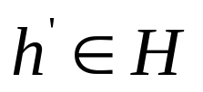
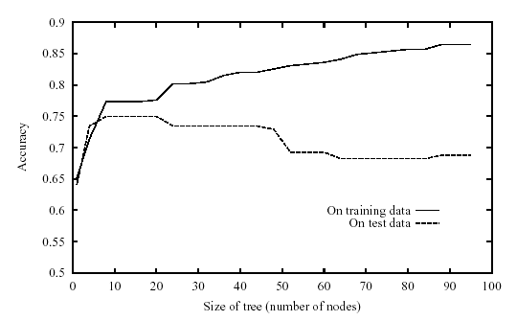
Issues in Decision Tree
Overfit
  Hypothesis overfits the training data if there is an alternative hypothesis such that
h has smaller error than h’ over the training examples, but
h’ has a smaller error than h over the entire distribution of instances

Slide 23
  Solution
    Stop growing the tree earlier
    Not successful in practice
    Post-prune the tree
      Reduced Error Pruning
      Rule Post Pruning
  Implementation
    Partition the available (training) data into two sets
      Training set: used to form the learned hypothesis
      Validation set : used to estimate the accuracy of this hypothesis over subsequent data

Slide 24
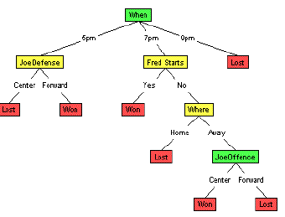
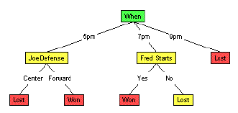
  Pruning
    Reduced Error Pruning
      Nodes are removed if the resulting pruned tree performs no worse than the original over the validation set.
    Rule Post Pruning
      Convert tree to set of rules.
      Prune each rules by improving
      its estimated accuracy
      Sort rules by accuracy

Slide 25
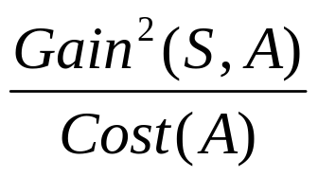
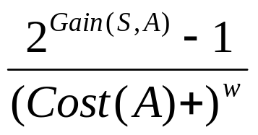
Continuous-Valued Attributes
  Dynamically defining new discrete-valued attributes that partition the continuous attribute value into a discrete set of intervals.
Alternative Measures for Selecting Attributes
  Based on some measure other than information gain.
Training Data with Missing Attribute Values
  Assign a probability to the unknown attribute value.
Handling Attributes with Differing Costs
  Replacing the information gain measure by other measures
or

Slide 26
Boosting: Combining Classifiers
The most material of this part come from: http://sifaka.cs.uiuc.edu/taotao/stat/chap10.ppt
  By Wang Rui

Slide 27
Boosting
INTUITION
  Combining Predictions of an ensemble is more accurate than a single classifier
Reasons
  Easy to find quite correct “rules of thumb” however hard to find single highly accurate prediction rule.
  If the training examples are few and the hypothesis space is large then there are several equally accurate classifiers.
  Hypothesis space does not contain the true function, but it has several good approximations.
  Exhaustive global search in the hypothesis space is expensive so we can combine the predictions of several locally accurate classifiers.

Slide 28
Cross Validation
k-fold Cross Validation
  Divide the data set into k sub samples
  Use k-1 sub samples as the training data and one sub sample as the test data.
  Repeat the second step by choosing different sub samples as the testing set.
Leave one out Cross validation
  Used when the training data set is small.
  Learn several classifiers each one with one data sample left out
  The final prediction is the aggregate of the predictions of the individual classifiers.

Slide 29
Bagging
Generate a random sample from training set
Repeat this sampling procedure, getting a sequence of K independent training sets
A corresponding sequence of classifiers C1,C2,…,Ck is constructed for each of these training sets, by using the same classification algorithm
To classify an unknown sample X, let each classifier predict.
The Bagged Classifier C* then combines the predictions of the individual classifiers to generate the final outcome. (sometimes combination is simple voting)

Slide 30
Boosting
The final prediction is a combination of the prediction of several predictors.
Differences between Boosting and previous methods?
  Its iterative.
  Boosting: Successive classifiers depends upon its predecessors.
  Previous methods : Individual classifiers were independent.
  Training Examples may have unequal weights.
  Look at errors from previous classifier step to decide how to focus on next iteration over data
  Set weights to focus more on ‘hard’ examples. (the ones on which we committed mistakes in the previous iterations)

Slide 31
Boosting(Algorithm)
W(x) is the distribution of weights over the N training points ∑ W(x_{i})=1
Initially assign uniform weights W₀(x) = 1/N for all x, step k=0
At each iteration k :
  Find best weak classifier C_{k}(x) using weights W_{k}(x)
  With error rate ε_{k} and based on a loss function:
    weight α_{k} the classifier C_{k}‘s weight in the final hypothesis
    For each x_{i} , update weights based on ε_{k} to get W_{k+1}(x_{i} )
C_{FINAL}(x) =sign [ ∑ α_{i} C_{i} (x) ]

Slide 32
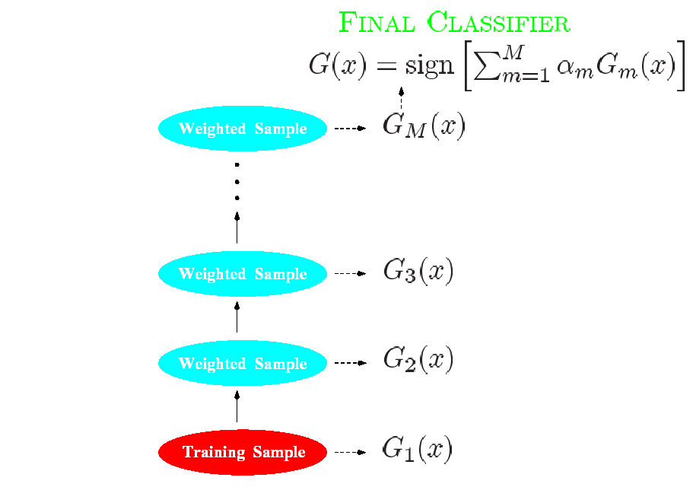
Boosting (Algorithm)

Slide 33
AdaBoost(Algorithm)
W(x) is the distribution of weights over the N training points ∑ W(x_{i})=1
Initially assign uniform weights W₀(x) = 1/N for all x.
At each iteration k :
  Find best weak classifier C_{k}(x) using weights W_{k}(x)
  Compute ε_{k} the error rate as
  ε_{k}= [ ∑ W(x_{i} ) ∙ I(y_{i} ≠ C_{k}(x_{i} )) ] / [ ∑ W(x_{i} )]
  weight α_{k} the classifier C_{k}‘s weight in the final hypothesis Set α_{k} = log ((1 – ε_{k} )/ε_{k} )
  For each x_{i} , W_{k+1}(x_{i} ) = W_{k}(x_{i} ) ∙ exp[α_{k} ∙ I(y_{i} ≠ C_{k}(x_{i} ))]
C_{FINAL}(x) =sign [ ∑ α_{i} C_{i} (x) ]
L(y, f (x)) = exp(-y ∙ f (x)) - the exponential loss function

Slide 34
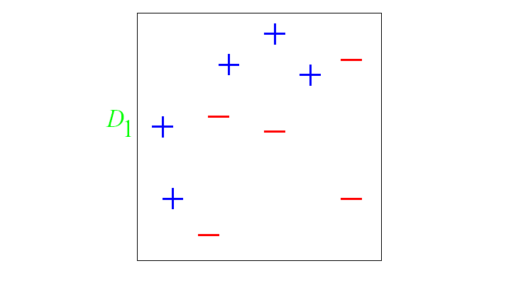
AdaBoost(Example)
Original Training set : Equal Weights to all training samples

Slide 35
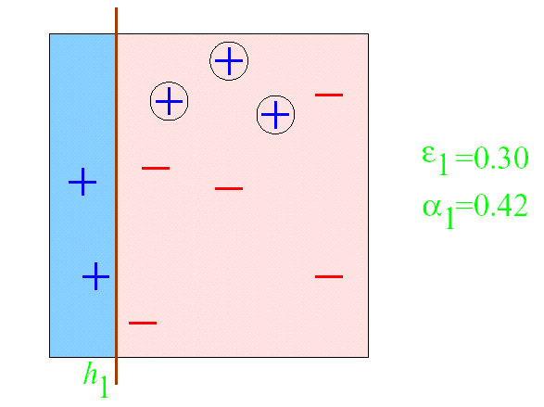
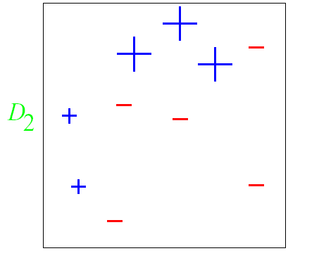
AdaBoost(Example)
ROUND 1

Slide 36
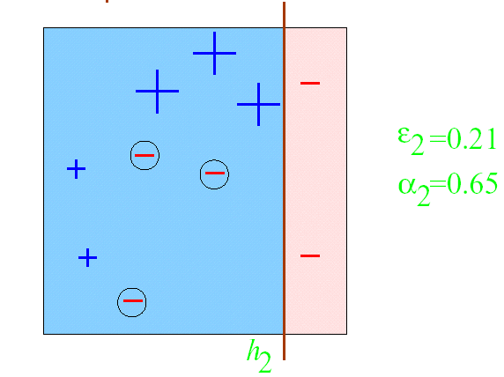
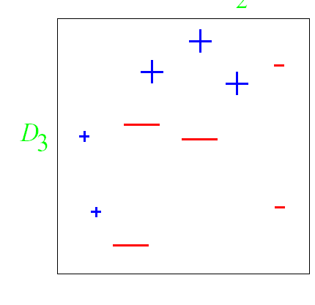
AdaBoost(Example)
ROUND 2

Slide 37
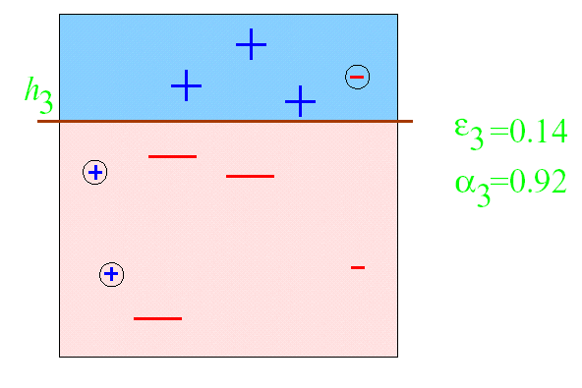
AdaBoost(Example)
ROUND 3

Slide 38
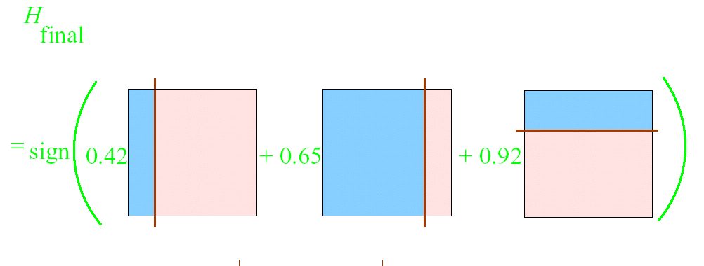
AdaBoost(Example)

Slide 39
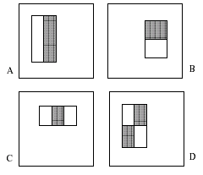
AdaBoost Case Study:
Rapid Object Detection using a Boosted
Cascade of Simple Features(CVPR01)
Object Detection
Features
  two-rectangle
  three-rectangle
  four-rectangle

Slide 40
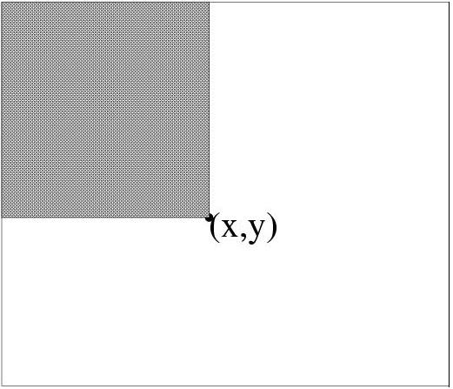

Integral Image
Definition: The integral image at location (x,y) contains the sum of the pixels above and to the left of (x,y) , inclusive:
Using the following pair of recurrences:
x
(0,0)
s(x,y) = s(x,y-1) + i(x,y)
ii(x,y) = ii(x-1,y) + s(x,y)
y
(x,y)

Slide 41
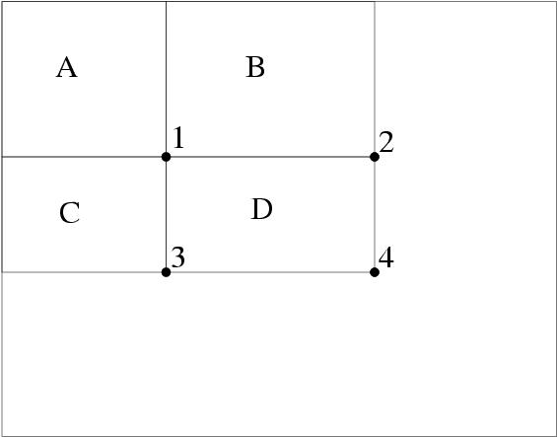
Features Computation
Using the integral image any rectangular sum can be computed in four array references
ii(4) + ii(1) – ii(2) – ii(3)

Slide 42
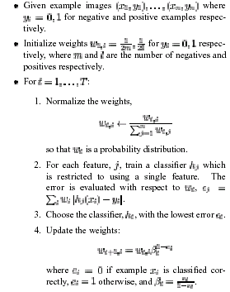

AdaBoost algorithm for classifier learning

Slide 43
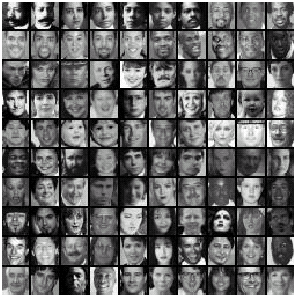
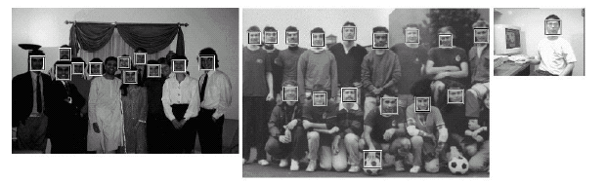

Slide 44
Thank you

