Slide 1
Internet of Things (IoT)
From early connected machines to AI-powered smart systems
A brief timeline of the evolution of IoT
Internet of Things (IoT) – History

Slide 2
What is IoT?
Internet of Things (IoT) connects physical objects to the internet.
Devices use sensors, software, and communication networks to collect and exchange data.
Examples: smart homes, wearables, connected vehicles, healthcare and smart agriculture.
Internet of Things (IoT) – History

Slide 3
1982 – First Internet-Connected Vending Machine
A Coca-Cola vending machine at Carnegie Mellon University was connected to the internet.
It could report whether drinks were available and whether they were cold.
This is widely regarded as one of the earliest practical examples of an Internet-connected object.
Key idea: a physical object could provide information through a network.
Internet of Things (IoT) – History

Slide 4
1990 – Internet-Connected Toaster
John Romkey demonstrated an internet-controlled toaster.
The demonstration showed that an ordinary household appliance could be controlled through a network.
Key idea: connectivity could move beyond computers to everyday objects.
Internet of Things (IoT) – History

Slide 5
1999 – The Term 'Internet of Things'
Kevin Ashton coined the term 'Internet of Things' while working at Procter & Gamble.
He emphasized using RFID and sensors to allow computers to collect information directly from physical objects.
This helped establish the vision of a world where objects could be identified and tracked digitally.
Internet of Things (IoT) – History

Slide 6
2000–2010 – Foundations of Modern IoT
Wireless communication became more affordable and widely available.
Sensors, RFID, embedded systems and microcontrollers improved.
Cloud computing enabled large-scale data storage and processing.
Early applications appeared in smart homes, industry and healthcare.
Internet of Things (IoT) – History

Slide 7
World Summit on the Information Society (WSIS), 2005
The concept of the Internet of Things (IoT) was discussed in the context of connecting physical objects to the digital world. Four important technologies commonly associated with enabling IoT are:
Radio Frequency Identification(RFID)
Wireless Sensor Network(WSN)
Embedded System
Nanotechnology

Slide 8
2011–2015 – Rapid Expansion
Smartphones and mobile networks accelerated IoT adoption.
Wearables, smart thermostats and connected vehicles became increasingly common.
Cloud platforms made it easier to collect and analyze data from many devices.
IoT shifted from experiments toward consumer and industrial applications.
Internet of Things (IoT) – History

Slide 9
2016–Present – Modern IoT Era
IoT has expanded into smart cities, healthcare, agriculture, manufacturing and transportation.
5G provides faster connectivity and supports large numbers of connected devices.
Edge computing enables data processing closer to devices.
AI and machine learning make IoT systems more intelligent and predictive.
Internet of Things (IoT) – History

Slide 10
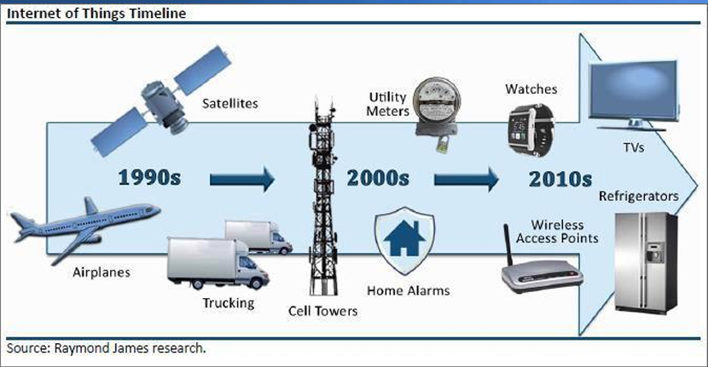
IOT Timeline

Slide 11
IoT Timeline at a Glance
1982 – Connected vending machine
1990 – Internet-controlled toaster
1999 – 'Internet of Things' term coined
2000s – Sensors, RFID, wireless networks and cloud computing
2010s – Rapid adoption of smart devices
2020s – AI + 5G + Edge Computing + IoT
Internet of Things (IoT) – History

Slide 12
Where is IoT Used Today?
Smart Homes – lighting, security, thermostats and appliances
Healthcare – remote monitoring and connected medical devices
Agriculture – soil, weather and crop monitoring
Manufacturing – predictive maintenance and automation
Transportation – connected vehicles and traffic management
Smart Cities – energy, waste, parking and public infrastructure
Internet of Things (IoT) – History

Slide 13
From IoT to Intelligent IoT
Traditional IoT: Sense → Connect → Collect Data
Modern IoT: Sense → Connect → Analyze → Predict → Act
AI/ML helps IoT systems identify patterns and make decisions.
Edge computing reduces latency by processing data near the source.
Internet of Things (IoT) – History

Slide 14
Conclusion
IoT evolved from simple connected experiments into a global ecosystem of smart devices.
Its growth has been driven by sensors, wireless networks, cloud computing, smartphones, 5G, AI and edge computing.
The future of IoT is increasingly intelligent, autonomous and interconnected.
Internet of Things (IoT) – History

