Slide 1
Data Science in Industry
Luke Bovard

Slide 2
What is data science?
My opinion: a data scientist is someone who uses scientific methods to tackle problems and extract insights from data to provide business value
Encompasses techniques from many areas: statistics, computer science, science, machine learning, business
Having a data person on your team is becoming an essential requirement for any team as data is now everywhere

Slide 3
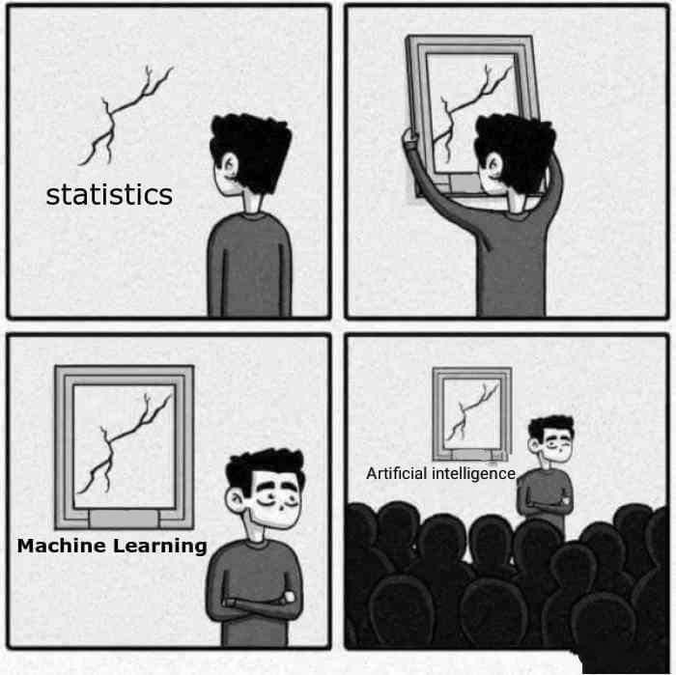
Data science involves a lot of techniques from statistics that have been around for centuries
Data science does not always have to have fancy algorithms or the latest deep learning results to provide insights

Slide 4
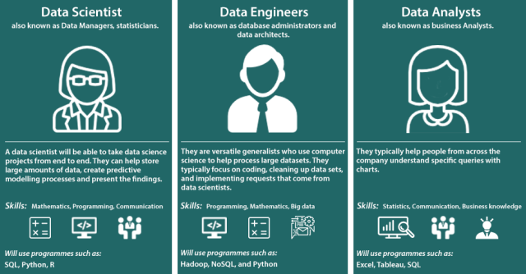
There is a lot of overlap between the roles and the lines are becoming blurrier all the time and merging into a single role
Source: Medium

Slide 5
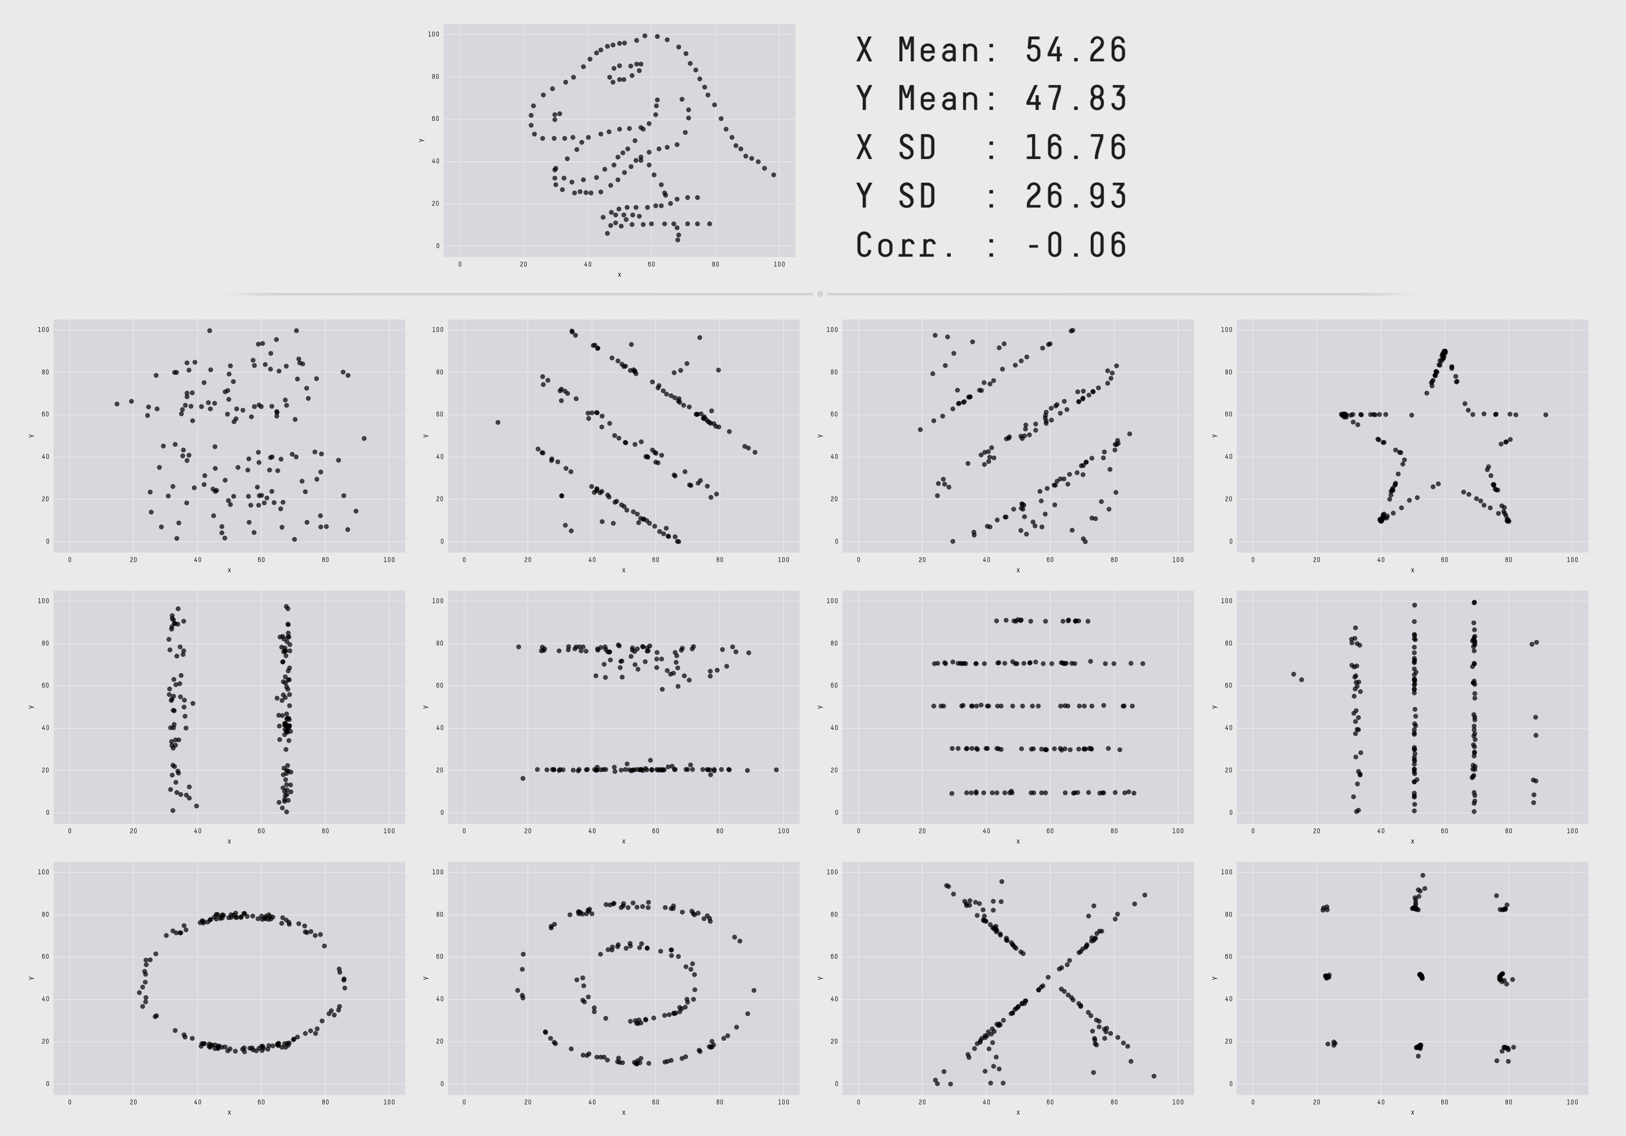
Qualitative vs Quantitative data
How to approach data science
What does the following tell you?

Slide 6
Qualitative vs Quantitative data
What does the following tell you?

Slide 7
Qualitative vs Quantitative data
What does the following tell you?

Slide 8
Qualitative vs Quantitative data
What does the following tell you?

Slide 9
Qualitative vs Quantitative data
What does the following tell you?

Slide 10
Source: Datasaurus

Slide 11
How to approach data science
First thing you should do with any dataset….
ALWAYS VISUALIZE YOUR DATA

Slide 12
How to approach data science
Scenario:
You work at a logistics company as a data scientist and your boss comes to you and says that they’ve just got out of a meeting and tells you:
“The head of business development in Germany has asked us to improve the delivery of widgets”
What do you do?

Slide 13
How to approach data science
General outline of a data science project
What question do I want to answer?
What data do I need?
Look at data to see what it looks like
Apply ML algorithm to analyse
Report results

Slide 14
How to approach data science
Actual outline of a data science project
What question do I want to answer?
This will constantly change day to day. What you want to do and what you do are always different
What data do I need?
Is it even possible to answer this question? Question if I can even answer this
How do I get that data?
Do I even have that data? Can I obtain it? Risk council said no. GOTO 2 or 1
Look at data to see what it looks like
Turns out our question isn’t possible to answer, but there is this other interesting feature GOTO above steps
Clean up data
Turns out there was a bug and we don’t have the complete dataset. GOTO above steps
Apply the fanciest ML algorithm you can think of
neural networks are pretty damn cool
Try the simplest ML algorithm you can think of
realise it is just as good as the fancy one because most data isn’t rich enough to have super deep insights. Also constantly GOTO 1 to question how relevant it is
Question results.
Does this even make sense? Does it agree with my intuition? Double, triple, quadruple check if it seems weird. Repeat all the previous steps if so. Maybe the data is wrong/the questions asked

Slide 15
How to approach data science
Actual outline of a data science project
What question do I want to answer?
This will constantly change day to day. What you want to do and what you do are always different
What data do I need?
Is it even possible to answer this question? Question if I can even answer this
How do I get that data?
Do I even have that data? Can I obtain it? Risk council said no. GOTO 2 or 1
Look at data to see what it looks like
Turns out our question isn’t possible to answer, but there is this other interesting feature GOTO above steps
Clean up data
Turns out there was a bug and we don’t have the complete dataset. GOTO above steps
Apply the fanciest ML algorithm you can think of
neural networks are pretty damn cool
Try the simplest ML algorithm you can think of
realise it is just as good as the fancy one because most data isn’t rich enough to have super deep insights. Also constantly GOTO 1 to question how relevant it is
Question results.
Does this even make sense? Does it agree with my intuition? Double, triple, quadruple check if it seems weird. Repeat all the previous steps if so. Maybe the data is wrong/the questions asked
Report results
Hope everyone likes the results. If not, iterate till they are ;)

Slide 16

How to approach data science
Actual outline of a data science project
What question do I want to answer?
This will constantly change day to day. What you want to do and what you are always different
What data do I need?
Is it even possible to answer this question? Often questio
How do I get that data?
Do I even have that data? Can I obtain it? Risk council said no. GOTO 2 or 1
Look at data to see what it looks like
Turns out our question isn’t possible to answer, but there is this other interesting feature GOTO above steps
Clean up data
Turns out there was a bug and we don’t have the complete dataset. GOTO above steps
Apply the fanciest ML algorithm you can think of
neural networks are pretty damn cool
Try the simplest ML algorithm you can think of
realise it is just as good as the fancy one because most data isn’t rich enough to have super deep insights. Also constantly GOTO 1 to question how relevant it is
Question results.
Does this even make sense? Does it agree with my intuition? Double, triple, quadruple check if it seems weird. Repeat all the previous steps if so. Maybe the data is wrong? The question asked
Report results
Hope everyone likes the results. If not, iterate till they are ;)

Slide 17
How can you learn it / do it yourself?
Try and collect as much data as possible, even if it doesn’t seem interesting
e.g. if building an app, can I track how every button is clicked, every screen is viewed, all timestamped, etc.… (can be done via Firebase for example)
Try and avoid using fancy methods. A lot of the time simple methods like linear regression give a good and sufficient answer. If a model seems overly complicated, it likely is
Visualise the data as much as possible. Firebase provides many dashboards to make this easy. It can’t do complicated analysis but the basic dashboards are good to get a basic overview
If the data is telling you something unexpected (and it seems to be valid) the data is telling you something
Experience plays a big role. It gets easier over time.

Slide 18
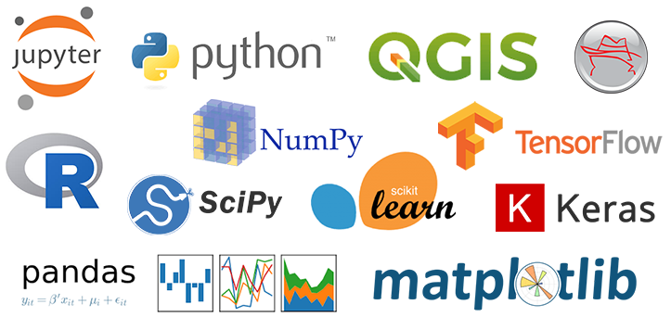
How can you learn it / do it yourself?
Python is the go to language for data science
Source
Kaggle has many datasets and tutorials (but data is cleaned and formatted for you)
Find your own data sets and do through the process of cleaning them

