Slide 1


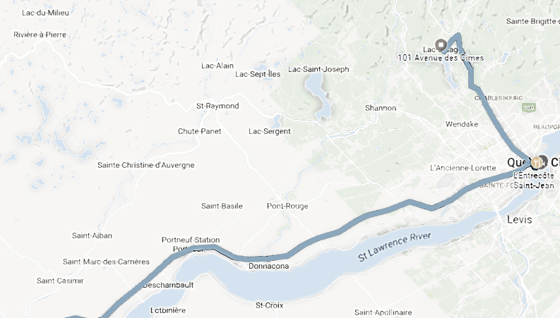

timesheet
VBA XML KML
Timeline

