Slide 1



Student Attendance Control
design and challenges
Arif A. BALIK
Team Leader
Embedded System Development
Huseyin BAYRAKTAR
Designer
Web Development Front End
Omer F. CAN
Developer
Web Development Back End

Slide 2
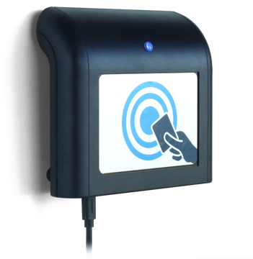
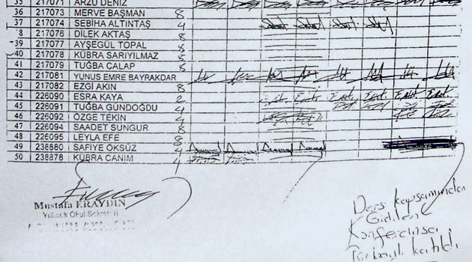
the project

Slide 3
Expectations
WE WILL CHANGE THE WORLD!

Slide 4
It shall be fancy pancy.

Slide 5
Device shall send every RFID card it detects along with other information as the following JSON format
{​
"Date" : "13.04.2019 12:20:48",​
"ID" : 18383400,​
"Key" : 12345677890​
"Class": "Software Engineering"
}

Slide 6
Web server shall generate detailed report for each student.
Device shall establish a communication channel with %95 percent success rate.
Data and application hosting on Amazon web servers
...

Slide 7
Reality
only one week left?

Slide 8
No time to implement
No time to test
Web server shall generate detailed report for each student.
Device shall establish a communication channel with %95 percent success rate.
Data and application hosting on Amazon web servers
...
Pricey!

Slide 9
Device shall send every RFID card it detects along with other information as the following JSON format
{
"Date" : "13.04.2019 12:20:48",
"ID" : 18383400,
"Key" : 12345677890
"Class": "Software Engineering"
}

Slide 10
Basic HTTP Request
webserver.com/out?studentid=123&classid=456

Slide 11
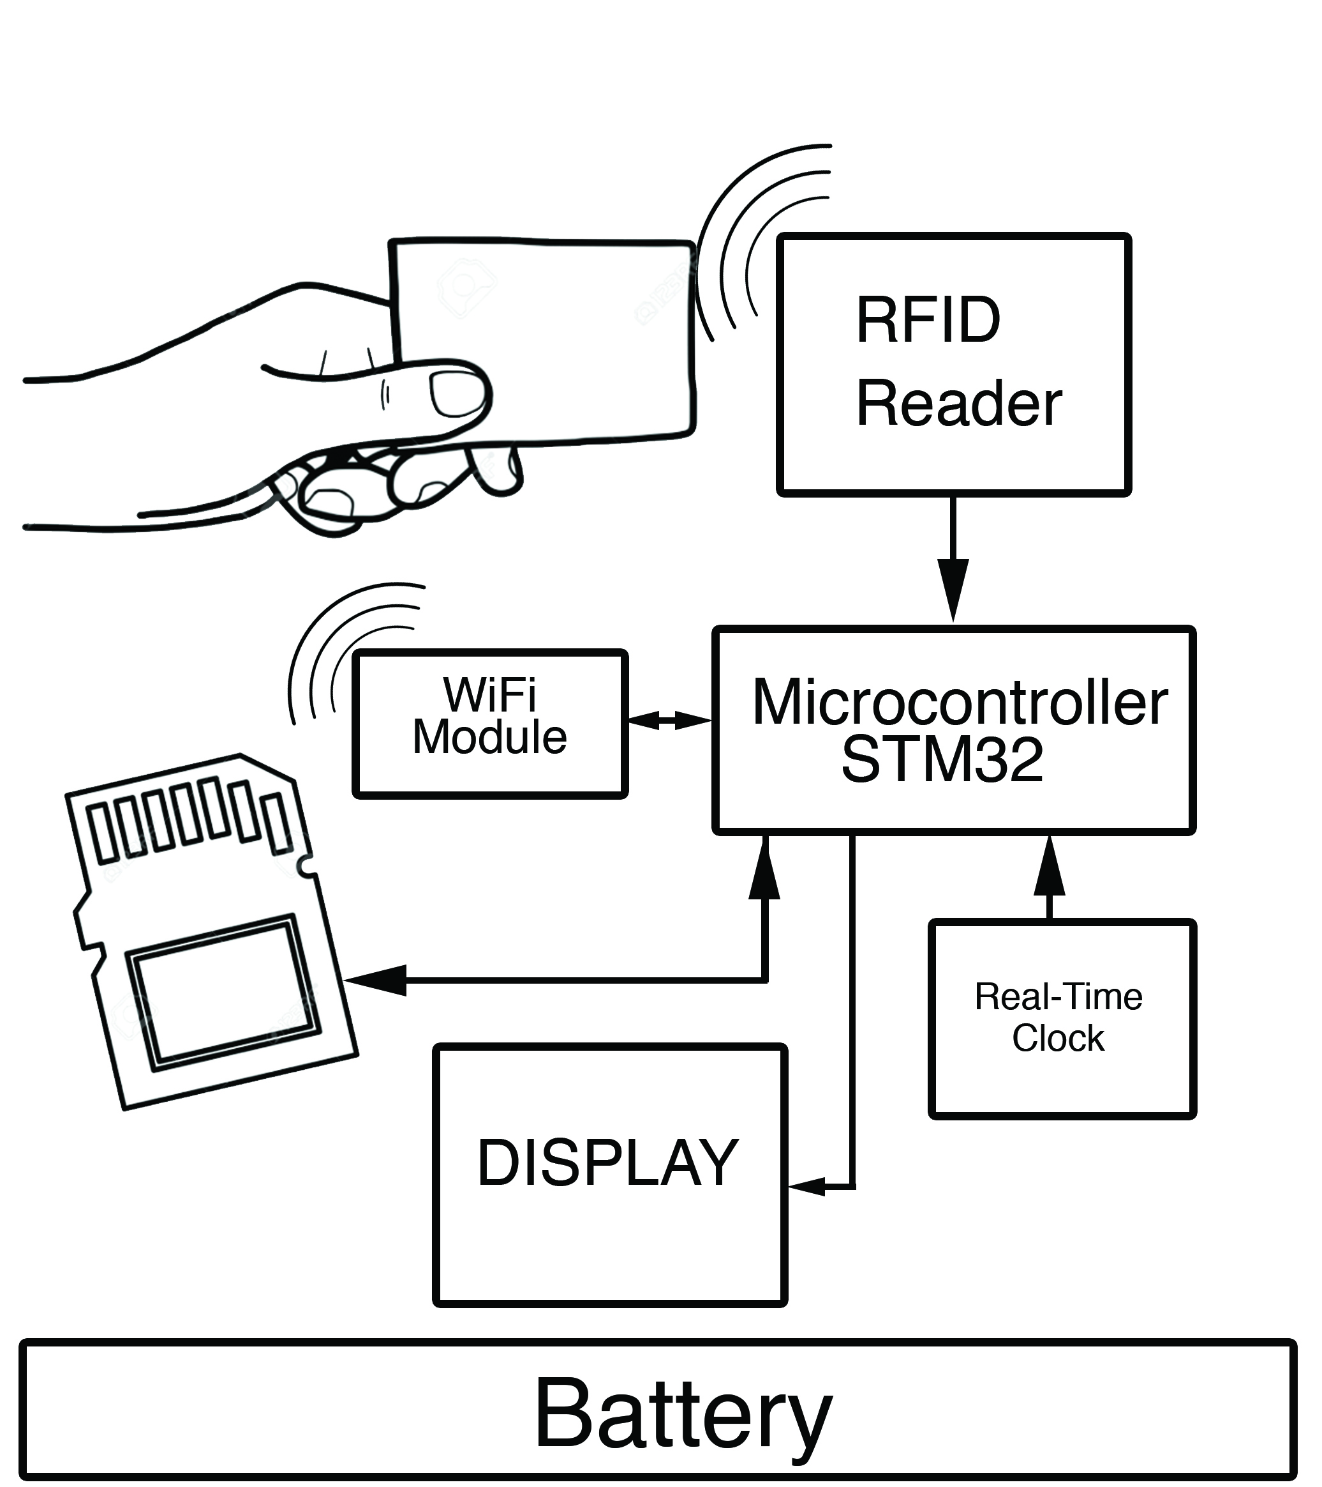
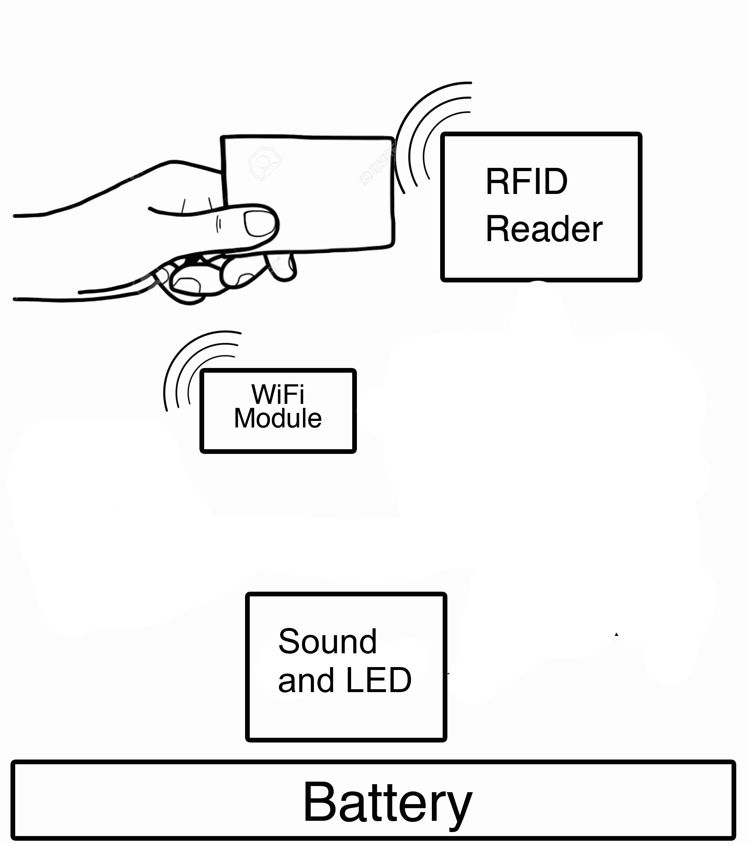

Slide 12
Conclusion
yes.. we did.. fine.. I guess

Slide 13
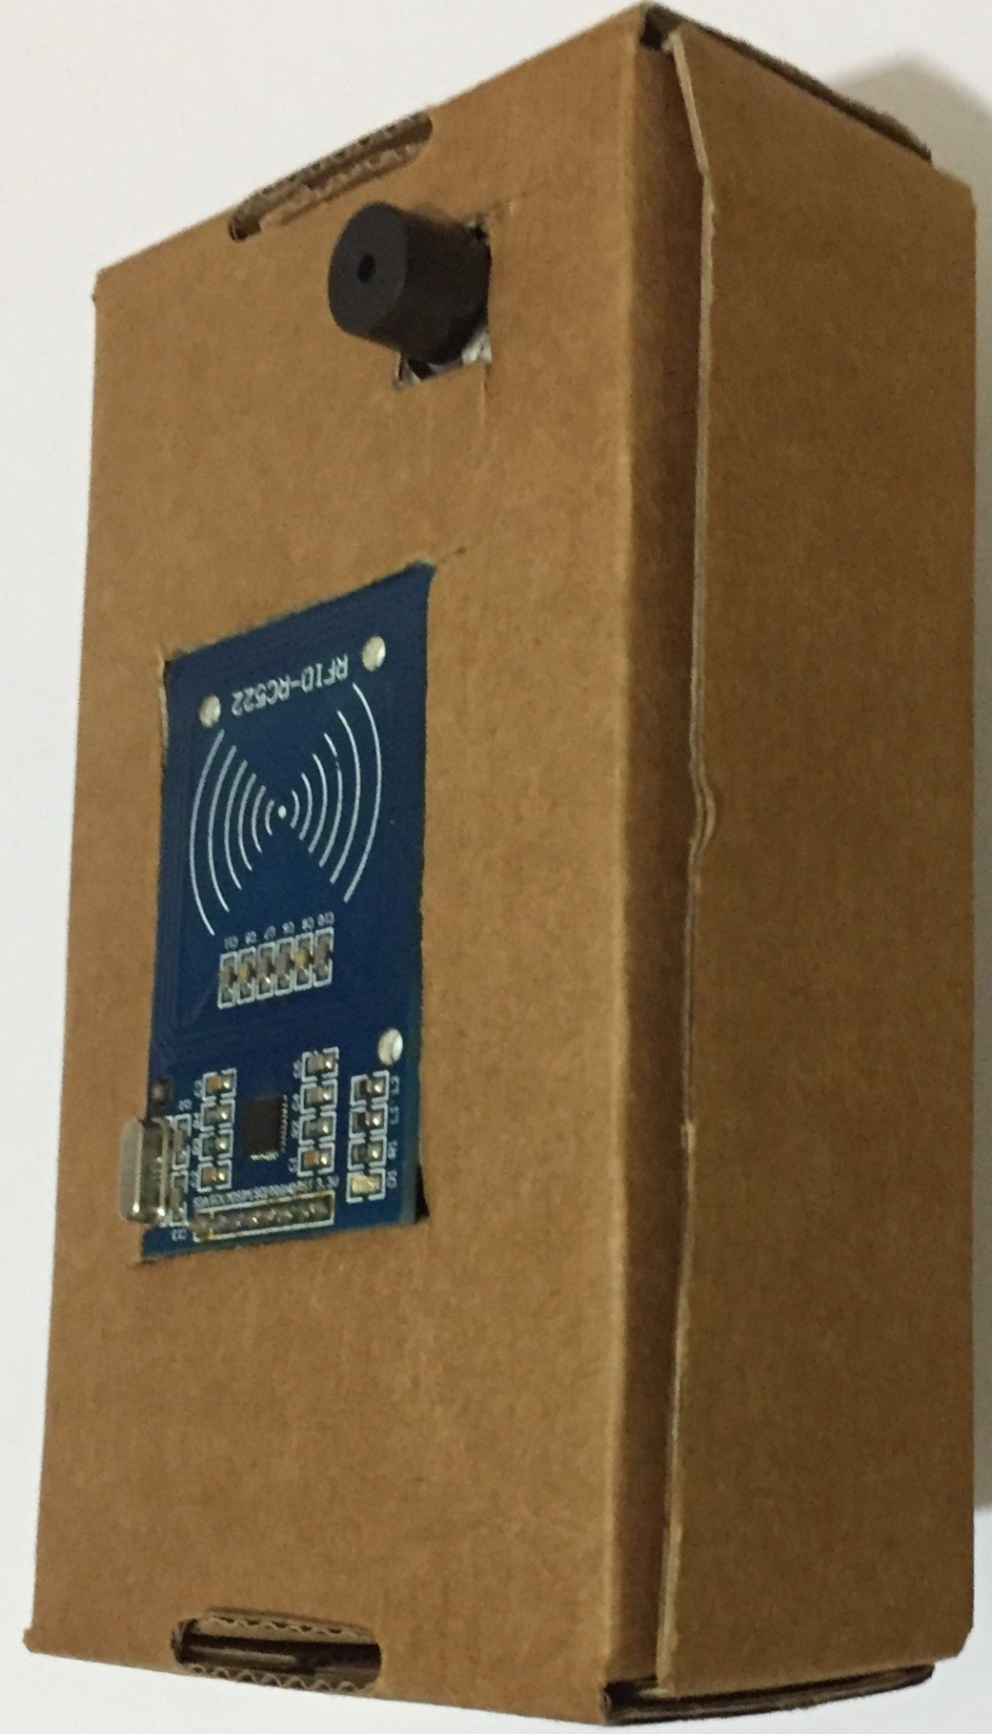
"the" project

Slide 14
Thanks!
github.com/student-attendance-control

