Slide 1

Seasonal Agriculture Performance Analysis
Seereddy Bhavya sri
Sir C R Reddy College Of Engineering
STU6a68e45d46f8f1785259101

Slide 2

PROBLEM STATEMENT
Agriculture performance varies across seasons due to differences in environmental conditions, farming practices, resource usage, and economic factors. However, it is difficult to clearly understand how these factors influence agricultural performance across different seasons and regions. This project aims to analyze the dataset to identify meaningful seasonal patterns, trends, relationships, and variations in crop yield, resource utilization, and economic performance.

Slide 3
Project Description
This project focuses on analyzing agricultural performance across different seasons, crops, regions, and farming conditions. The dataset contains information on environmental factors, farming practices, resource usage, crop yield, production, market price, revenue, cost, and profit.
The analysis involves data cleaning, descriptive statistics, visualization, correlation analysis, seasonal comparisons, and student-driven analyses to identify meaningful patterns and relationships. The findings help understand variations in agricultural performance and support data-driven recommendations for seasonal planning, resource management, and crop selection.

Slide 4

WHO ARE THE END USERS?
Farmers – for seasonal and crop performance insights.
Agricultural Planners – for seasonal planning and resource management.
Agricultural Researchers – for studying crop and environmental patterns.
Agribusiness Stakeholders – for understanding crop profitability and market performance.
Policy Makers – for supporting data-driven agricultural decisions.

Slide 5
Technology Used
Python
Pandas — Data Cleaning & Analysis
NumPy — Numerical Computation
Matplotlib & Seaborn — Data Visualization
Google Colab — Development Environment

Slide 6
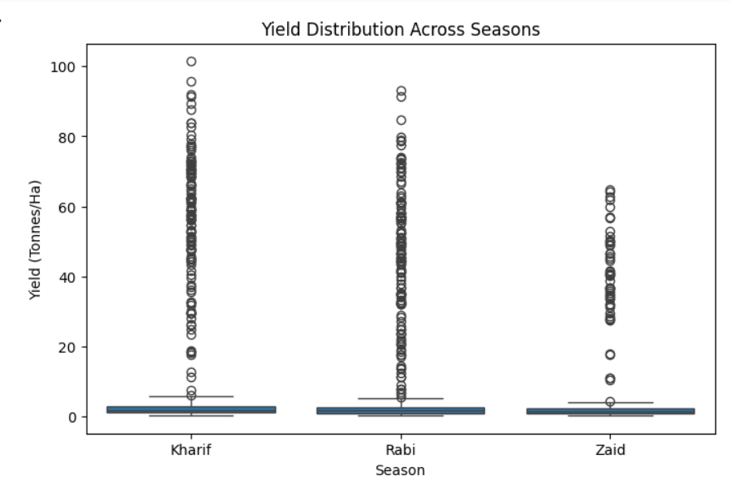
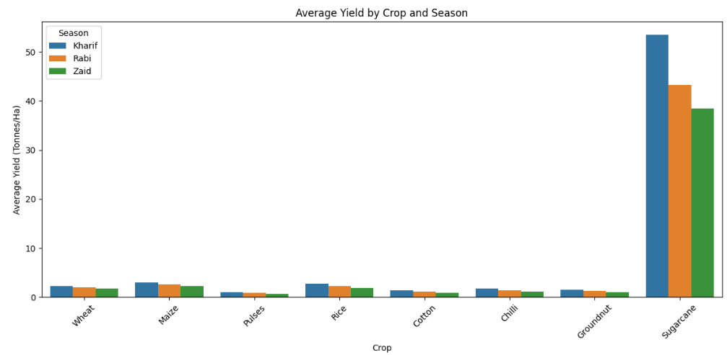
RESULTS
Yield Distribution Across Seasons
Average Yield by Crop and Season

Slide 7
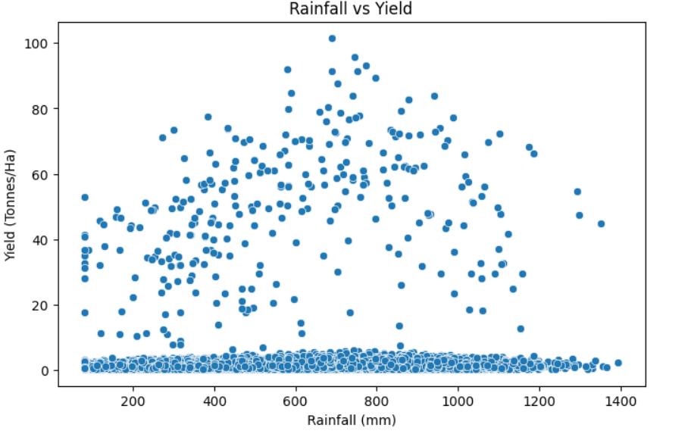
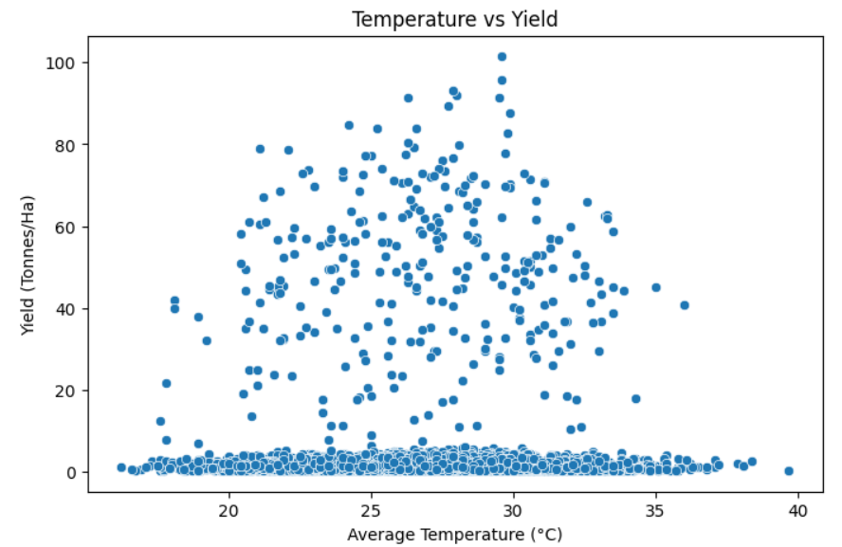
RESULTS
Rainfall vs Yield
Temperature vs Yield

Slide 8
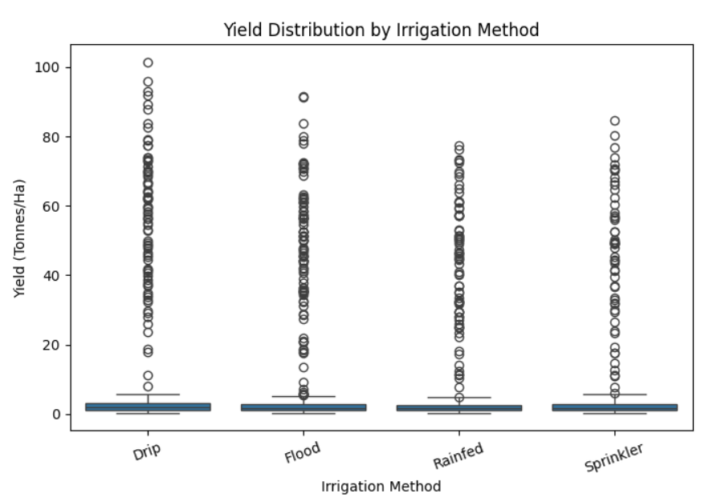
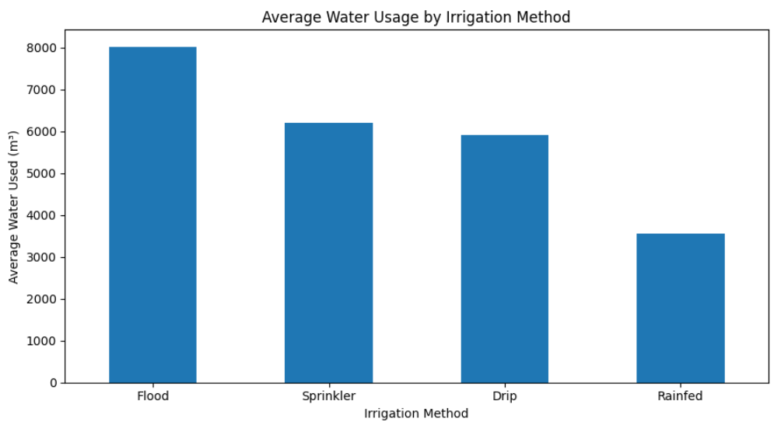
RESULTS
Yield by Irrigation Method
Average Water Usage by
Irrigation Method

Slide 9
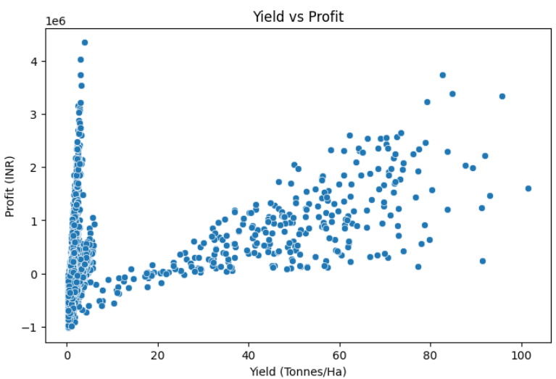
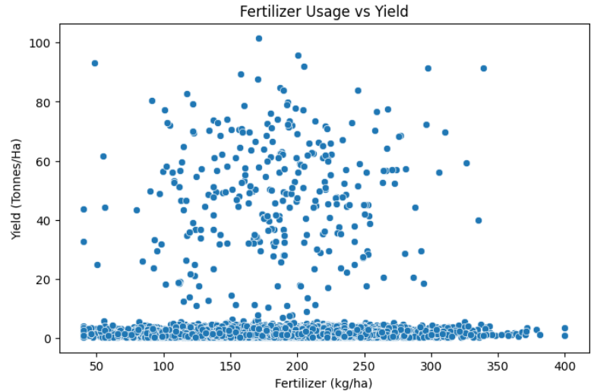
RESULTS
Yield vs Profit
Fertilizer Usage vs Yield

Slide 10
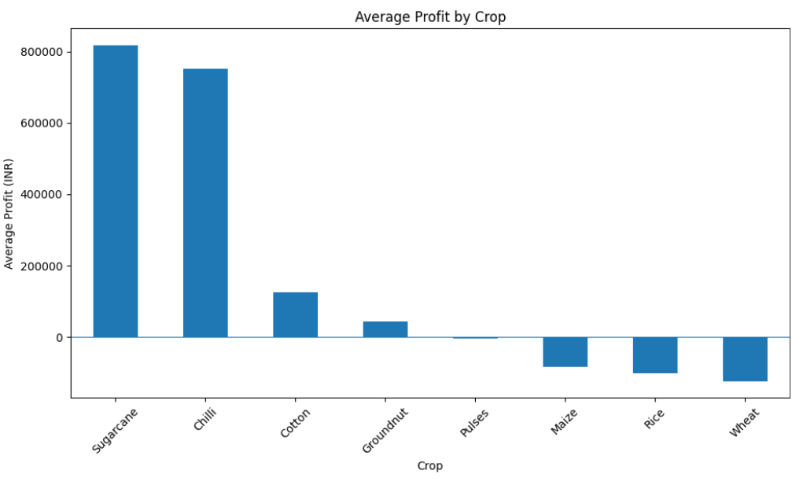
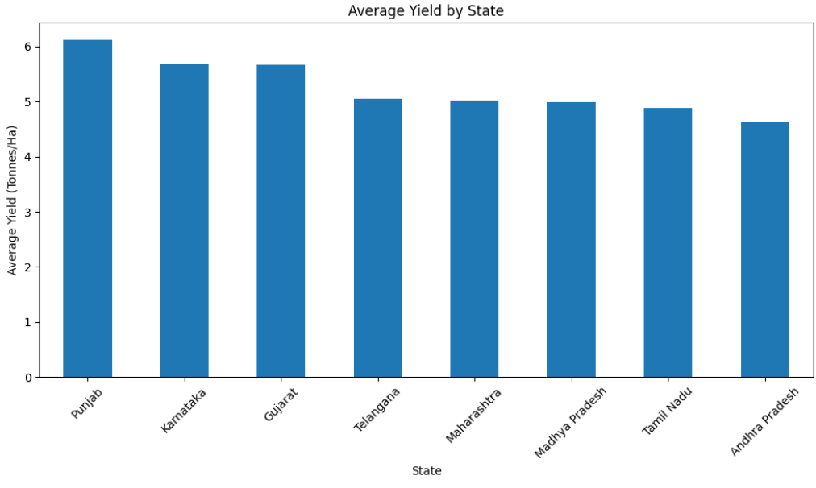
RESULTS
Average Profit by Crop
Average Yield by State

Slide 11
Future scope
• Predictive Analysis – Use machine learning to predict crop yield and profitability.
• More Data – Include more years, regions, crops, and weather information.
• Advanced Analysis – Study the combined effect of environment, irrigation, and farming practices.
• Decision Support – Develop tools for crop selection, resource planning, and seasonal decisions.

Slide 12
GitHub Link

Slide 13
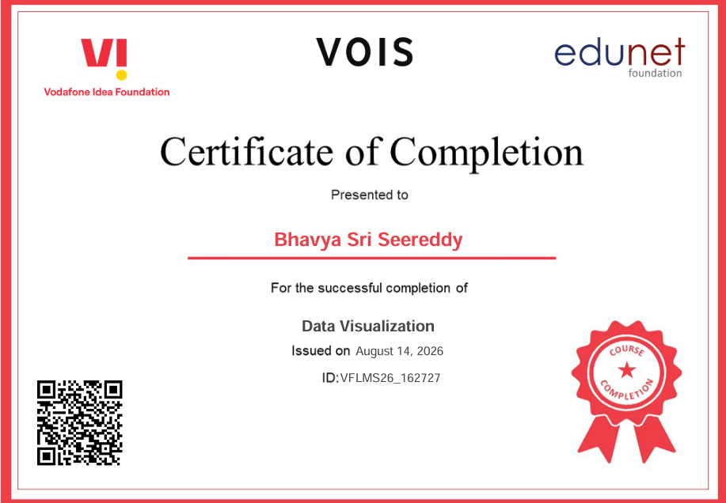
VOIS Course completion certificate -
Course name- Data Visualization

Slide 14
Thank you
.
.
Presented by
Bhavya sri

