Slide 1
Biodiversity and Food Security
Are Diverse Agricultural Landscapes More Stable? A 142-country analysis, 2000–2020
Presentation by
Mounika 2024102006
Rushita 2024101117
Pranathi Sindhu 2024101106
Haritha 2024102080
Nikila 2024101019
Mid-submission: data pipeline, scale harmonisation, exploratory analysis, statistical and machine-learning models

Slide 2
Introduction and Objective
Problem statement
SDGs addressed
Does greater agricultural and habitat diversity buffer food production against climatic disturbances? We compare crop, landscape and habitat diversity with the year-to-year stability of cereal yields under drought and heat stress.
SDG 2
Zero Hunger
Why this matters
SDG 13
Climate Action
Yield shocks are common: 15.9% of the 2,982 country-years in our panel lost more than 10% of expected cereal yield.
Climate drives them: a 1 SD drier growing season lowers yield by 1.6%, a 1 SD hotter season by 1.8% (p < 0.001).
Diversity is a cheap lever: if mixed crops and habitats stabilise output, they are an adaptation option that needs no new technology.
SDG 15
Life on Land
SDG 12
Responsible Consumption & Production

Slide 3
Three Questions Behind the Project
1
2
3
Biodiversity
Climate shocks
Food security
Do countries that grow many crops and keep more natural habitat have steadier harvests?
How much do droughts and heat waves cut cereal yields, and in which regions?
Does diversity reduce the damage when a shock hits (buffering), and can we predict shock years?
Measured with
Crop Shannon index, land-use mix, natural-habitat share, bird richness
Measured with
Growing-season rainfall and temperature anomalies (z-scores)
Measured with
Interaction models, XGBoost/LightGBM/RF, ROC-AUC, SHAP

Slide 4
Research Questions and Hypotheses
# | Hypothesis | Test used | Outcome so far
H1 | More diverse countries have less unstable cereal yields | Spearman correlations; country-level regressions | Partly supported: national crop diversity ρ = −0.24
H2 | Diversity reduces the yield damage of drought and heat (buffering) | Fixed-effects panel with climate × diversity terms | Partly supported: crop diversity (rain), bird richness (heat)
H3 | The result does not depend on the scale used to measure diversity | Re-estimation at 5′, 0.25°, 0.5°, 1°, 2°, national | Not supported: buffering grows with scale
H4 | Diversity improves out-of-sample prediction of yield shocks | GroupKFold by country; ROC-AUC with and without diversity | Supported: AUC 0.63 → 0.71 (with context)
Buffering means: in a drought or heat year, a more diverse country loses less yield than a less diverse one hit by the same shock.

Slide 5
Project Scope and Mid-course Progress
COMPLETED
NEXT PHASE (final)
Data: 142 countries × 21 years (2000–2020), 2,982 cereal country-years
Crops: cereals aggregate plus wheat, rice and maize modelled separately
Diversity: FAOSTAT crop Shannon, MapSPAM 2020 spatial diversity (5 scales), FAOSTAT land use, GBIF bird richness
Climate: CRU TS 4.07 growing-season rainfall and Tmax, weighted by harvested area
Scale harmonisation: common grids, cropland weighting, masks, multi-scale tests, WorldCover 10 m demonstration
EDA: 30 diagnostic figures
Models: fixed-effects buffering tests, Ridge, Random Forest, XGBoost, LightGBM, SHAP
Crop-specific growing seasons for wheat, rice and maize
Sub-national test on India district data (ICRISAT, already downloaded)
Separate regional portfolio effects from local crop mixing
Stronger controls: income, fertiliser, irrigation interactions
Final report with policy recommendations

Slide 6
Mentor's Mid-evaluation Feedback and How We Addressed It
Feedback | What we did | Where in this deck
Only ~10% of the project was done | Rebuilt the pipeline from scratch: 142 countries (was 41), 7 datasets, 20 notebook steps | Methodology, data slides
Add ML models, preferably XGBoost | Ridge, Random Forest, XGBoost and LightGBM for yield anomalies and shock years, with SHAP | Machine-learning section
What does the cereal data include? | Showed "Cereals, primary" = sum of 15 cereal items (ratio 1.000); modelled wheat, rice, maize separately | Cereal composition slides
How is the scale mismatch handled? | Common grids, harvested-area weighting, cropland mask, 6 diversity scales, 3 climate versions, 10 m demo | Scale-harmonisation section
Show more plots and meaningful work | 30 figures, each with key findings; full model comparison tables | Every section

Slide 7
Methodology
1
Step 1: Data acquisition: FAOSTAT crops and land use, MapSPAM 2020, CRU TS 4.07, ESA WorldCover, GBIF, Natural Earth
2
Step 2: Outcome: Detrend each country-crop yield series; anomaly = (yield − trend) / trend; instability = SD of anomaly
3
Step 3: Diversity metrics: Shannon index of crop area (yearly and spatial), land-use mix, natural-habitat share, rarefied bird richness
4
Step 4: Scale harmonisation: Common 5′/0.25°/0.5° grids, country masks, harvested-area weighting, multi-scale recomputation
5
Step 5: Climate stress: Wettest 4-month season per country; rainfall and Tmax z-scores; dry and hot month counts
6
Step 6: Master panel and EDA: Merge into a country-year panel; quality checks; maps, distributions, correlations
7
Step 7: Statistical models: Fixed-effects regressions with climate × diversity interactions, clustered by country
8
Step 8: Machine learning: Ridge, RF, XGBoost, LightGBM; GroupKFold by country and year; SHAP explanations

Slide 8
Analysis Pipeline at a Glance
Raw data
7 datasets
10 m to national
Harmonise
Grids, masks,
weights
Panel
142 countries
2000–2020
EDA
30 figures
Panel models
Fixed effects,
interactions
ML + SHAP
4 models,
unseen countries
Outputs saved
Quality controls
Reproducibility
outputs/*.csv: yield panel, diversity, climate, master panel
outputs/figs: 30 PNG figures
Result tables for every model
Text-encoding check (Türkiye was dropped before the fix)
Livestock "No/An" yields removed
Aggregates and the "China" double count excluded
Runs locally in VS Code, no Earth Engine
Every year and country cached, so re-runs resume
Same random seed for all models

Slide 9
Study Design: Unit of Analysis
142
21
study countries
years, 2000–2020
2,982
4
cereal country-years
crop series modelled
Selection rule
Cereal yield reported for at least 18 of 21 years
At least 50,000 ha of cereals on average
Regional aggregates and the "China" total (code 351) removed

Slide 10
Data Sources and Quality Control (Data Used)
Variable | Source | Resolution | QA/QC applied
Yield, area, production | FAOSTAT Crops & Livestock (938,613 rows used) | National, yearly | Encoding check, kg/ha only, aggregates dropped
Land use | FAOSTAT Land Use (163,266 rows used) | National, yearly | 8 items matched by name; "other land" filled
Crop harvested area | MapSPAM 2020 v2r2 (964,647 cells, 46 crops) | 5′ (~9 km) | Negatives set to 0; country from MapSPAM name
Climate | CRU TS 4.07 pre and tmx | 0.5° (~55 km), monthly | Missing cells excluded from weights
Land cover (demo) | ESA WorldCover v200, tile N51E003 | 10 m | Aggregated to 100 m class counts
Biodiversity | GBIF bird occurrences (API) | National | Rarefied to 5,000 records
Boundaries | Natural Earth admin-0, 1:50 m | Vector | All 142 countries matched

Slide 11
Variables Used in the Analysis
Group | Variable | Meaning
Outcome | anom, instability | Yield deviation from trend (fraction); SD of anomaly per country
Crop diversity | crop_H, crop_H_lag1, crop_effN | Shannon index of FAOSTAT harvested area; previous year; effective number of crops
Spatial crop diversity | spam_H_cell … spam_H_nat | MapSPAM Shannon index at 5′, 0.25°, 0.5°, 1°, 2° and national
Landscape / habitat | landuse_H, natural_share, forest_share | Shannon of land-use mix; forest + pasture share; forest share
Biodiversity | bird_rich_rare | Bird species expected in 5,000 GBIF records
Climate | rain_z, heat_z, tmax_z, dry/hot_months | Season rainfall and temperature z-scores; months beyond 20th/80th percentile
Controls | irrig_share, cereal_share, log_mean_yield | Irrigated share of harvested area; cereal share; yield level

Slide 12
Outcome: Cereal Yield Stability
How we turned FAOSTAT yields into anomalies and an instability score for each country and crop

Slide 13
Yield Anomaly and Instability: Method
Step 1: Select item codes: Cereals, primary (1717), Wheat (15), Rice (27), Maize (56)
Results
1
Series kept: cereals 142, maize 108, wheat 85, rice 80 countries
Linear vs quadratic: instability correlates at r = 0.981, so the trend choice barely matters
Shock years: 474 of 2,982 (15.9%) had a loss over 10%
Step 2: Keep series with ≥15 years and enough area (50,000 ha cereals; 20,000 ha per crop)
2
Step 3: Fit a linear trend per country and crop to remove technology and management gains
3
Step 4: Anomaly = (yield − trend) / trend, e.g. −0.10 means 10% below expected
4
Step 5: Winsorise at the 1st and 99th percentile to limit data errors
5
Step 6: Instability = standard deviation of the anomaly over 2000–2020
6
Step 7: Robustness: repeat with a quadratic trend
7

Slide 14
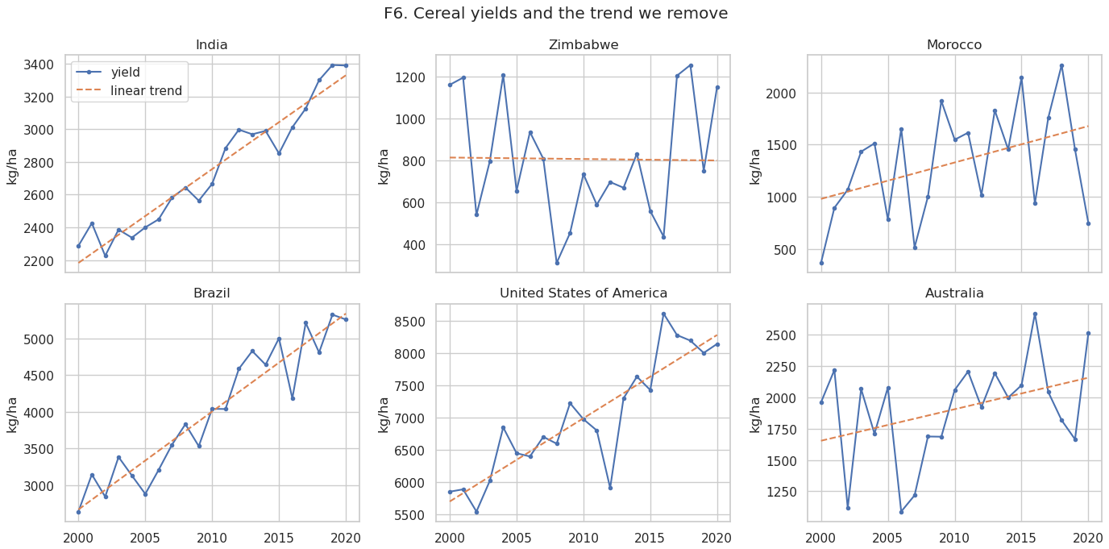
Cereal Yields and the Trend We Remove
Steady growers
India, Brazil and the USA follow their trend closely; deviations are a few percent.
Volatile producers
Zimbabwe, Morocco and Australia swing by 30–60% between years, driven by rainfall.
Why detrend
Without removing the trend, long-term yield growth would look like instability.

Slide 15
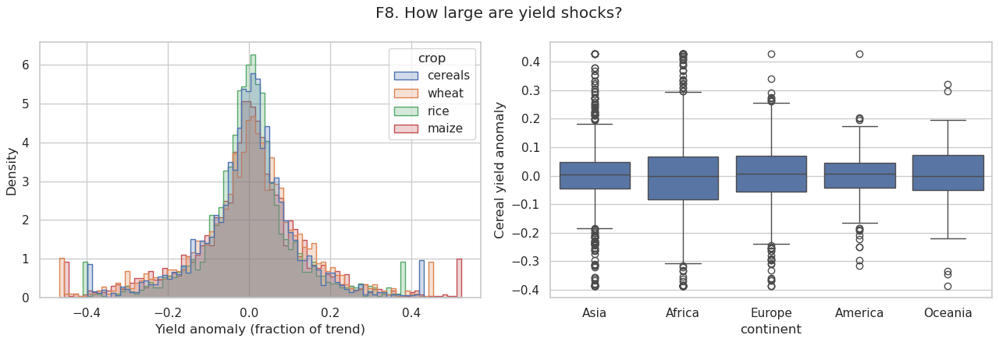
How Large Are Yield Shocks?
Centred on zero
Anomalies of all four crop series peak at 0; most years are within ±10% of trend.
Fat tails
Losses and gains of 30–40% occur in all crops, so averages hide real risk.
Africa widest
Africa has the widest spread of cereal anomalies; America the narrowest.

Slide 16
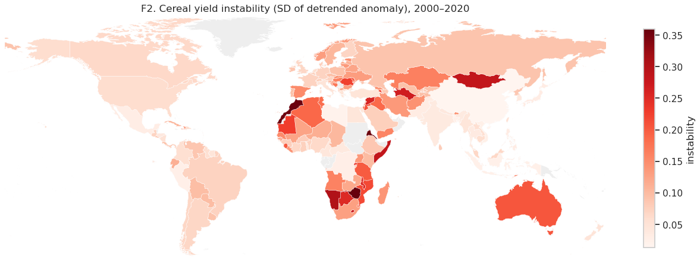
Where Are Cereal Yields Most Unstable?
Dryland hotspots
North Africa (Morocco, Algeria), southern Africa and Australia show the highest instability (up to ~0.35).
Central Asia
Mongolia and Kazakhstan are also highly unstable: short, rain-fed seasons.
Stable core
South and East Asia, with large irrigated rice areas, are among the most stable.

Slide 17
What Does "Cereals, Primary" Include?
Answer to the mentor's question
It is an aggregate, not a single crop: FAOSTAT item 1717 sums all primary cereals.
15 items: wheat, rice, barley, maize, rye, oats, millet, sorghum, buckwheat, quinoa, fonio, triticale, canary seed, mixed grain, cereals n.e.c.
Checked in the data: sum of the 15 item areas ÷ aggregate area = 1.000 in all 2,982 country-years (SD 0.0).
Weakness: crops with different seasons and heat tolerance are blended; a shift in crop mix can look like a yield change.
Our fix: model wheat, rice and maize separately and keep the aggregate for comparison.

Slide 18
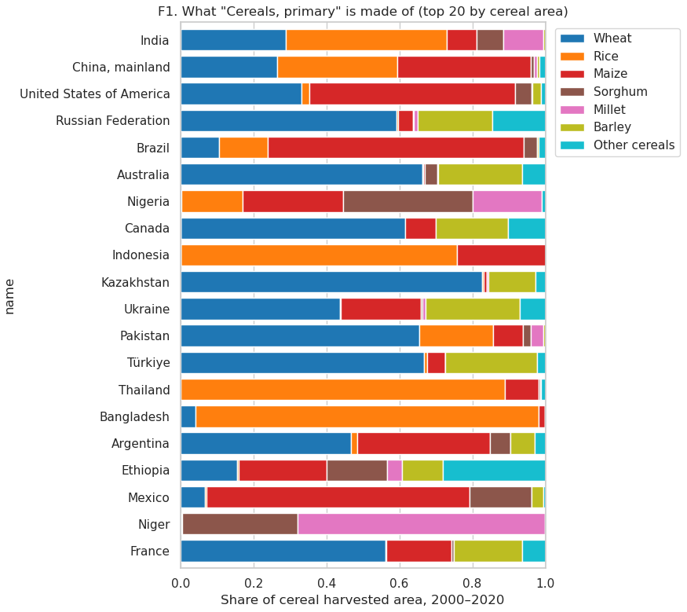
Cereal Mix of the 20 Largest Producers
Key findings
Rice systems: Thailand, Bangladesh and Indonesia are 75–95% rice.
Wheat systems: Kazakhstan, Australia, Russia, Canada, Pakistan and Türkiye are 60–85% wheat.
Maize systems: Brazil, Mexico and the USA are mostly maize.
Mixed systems: India (rice + wheat), Nigeria and Ethiopia (sorghum, maize, millet) mix several cereals; Niger is millet and sorghum.
Implication: the aggregate behaves like a different crop in each country, which is why per-crop models are needed.

Slide 19
Measuring Diversity
Crop diversity over time, spatial crop diversity, landscape composition and habitat biodiversity

Slide 20
Diversity Indices Used
Shannon index (H)
Simpson index
H = −Σ pᵢ ln pᵢ, where pᵢ is the share of crop or land-use class i. 0 = one crop; higher = more crops, more evenly spread.
1 − Σ pᵢ²: probability that two random hectares grow different crops.
Effective number
Rarefied richness
exp(H): the number of equally common crops that gives the same H. Easier to read than H itself.
Expected number of bird species in a random sample of 5,000 GBIF records (Hurlbert formula), so countries are compared at equal sampling effort.

Slide 21
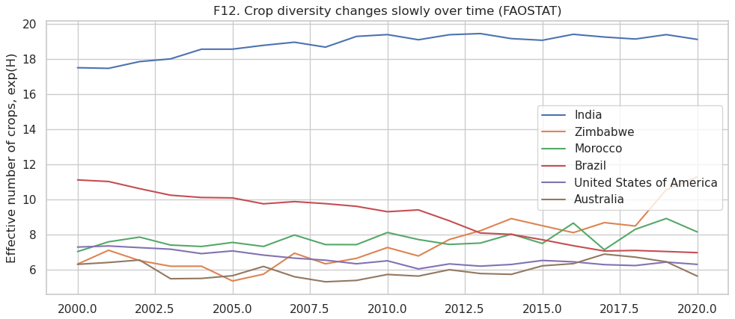
Crop Diversity Over Time (FAOSTAT)
2.19
9.9
mean Shannon H
effective crops (mean)
52
1.6–27
crops grown (mean)
effective crops, range
Method
Area of every individual crop item, per country and year
11 FAOSTAT totals (fruit, pulses …) excluded
Models use last year's value (lag 1)
India grows the most diverse mix (~18–19 effective crops), rising slightly.
Brazil specialised: 11 → 7 effective crops (likely soy and maize expansion).
Zimbabwe diversified from about 6 to 11 effective crops.

Slide 22
Spatial Crop Diversity from MapSPAM 2020
Input: 964,647 grid cells (5′, ~9 km) with harvested area for 46 crops; all 142 countries found
Summary
1
spam_H_cell: mean 1.48, range 0.56–2.31
spam_H_nat: mean 2.03, range 0.72–2.91
Cereal share: mean 52% of harvested area
Irrigated share: mean 20% (141 countries)
Cell diversity: Shannon index of the 46 crop areas inside each cell
2
Country value: Average of cell Shannon, weighted by harvested area in the cell
3
Coarser scales: Sum cells into 0.25°, 0.5°, 1° and 2° blocks and recompute (scale test)
4
National: Shannon of the country's total crop areas
5
Irrigation: Irrigated (TI) ÷ total (TA) harvested area = irrig_share, a key control
6

Slide 23
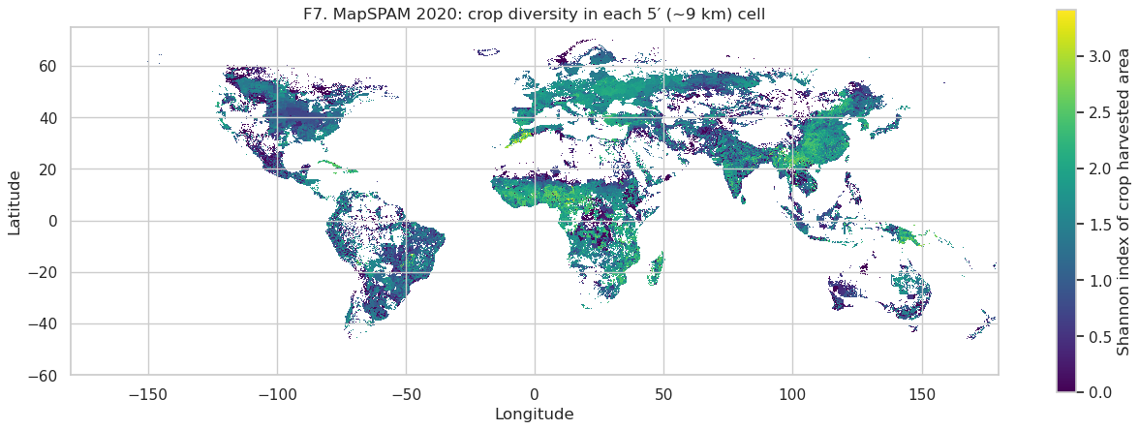
Crop Diversity in Every 5′ Cell (MapSPAM 2020)
Diverse belts
West and East Africa, the Mediterranean and parts of Europe and South Asia grow many crops side by side.
Specialised zones
The US Corn Belt, much of Brazil and the Central Asian steppe show low cell diversity.
Why it matters
This local mix is the closest global measure of diversity at field-landscape scale.

Slide 24
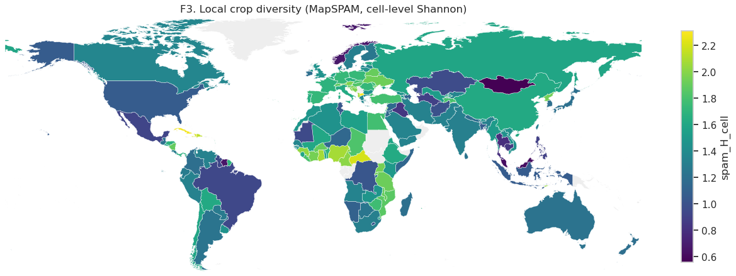
Local Crop Diversity by Country
Highest
Parts of West Africa and Central America, and East Africa, have the most mixed cropland.
Lowest
Mongolia, Brazil, the USA and Southeast Asian rice countries are dominated by a few crops.
Not the same as national
Local and national diversity correlate only ρ = 0.58: a country can be diverse overall but specialised locally.

Slide 25
Landscape Diversity from FAOSTAT Land Use
Input: FAOSTAT Land Use: land area, arable land, permanent crops, meadows and pastures, forest, other land
Summary (3,123 country-years)
1
landuse_H: mean 1.14 (0.16–1.56)
Natural share: mean 0.56
Forest share: mean 0.32
Limitation: national composition, not the mosaic around fields
Composition: Shares of arable, permanent crops, pasture, forest and other land in each country-year
2
landuse_H: Shannon index of those five shares (landscape heterogeneity)
3
Habitat share: natural_share = (forest + pasture) / land area; forest_share also kept
4
Timing: Panel uses last year's value; maps use the 2000–2004 average
5

Slide 26
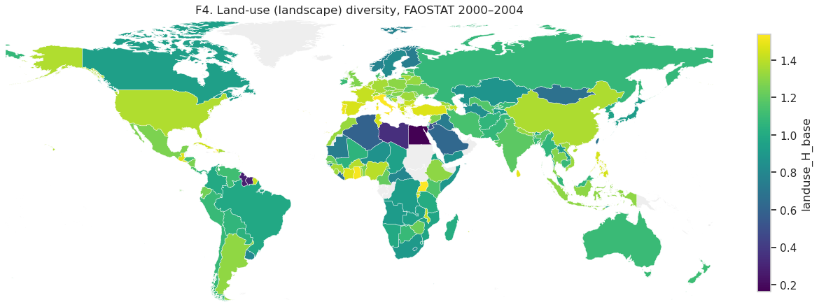
Land-use (Landscape) Diversity, 2000–2004
Low diversity
Desert countries (Egypt, Libya) are dominated by "other land" and score lowest.
High diversity
The USA, China, Mexico and much of Europe mix cropland, pasture and forest.
Link to crops
Landscape and crop diversity correlate only weakly (ρ = 0.28–0.40), so they measure different things.

Slide 27
Habitat Biodiversity from GBIF
Query: GBIF occurrence API: birds (class Aves), 2000–2020, per country, counts by species
Summary
1
Countries: 137 of 142 with ≥5,000 records
Raw species: 207–2,137
Rarefied: 171–1,044 (mean 400)
Use: habitat proxy; treated with caution
Problem: Raw species counts mostly reflect how much people record (records range 2,859 to 580 million)
2
Rarefaction: Expected species in 5,000 random records, so all countries are compared at equal effort
3
Effort: Records per 1,000 km² of land area, from Natural Earth polygons
4
Check: Raw richness rises with effort (ρ = 0.32); rarefied richness does not (ρ = −0.14)
5

Slide 28
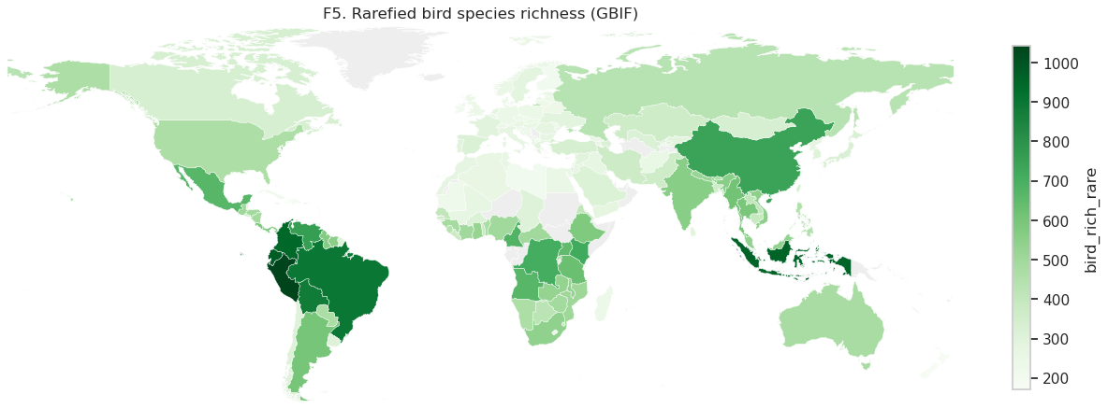
Rarefied Bird Species Richness (GBIF)
Richest
Colombia, Peru, Ecuador, Brazil and Indonesia: tropical forest countries.
Also high
China, Mexico and Central Africa have high richness even after effort correction.
Caution
Bird richness also tracks latitude and climate, so it partly stands in for region.

Slide 29
Handling the Scale Mismatch
Datasets range from 10 m pixels to whole countries; this section shows how we aligned them and tested the effect

Slide 30
The Scale Mismatch Problem
Dataset | Native resolution | Brought to | How
ESA WorldCover | 10 m | 100 m – 10 km (demo) | Class counts summed into blocks
MapSPAM 2020 | 5′ (~9 km) | 5′, 0.25°, 0.5°, 1°, 2°, national | Crop areas summed, Shannon recomputed
CRU TS 4.07 | 0.5° (~55 km) | Country, 3 versions | Area, cropland-mask and harvested-area weights
FAOSTAT | National | National | Native unit of the panel
GBIF | Points | National | Rarefied counts per country
Why it matters
Diversity measured over a bigger area always looks higher, because more crops fit inside
National climate averages include deserts and mountains where no crops grow
Results can change with the unit chosen (modifiable areal unit problem)
National averages hide local variation (ecological fallacy)

Slide 31
Our Harmonisation Approach
Common grids: One country mask from Natural Earth, rasterised onto each dataset's own grid (5′, 0.25°, 0.5°)
Result in one line
1
Climate inputs are robust to weighting (r = 0.88 rain, 0.92 heat)
Diversity is not: values and rankings change with scale
Buffering effects appear only at coarse scales
Cropland weighting: Climate averaged with MapSPAM harvested area as weights: the climate the crops actually experience
2
Cropland mask: Second version keeps only cells where crops cover ≥5% of the cell
3
Multi-scale diversity: Crop Shannon recomputed at 5′, 0.25°, 0.5°, 1°, 2° and national
4
Sensitivity tests: Every buffering model re-run with each scale and each climate version
5
10 m demonstration: WorldCover tile shows the scale effect with real high-resolution land cover
6

Slide 32
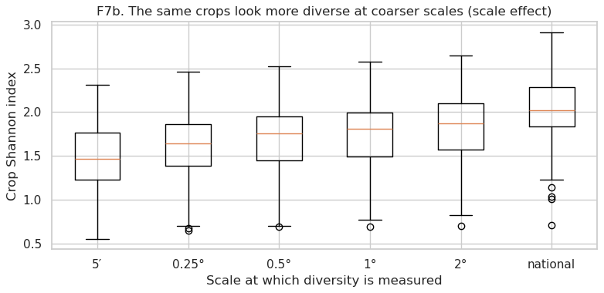
Crop Diversity Rises with the Measurement Scale
Key findings
Same crops, different numbers: mean Shannon rises from 1.48 at 5′ to 1.63 (0.25°), 1.70 (0.5°), 1.77 (1°), 1.84 (2°) and 2.03 nationally.
Why: a larger area contains more crops, so it always looks more diverse.
Consequence: diversity values from different scales cannot be compared directly; the scale must be stated.
Spread narrows at coarse scales: local specialisation is averaged away.

Slide 33
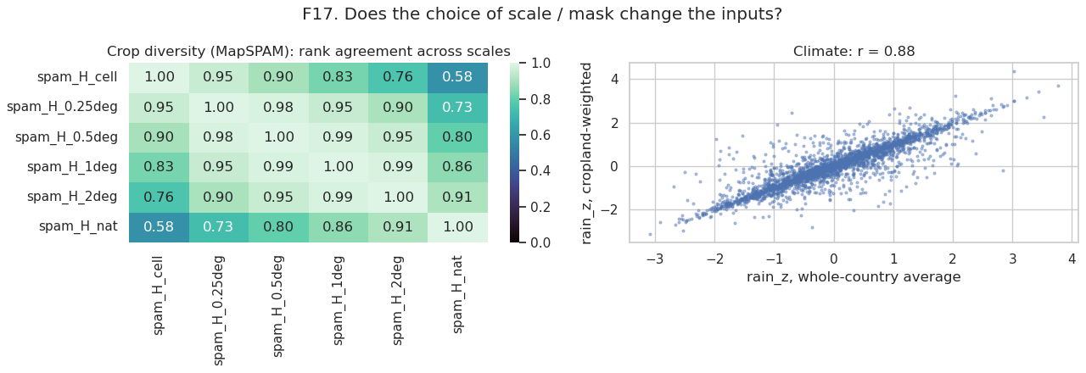
Does the Choice of Scale or Mask Change the Inputs?
Neighbouring scales agree
Rank correlation 0.95–0.99 between adjacent scales (e.g. 0.5° vs 1°).
Distant scales disagree
Cell vs national diversity only ρ = 0.58: country rankings change.
Climate is robust
Harvested-area-weighted vs whole-country rain_z: r = 0.88 (heat_z 0.92).

Slide 34
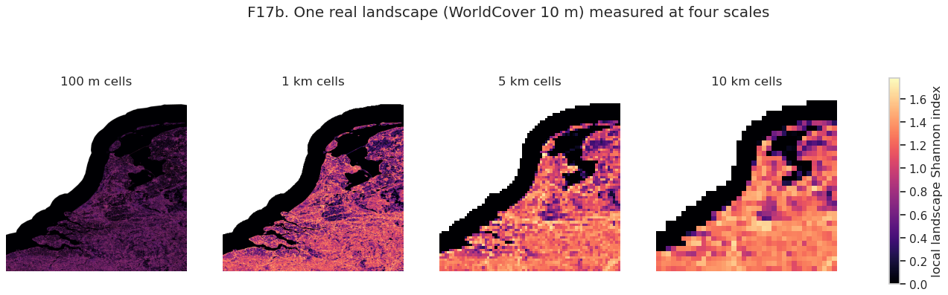
Real 10 m Land Cover at Four Scales (WorldCover)
Scale | 100 m | 1 km | 5 km | 10 km | Whole tile
Mean Shannon H | 0.23 | 0.60 | 0.81 | 0.88 | 1.55
Cropland-weighted H | 0.25 | 0.86 | 1.14 | 1.25 | 1.55
Cells | 8,251,771 | 82,794 | 3,361 | 858 | 1
Tile (Belgium–Netherlands coast): water 36%, grass 24%, tree 15%, crop 15%, built 9%
At 100 m most cells hold one class (H ≈ 0.2); at 10 km the same land looks 4–5× more diverse

Slide 35
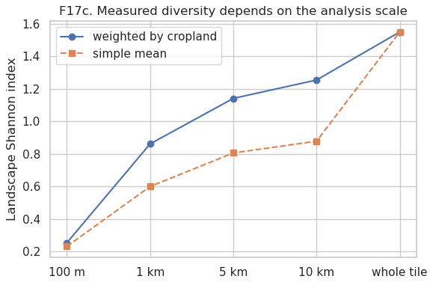
Measured Landscape Diversity Depends on Scale
Key findings
About 6× increase: cropland-weighted H goes from 0.25 at 100 m to 1.55 for the whole 3°×3° tile.
Farmland is in mixed landscapes: at 1–10 km the cropland-weighted value is 0.26–0.38 higher than the simple mean.
Lesson: diversity must be measured at the scale where buffering is expected to act, and results reported for several scales.
Use in project: demonstration only; one tile cannot cover 142 countries.

Slide 36
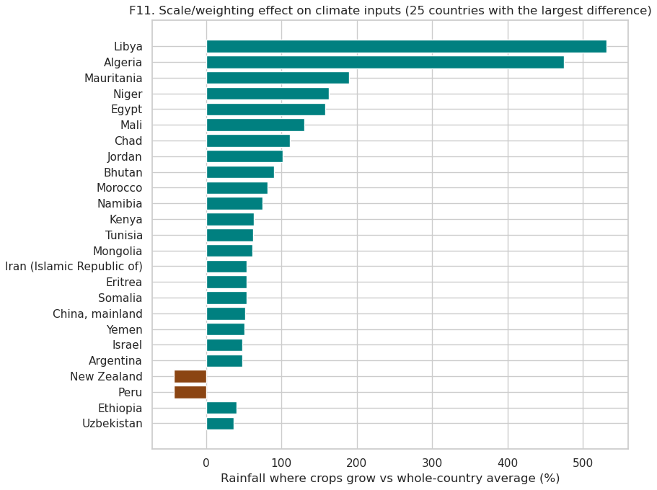
Why Cropland Weighting Matters for Climate
Key findings
Deserts distort averages: in Libya and Algeria rainfall where crops grow is about 6× the national average, because farms sit on the wetter coast.
Sahel and dry Asia: Mauritania, Niger, Egypt, Mali, Chad, Jordan: cropland rainfall is 2–3 times the country mean.
Opposite case: in New Zealand and Peru, crops grow in drier areas than the national average.
Anomalies agree: year-to-year z-scores still correlate r = 0.88, so the weighting matters most for levels.

Slide 37
Climate Stress Variables: Method
Source: CRU TS 4.07 monthly precipitation and Tmax, 0.5° (TerraClimate download was too slow; noted as a change)
Coverage
1
Years: 1999–2020 (1999 for seasons crossing New Year)
Countries: 142 of 142
Panel rows: 2,982 with climate
Limitation: one season per country; winter crops such as rabi wheat are approximated
Weighting: Country-month averages weighted by MapSPAM harvested area (plus whole-country and mask versions)
2
Growing season: Four consecutive wettest months of each country's 2000–2020 climatology, assigned to the harvest year
3
Anomalies: rain_z and heat_z: season totals and means standardised within each country
4
Stress counts: dry_months: below the 20th rainfall percentile; hot_months: above the 80th temperature percentile
5
Flags: Drought: rain_z < −1; heat year: heat_z > 1
6

Slide 38
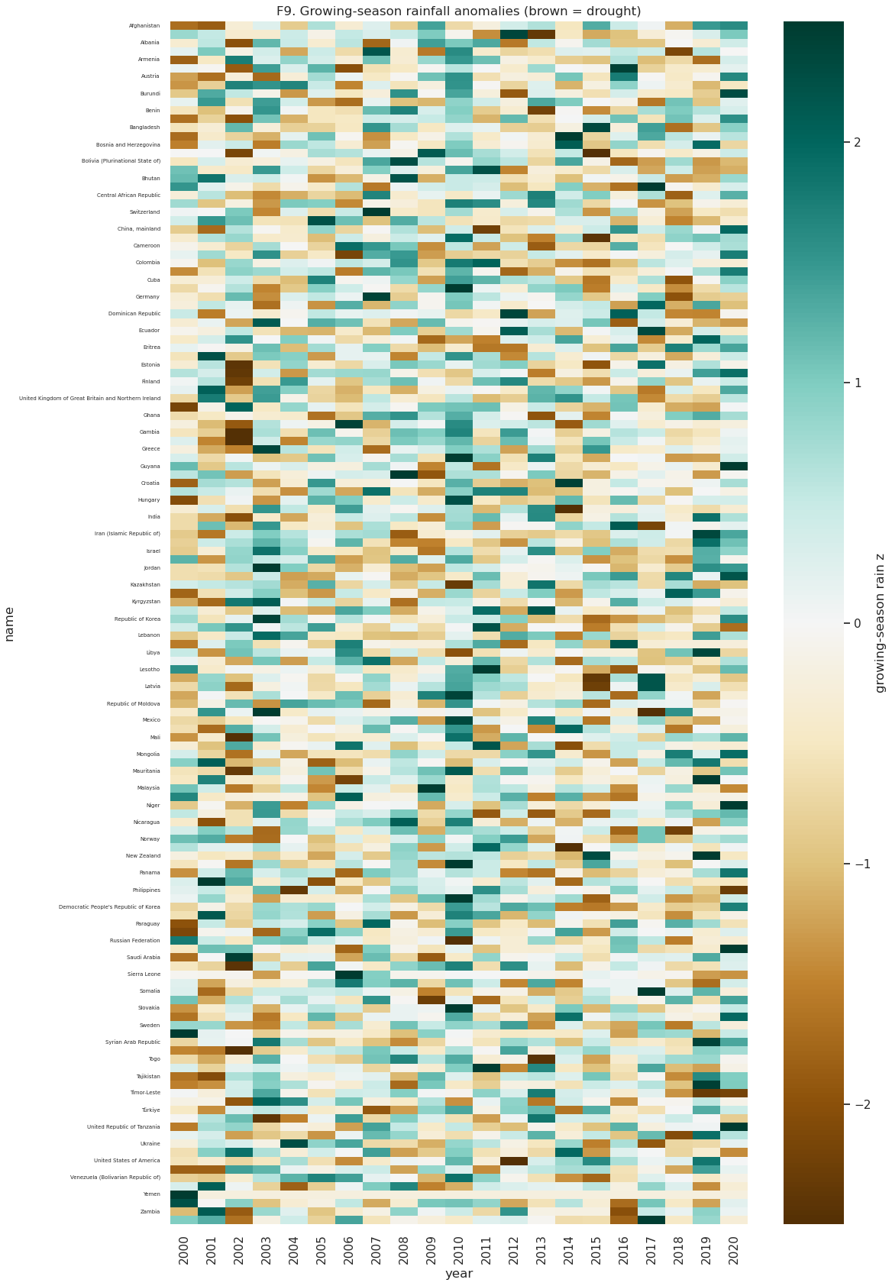
Growing-season Rainfall Anomalies, 2000–2020
Key findings
No global drought year: brown (dry) and green (wet) cells are scattered; shocks are mostly regional.
Driest years on average: 2015 (−0.31 SD), 2018 (−0.28) and 2000 (−0.26).
Wettest year: 2010 (+0.6 SD on average across study countries).
Why within-country z-scores: each row is compared with its own normal, so arid and humid countries are on one scale.
Drought years: 452 country-years have rain_z < −1 (about 15%), enough to estimate buffering.

Slide 39
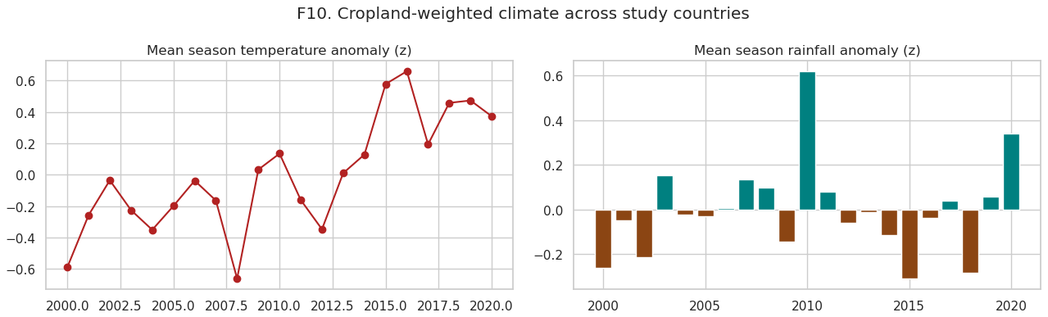
Cropland-weighted Climate Across Study Countries
Warming
Mean season temperature anomaly rose from about −0.6 SD (2000) to +0.65 SD (2016).
Rainfall
No trend: 2010 was wettest (+0.6 SD); 2000, 2015 and 2018 were the driest years.
Meaning
Heat stress is becoming more frequent, which raises the stakes of any buffering effect.

Slide 40
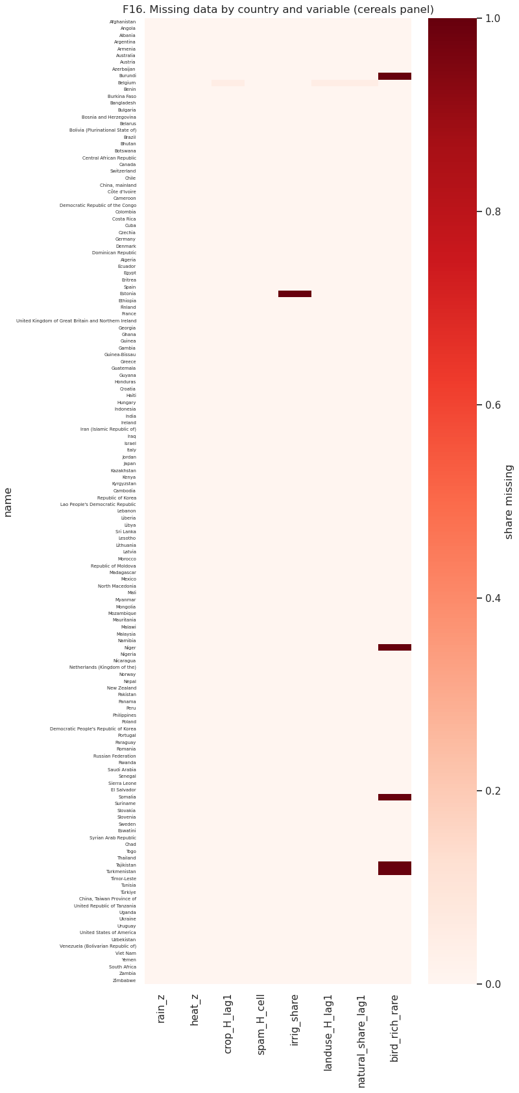
Data Completeness of the Master Panel
Variable | Share missing
rain_z, heat_z | 0.0%
crop_H_lag1 | 0.0%
spam_H_cell | 0.0%
landuse_H_lag1, natural_share_lag1 | 0.0%
irrig_share | 0.7%
bird_rich_rare | 3.5%
Key findings
The panel is almost complete: 2,982 cereal country-years with climate
Missing bird richness: 5 countries with fewer than 5,000 GBIF records
Missing irrigation: 1 country without MapSPAM irrigated area
Models drop only those rows, so results are not driven by gaps
Earlier version: 41 countries and no completeness check. Now: 142 countries, with every variable checked.

Slide 41
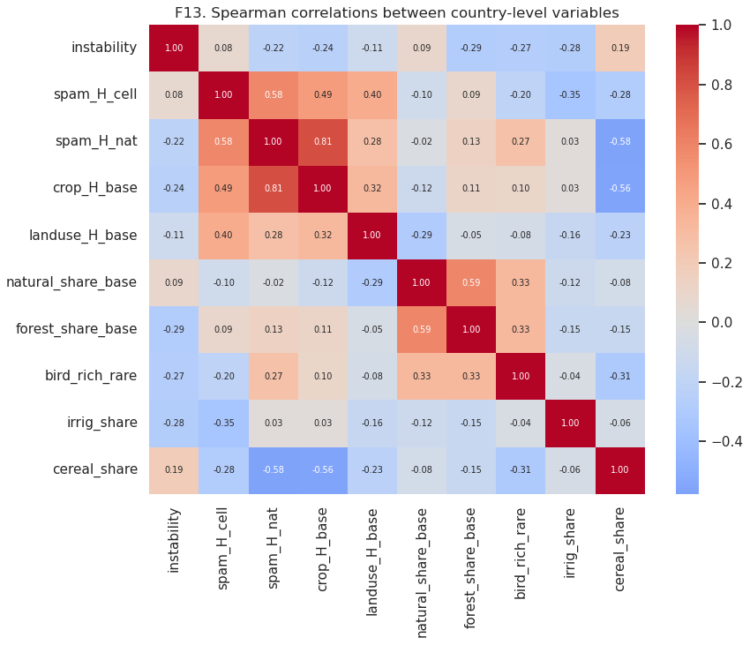
Correlations Between Country-level Variables
Key findings
Instability falls with diversity: national crop diversity ρ = −0.24 (crop_H_base) and −0.22 (spam_H_nat).
Habitat also helps: forest share ρ = −0.29 and bird richness ρ = −0.27.
Irrigation: ρ = −0.28, as strong as diversity, so it must be controlled for.
Cereal-heavy countries are less stable (ρ = +0.19).
Local diversity: spam_H_cell shows no link (ρ = +0.08).

Slide 42
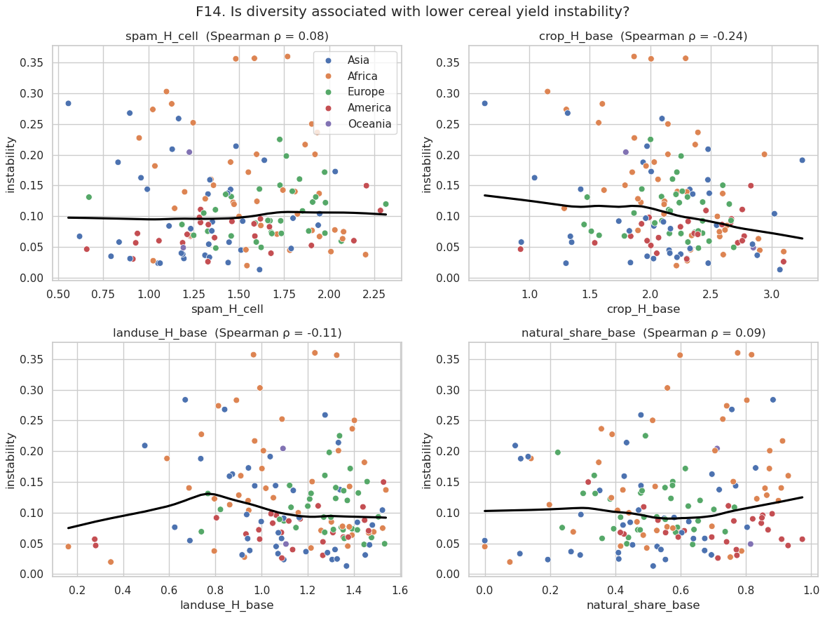
Is Diversity Associated with Lower Yield Instability?
Key findings
National crop diversity: downward slope; the most diverse countries rarely exceed 0.15 instability.
Local (cell) diversity: flat line (ρ = 0.08).
Land-use diversity: weak (ρ = −0.11); natural share: none (ρ = 0.09).
Africa: the most unstable countries (orange) occur at every diversity level, so climate and irrigation dominate.

Slide 43
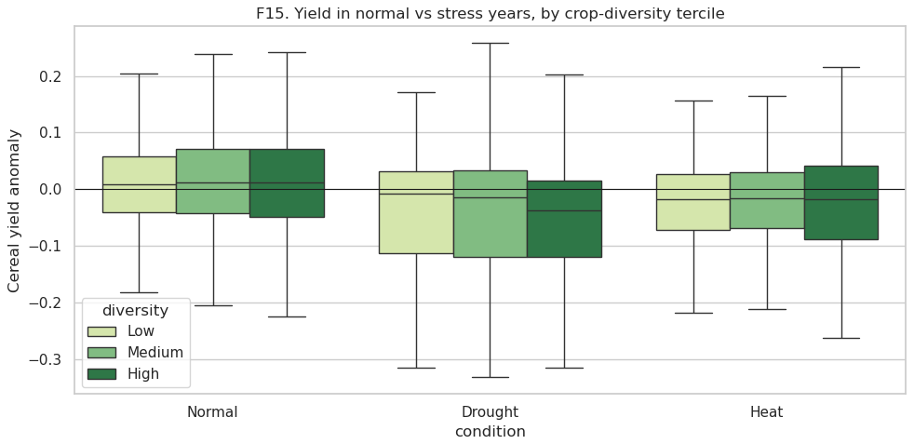
Yield in Normal vs Stress Years, by Crop-diversity Tercile
Key findings
Shocks hurt: mean anomaly is about +1.4% in normal years, −4 to −6% in drought years and about −2.5% in heat years.
No visible buffering here: high local diversity (spam_H_cell) loses as much in drought (−5.5%) as low diversity (−4.4%).
Next step: this simple split ignores country differences, so we use fixed-effects models.
Mean anomaly | Low | Medium | High
Normal | +1.2% | +1.4% | +1.5%
Drought | −4.4% | −4.1% | −5.5%
Heat | −2.6% | −2.9% | −2.4%

Slide 44
Statistical Models: Does Diversity Buffer Shocks?
Fixed-effects panel regressions with climate × diversity interactions, 142 countries

Slide 45
Baseline: How Much Do Drought and Heat Cost?
Model: anomaly = β₁·rain_z + β₂·heat_z + country effect + year effect + error (standard errors clustered by country)
+1.6%
−1.8%
0.06
yield per +1 SD season rainfall (p < 0.001)
yield per +1 SD season temperature (p < 0.001)
R²: climate explains a small share of yield noise
Key findings
Both drought and heat significantly reduce cereal yields across 142 countries
Heat is at least as damaging as low rainfall per standard deviation
Most year-to-year variation comes from other factors (pests, prices, policy, conflict, data noise), which limits any model

Slide 46
Buffering Test: Model Specification
anomaly = β₁·rain_z + β₂·heat_z + β₃·(rain_z × D) + β₄·(heat_z × D) [+ irrigation interactions] + country + year
D = diversity
Reading β₃ (rain × D)
Standardised (mean 0, SD 1) so effects are comparable: crop_H_lag1, spam_H_cell, spam_H_nat, landuse_H_lag1, natural_share_lag1, bird_rich_rare
Negative = buffering: more diverse countries depend less on rainfall, so they lose less in droughts
Reading β₄ (heat × D)
Irrigation control
Positive = buffering: the yield loss from a hot season is smaller where diversity is higher
Irrigation also buffers drought and may go with diversity, so every model is run with and without rain × irrigation and heat × irrigation

Slide 47
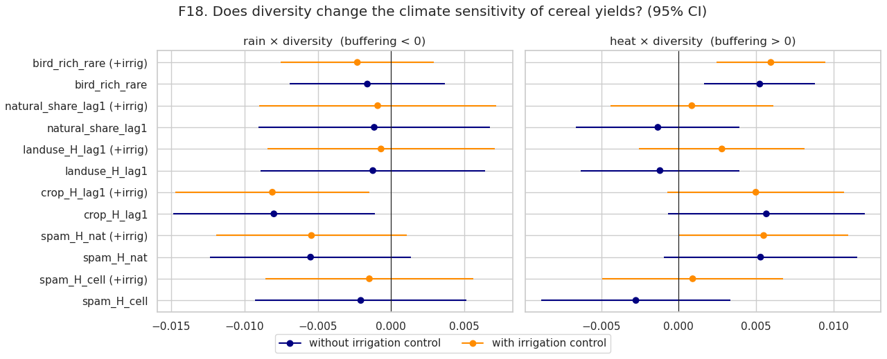
Does Diversity Change Climate Sensitivity? (95% CI)
Crop diversity buffers rainfall
crop_H_lag1 × rain = −0.008 (p = 0.02); it halves the baseline rain effect of 0.016, with or without irrigation control.
Birds and heat
bird richness × heat = +0.006 (p < 0.001 with irrigation control): richer habitats lose less in hot years.
No effect
Local crop diversity, land-use diversity and natural share: intervals cross zero.

Slide 48
Buffering Results Table (with Irrigation Control)
Diversity measure | rain × D | p | heat × D | p | Verdict
Crop diversity, yearly (crop_H_lag1) | −0.0081 | 0.016 | +0.0050 | 0.086 | Buffers drought
National crop diversity (spam_H_nat) | −0.0054 | 0.102 | +0.0055 | 0.049 | Weak heat buffering
Local crop diversity (spam_H_cell) | −0.0015 | 0.682 | +0.0009 | 0.761 | No effect
Land-use diversity (landuse_H_lag1) | −0.0007 | 0.862 | +0.0028 | 0.306 | No effect
Natural-habitat share (natural_share_lag1) | −0.0009 | 0.825 | +0.0008 | 0.752 | No effect
Bird richness (bird_rich_rare) | −0.0023 | 0.387 | +0.0060 | 0.001 | Buffers heat
n = 2,960 country-years, 141 countries; R² 0.068–0.074. Without irrigation control the conclusions are the same (crop_H_lag1 rain p = 0.023; birds heat p = 0.004).
Only 2 of 6 measures show buffering at p < 0.05, so the evidence is selective, not general.

Slide 49
Sensitivity: Crops, Climate Versions and Scales
Test (diversity = spam_H_cell unless stated) | rain × D | p | heat × D | p
Wheat only | −0.0130 | 0.018 | +0.0001 | 0.989
Rice only | −0.0001 | 0.973 | −0.0006 | 0.867
Maize only | +0.0018 | 0.659 | −0.0038 | 0.169
Climate: whole-country mean | −0.0008 | 0.794 | +0.0013 | 0.611
Climate: cropland mask | −0.0010 | 0.775 | +0.0001 | 0.976
Diversity at 0.25° / 0.5° | −0.0027 / −0.0030 | 0.46 / 0.41 | +0.0022 / +0.0029 | 0.45 / 0.32
Diversity at 1° / 2° | −0.0033 / −0.0037 | 0.37 / 0.31 | +0.0035 / +0.0040 | 0.23 / 0.17
Diversity national | −0.0054 | 0.102 | +0.0055 | 0.049
Quadratic detrending | −0.0019 | 0.614 | −0.0004 | 0.876
Key findings
Scale matters: the heat-buffering coefficient grows steadily from 0.0009 (5′) to 0.0055 (national), becoming significant only nationally.
Interpretation: diversity spread across regions (a portfolio) protects output more than mixing crops locally.
Wheat is the crop where diversity buffers rainfall (p = 0.018).
Robust to climate weighting and detrending choices.

Slide 50
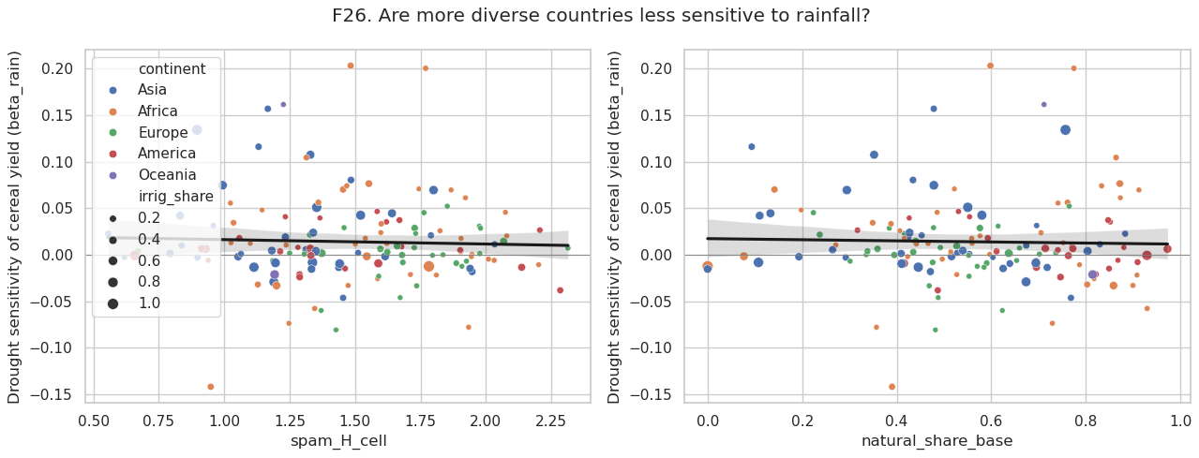
Are More Diverse Countries Less Sensitive to Rainfall?
Country slopes
For each country we estimate beta_rain, the yield change per 1 SD of rainfall (most lie between −0.05 and +0.10).
Crop diversity helps
Countries with higher 2000–2004 crop diversity have lower drought sensitivity: −0.016 per unit H (p = 0.019).
Others not significant
Local diversity (p = 0.74), land-use H (0.91), natural share (0.82), birds (0.62).

Slide 51
Machine Learning
Can climate and diversity predict yield anomalies and shock years in countries the model has never seen?

Slide 52
Machine-learning Setup
Feature set | Variables
Climate only | rain_z, heat_z, tmax_z, dry_months, hot_months, rain_ann_z, heat_ann_z
+ Context | irrig_share, cereal_share, log_mean_yield
+ Diversity | crop_H_lag1, spam_H_cell, spam_H_nat, landuse_H_lag1, natural_share_lag1, forest_share_lag1, bird_rich_rare
Validation
GroupKFold by country: 5 folds; each test country is never seen in training
GroupKFold by year: tests prediction for unseen years
Metrics: R², RMSE, MAE; ROC-AUC and PR-AUC for shocks
Key comparison: climate only vs climate + context + diversity
Ridge
linear baseline
Random Forest
500 trees
XGBoost
600 trees, depth 4
LightGBM
600 trees, 15 leaves
Targets: yield anomaly (regression) and shock year = loss > 10% (classification)

Slide 53
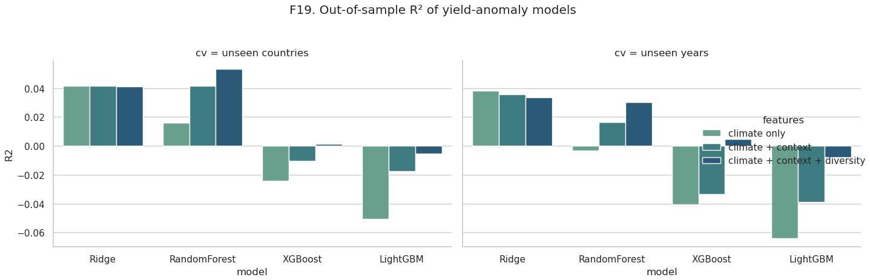
Out-of-sample R² of Yield-anomaly Models
Low predictability
All R² values are between −0.06 and +0.05: year-to-year anomalies are hard to predict from national data.
Best model
Random Forest with climate + context + diversity: R² = 0.053 for unseen countries (0.016 with climate only).
Boosting overfits
XGBoost and LightGBM score at or below zero; the simpler Ridge (0.041) is competitive.

Slide 54
Regression Model Comparison (Unseen Countries)
Model | Climate only R² | + Context R² | + Diversity R² | RMSE (full) | MAE (full)
Ridge | 0.041 | 0.041 | 0.041 | 0.122 | 0.086
Random Forest | 0.016 | 0.042 | 0.053 | 0.122 | 0.085
XGBoost | −0.024 | −0.011 | 0.001 | 0.125 | 0.089
LightGBM | −0.051 | −0.017 | −0.006 | 0.125 | 0.089
Adding diversity to climate + context improves every tree model (RF, XGBoost, LightGBM: +0.011 to +0.012 R²)
Unseen years: best is Ridge with climate only (R² 0.038)
Errors stay ~0.12, i.e. ±12% of trend

Slide 55
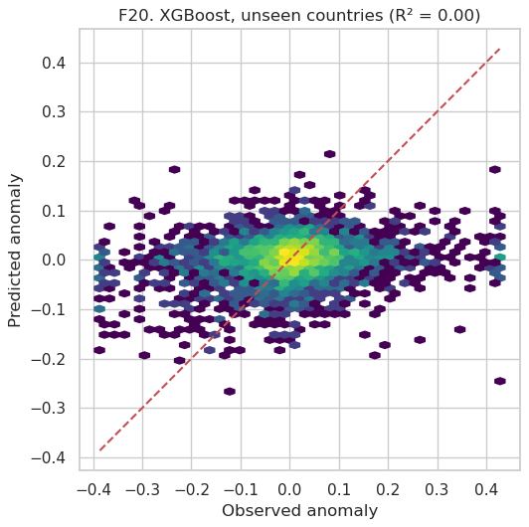
Predicted vs Observed Anomalies (XGBoost)
Key findings
Shrunk predictions: predictions stay mostly within ±0.1 while observed anomalies reach ±0.4.
No skill for extremes: large losses are not predicted from climate and diversity alone.
Meaning: national climate averages capture only part of the shock; local weather, pests and markets are missing.
Better framing: instead of the exact size, predict whether a year is a shock (next slides).

Slide 56
Classifying Yield-shock Years
474
15.9%
Model | Climate only AUC | Full AUC | Full PR-AUC
Logistic | 0.631 | 0.704 | 0.297
Random Forest | 0.623 | 0.711 | 0.344
XGBoost | 0.610 | 0.698 | 0.322
LightGBM | 0.600 | 0.683 | 0.320
shock years (loss > 10%)
of 2,982 country-years
Method
Same 4 model families, with class weights for imbalance
GroupKFold by country: predictions for unseen countries
ROC-AUC: 0.5 = guessing, 1.0 = perfect
PR-AUC compared with the no-skill level of 0.159
Key findings
Adding context and diversity raises AUC by 0.07–0.09 for every model
Random Forest PR-AUC 0.344 = 2.2× the no-skill rate
Shock years are far more predictable than anomaly size

Slide 57
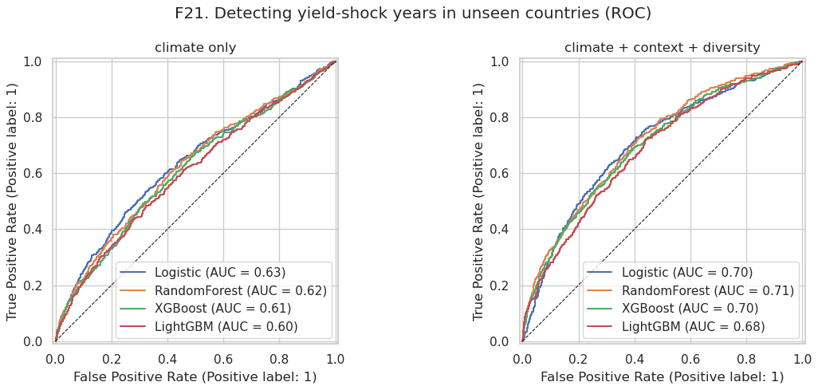
Detecting Yield-shock Years in Unseen Countries (ROC)
Climate only
AUC 0.60–0.63: weather alone separates shock years only modestly from normal years.
+ Context + diversity
AUC 0.68–0.71: all four curves move clearly above the diagonal.
Caveat
Context (irrigation, cereal share, yield level) was added at the same time, so the gain is not from diversity alone.

Slide 58
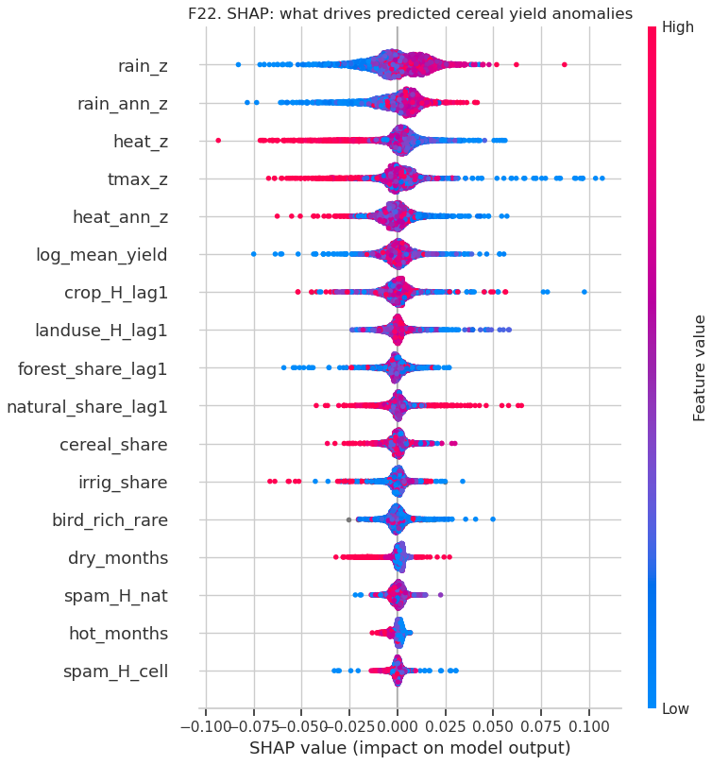
SHAP: What Drives Predicted Yield Anomalies?
Key findings
Climate first: the top five features are all climate: rain_z, rain_ann_z, heat_z, tmax_z, heat_ann_z.
Direction: low rainfall (blue) pushes predictions down; high temperature (red) pushes them down.
Diversity next: crop_H_lag1 is the 7th most important feature and the strongest diversity variable.
Least important: local crop diversity (spam_H_cell) ranks last.

Slide 59
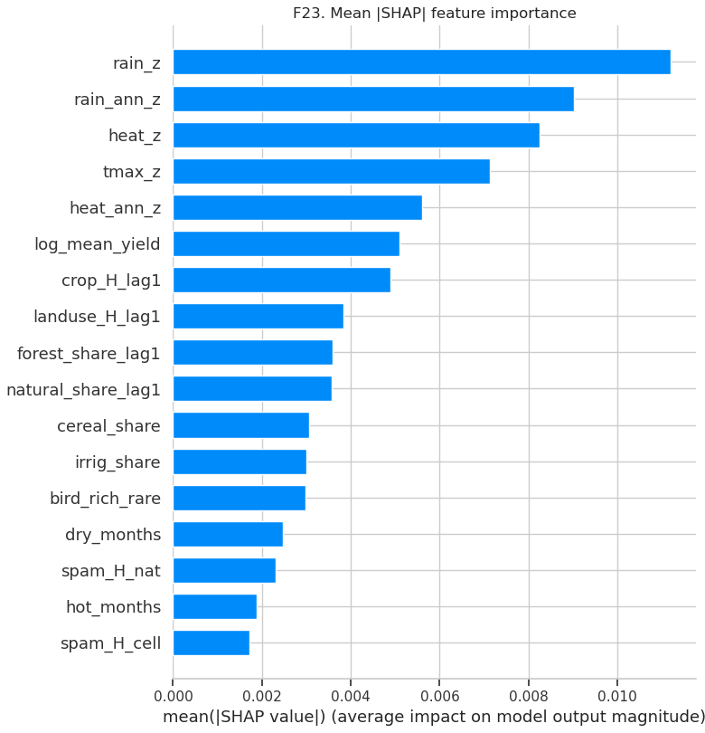
Mean |SHAP| Feature Importance
Key findings
Rainfall dominates: season rainfall has the largest mean impact (0.011), followed by annual rainfall and heat.
Diversity block: crop_H_lag1, landuse_H_lag1, forest share and natural share each contribute 0.0036–0.0049, more than irrigation (0.0030) or cereal share.
Together: the 7 diversity variables carry a real but secondary share of the signal.
Consistent with the regressions: yearly crop diversity matters most.

Slide 60
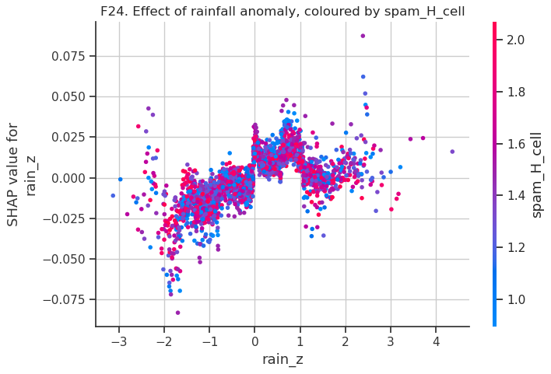
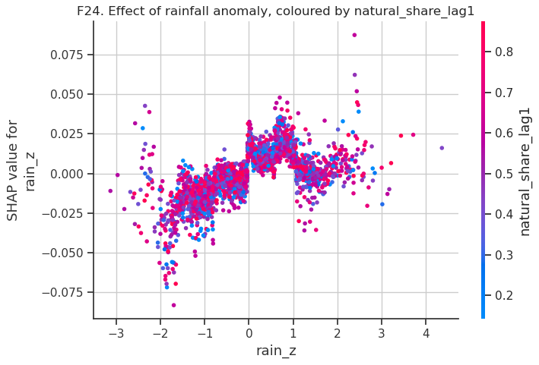
How the Rainfall Effect Varies with Diversity (SHAP)
Non-linear rainfall
Below-normal rain (rain_z < 0) lowers predicted yield by up to 8%; above normal helps up to rain_z ≈ +1.
Too wet also hurts
Beyond +1 SD the benefit falls back, consistent with flooding and disease.
Colour mixing
High and low diversity points overlap, so the model finds only a small buffering effect.

Slide 61
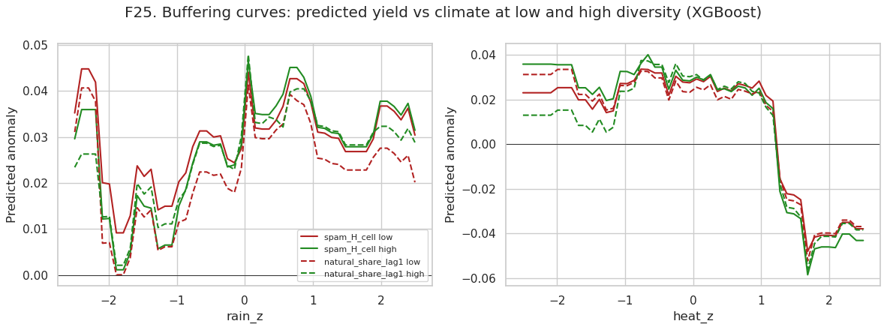
Buffering Curves: Predicted Yield at Low vs High Diversity
Heat threshold
Predicted yield drops sharply once heat_z exceeds about +1.2 (from +2% to about −4%).
Small gaps
High (green) and low (red) diversity curves differ by only about 1–2 percentage points.
No consistent order
High diversity is not above low diversity in the hottest or driest years, so the model shows no clear buffering.

Slide 62
What We've Discovered So Far
1. Climate shocks are costly
1 SD drier season: −1.6% yield; 1 SD hotter season: −1.8%; 15.9% of country-years are shock years.
2. Crop diversity buffers drought
Yearly crop diversity halves the rainfall sensitivity (p = 0.02); more diverse countries have lower drought slopes (p = 0.019).
3. Habitat richness and heat
Bird-rich countries lose less in hot years (p < 0.001); interpret with caution (regional proxy).
4. Scale decides the answer
Diversity values rise from 1.48 (5′) to 2.03 (national); buffering appears only at national scale.
5. Local diversity alone: no effect
MapSPAM cell diversity, land-use mix and natural share do not buffer shocks in our models.
6. Shocks are partly predictable
Adding context and diversity lifts shock detection in unseen countries from AUC 0.63 to 0.71.

Slide 63
Answer to the Research Question
Are diverse agricultural landscapes more stable? Partly. Diversity across a country's crops gives measurable protection against drought, but the effect is small, depends on scale, and is weaker than climate and irrigation.
Supported
Not supported
Open questions
National and yearly crop diversity lowers instability and drought sensitivity
Bird richness reduces heat losses
Diversity adds predictive power for shock years
Field-scale (5′) crop mix does not buffer shocks
Land-use mix and natural-habitat share show no effect
No buffering visible in simple tercile comparisons
Is the national effect a portfolio of regions with different weather?
Would crop-specific seasons reveal stronger effects?
Does it hold within countries (districts)?

Slide 64
Limitations
!
National averages
!
One growing season
!
Coarser climate
Country-level data hide local variation (ecological fallacy); buffering may act at farm or district scale.
The wettest 4 months are used for every crop; winter wheat and double-cropped rice are approximated.
CRU TS at 0.5° replaced TerraClimate (4 km) because downloads were too slow.
!
Static spatial data
!
Proxies
!
Association, not cause
MapSPAM (2020) and bird richness are single snapshots, so they only vary between countries.
Bird richness partly reflects region and climate; land-use shares are national, not around fields.
Diversity may go with income, irrigation or institutions; models control for irrigation only.

Slide 65
What's Next: The Final Phase
Single next phase (final submission): test where and why diversity buffers shocks, at the scale where it acts, and turn the results into recommendations.
1
Crop-specific seasons: Use a crop calendar so wheat, rice and maize each get their own growing-season climate
2
Sub-national test: Repeat the buffering model on India district data (ICRISAT, already downloaded) to check the national result locally
3
Portfolio vs local: Measure how much regional spread of crops explains the national buffering (scale finding)
4
Stronger controls: Add income and fertiliser use; test interactions with irrigation
5
Final outputs: Report, policy recommendations, final presentation and cleaned, documented notebook

Slide 66
Contributions
Work package | Members | Tasks
Data collection and preprocessing | [Names] | FAOSTAT, MapSPAM, CRU TS, GBIF, WorldCover, Natural Earth; cleaning and quality checks
Diversity and scale harmonisation | [Names] | Shannon indices, multi-scale MapSPAM, land use, WorldCover demonstration
Climate and yield analysis | [Names] | Growing seasons, anomalies, detrending, exploratory figures
Statistical modelling | [Names] | Fixed-effects buffering models, sensitivity tests, country-level slopes
Machine learning and presentation | [Names] | Ridge, RF, XGBoost, LightGBM, SHAP; slides and write-up

Slide 67
References
FAO. FAOSTAT: Crops and Livestock Products; Land Use. Food and Agriculture Organization of the United Nations.
IFPRI. MapSPAM 2020 Global Spatially-Disaggregated Crop Production Statistics, v2r2.
Harris, I. et al. (2020). Version 4 of the CRU TS monthly high-resolution gridded multivariate climate dataset. Scientific Data 7, 109.
Zanaga, D. et al. (2022). ESA WorldCover 10 m 2021 v200.
GBIF.org. Global Biodiversity Information Facility occurrence data (accessed via API).
Natural Earth. Admin-0 countries, 1:50 m.
Renard, D. and Tilman, D. (2019). National food production stabilized by crop diversity. Nature 571, 257–260.
Shannon, C. E. (1948). A mathematical theory of communication. Bell System Technical Journal 27.
Hurlbert, S. H. (1971). The nonconcept of species diversity: a critique and alternative parameters. Ecology 52, 577–586.
Openshaw, S. (1984). The Modifiable Areal Unit Problem. Geo Books.
Chen, T. and Guestrin, C. (2016). XGBoost: A scalable tree boosting system. KDD.
Ke, G. et al. (2017). LightGBM: A highly efficient gradient boosting decision tree. NeurIPS.
Lundberg, S. M. and Lee, S.-I. (2017). A unified approach to interpreting model predictions. NeurIPS.

Slide 68
THANK YOU
Questions and feedback are welcome

