Slide 1
CIT-205 / PORTFOLIO PUBLICATION
CIT-205 | From Word Document
to Professional Portfolio
LEARN → PRACTICE → OPERATE → QUALIFY
Professor Sneaker | Monday, October 12, 2026
Today: publish your own evidence, then prove it works.
Open Blackboard lesson ↗
1
Notes:
SLIDE 1 | Professor Sneaker
DEMONSTRATE: Open the Monday lesson before students arrive. Explain that we are continuing the existing Day 14 assignment, not adding an exam, points, or a due date. Students need GitHub credentials, Word access and one existing sanitized CIT-205 artifact. Do not ask students to share credentials.
STUDENT ACTION: LEARN → PRACTICE → OPERATE → QUALIFY; Professor Sneaker | Monday, October 12, 2026; Today: publish your own evidence, then prove it works.
CHECKPOINT: Confirm the student can reproduce this step before proceeding.
RESOURCE: https://courses.ccac.edu/ultra/courses/_227360_1/document/_21358910_1?view=content
SCREENSHOT: No application screenshot claimed.

Slide 2
CIT-205 / PORTFOLIO PUBLICATION
Evidence beats a skill claim
Claim: “I can troubleshoot.”
Evidence: symptom → safe test → result → validation.
Explain your contribution, not just the team’s output.
An employer can inspect the actual work.
2
Notes:
SLIDE 2 | Professor Sneaker
DEMONSTRATE: Ask: which candidate would you trust, a skill list or a documented repair? Model a résumé statement tied to a validation artifact. Students choose one real course artifact they authored. Never imply a fictional sample is their own work.
STUDENT ACTION: Claim: “I can troubleshoot.”; Evidence: symptom → safe test → result → validation.; Explain your contribution, not just the team’s output.; An employer can inspect the actual work.
CHECKPOINT: Confirm the student can reproduce this step before proceeding.
RESOURCE: https://courses.ccac.edu/ultra/courses/_227360_1/document/_21358910_1?view=content
SCREENSHOT: No application screenshot claimed.

Slide 3
CIT-205 / PORTFOLIO PUBLICATION
A portfolio grows with your skills
LEARN: explain the method and vocabulary.
PRACTICE: produce a reviewed artifact.
OPERATE: apply it within authorized scope.
QUALIFY: demonstrate a verified result.
The portfolio holds semester evidence; it is not a final exam.
3
Notes:
SLIDE 3 | Professor Sneaker
DEMONSTRATE: Connect existing workstation, server, tickets and Knowledge Base assignments to this evidence container. Keep the canonical progression and current 1,000-point course structure. Ownership stays in the student’s personal account; later networking, server and security work can extend it.
STUDENT ACTION: LEARN: explain the method and vocabulary.; PRACTICE: produce a reviewed artifact.; OPERATE: apply it within authorized scope.; QUALIFY: demonstrate a verified result.; The portfolio holds semester evidence; it is not a final exam.
CHECKPOINT: Confirm the student can reproduce this step before proceeding.
RESOURCE: https://courses.ccac.edu/ultra/courses/_227360_1/document/_21358910_1?view=content
SCREENSHOT: No application screenshot claimed.

Slide 4
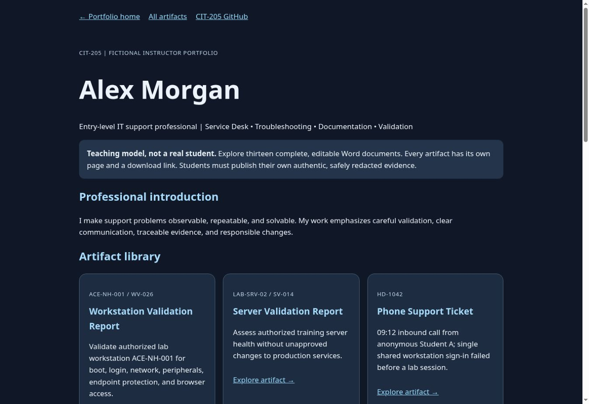
CIT-205 / PORTFOLIO PUBLICATION
Tour the live Alex Morgan portfolio
Fictional instructional model, not a real student.
Homepage → artifact page → complete PDF.
Read context, action, evidence and reflection.
Actual application capture · October 11, 2026
Open live Alex portfolio ↗
4
Notes:
SLIDE 4 | Professor Sneaker
DEMONSTRATE: Click this link, not a GitHub blob view. Point out identity, navigation and artifact groups. Have students open the live URL in a new tab. Explain that the example has 13 individual artifact pages and 13 PDFs; tomorrow’s starter submission needs at least one real, safe PDF, not 13 fabricated documents.
STUDENT ACTION: Fictional instructional model, not a real student.; Homepage → artifact page → complete PDF.; Read context, action, evidence and reflection.
CHECKPOINT: Confirm the student can reproduce this step before proceeding.
RESOURCE: https://student-operated-technology-ecosystem.github.io/CIT-205-classroom/examples/exemplary-portfolio/
SCREENSHOT: Real browser/application capture on October 11, 2026; not a mockup.

Slide 5
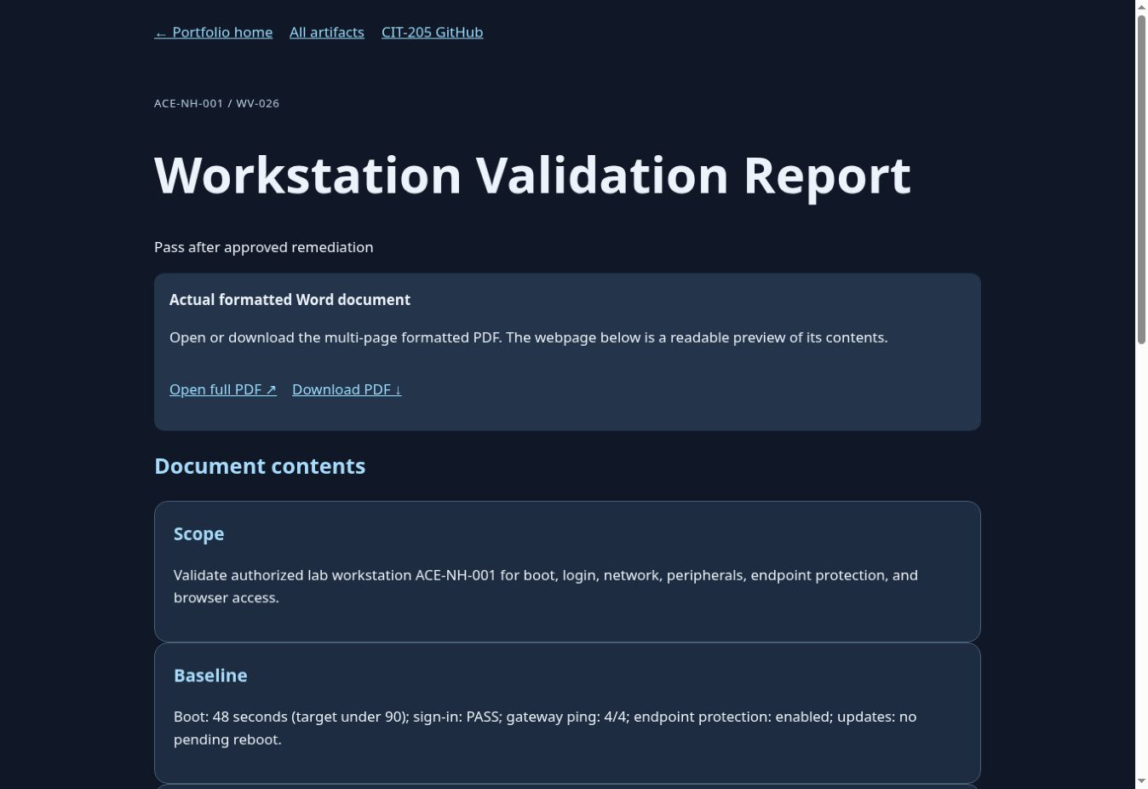
CIT-205 / PORTFOLIO PUBLICATION
Validation: prove a defensible outcome
Workstation Validation: expected versus observed.
Server Validation: pass, hold or escalate.
Evidence never grants permission to repair.
Actual application capture · October 11, 2026
Open Workstation Validation ↗
5
Notes:
SLIDE 5 | Professor Sneaker
DEMONSTRATE: Open the workstation page, then its full PDF. Inspect title, metadata, inspection table, expected and actual observations and final disposition. Next open server-validation.html and its PDF. Ask students to distinguish validation from repair authorization. Both use fictional/sanitized lab context.
STUDENT ACTION: Workstation Validation: expected versus observed.; Server Validation: pass, hold or escalate.; Evidence never grants permission to repair.
CHECKPOINT: Confirm the student can reproduce this step before proceeding.
RESOURCE: https://student-operated-technology-ecosystem.github.io/CIT-205-classroom/examples/exemplary-portfolio/artifacts/workstation-validation.html
SCREENSHOT: Real browser/application capture on October 11, 2026; not a mockup.

Slide 6
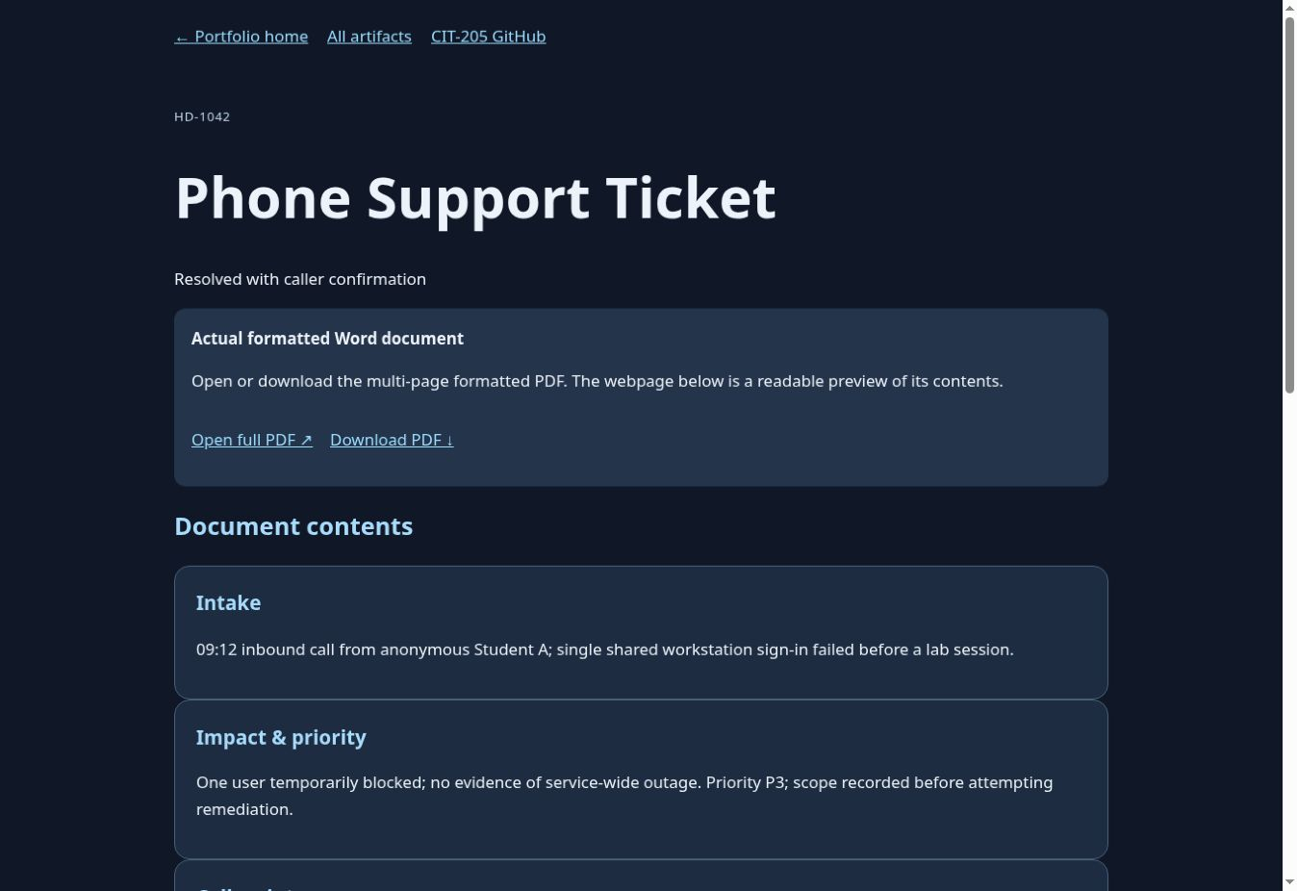
CIT-205 / PORTFOLIO PUBLICATION
Tickets: communicate and close the loop
Phone Support Ticket: clarify, record, validate.
Email Support Ticket: readable written handoff.
A closed ticket needs a confirmed outcome.
Actual application capture · October 11, 2026
Open Phone Support Ticket ↗
6
Notes:
SLIDE 6 | Professor Sneaker
DEMONSTRATE: Open phone-support-ticket.html, scroll through evidence and use Open full PDF. Compare email-support-ticket.html. Ask where the customer symptoms, timeline, actions, safe escalation and closure are documented. Students should redact real names, contact details and private ticket identifiers.
STUDENT ACTION: Phone Support Ticket: clarify, record, validate.; Email Support Ticket: readable written handoff.; A closed ticket needs a confirmed outcome.
CHECKPOINT: Confirm the student can reproduce this step before proceeding.
RESOURCE: https://student-operated-technology-ecosystem.github.io/CIT-205-classroom/examples/exemplary-portfolio/artifacts/phone-support-ticket.html
SCREENSHOT: Real browser/application capture on October 11, 2026; not a mockup.

Slide 7
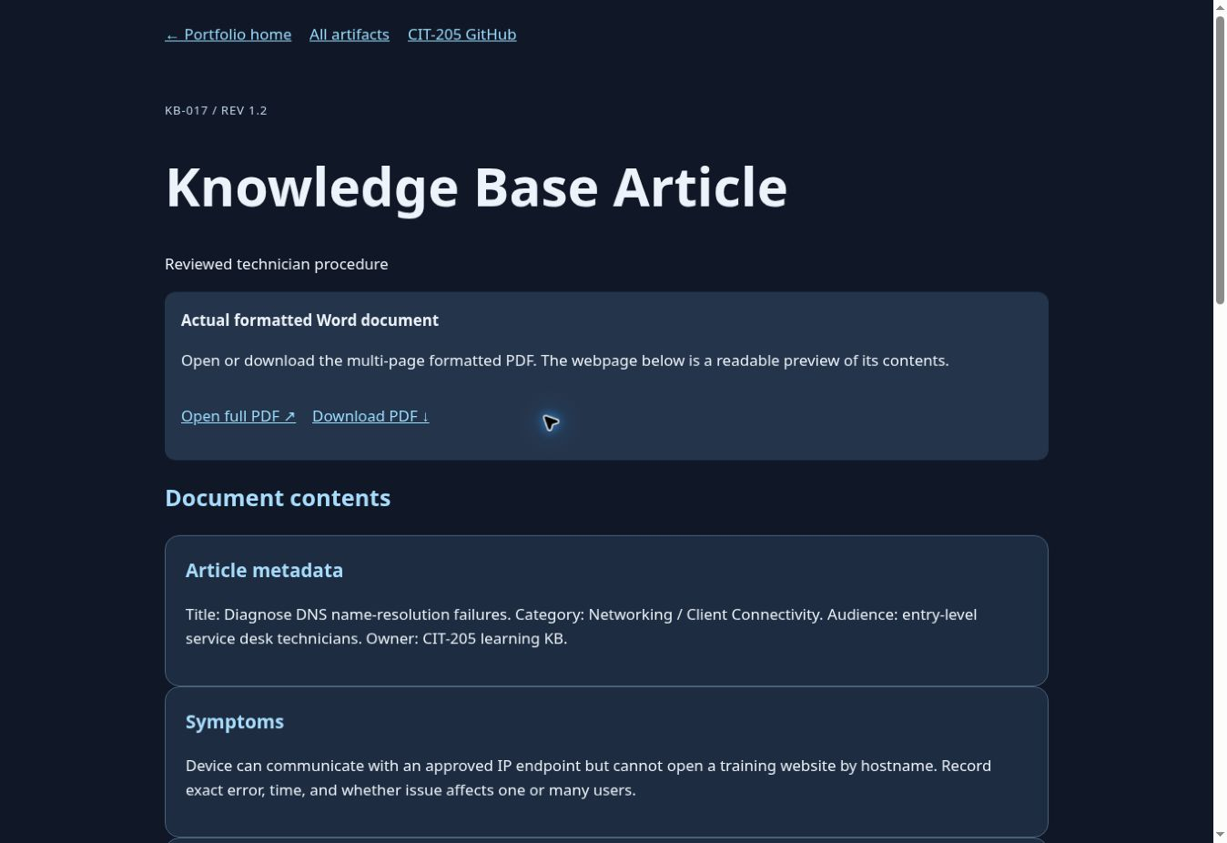
CIT-205 / PORTFOLIO PUBLICATION
Knowledge: make a solution repeatable
Knowledge Base Article: reusable procedure.
ACE Decision Tree: defensible troubleshooting.
State prerequisites, safety and stop conditions.
Actual application capture · October 11, 2026
Open Knowledge Base Article ↗
7
Notes:
SLIDE 7 | Professor Sneaker
DEMONSTRATE: Open the KB artifact and full PDF. Ask how a new technician would reproduce the procedure. Next open troubleshooting-decision-tree.html and its PDF. Explain that a decision tree records reasoning rather than random fixes; identify validation and escalation branches.
STUDENT ACTION: Knowledge Base Article: reusable procedure.; ACE Decision Tree: defensible troubleshooting.; State prerequisites, safety and stop conditions.
CHECKPOINT: Confirm the student can reproduce this step before proceeding.
RESOURCE: https://student-operated-technology-ecosystem.github.io/CIT-205-classroom/examples/exemplary-portfolio/artifacts/knowledge-base-article.html
SCREENSHOT: Real browser/application capture on October 11, 2026; not a mockup.

Slide 8
CIT-205 / PORTFOLIO PUBLICATION
Review the mission and knowledge record
Mission Proposal: need, scope, evidence, constraints.
Ticket & Knowledge Review: improve the record.
Documentation Vocabulary: use terms accurately.
Open Mission Proposal ↗
8
Notes:
SLIDE 8 | Professor Sneaker
DEMONSTRATE: Live demo three individual pages and their PDFs: mission-proposal.html, ticket-and-knowledge-review.html, documentation-vocabulary.html. Review proposal scope and authorization, reviewer findings and vocabulary distinctions. Students explain how a reviewer could reproduce a result, not simply award a polished appearance.
STUDENT ACTION: Mission Proposal: need, scope, evidence, constraints.; Ticket & Knowledge Review: improve the record.; Documentation Vocabulary: use terms accurately.
CHECKPOINT: Confirm the student can reproduce this step before proceeding.
RESOURCE: https://student-operated-technology-ecosystem.github.io/CIT-205-classroom/examples/exemplary-portfolio/artifacts/mission-proposal.html
SCREENSHOT: No application screenshot claimed.

Slide 9
CIT-205 / PORTFOLIO PUBLICATION
Professional identity is evidence-backed
GitHub Evidence: changes and review history.
Resume: achievements supported by artifacts.
LinkedIn evidence: professional presentation.
Professional Reflection: limits and next steps.
Open GitHub Evidence ↗
9
Notes:
SLIDE 9 | Professor Sneaker
DEMONSTRATE: Open github-evidence.html, resume.html, linkedin-evidence.html and portfolio-reflection.html; use each PDF link. Alex’s LinkedIn evidence is a fictional document, not a real person’s profile. Discuss meaningful commits, concise résumé claims, appropriate public identity and reflection. These existing course requirements keep their own timing; do not add new deadlines today.
STUDENT ACTION: GitHub Evidence: changes and review history.; Resume: achievements supported by artifacts.; LinkedIn evidence: professional presentation.; Professional Reflection: limits and next steps.
CHECKPOINT: Confirm the student can reproduce this step before proceeding.
RESOURCE: https://student-operated-technology-ecosystem.github.io/CIT-205-classroom/examples/exemplary-portfolio/artifacts/github-evidence.html
SCREENSHOT: No application screenshot claimed.

Slide 10
CIT-205 / PORTFOLIO PUBLICATION
What makes a document professional?
Clear title + author/date/version.
Problem and scope before the procedure.
Tables compare expected and actual outcomes.
Evidence + validation + review + reflection.
Consistent headings and readable page breaks.
Inspect the full example ↗
10
Notes:
SLIDE 10 | Professor Sneaker
DEMONSTRATE: Return to the KB PDF and point to each feature. Ask students to find a missing expected outcome in their own draft. Explain that Word is the editable source; PDF is stable public evidence. Professional means usable and accurate, not merely decorative.
STUDENT ACTION: Clear title + author/date/version.; Problem and scope before the procedure.; Tables compare expected and actual outcomes.; Evidence + validation + review + reflection.; Consistent headings and readable page breaks.
CHECKPOINT: Confirm the student can reproduce this step before proceeding.
RESOURCE: https://student-operated-technology-ecosystem.github.io/CIT-205-classroom/examples/exemplary-portfolio/artifacts/knowledge-base-article.html
SCREENSHOT: No application screenshot claimed.

Slide 11
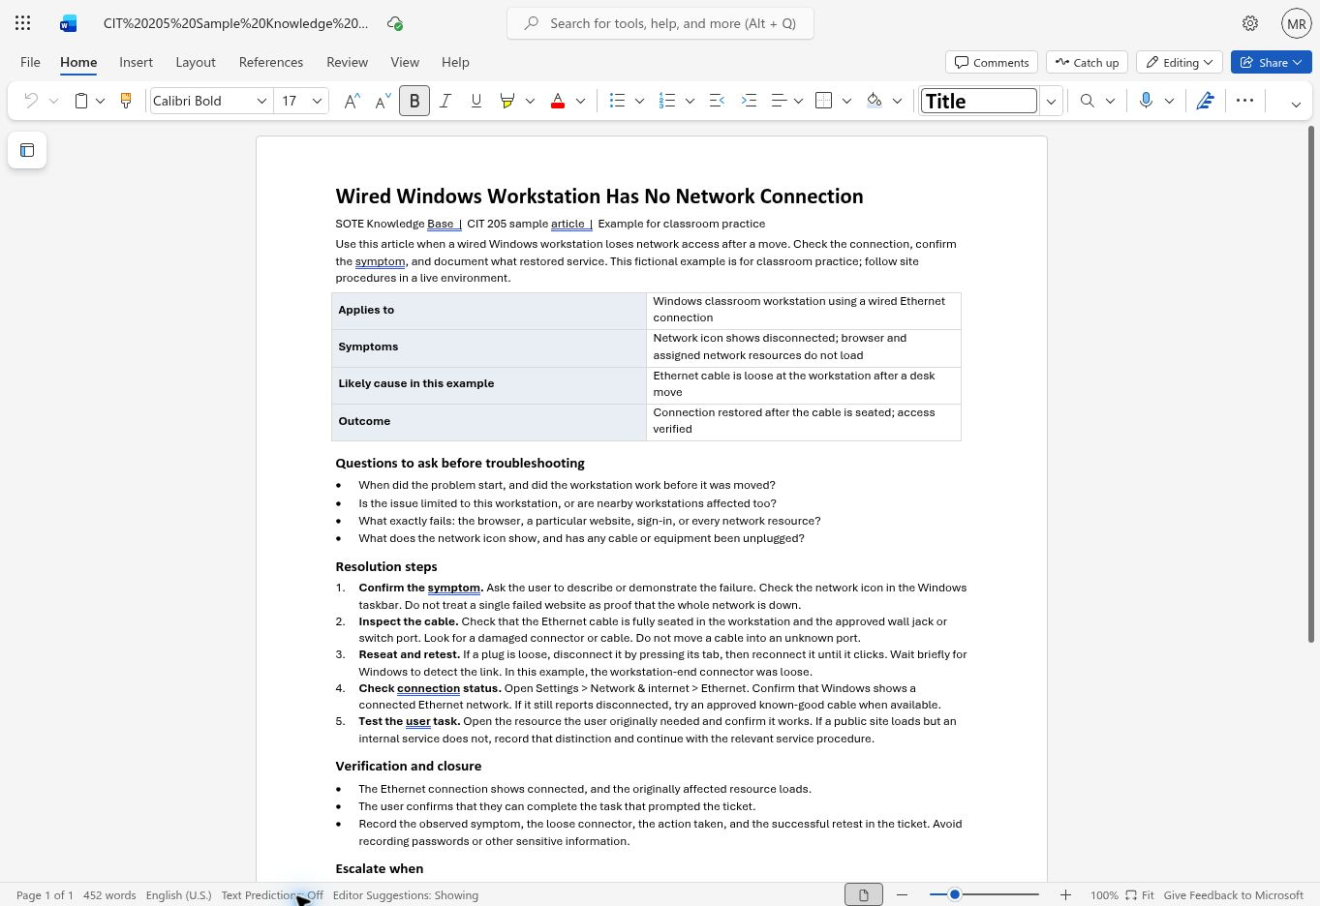
CIT-205 / PORTFOLIO PUBLICATION
Open Word and reuse your existing draft
Sign in to Microsoft 365 → Word.
Open your CIT-205 Knowledge Article draft/template.
Save a personal copy before changing a shared template.
Keep the editable .docx in a known course folder.
Actual application capture · October 11, 2026
Open Microsoft Word ↗
11
Notes:
SLIDE 11 | Professor Sneaker
DEMONSTRATE: This is a real Word for the web capture of the existing CIT-205 sample Knowledge Base Article. Do not claim it is desktop Word. Demonstrate Word from Microsoft 365 and open the student’s existing draft, not a blank invention. Preserve any shared original via Save a copy. Instructor sample: Wired Windows Workstation Has No Network Connection. Desktop ribbon/export labels may differ.
STUDENT ACTION: Sign in to Microsoft 365 → Word.; Open your CIT-205 Knowledge Article draft/template.; Save a personal copy before changing a shared template.; Keep the editable .docx in a known course folder.
CHECKPOINT: Confirm the student can reproduce this step before proceeding.
RESOURCE: https://word.cloud.microsoft/
SCREENSHOT: Real browser/application capture on October 11, 2026; not a mockup.

Slide 12
CIT-205 / PORTFOLIO PUBLICATION
Title, metadata and scope come first
Title: Wired Windows Workstation Has No Network Connection.
Author • date • version • lab environment.
Purpose: restore approved wired connectivity.
Symptoms: link/network access unavailable.
Prerequisites + safety: approved lab; no credentials.
Actual application capture · October 11, 2026
12
Notes:
SLIDE 12 | Professor Sneaker
DEMONSTRATE: Students replace sample metadata with truthful details. Use a fictional or approved lab machine. Explain applies-to scope, purpose, symptoms, access requirements and safety precautions. Stop if the issue requires production changes or elevated authority; do not publish infrastructure details. Put no real passwords or private addresses in the demonstration.
STUDENT ACTION: Title: Wired Windows Workstation Has No Network Connection.; Author • date • version • lab environment.; Purpose: restore approved wired connectivity.; Symptoms: link/network access unavailable.; Prerequisites + safety: approved lab; no credentials.
CHECKPOINT: Confirm the student can reproduce this step before proceeding.
RESOURCE: https://courses.ccac.edu/ultra/courses/_227360_1/document/_21358910_1?view=content
SCREENSHOT: Real browser/application capture on October 11, 2026; not a mockup.

Slide 13
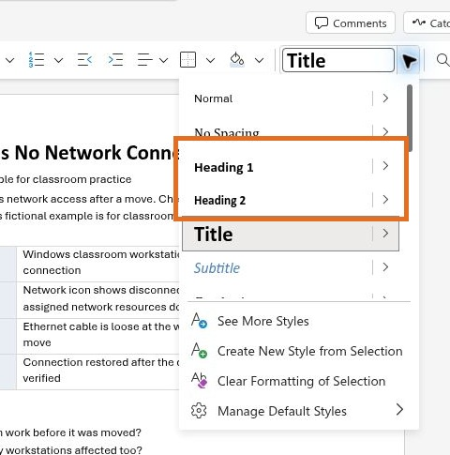
CIT-205 / PORTFOLIO PUBLICATION
Use Word heading styles
Select a section title → Home → Styles.
Choose Heading 1 for major sections.
Use Heading 2 for subsections.
Do not simulate headings with bold text alone.
Actual application capture · October 11, 2026
13
Notes:
SLIDE 13 | Professor Sneaker
DEMONSTRATE: The screenshot is the real current Word Styles menu. Demonstrate selecting Purpose then Heading 1, and a subsection then Heading 2 in a personal copy. Show how headings support navigation and accessibility. Students apply styles to purpose, symptoms, procedure, validation and escalation, then save.
STUDENT ACTION: Select a section title → Home → Styles.; Choose Heading 1 for major sections.; Use Heading 2 for subsections.; Do not simulate headings with bold text alone.
CHECKPOINT: Confirm the student can reproduce this step before proceeding.
RESOURCE: https://courses.ccac.edu/ultra/courses/_227360_1/document/_21358910_1?view=content
SCREENSHOT: Real browser/application capture on October 11, 2026; not a mockup.

Slide 14
CIT-205 / PORTFOLIO PUBLICATION
Write steps a technician can follow
Home → Numbering: one action per step.
1. Confirm the approved cable and port.
2. Inspect link indicators and network status.
3. Test an approved lab destination.
4. Record results; stop/escalate at the boundary.
14
Notes:
SLIDE 14 | Professor Sneaker
DEMONSTRATE: Demonstrate the actual numbered-list control in Word. Use an existing approved lab procedure rather than changing production settings. Each step should specify the action and what to observe. Avoid vague “fix the network” instructions and blind resets. Have a partner read the procedure without verbal clarification.
STUDENT ACTION: Home → Numbering: one action per step.; 1. Confirm the approved cable and port.; 2. Inspect link indicators and network status.; 3. Test an approved lab destination.; 4. Record results; stop/escalate at the boundary.
CHECKPOINT: Confirm the student can reproduce this step before proceeding.
RESOURCE: https://courses.ccac.edu/ultra/courses/_227360_1/document/_21358910_1?view=content
SCREENSHOT: No application screenshot claimed.

Slide 15
CIT-205 / PORTFOLIO PUBLICATION
Compare expected and actual results
Insert → Table: Test | Expected | Actual | Decision.
Link light | On | Record observation | Pass/Hold.
Approved test | Reachable | Record result | Validate.
Do not write “works” without the evidence.
15
Notes:
SLIDE 15 | Professor Sneaker
DEMONSTRATE: In a personal Word copy, insert a simple four-column table. Add header labels and use plain text values. Mark a table header row where supported, avoid merged cells and allow readable wrapping. Record actual observations honestly. Use fictional sample values only when labeled. Explain that expected results must be defined before declaring success.
STUDENT ACTION: Insert → Table: Test | Expected | Actual | Decision.; Link light | On | Record observation | Pass/Hold.; Approved test | Reachable | Record result | Validate.; Do not write “works” without the evidence.
CHECKPOINT: Confirm the student can reproduce this step before proceeding.
RESOURCE: https://courses.ccac.edu/ultra/courses/_227360_1/document/_21358910_1?view=content
SCREENSHOT: No application screenshot claimed.

Slide 16
CIT-205 / PORTFOLIO PUBLICATION
Validate, escalate, proofread and save
Retest the original symptom; record the outcome.
Escalate when unsafe, unauthorized or unresolved.
Review → Editor; check spelling and clarity.
Review → Check Accessibility; fix findings.
Save the editable Word source before export.
16
Notes:
SLIDE 16 | Professor Sneaker
DEMONSTRATE: Demonstrate review tools in the available Word application; labels can vary. Verify headings, table headers, alt text and readable contrast. Remove comments and tracked changes from the public version where appropriate. Word for the web autosaves; confirm the saved indicator and download/save the editable .docx if needed. Never export first and assume the article is complete.
STUDENT ACTION: Retest the original symptom; record the outcome.; Escalate when unsafe, unauthorized or unresolved.; Review → Editor; check spelling and clarity.; Review → Check Accessibility; fix findings.; Save the editable Word source before export.
CHECKPOINT: Confirm the student can reproduce this step before proceeding.
RESOURCE: https://courses.ccac.edu/ultra/courses/_227360_1/document/_21358910_1?view=content
SCREENSHOT: No application screenshot claimed.

Slide 17
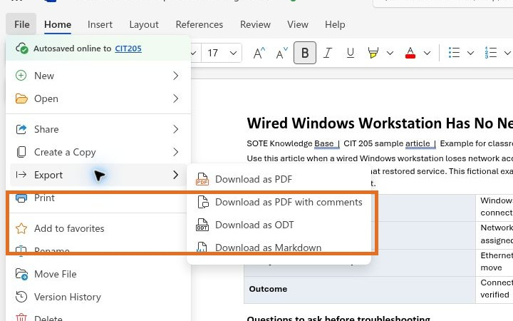
CIT-205 / PORTFOLIO PUBLICATION
Export Word to PDF
Word for the web: File → Export → Download as PDF.
Desktop Word: File → Save As/Export → PDF.
Name it knowledge-base-article.pdf.
Save to your known CIT-205 portfolio folder.
Actual application capture · October 11, 2026
17
Notes:
SLIDE 17 | Professor Sneaker
DEMONSTRATE: This screenshot is the actual current Word for the web File → Export menu. Open the completed article, choose Download as PDF, wait for the ready prompt, then Download. The PDF may go to browser Downloads; move/rename it professionally in the known course folder. Do not claim a desktop Save As screenshot is shown. Word remains the authoring source.
STUDENT ACTION: Word for the web: File → Export → Download as PDF.; Desktop Word: File → Save As/Export → PDF.; Name it knowledge-base-article.pdf.; Save to your known CIT-205 portfolio folder.
CHECKPOINT: Confirm the student can reproduce this step before proceeding.
RESOURCE: https://courses.ccac.edu/ultra/courses/_227360_1/document/_21358910_1?view=content
SCREENSHOT: Real browser/application capture on October 11, 2026; not a mockup.

Slide 18
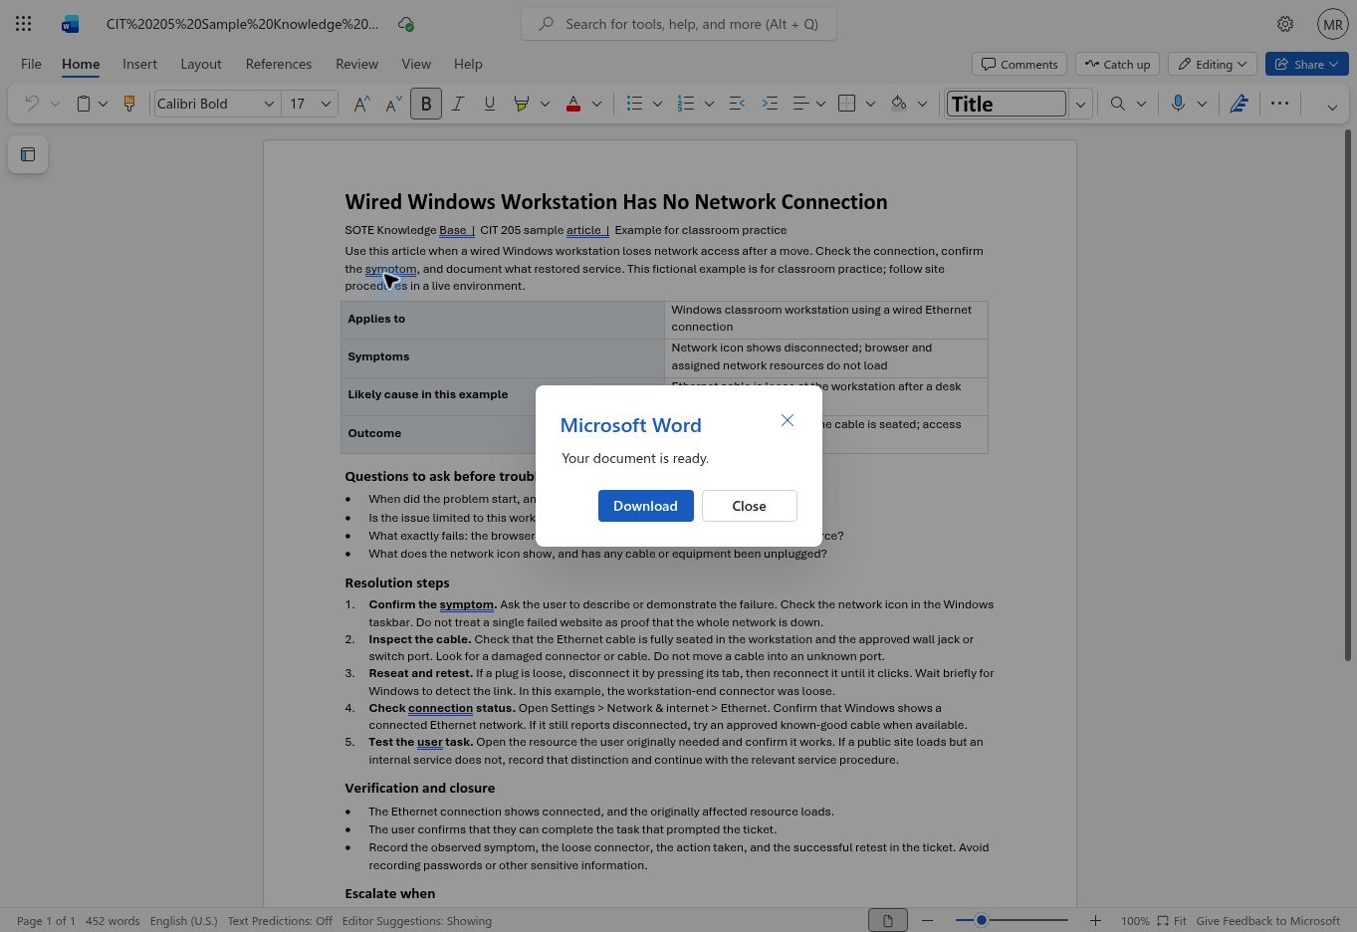
CIT-205 / PORTFOLIO PUBLICATION
Open the PDF before publishing
Download complete → open the saved PDF.
Check every page, table and page break.
Confirm selectable, readable text and no comments.
Inspect for sensitive information inside the file.
Redact in Word, export again, then recheck.
Actual application capture · October 11, 2026
18
Notes:
SLIDE 18 | Professor Sneaker
DEMONSTRATE: The real Word export produced a PDF during preparation. Demonstrate opening it in the PDF viewer. Zoom to normal reading size, check all pages and table boundaries. Redaction must remove the content, not just cover it with a shape. Never upload a private ticket, password, token, student record or sensitive screenshot. Retain .docx privately and publish only reviewed PDF evidence.
STUDENT ACTION: Download complete → open the saved PDF.; Check every page, table and page break.; Confirm selectable, readable text and no comments.; Inspect for sensitive information inside the file.; Redact in Word, export again, then recheck.
CHECKPOINT: Confirm the student can reproduce this step before proceeding.
RESOURCE: https://courses.ccac.edu/ultra/courses/_227360_1/document/_21358910_1?view=content
SCREENSHOT: Real browser/application capture on October 11, 2026; not a mockup.

Slide 19
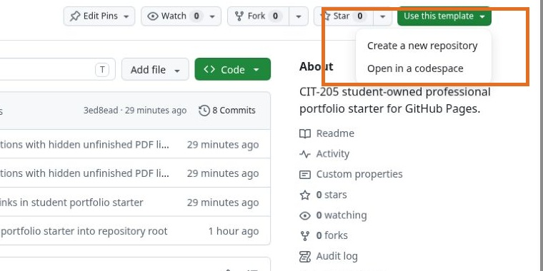
CIT-205 / PORTFOLIO PUBLICATION
Use the actual GitHub template
Sign in → open cit205-portfolio-template.
Use this template → Create a new repository.
Do not fork the classroom for this portfolio.
Already started? Preserve your existing repository.
Actual application capture · October 11, 2026
Use this template ↗
19
Notes:
SLIDE 19 | Professor Sneaker
DEMONSTRATE: Show the real current template repository/menu. Students click Use this template and Create a new repository, or the direct link. The screenshot is not a mockup. A GitHub account owns the portfolio independently of the class. If students already have a username.github.io site, do not overwrite their unrelated work; review how to integrate the starter safely.
STUDENT ACTION: Sign in → open cit205-portfolio-template.; Use this template → Create a new repository.; Do not fork the classroom for this portfolio.; Already started? Preserve your existing repository.
CHECKPOINT: Confirm the student can reproduce this step before proceeding.
RESOURCE: https://github.com/student-operated-technology-ecosystem/cit205-portfolio-template/generate
SCREENSHOT: Real browser/application capture on October 11, 2026; not a mockup.

Slide 20
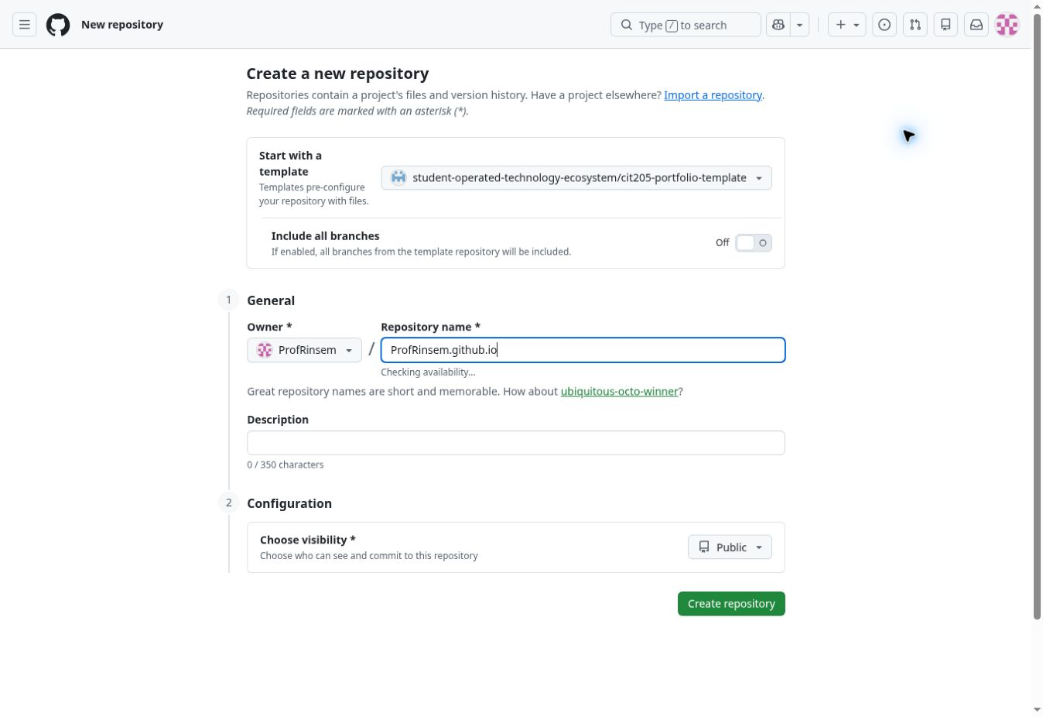
CIT-205 / PORTFOLIO PUBLICATION
Create your student-owned repository
Owner: YOUR personal account.
Name: USERNAME.github.io, exact GitHub username.
Visibility: Public. Leave all branches unchecked.
Create repository; starter files appear automatically.
Actual application capture · October 11, 2026
Open creation form ↗
20
Notes:
SLIDE 20 | Professor Sneaker
DEMONSTRATE: This real form capture shows the instructor account ProfRinsem and demonstration name ProfRinsem.github.io. Students must substitute their own exact account and username; never choose the SOTE organization. No demonstration repository was created during this screenshot capture. Explain that repository name and URL must agree, e.g. alexmorgan → alexmorgan.github.io.
STUDENT ACTION: Owner: YOUR personal account.; Name: USERNAME.github.io, exact GitHub username.; Visibility: Public. Leave all branches unchecked.; Create repository; starter files appear automatically.
CHECKPOINT: Confirm the student can reproduce this step before proceeding.
RESOURCE: https://github.com/student-operated-technology-ecosystem/cit205-portfolio-template/generate
SCREENSHOT: Real browser/application capture on October 11, 2026; not a mockup.

Slide 21
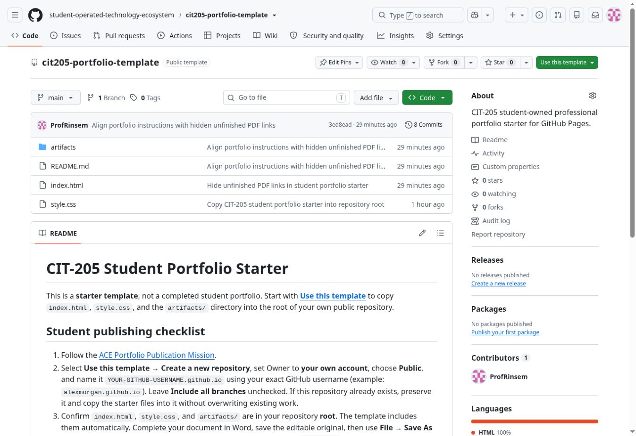
CIT-205 / PORTFOLIO PUBLICATION
Find the files you will actually edit
index.html: identity, sections and artifact links.
style.css: existing responsive appearance.
artifacts/: PDFs and filename guide.
Do not rebuild or delete the starter structure.
Actual application capture · October 11, 2026
Inspect template files ↗
21
Notes:
SLIDE 21 | Professor Sneaker
DEMONSTRATE: Show the actual repository root. The student starter uses direct PDF links in index.html, not Alex’s additional individual HTML artifact pages. Read artifacts/README.md for supported filenames. Do not teach students to invent a conflicting pages directory. Keep style.css and the root index.html intact unless there is a verified need.
STUDENT ACTION: index.html: identity, sections and artifact links.; style.css: existing responsive appearance.; artifacts/: PDFs and filename guide.; Do not rebuild or delete the starter structure.
CHECKPOINT: Confirm the student can reproduce this step before proceeding.
RESOURCE: https://github.com/student-operated-technology-ecosystem/cit205-portfolio-template
SCREENSHOT: Real browser/application capture on October 11, 2026; not a mockup.

Slide 22
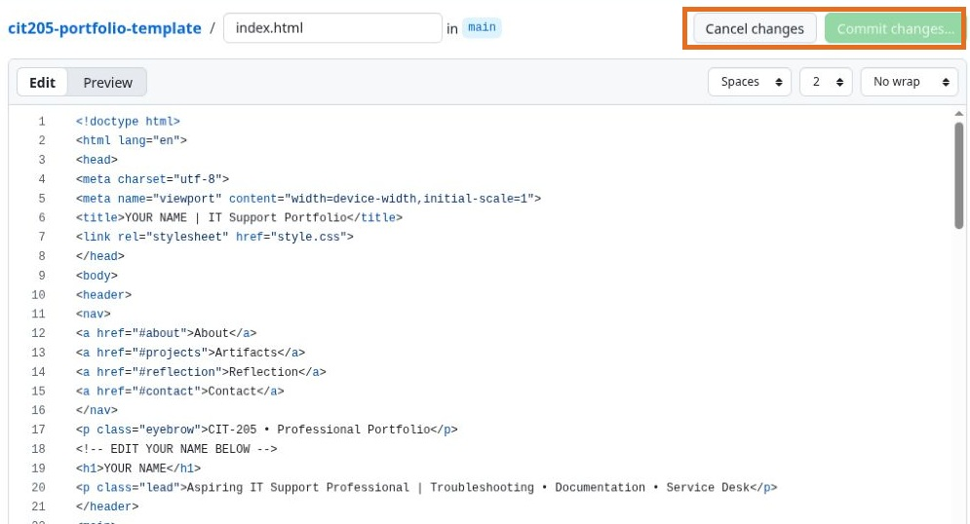
CIT-205 / PORTFOLIO PUBLICATION
Personalize index.html
Open index.html → pencil / Edit this file.
Replace YOUR NAME, intro and placeholder profile links.
Describe context, your action, evidence and result.
Keep incomplete PDF links hidden.
Actual application capture · October 11, 2026
22
Notes:
SLIDE 22 | Professor Sneaker
DEMONSTRATE: In the student’s own repository, open index.html and use the pencil. Replace title/name and introduction, reflective content and placeholder GitHub/LinkedIn URLs. Do not publish a made-up résumé or generic LinkedIn profile as evidence. Demonstrate one small edit, not a full website rewrite. Keep valid HTML quotes and closing tags. The current starter is expanded into readable lines with EDIT YOUR NAME BELOW and EDIT YOUR INTRODUCTION BELOW comments. Use those comments or editor Find to locate the exact text. Keep all HTML tags intact.
STUDENT ACTION: Open index.html → pencil / Edit this file.; Replace YOUR NAME, intro and placeholder profile links.; Describe context, your action, evidence and result.; Keep incomplete PDF links hidden.
CHECKPOINT: Confirm the student can reproduce this step before proceeding.
RESOURCE: https://courses.ccac.edu/ultra/courses/_227360_1/document/_21358910_1?view=content
SCREENSHOT: Real browser/application capture on October 11, 2026; not a mockup.

Slide 23
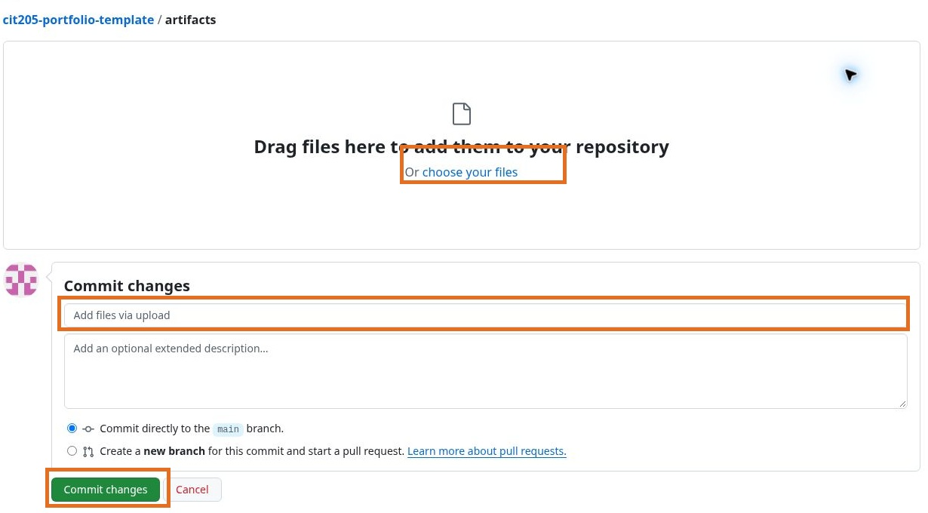
CIT-205 / PORTFOLIO PUBLICATION
Commit changes with a useful message
Commit changes → describe what changed.
Example: Personalize portfolio introduction.
Commit directly to main for this personal site.
Confirm the commit and reopen the saved file.
Actual application capture · October 11, 2026
23
Notes:
SLIDE 23 | Professor Sneaker
DEMONSTRATE: Explain that typing in the editor does not publish an uncommitted draft. In the student repository, Commit changes opens a message form; use a meaningful message, keep main as the target and confirm. Reopen file/history to verify the saved change. Never commit demonstration edits to the organization template. Screenshot shows upload commit form; homepage edit uses the same meaningful-message/main principle. No template edits were committed.
STUDENT ACTION: Commit changes → describe what changed.; Example: Personalize portfolio introduction.; Commit directly to main for this personal site.; Confirm the commit and reopen the saved file.
CHECKPOINT: Confirm the student can reproduce this step before proceeding.
RESOURCE: https://courses.ccac.edu/ultra/courses/_227360_1/document/_21358910_1?view=content
SCREENSHOT: Real browser/application capture on October 11, 2026; not a mockup.

Slide 24
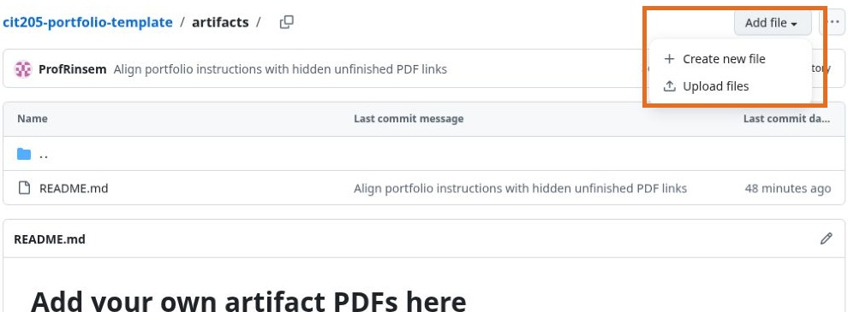
CIT-205 / PORTFOLIO PUBLICATION
Upload your first real PDF
Open artifacts/ → Add file → Upload files.
Select knowledge-base-article.pdf.
Verify the filename and location.
Commit: Add reviewed knowledge base PDF.
Actual application capture · October 11, 2026
24
Notes:
SLIDE 24 | Professor Sneaker
DEMONSTRATE: Show this click sequence live in a student-owned or authorized instructor demonstration repository. Do not upload private Word source by mistake. Confirm the upload is inside artifacts, not a second nested artifacts/artifacts directory. Student can use another approved artifact if it follows the existing filename guide. Confirm commit before linking.
STUDENT ACTION: Open artifacts/ → Add file → Upload files.; Select knowledge-base-article.pdf.; Verify the filename and location.; Commit: Add reviewed knowledge base PDF.
CHECKPOINT: Confirm the student can reproduce this step before proceeding.
RESOURCE: https://courses.ccac.edu/ultra/courses/_227360_1/document/_21358910_1?view=content
SCREENSHOT: Real browser/application capture on October 11, 2026; not a mockup.

Slide 25
CIT-205 / PORTFOLIO PUBLICATION
Make the matching artifact link visible
In index.html find Knowledge Base Article.
Remove hidden only after the PDF exists.
Keep href="artifacts/knowledge-base-article.pdf".
Commit: Link completed knowledge base evidence.
Test the live PDF after deployment.
Actual application capture · October 11, 2026
Open artifact filename guide ↗
25
Notes:
SLIDE 25 | Professor Sneaker
DEMONSTRATE: The current starter intentionally hides unfinished PDF links. Merely uploading does not reveal the KB link: remove the hidden attribute on its matching anchor. Do not remove hidden globally. Paths are relative to root index.html, so artifacts/knowledge-base-article.pdf is correct. Existing LinkedIn and reflection structure differs from PDF examples; use only truthful completed evidence.
STUDENT ACTION: In index.html find Knowledge Base Article.; Remove hidden only after the PDF exists.; Keep href="artifacts/knowledge-base-article.pdf".; Commit: Link completed knowledge base evidence.; Test the live PDF after deployment.
CHECKPOINT: Confirm the student can reproduce this step before proceeding.
RESOURCE: https://github.com/student-operated-technology-ecosystem/cit205-portfolio-template/blob/main/artifacts/README.md
SCREENSHOT: Real browser/application capture on October 11, 2026; not a mockup.

Slide 26
CIT-205 / PORTFOLIO PUBLICATION
A filename is part of the link
knowledge-base-article.pdf ≠ Knowledge-Base-Article.PDF
Keep lowercase names and hyphens.
Match folder, spelling, capitalization and extension.
No local C:\Users path; no Downloads path.
A relative URL points inside the published site.
26
Notes:
SLIDE 26 | Professor Sneaker
DEMONSTRATE: Show a deliberately described mismatch without committing a broken file. Ask a partner to compare href to the repository filename character by character. A file in artifacts/ requires artifacts/ in the link. Avoid spaces because they invite copying/encoding errors. Check that Windows did not hide or double the extension.
STUDENT ACTION: knowledge-base-article.pdf ≠ Knowledge-Base-Article.PDF; Keep lowercase names and hyphens.; Match folder, spelling, capitalization and extension.; No local C:\Users path; no Downloads path.; A relative URL points inside the published site.
CHECKPOINT: Confirm the student can reproduce this step before proceeding.
RESOURCE: https://courses.ccac.edu/ultra/courses/_227360_1/document/_21358910_1?view=content
SCREENSHOT: No application screenshot claimed.

Slide 27
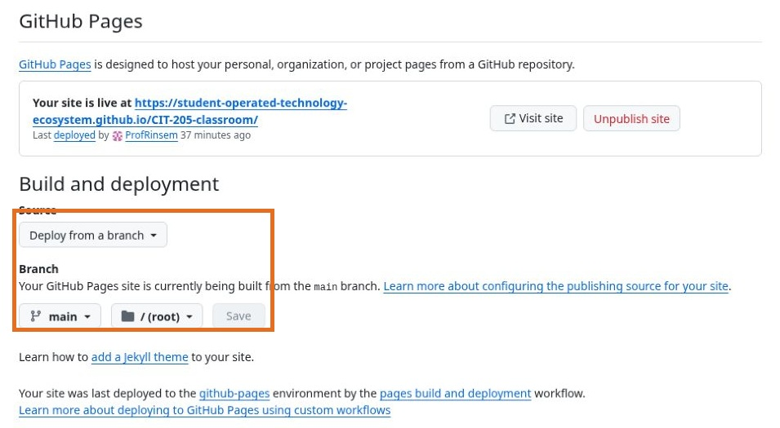
CIT-205 / PORTFOLIO PUBLICATION
Publish with GitHub Pages
Your repository → Settings → Pages.
Source: Deploy from a branch.
Branch: main. Folder: /(root).
Save; wait for successful deployment.
Actual application capture · October 11, 2026
GitHub Pages documentation ↗
27
Notes:
SLIDE 27 | Professor Sneaker
DEMONSTRATE: This real screenshot shows the classroom repository already live with the same branch settings; students configure THEIR personal repository, not the classroom. Save is disabled in this capture because settings are already saved. On the student site select source, main and root then Save. Pages may take several minutes. Do not press Unpublish or change the classroom settings.
STUDENT ACTION: Your repository → Settings → Pages.; Source: Deploy from a branch.; Branch: main. Folder: /(root).; Save; wait for successful deployment.
CHECKPOINT: Confirm the student can reproduce this step before proceeding.
RESOURCE: https://docs.github.com/en/pages/getting-started-with-github-pages/creating-a-github-pages-site
SCREENSHOT: Real browser/application capture on October 11, 2026; not a mockup.

Slide 28
CIT-205 / PORTFOLIO PUBLICATION
Know which URL you are testing
Repository: github.com/USERNAME/USERNAME.github.io
Website: https://USERNAME.github.io/
PDF: https://USERNAME.github.io/artifacts/knowledge-base-article.pdf
The live website is not GitHub’s HTML code view.
28
Notes:
SLIDE 28 | Professor Sneaker
DEMONSTRATE: Ask students to paste all three URLs into a private window or signed-out browser. The website should render professionally, not display the index.html source. The PDF should open/download a real readable file. Never submit a Settings page URL or local filesystem path. The Alex example uses a project subpath; student username sites use the domain root.
STUDENT ACTION: Repository: github.com/USERNAME/USERNAME.github.io; Website: https://USERNAME.github.io/; PDF: https://USERNAME.github.io/artifacts/knowledge-base-article.pdf; The live website is not GitHub’s HTML code view.
CHECKPOINT: Confirm the student can reproduce this step before proceeding.
RESOURCE: https://courses.ccac.edu/ultra/courses/_227360_1/document/_21358910_1?view=content
SCREENSHOT: No application screenshot claimed.

Slide 29
CIT-205 / PORTFOLIO PUBLICATION
Future commits automatically republish
Commit to main → Pages builds → deployment succeeds.
Open the live URL after the successful run.
Refresh or use a private window for a stale page.
A queued/failed build is not a published change.
Actual application capture · October 11, 2026
View successful classroom deployment ↗
29
Notes:
SLIDE 29 | Professor Sneaker
DEMONSTRATE: The classroom’s main/root Pages settings and latest successful workflow were verified on October 11. Demonstrate Actions or the Pages deployment link, check green success and current commit, then visit the website. Students’ future main commits republish with this configuration. If a build fails, read the failure before changing files randomly. Do not promise instantaneous publishing.
STUDENT ACTION: Commit to main → Pages builds → deployment succeeds.; Open the live URL after the successful run.; Refresh or use a private window for a stale page.; A queued/failed build is not a published change.
CHECKPOINT: Confirm the student can reproduce this step before proceeding.
RESOURCE: https://github.com/student-operated-technology-ecosystem/CIT-205-classroom/actions/runs/38149597827
SCREENSHOT: Real browser/application capture on October 11, 2026; not a mockup.

Slide 30
CIT-205 / PORTFOLIO PUBLICATION
Verify desktop and mobile
Open the live site on desktop and your phone.
Read the introduction; test navigation.
Open at least one real redacted PDF, signed out.
No horizontal scrolling, tiny text or overlapping links.
Ask a partner to reproduce the result.
Actual application capture · October 11, 2026
Open live verification example ↗
30
Notes:
SLIDE 30 | Professor Sneaker
DEMONSTRATE: The screenshot shows verified desktop rendering; it is not a mobile capture. Instructor should perform a live phone test in class. Students verify their own actual mobile layout and artifact opening. Use another device or responsive browser tools when available. A repository inspection alone does not establish a functioning public website.
STUDENT ACTION: Open the live site on desktop and your phone.; Read the introduction; test navigation.; Open at least one real redacted PDF, signed out.; No horizontal scrolling, tiny text or overlapping links.; Ask a partner to reproduce the result.
CHECKPOINT: Confirm the student can reproduce this step before proceeding.
RESOURCE: https://student-operated-technology-ecosystem.github.io/CIT-205-classroom/examples/exemplary-portfolio/
SCREENSHOT: Real browser/application capture on October 11, 2026; not a mockup.

Slide 31
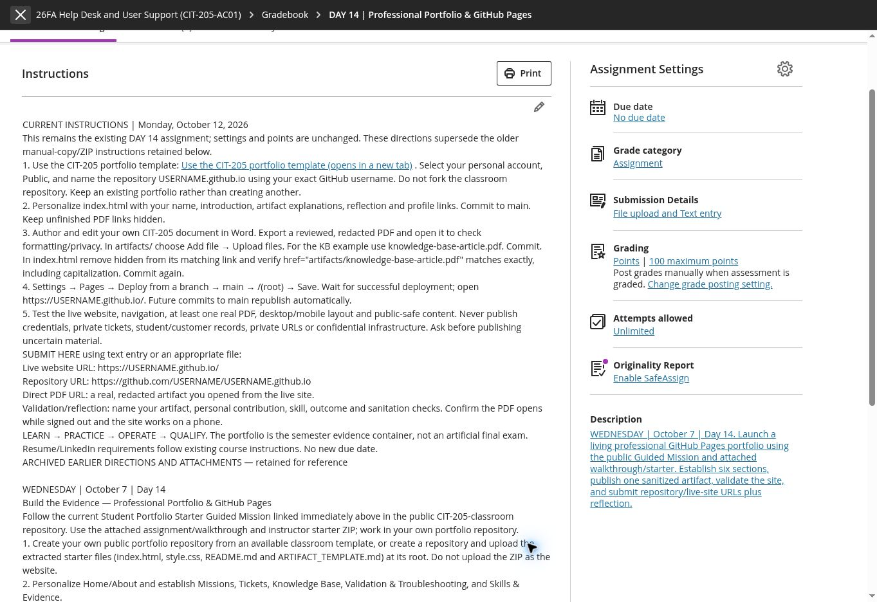
CIT-205 / PORTFOLIO PUBLICATION
Submit in the existing Blackboard assignment
Open the existing DAY 14 portfolio publication assignment.
Submit live website URL + repository URL.
Include direct PDF URL + brief validation/reflection.
Confirm a real, redacted PDF opens successfully.
Use Submit; verify Blackboard’s confirmation.
Actual application capture · October 11, 2026
Open existing submission assignment ↗
31
Notes:
SLIDE 31 | Professor Sneaker
DEMONSTRATE: This is the existing 100-point assignment, no due date, not a newly created assessment. The current instructions supersede archived manual-copy/ZIP directions; old attachments remain preserved. Student text: Live website; Repository; PDF; I tested desktop/phone and signed-out access; here is my contribution/result/redaction. Show the student submission workflow live without creating an instructor attempt or altering submissions.
STUDENT ACTION: Open the existing DAY 14 portfolio publication assignment.; Submit live website URL + repository URL.; Include direct PDF URL + brief validation/reflection.; Confirm a real, redacted PDF opens successfully.; Use Submit; verify Blackboard’s confirmation.
CHECKPOINT: Confirm the student can reproduce this step before proceeding.
RESOURCE: https://courses.ccac.edu/ultra/courses/_227360_1/assessment/test/_21349174_1?gradeitemView=details
SCREENSHOT: Real browser/application capture on October 11, 2026; not a mockup.

Slide 32
CIT-205 / PORTFOLIO PUBLICATION
Troubleshoot publication failures
Code view? Use the github.io URL.
404 homepage? Check exact name + root index.html + Pages.
PDF 404? Check artifacts/, filename, case and commit.
Old version? Check successful deployment; refresh.
Sensitive content? Stop publication and notify instructor.
32
Notes:
SLIDE 32 | Professor Sneaker
DEMONSTRATE: Use qualification as diagnosis, not blame. For missing index.html ensure it is at root and lowercase. For uncommitted changes save the commit. For wrong folder match the relative href. For stale Pages check the deployment SHA and browser cache. If sensitive content was published, merely deleting a file may leave git history; stop sharing and ask the instructor to handle removal/credential rotation through approved processes.
STUDENT ACTION: Code view? Use the github.io URL.; 404 homepage? Check exact name + root index.html + Pages.; PDF 404? Check artifacts/, filename, case and commit.; Old version? Check successful deployment; refresh.; Sensitive content? Stop publication and notify instructor.
CHECKPOINT: Confirm the student can reproduce this step before proceeding.
RESOURCE: https://courses.ccac.edu/ultra/courses/_227360_1/document/_21358910_1?view=content
SCREENSHOT: No application screenshot claimed.

Slide 33
CIT-205 / PORTFOLIO PUBLICATION
Qualify your professional portfolio
□ Personal public repository and truthful homepage.
□ Reviewed Word source saved privately.
□ Real redacted PDF opens from the live site.
□ Desktop + phone navigation tested.
□ Main/root Pages deployment successful.
□ Live URL + repo URL + PDF URL + reflection submitted.
Return to the existing assignment ↗
33
Notes:
SLIDE 33 | Professor Sneaker
DEMONSTRATE: Have partners check each item, then students submit to the existing assignment and verify confirmation. Quality is safe, working evidence, not a finished-semester claim. If time runs short, use optional independent work on the same existing assignment; no new due date is introduced.
STUDENT ACTION: □ Personal public repository and truthful homepage.; □ Reviewed Word source saved privately.; □ Real redacted PDF opens from the live site.; □ Desktop + phone navigation tested.; □ Main/root Pages deployment successful.; □ Live URL + repo URL + PDF URL + reflection submitted.
CHECKPOINT: Confirm the student can reproduce this step before proceeding.
RESOURCE: https://courses.ccac.edu/ultra/courses/_227360_1/assessment/test/_21349174_1?gradeitemView=details
SCREENSHOT: No application screenshot claimed.

Slide 34
CIT-205 / PORTFOLIO PUBLICATION
Your next artifact belongs here too
Reuse the portfolio throughout CIT.
Add only completed, reviewed, authorized evidence.
Keep meaningful commits and revise after feedback.
The showcase is optional and separately reviewed.
View the SOTE portfolio showcase ↗
34
Notes:
SLIDE 34 | Professor Sneaker
DEMONSTRATE: Close with ownership and continuity. Students keep their own repository after the course. Future artifacts improve evidence quality and résumé claims. The SOTE directory is voluntary with instructor review and consent; Blackboard submission is the course requirement. Direct students back to the Monday lesson for the guides and checklist.
STUDENT ACTION: Reuse the portfolio throughout CIT.; Add only completed, reviewed, authorized evidence.; Keep meaningful commits and revise after feedback.; The showcase is optional and separately reviewed.
CHECKPOINT: Confirm the student can reproduce this step before proceeding.
RESOURCE: https://professorsneaker.com/portfolios.html
SCREENSHOT: No application screenshot claimed.

