Slide 1
SOTE / CIT-205
Incident reporting under pressure
CIT-205 · Professor Sneaker
LEARN → PRACTICE → OPERATE → QUALIFY
Three F1 cases. One evidence standard.
1
Notes:
DEMONSTRATE / DISCUSS: Open the existing Day 15 clock-in. Ask what a responsible technician does before the cause is known. Today students choose one case for the existing Post-Incident Review. No added points or due date.
STUDENT ACTION: CIT-205 · Professor Sneaker LEARN → PRACTICE → OPERATE → QUALIFY Three F1 cases. One evidence standard.
SOURCES: SOTE Field Guide v1.0, pp.60–74, 77–84, 108–113, 130–133
VIDEO: No embedded video on this slide.

Slide 2
SOTE / CIT-205
The service and its expected state
A: cars retain usable power during wet formation laps.
B: lap timing and qualifying power settings work consistently.
C: driver and engineer exchange intelligible messages.
2
Notes:
DEMONSTRATE / DISCUSS: Ask students to define the service before naming a component. A failure has meaning relative to expected behavior. Compare a shared racing service with a single team communication channel.
STUDENT ACTION: A: cars retain usable power during wet formation laps. B: lap timing and qualifying power settings work consistently. C: driver and engineer exchange intelligible messages.
SOURCES: SOTE Field Guide v1.0, pp.60–74, 77–84, 108–113, 130–133
VIDEO: No embedded video on this slide.

Slide 3
SOTE / CIT-205
The SOTE analysis lens
OBSERVE · DEFINE · INVESTIGATE · DECIDE
ACT · VALIDATE · DOCUMENT
Revisit questions as the evidence changes.
3
Notes:
DEMONSTRATE / DISCUSS: Field Guide pp.60–69. This is an analysis lens, not the prescribed personal troubleshooting methodology. Ask for an observation, a hypothesis and a justified next decision. Preserve uncertainty rather than force certainty.
STUDENT ACTION: OBSERVE · DEFINE · INVESTIGATE · DECIDE ACT · VALIDATE · DOCUMENT Revisit questions as the evidence changes.
SOURCES: SOTE Field Guide v1.0, pp.60–74, 77–84, 108–113, 130–133
VIDEO: No embedded video on this slide.

Slide 4
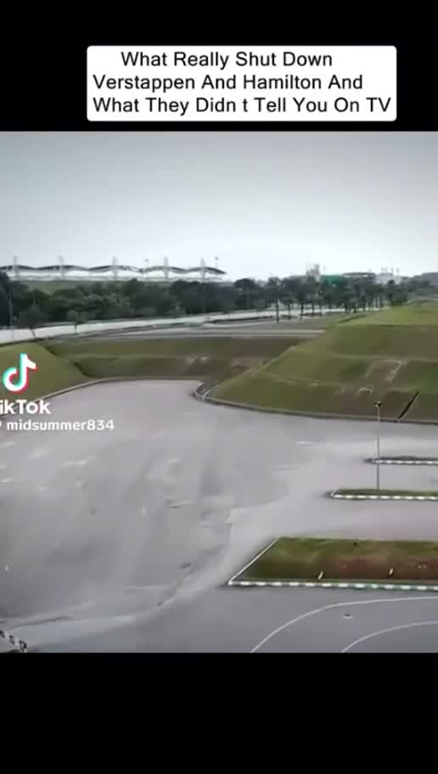
SOTE / CIT-205
Case A: the environment changes
October 4 · Sepang wet formation laps
Several cars lose usable power.
What scope and evidence would you establish?
Classroom clip · play, pause, discuss
Open source / fallback ↗
4
Notes:
DEMONSTRATE / DISCUSS: Play the first existing Sepang segment. Pause before explaining the cause. Students record changed conditions and separate the symptom from a diagnosis. The event was officially titled Bahrain GP in Malaysia at Sepang.
STUDENT ACTION: October 4 · Sepang wet formation laps Several cars lose usable power. What scope and evidence would you establish?
SOURCES: https://www.fia.com/news/fia-concludes-investigation-bahrain-gp-malaysia-formation-lap-software-bug
VIDEO: Existing supplied classroom media. Student/public edition uses source links. Instructor edition embeds this media.

Slide 5
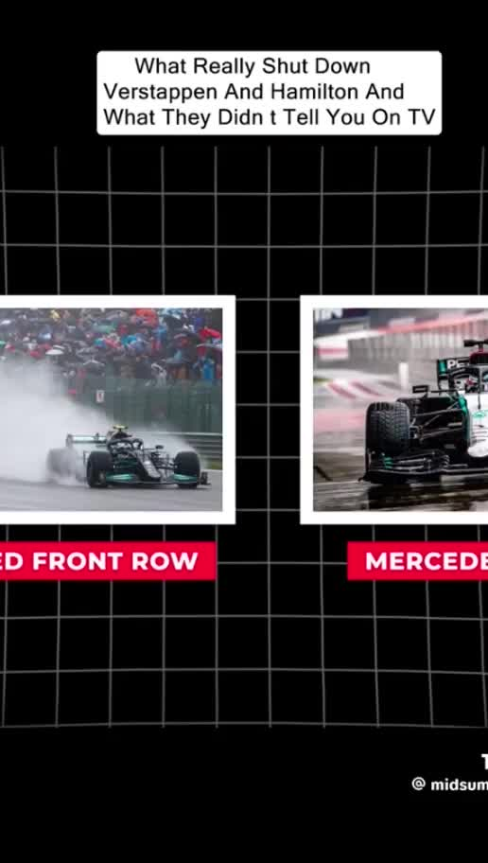
SOTE / CIT-205
Case A: reports become evidence
Which cars and sectors are affected?
What do RPM and energy-management records show?
What authority controls the shared configuration?
Classroom clip · play, pause, discuss
Open source / fallback ↗
5
Notes:
DEMONSTRATE / DISCUSS: Play the second existing Sepang segment. Collect KNOW / SUSPECT / NEED TO KNOW. Students request telemetry, timestamps, configuration versions and affected-versus-unaffected comparisons. A user report is useful evidence with a source and scope.
STUDENT ACTION: Which cars and sectors are affected? What do RPM and energy-management records show? What authority controls the shared configuration?
SOURCES: https://www.fia.com/news/fia-concludes-investigation-bahrain-gp-malaysia-formation-lap-software-bug
VIDEO: Existing supplied classroom media. Student/public edition uses source links. Instructor edition embeds this media.

Slide 6
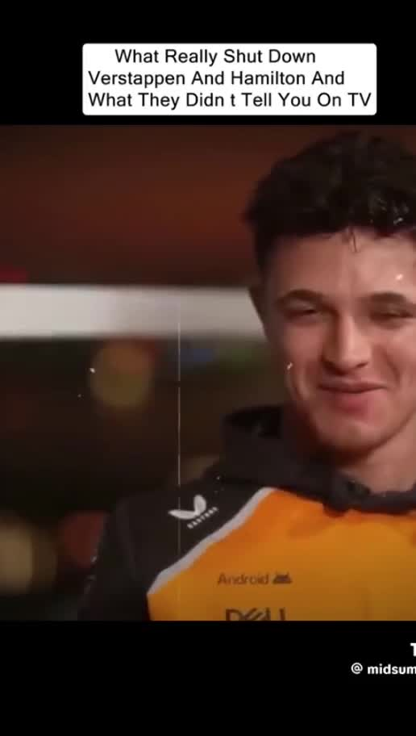
SOTE / CIT-205
Case A: the change decision
The start procedure is suspended.
Compare the risk of changing with the risk of waiting.
Name approval, safe checks, rollback and acceptance criteria.
Classroom clip · play, pause, discuss
Open source / fallback ↗
6
Notes:
DEMONSTRATE / DISCUSS: Play the diagnosis segment, then stop. Ask whether to authorize an emergency configuration change. Do not reveal the response until students state a defensible decision. Emergency change still needs authority and validation.
STUDENT ACTION: The start procedure is suspended. Compare the risk of changing with the risk of waiting. Name approval, safe checks, rollback and acceptance criteria.
SOURCES: https://www.fia.com/news/fia-concludes-investigation-bahrain-gp-malaysia-formation-lap-software-bug
VIDEO: Existing supplied classroom media. Student/public edition uses source links. Instructor edition embeds this media.

Slide 7
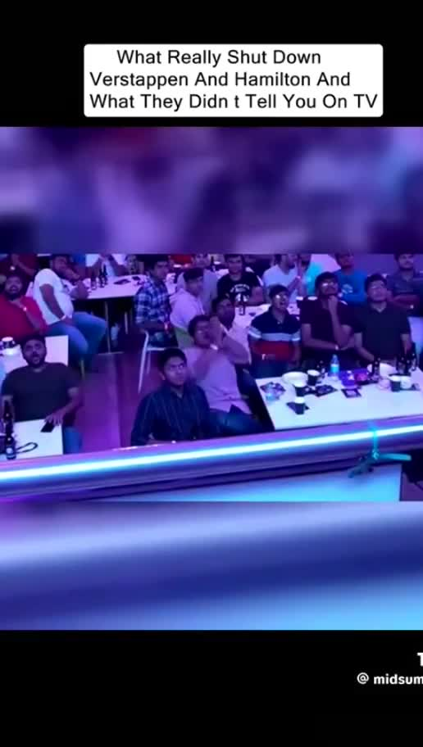
SOTE / CIT-205
Case A: confirmed finding
Low RPM plus a 250 kW sector power reduction
produced excessive power loss that could not recover there.
The FIA released an updated configuration.
Classroom clip · play, pause, discuss
Open source / fallback ↗
7
Notes:
DEMONSTRATE / DISCUSS: The FIA October 8 review supports this bounded finding. Avoid inventing a failing line of code, vendor blame or a universal hardware defect. Play the recovery segment after the class decision.
STUDENT ACTION: Low RPM plus a 250 kW sector power reduction produced excessive power loss that could not recover there. The FIA released an updated configuration.
SOURCES: https://www.fia.com/news/fia-concludes-investigation-bahrain-gp-malaysia-formation-lap-software-bug
VIDEO: Existing supplied classroom media. Student/public edition uses source links. Instructor edition embeds this media.

Slide 8
SOTE / CIT-205
Case A: the response timeline
15:45 suspend start · 15:50 revised configuration
16:03 guidance · 16:20 integration complete
16:22 restart signal · 16:33 cars leave pit lane
Open source / fallback ↗
8
Notes:
DEMONSTRATE / DISCUSS: FIA-published clock times, reproduced as given. Keep the clock basis consistent and label it event time. Calculate elapsed times from suspension. Configuration release, integration and usable service restoration are different milestones.
STUDENT ACTION: 15:45 suspend start · 15:50 revised configuration 16:03 guidance · 16:20 integration complete 16:22 restart signal · 16:33 cars leave pit lane
SOURCES: https://www.fia.com/news/fia-concludes-investigation-bahrain-gp-malaysia-formation-lap-software-bug
VIDEO: No embedded video on this slide.

Slide 9
SOTE / CIT-205
Case A: testing and prevention
The original package had simulation and FP1 testing.
The incident exposed a missed operating condition.
The FIA planned further wet-weather updates and validation.
Open source / fallback ↗
9
Notes:
DEMONSTRATE / DISCUSS: Correct earlier claims that the software had never been tested. Prior testing did not guarantee coverage of this combined condition. Ask what a low-RPM wet-sector test should observe and how independent review could challenge assumptions.
STUDENT ACTION: The original package had simulation and FP1 testing. The incident exposed a missed operating condition. The FIA planned further wet-weather updates and validation.
SOURCES: https://www.fia.com/news/fia-concludes-investigation-bahrain-gp-malaysia-formation-lap-software-bug
VIDEO: No embedded video on this slide.

Slide 10
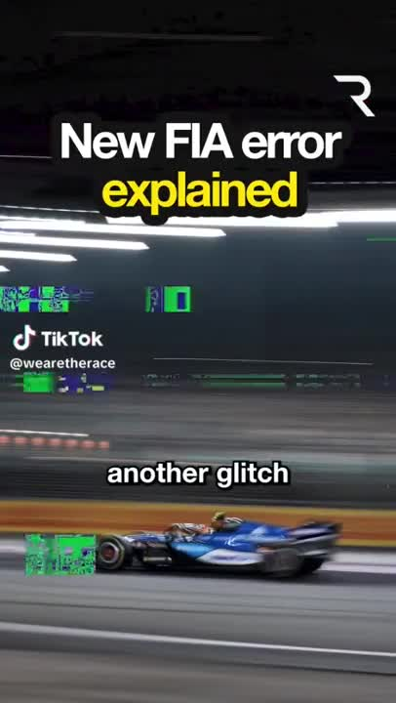
SOTE / CIT-205
Case B: restart state
October 9 · Singapore Sprint Qualifying
Watch the supplied commentary.
Identify the claim and the evidence needed to verify it.
Classroom clip · play, pause, discuss
Open source / fallback ↗
10
Notes:
DEMONSTRATE / DISCUSS: The supplied 74.605-second @wearetherace commentary concerns Overtake Mode after the SQ1 red flag. Play 0:00–0:33 then pause for expected versus actual state. Continue to 1:00 and discuss unequal run timing. The commentator’s conclusions are reporting, not a technical log. The complete clip remains intact.
STUDENT ACTION: October 9 · Singapore Sprint Qualifying Watch the supplied commentary. Identify the claim and the evidence needed to verify it.
SOURCES: https://www.the-race.com/formula-1/fia-error-left-some-drivers-without-full-power-in-sprint-qualifying/
VIDEO: Existing supplied classroom media. Student/public edition uses source links. Instructor edition embeds this media.

Slide 11
SOTE / CIT-205
Case B: two concurrent incidents
Timing: some SQ1 laps did not register initially.
Race Control: Overtake Mode remained unavailable after restart.
A 27-second activation created uneven availability.
Open source / fallback ↗
11
Notes:
DEMONSTRATE / DISCUSS: RACER quotes the FIA statement: Race Control human error was unrelated to the timing issue. Keep separate records or linked child incidents. Do not infer the timing failure’s technical cause or claim which driver would otherwise have qualified.
STUDENT ACTION: Timing: some SQ1 laps did not register initially. Race Control: Overtake Mode remained unavailable after restart. A 27-second activation created uneven availability.
SOURCES: https://racer.com/2026/10/09/fom-and-fia-issues-combine-to-disrupt-sprint-qualifying-in-singapore
VIDEO: No embedded video on this slide.

Slide 12
SOTE / CIT-205
Case B: impact and recovery
Missing timing data affects trust in classification.
Unequal mode availability affects competitive fairness.
A resumed session needs evidence that both services work.
Open source / fallback ↗
12
Notes:
DEMONSTRATE / DISCUSS: Ask who owns each service, who authorizes continuation and what would demonstrate consistent availability. Reported SQ2 delay allowed timing checks and sporting review. Distinguish system recovery from fairness decisions. No invented seconds or lap timestamps.
STUDENT ACTION: Missing timing data affects trust in classification. Unequal mode availability affects competitive fairness. A resumed session needs evidence that both services work.
SOURCES: https://racer.com/2026/10/09/fom-and-fia-issues-combine-to-disrupt-sprint-qualifying-in-singapore
VIDEO: No embedded video on this slide.

Slide 13
SOTE / CIT-205
Case C: degraded communication
October 11 · Singapore race
Driver-to-engineer speech is degraded.
Radio keying or silence carries coded responses.
Open source / fallback ↗
13
Notes:
DEMONSTRATE / DISCUSS: Open the official F1 40-second clip. Ask what path still carries information. Use the FIA post-race transcript if streaming fails. Verstappen describes coded questions and season-long difficulties. Technical cause remains unverified.
STUDENT ACTION: October 11 · Singapore race Driver-to-engineer speech is degraded. Radio keying or silence carries coded responses.
SOURCES: https://www.formula1.com/en/video/2026-singapore-grand-prix-red-bull-forced-to-improvise-after-verstappen-radio-problems.1878767102419578531
VIDEO: No embedded video on this slide.

Slide 14
SOTE / CIT-205
Case C: the fallback
A simple response can carry a strategy decision.
Silence can also mean a failed channel.
A fallback needs confirmation, a timeout and an escalation rule.
Open source / fallback ↗
14
Notes:
DEMONSTRATE / DISCUSS: These are classroom recommendations, not a claim Red Bull used every proposed control. Contrast an explicit received signal with absence of a signal. Ask students how an engineer can confirm the driver understood the code without assuming silence always means no.
STUDENT ACTION: A simple response can carry a strategy decision. Silence can also mean a failed channel. A fallback needs confirmation, a timeout and an escalation rule.
SOURCES: https://api.fia.com/news/f1-2026-singapore-grand-prix-post-race-press-conference-transcript
VIDEO: No embedded video on this slide.

Slide 15
SOTE / CIT-205
Case C: hypothesis boundaries
Microphone or transmit path?
Configuration or audio processing?
RF conditions or reception?
Which evidence would discriminate between them?
Open source / fallback ↗
15
Notes:
DEMONSTRATE / DISCUSS: All three are hypotheses. Request timestamped uplink/downlink recordings, location correlation, hardware history and configuration changes. Propose safe diagnostics rather than announce a software root cause. A race win does not prove the radio was repaired.
STUDENT ACTION: Microphone or transmit path? Configuration or audio processing? RF conditions or reception? Which evidence would discriminate between them?
SOURCES: https://api.fia.com/news/f1-2026-singapore-grand-prix-post-race-press-conference-transcript
VIDEO: No embedded video on this slide.

Slide 16
SOTE / CIT-205
Comparison without a shared root cause
A: shared configuration under an unusual operating condition.
B: timing service plus separate control-state error.
C: a team communication channel with uncertain cause.
16
Notes:
DEMONSTRATE / DISCUSS: Students compare detection, ownership, impact, workarounds and validation. Similar symptoms of information loss do not prove a common defect. Keep causal conclusions inside each source’s scope.
STUDENT ACTION: A: shared configuration under an unusual operating condition. B: timing service plus separate control-state error. C: a team communication channel with uncertain cause.
SOURCES: SOTE Field Guide v1.0, pp.60–74, 77–84, 108–113, 130–133
VIDEO: No embedded video on this slide.

Slide 17
SOTE / CIT-205
Incident management and problem management
Incident management restores acceptable service.
Problem management investigates causes and recurrence.
A workaround can restore operation while a problem remains.
Open source / fallback ↗
17
Notes:
DEMONSTRATE / DISCUSS: PeopleCert ITIL incident-management practice. Apply to the temporary Sepang configuration and coded radio messages. Avoid turning service management into vocabulary memorization. Students identify what remains open after the immediate incident ends.
STUDENT ACTION: Incident management restores acceptable service. Problem management investigates causes and recurrence. A workaround can restore operation while a problem remains.
SOURCES: https://www.peoplecert.org/browse-certifications/it-governance-and-service-management/ITIL-1/itil4-practices-incident-management-3684
VIDEO: No embedded video on this slide.

Slide 18
SOTE / CIT-205
Authority and communication
Service Desk coordinates reports and updates.
Specialists investigate within their remit.
Owners authorize risky changes.
Every handoff names the next decision and responsible role.
18
Notes:
DEMONSTRATE / DISCUSS: Use Field Guide pp.70–74. Discuss functional escalation versus management escalation in plain language. Classroom students simulate decisions and do not change production SOTE infrastructure. Ask who can authorize a restart or emergency patch.
STUDENT ACTION: Service Desk coordinates reports and updates. Specialists investigate within their remit. Owners authorize risky changes. Every handoff names the next decision and responsible role.
SOURCES: SOTE Field Guide v1.0, pp.60–74, 77–84, 108–113, 130–133
VIDEO: No embedded video on this slide.

Slide 19
SOTE / CIT-205
A defensible recovery claim
Define the acceptance test before declaring recovery.
Test the service from the user’s perspective.
Record the result, residual limits and observation period.
19
Notes:
DEMONSTRATE / DISCUSS: Students propose recovery evidence for their chosen case. Public reporting may not establish every test. Label proposed tests separately from reported tests. Never rewrite history to make your recommendation look like an action the actual team performed.
STUDENT ACTION: Define the acceptance test before declaring recovery. Test the service from the user’s perspective. Record the result, residual limits and observation period.
SOURCES: SOTE Field Guide v1.0, pp.60–74, 77–84, 108–113, 130–133
VIDEO: No embedded video on this slide.

Slide 20
SOTE / CIT-205
Case choice and existing submission
Choose A, B or C. Keep its technical boundary clear.
Use the existing ACE Post-Incident Review.
Cite evidence, mark uncertainty and defend your next decision.
Open existing assignment ↗
20
Notes:
DEMONSTRATE / DISCUSS: Open the existing assignment. Preserve its eleven-section framework. Emergency-change section can evaluate a proposed change or explain why the documented workaround did not establish a software patch. No student must invent a patch for the radio case.
STUDENT ACTION: Choose A, B or C. Keep its technical boundary clear. Use the existing ACE Post-Incident Review. Cite evidence, mark uncertainty and defend your next decision.
SOURCES: https://courses.ccac.edu/ultra/courses/_227360_1/assessment/test/_21351590_1?gradeitemView=details
VIDEO: No embedded video on this slide.

Slide 21
SOTE / CIT-205
Qualification discussion
What is confirmed? What remains unknown?
What evidence would change your recommendation?
What should the next operator inherit?
21
Notes:
DEMONSTRATE / DISCUSS: Have a partner challenge one causal claim and one recovery claim. Students revise using evidence. Save the artifact for the later personal Troubleshooting Methodology qualification and portfolio. No new assessment or deadline.
STUDENT ACTION: What is confirmed? What remains unknown? What evidence would change your recommendation? What should the next operator inherit?
SOURCES: SOTE Field Guide v1.0, pp.60–74, 77–84, 108–113, 130–133
VIDEO: No embedded video on this slide.

Slide 22
SOTE / CIT-205
Source and video locker
FIA Sepang review · FIA Singapore transcript
RACER statement report · The Race commentary
Official F1 radio clip · existing classroom clips
22
Notes:
DEMONSTRATE / DISCUSS: Use source links in notes and Blackboard. Supplied commentary and existing clips are classroom media, not official FIA findings. Official F1 radio video is linked, not embedded. If the player fails, read the transcript and conduct the same analysis. Sources checked October 11, 2026.
STUDENT ACTION: FIA Sepang review · FIA Singapore transcript RACER statement report · The Race commentary Official F1 radio clip · existing classroom clips
SOURCES: SOTE Field Guide v1.0, pp.60–74, 77–84, 108–113, 130–133
VIDEO: No embedded video on this slide.

