Slide 1

Impact of Parental Education on Student Performance
Team Number: 43
Authors:
Mitali Kamal Bagadia | 1234311613
Kruthika Suresh | 1233969895
Aditya Rallapalli | 1236173642
Sharan Kumar Varma Chekuri | 1234208003

Slide 2
Overview
Objective: Investigate how parental education impacts students' academic performance in math, reading, and writing.
Methods Used:
Exploratory Data Analysis (EDA)
Hypothesis Testing (ANOVA, t-tests)
Linear and Regularized Regression (Lasso, Elastic Net)
Key Findings:
Students with college-educated parents consistently scored higher.
The effect was strongest in reading and writing.
Socioeconomic factors like lunch type and test prep completion also played significant roles.
Full regression model explained up to 94.8% of the variance in writing scores.
Conclusion: Educational background and support systems at home significantly shape student success. Data-driven, equity-based academic interventions are crucial.

Slide 3
Problem Definition & Context
Research Question: Does a student’s academic performance in math, reading, and writing vary based on their parents’ level of education?
Why This Matters:
Parental education is a consistently cited factor influencing student achievement.
Understanding this relationship can help educators and policymakers design targeted academic support.
With the rise of data-driven decision-making in education, such insights are valuable for creating fairer systems.
Motivation:
Prior studies show that students from more educated households often benefit from better academic guidance and learning environments.
Our goal is to validate this with empirical analysis and quantify its impact.

Slide 4
Dataset Overview
Dataset Name: StudentsPerformance.csv
Number of Records: 1,000 anonymized student entries
Data Quality:
No missing values
Clean, well-structured data suitable for statistical and regression analysis.
Categorical Features:
Gender
Race/Ethnicity
Parental Level of Education (ordinal)
Lunch Type
Test Preparation Course
Numerical Features:
Math score
Reading score
Writing score
All scores are integer values ranging from 0 to 100

Slide 5
Research Hypotheses
Main Hypothesis:
H₀: There is no significant difference in student scores across different parental education levels.
H₁: Students with more educated parents tend to score better in math, reading, and writing.
Sub-Hypotheses:
H1: Students whose parents have a master’s degree will have higher average scores than those whose parents only completed high school.
H2: Reading and writing scores are more strongly influenced by parental education than math scores.
H3: Students with college-educated parents (associate’s, bachelor’s, master’s) perform better than those with non-college-educated parents (some HS, HS, some college).

Slide 6
Literature Review: Key Insights
Brew et al. (2021): Found that parental education and family income were the strongest predictors of student performance. Mothers' education was especially linked to academic support at home.
Nawang et al. (2021): Identified demographic variables (like PED) as key predictors, though institutional quality and early academic history also played major roles.
Khanna et al. (2018): Suggested that psychological factors, such as student motivation and attitude, interact with PED to influence academic outcomes.
Davaatseren et al. (2024): Highlighted that students from low-income families face cumulative disadvantages—limited resources, domestic workload, emotional stress—all affecting academic success.

Slide 7
Exploratory Data Analysis: Summary Statistics
We began by summarizing the core academic performance variables — math, reading, and writing scores — to understand their overall distribution.
All scores range from 0 to 100, distributions are symmetric overall, slight variations appear across demographic subgroups.
Metric | Math Score | Reading Score | Writing Score
Mean | 66.09 | 69.17 | 68.05
Median | 66 | 70 | 69
Std. Deviation | 15.2 | 14.6 | 15.0

Slide 8
EDA: Score Distributions by Parental Education
Key Observations:
Students whose parents hold a master’s degree scored the highest across math, reading, and writing.
Those whose parents had only completed high school or some high school had the lowest average scores.
A clear upward trend is visible — the higher the parental education, the better the student performance.

Slide 9
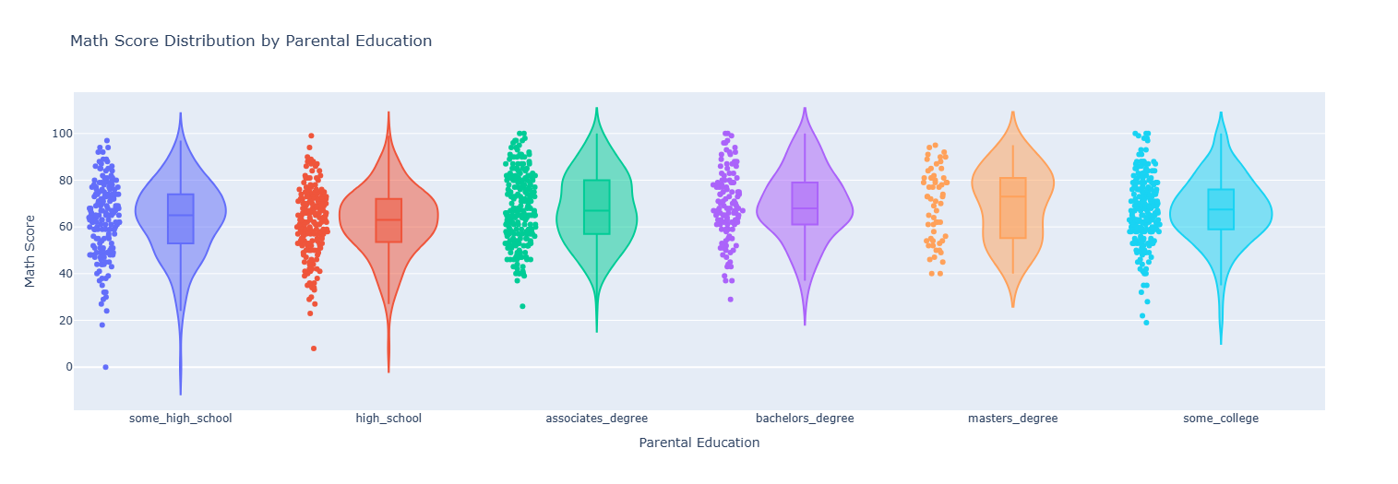
Visual Insights (from Violin Plots)
Math Scores: Higher median and narrower spread for students with college-educated parents, and greater variability among students with less-educated parents.

Slide 10
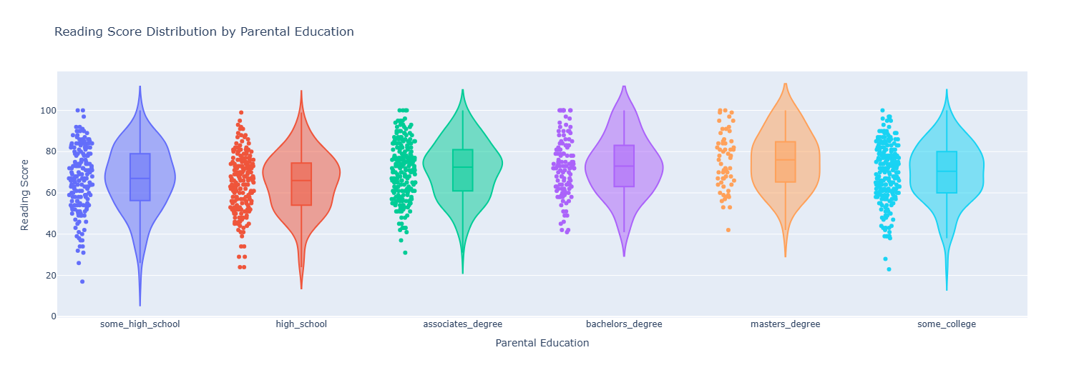
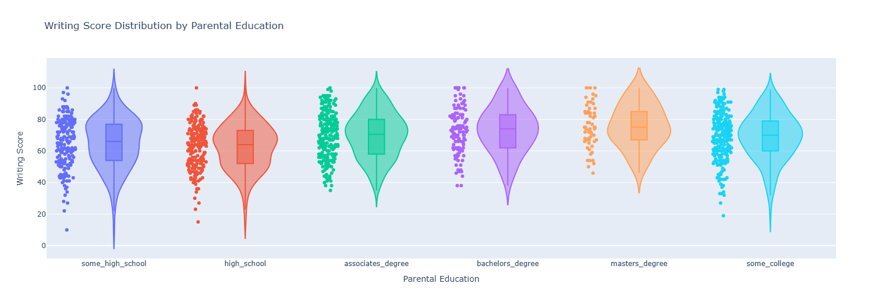
Visual Insights (from Violin Plots)
Reading & Writing Scores:
Stronger separation across education levels
Wider gaps suggest greater influence of parental education on language-related subjects
Additional Finding:
Outliers are more frequent in lower education groups, indicating inconsistent performance and greater spread.

Slide 11
EDA: Gender, Lunch Type, and Test Prep
Gender Differences:
Females scored slightly higher in reading and writing.
Males had marginally higher scores in math.
Lunch Type (Socioeconomic Indicator):
Students with standard lunch consistently outperformed those on free/reduced lunch.
Highlights the impact of socioeconomic status on academic performance.
Test Preparation Course:
Students who completed the course performed better in all subjects.
Most significant improvement observed in writing scores.

Slide 12
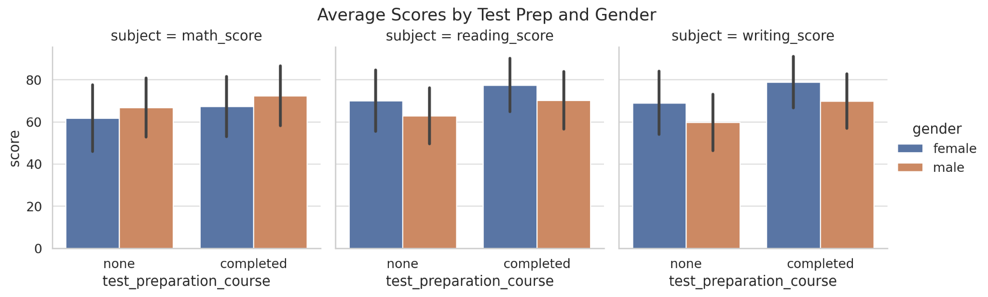
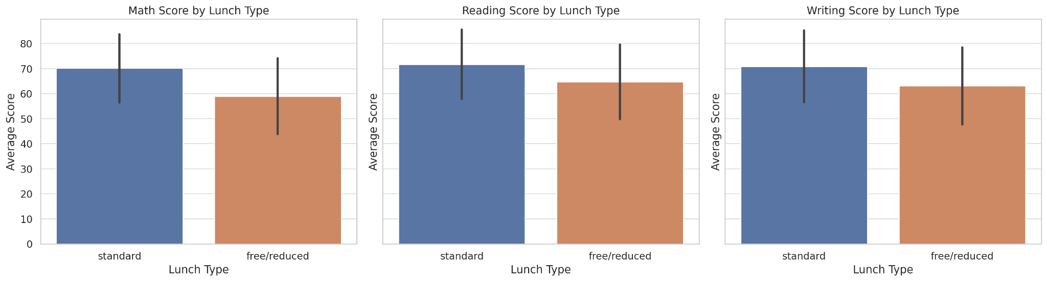
Contd
1st figure is the facet grid showing scores by test prep status and gender.
2nd figure is grouped bar chart of average scores by lunch type.
These figures gives justifications for the previous slide.

Slide 13
Hypothesis Testing Results
1. ANOVA: Do scores differ by parental education?
Method: One-Way ANOVA
Result: Statistically significant differences found for all subjects (p < 0.001)
Subject | F-statistic | p-value
Math | 6.522 | 0.00001
Reading | 9.289 | 0.00000
Writing | 14.442 | 0.00000

Slide 14
Contd
2. Master’s vs High School (Welch’s t-test)
Students with master’s-educated parents scored significantly higher
Subject | t-statistic | p-value | Mean difference
Math | 3.412 | 0.00096 | 7.61
Reading | 5.184 | 0.00000 | 10.67
Writing | 6.449 | 0.00000 | 13.23

Slide 15
Contd
3. Effect Sizes (Eta²): PED’s strongest effect is on writing
Subject | Eta²
Math | 0.030
Reading | 0.044
Writing | 0.068

Slide 16
Contd
4. College vs Non-College (t-test)
College-educated parent group performed better (moderate effect size)
Subject | t-statistic | p-value | Effect Size (Cohen’s d)
Math | 4.309 | 0.00002 | Moderate
Reading | 5.467 | 0.00000 | Moderate
Writing | 6.507 | 0.00000 | Moderate

Slide 17
Regression Modeling Overview
Models Built:
Simple Model
Predictor: Parental Level of Education
Example: writing_score ~ C(parental_level_of_education)
Full Model
Predictors:
Parental education
Gender
Lunch type
Test preparation course
Race/ethnicity
Example: writing_score ~ C(parental_level_of_education) + C(lunch) + C(test_prep_course) + C(gender) + C(race_ethnicity)

Slide 18
Contd
Regularized Models
Lasso Regression (L1): Shrinks irrelevant coefficients to zero
Elastic Net (L1 + L2): Combines strengths of Lasso and Ridge
Multicollinearity Check (VIF Scores):
All Variance Inflation Factor (VIF) values were well below 5
Highest VIF: 3.17
Confirms no severe multicollinearity

Slide 19
Regularized Regression Models
Why Regularization?
Controls for multicollinearity
Helps with feature selection
Prevents overfitting by penalizing less relevant predictors
Model Comparison (Socio-Demographic Features Only)
Key Takeaways: Elastic Net slightly outperformed Lasso in both R² and MSE. Both models reaffirmed the predictive value of: Parental education, lunch type, and test preparation course
Model | R² Score | Mean Squared Error (MSE)
Lasso Regression | 0.156 | 181.02
Elastic Net | 0.160 | 180.15

Slide 20
Residual Diagnostics
To validate the assumptions of linear regression, we performed several diagnostic tests:
1. Normality of Residuals
Test Used: Shapiro-Wilk
Result: p-value > 0.05 ➤ Residuals are approximately normally distributed

Slide 21
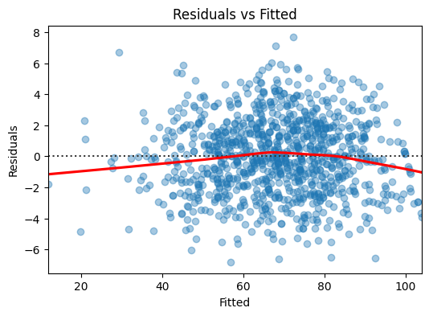
Contd
2. Linearity & Homoscedasticity
Test Used: Breusch-Pagan
Result: No significant heteroskedasticity detected
Visual Check: Residuals vs. Fitted plot showed no trend

Slide 22
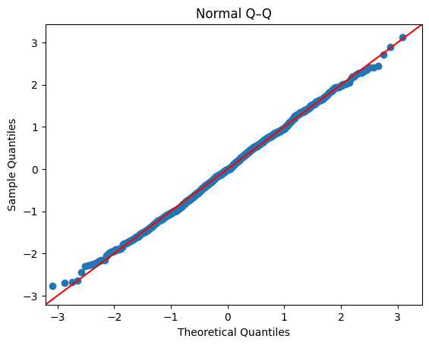
Contd
3. Q–Q Plot
Residuals aligned well with the 45° reference line
➤ Confirms normal distribution visually

Slide 23
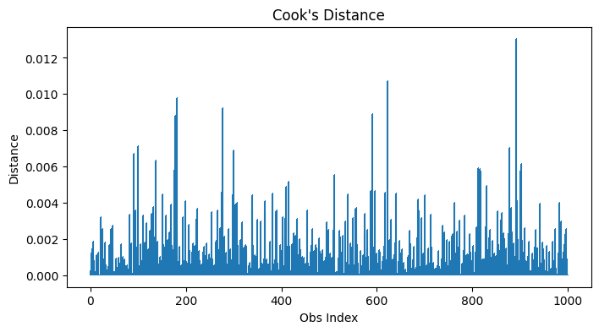
Contd
4. Influential Points
Metric Used: Cook’s Distance
No extreme outliers detected
Model is not unduly influenced by any single observation

Slide 24
Final Insights
Key Findings:
Parental education is a strong and consistent predictor of student performance across math, reading, and writing.
The impact is greatest in reading and writing, as shown by larger effect sizes.
Students with master’s-educated parents outperform those whose parents only completed high school.
Other Significant Predictors:
Lunch type (an SES indicator): Students with standard lunch scored notably higher, revealing socioeconomic disparities.
Test preparation course: Completion is associated with higher scores, especially in writing.

Slide 25
Contd
Model Performance Highlights:
A simple model with only parental education explained 6.8% of the variance in writing scores.
A full regression model including demographic and academic features explained 94.8% of the variance.
Regularized models (Lasso, Elastic Net) confirmed the predictive strength of parental education, lunch, and test prep using socio-demographic features alone.

Slide 26
Conclusion
Study Summary:
Parental education level has a statistically and practically significant effect on student achievement.
Students from college-educated families, especially those with master’s-educated parents, perform better across all subjects.
Reading and writing scores are more sensitive to parental education than math.
Policy Implications: Highlights the need for equity-focused academic interventions:
Targeted support for students from less-educated or low-income households
Expanded access to test preparation programs
Enhanced nutritional support (standard lunch access)
Broader Message: Family background shapes educational opportunity, but schools can narrow performance gaps through data-driven, inclusive strategies.

Slide 27
References
[1] Brew, E. A., Nketiah, B., & Koranteng, R. (2021). A literature review of academic performance: An insight into factors and their influences on academic outcomes of students at senior high schools. Open Access Library Journal, 8, 1–14. https://doi.org/10.4236/oalib.1107423
[2] Nawang, H., Makhtar, M., & Hamza, W. M. (2021). A systematic literature review on student performance predictions. International Journal of Advanced Technology and Engineering Exploration, 8(84), 1441–1453. https://doi.org/10.19101/IJATEE.2021.874521
[3] Khanna, L., Singh, S. N., & Alam, M. (2018). Multidimensional analysis of psychological factors affecting students’ academic performance. arXiv. https://arxiv.org/abs/1806.03242
[4] Davaatseren, A., Myagmar, M., & Dulamsuren, N. (2024). Factors affecting students’ academic performance: In the case of the accounting study of National University of Mongolia. In Proceedings of the 4th International Conference on Education and Social Science Research (pp. 39-44). Atlantis Press. https://doi.org/10.2991/978-94-6463-382-5_6
[5] Wang, A. (2023). Parent's education and child's school performance [Kaggle notebook]. https://www.kaggle.com/code/adastroabyssosque/parent-s-education-and-child-s-school-performance
[6] Hidayatullah, A., & Csíkos, C. (2024). The role of students’ beliefs, parents' educational level, and the mediating role of attitude and motivation in students’ mathematics achievement. Asia-Pacific Education Researcher, 33, 253–262. https://doi.org/10.1007/s40299-023-00724-2
[7] Mitali, K. B., Kruthika, S., Aditya, R., & Sharan, K. V. C. (2025). Analysis of student performance [Source code]. GitHub. https://github.com/student-performance-dse501/analysis-on-student-performance

