Slide 1
Smart Sales System
Friday 27 January 2017

Slide 2
Presentation Outline
Introduction
Objective
What we learnt?
Software Requirements
Future enhancement
Conclusions

Slide 3
Project Objective
To develop an Automation System By Android and Web which provides:
Create Sales Representative, Outlet, SKU
Take Order From Outlet
Order Distance from Outlet
Order Date and Time
Using the simple and cheaper android based platform
And use PHP on Web And Mobile API

Slide 4
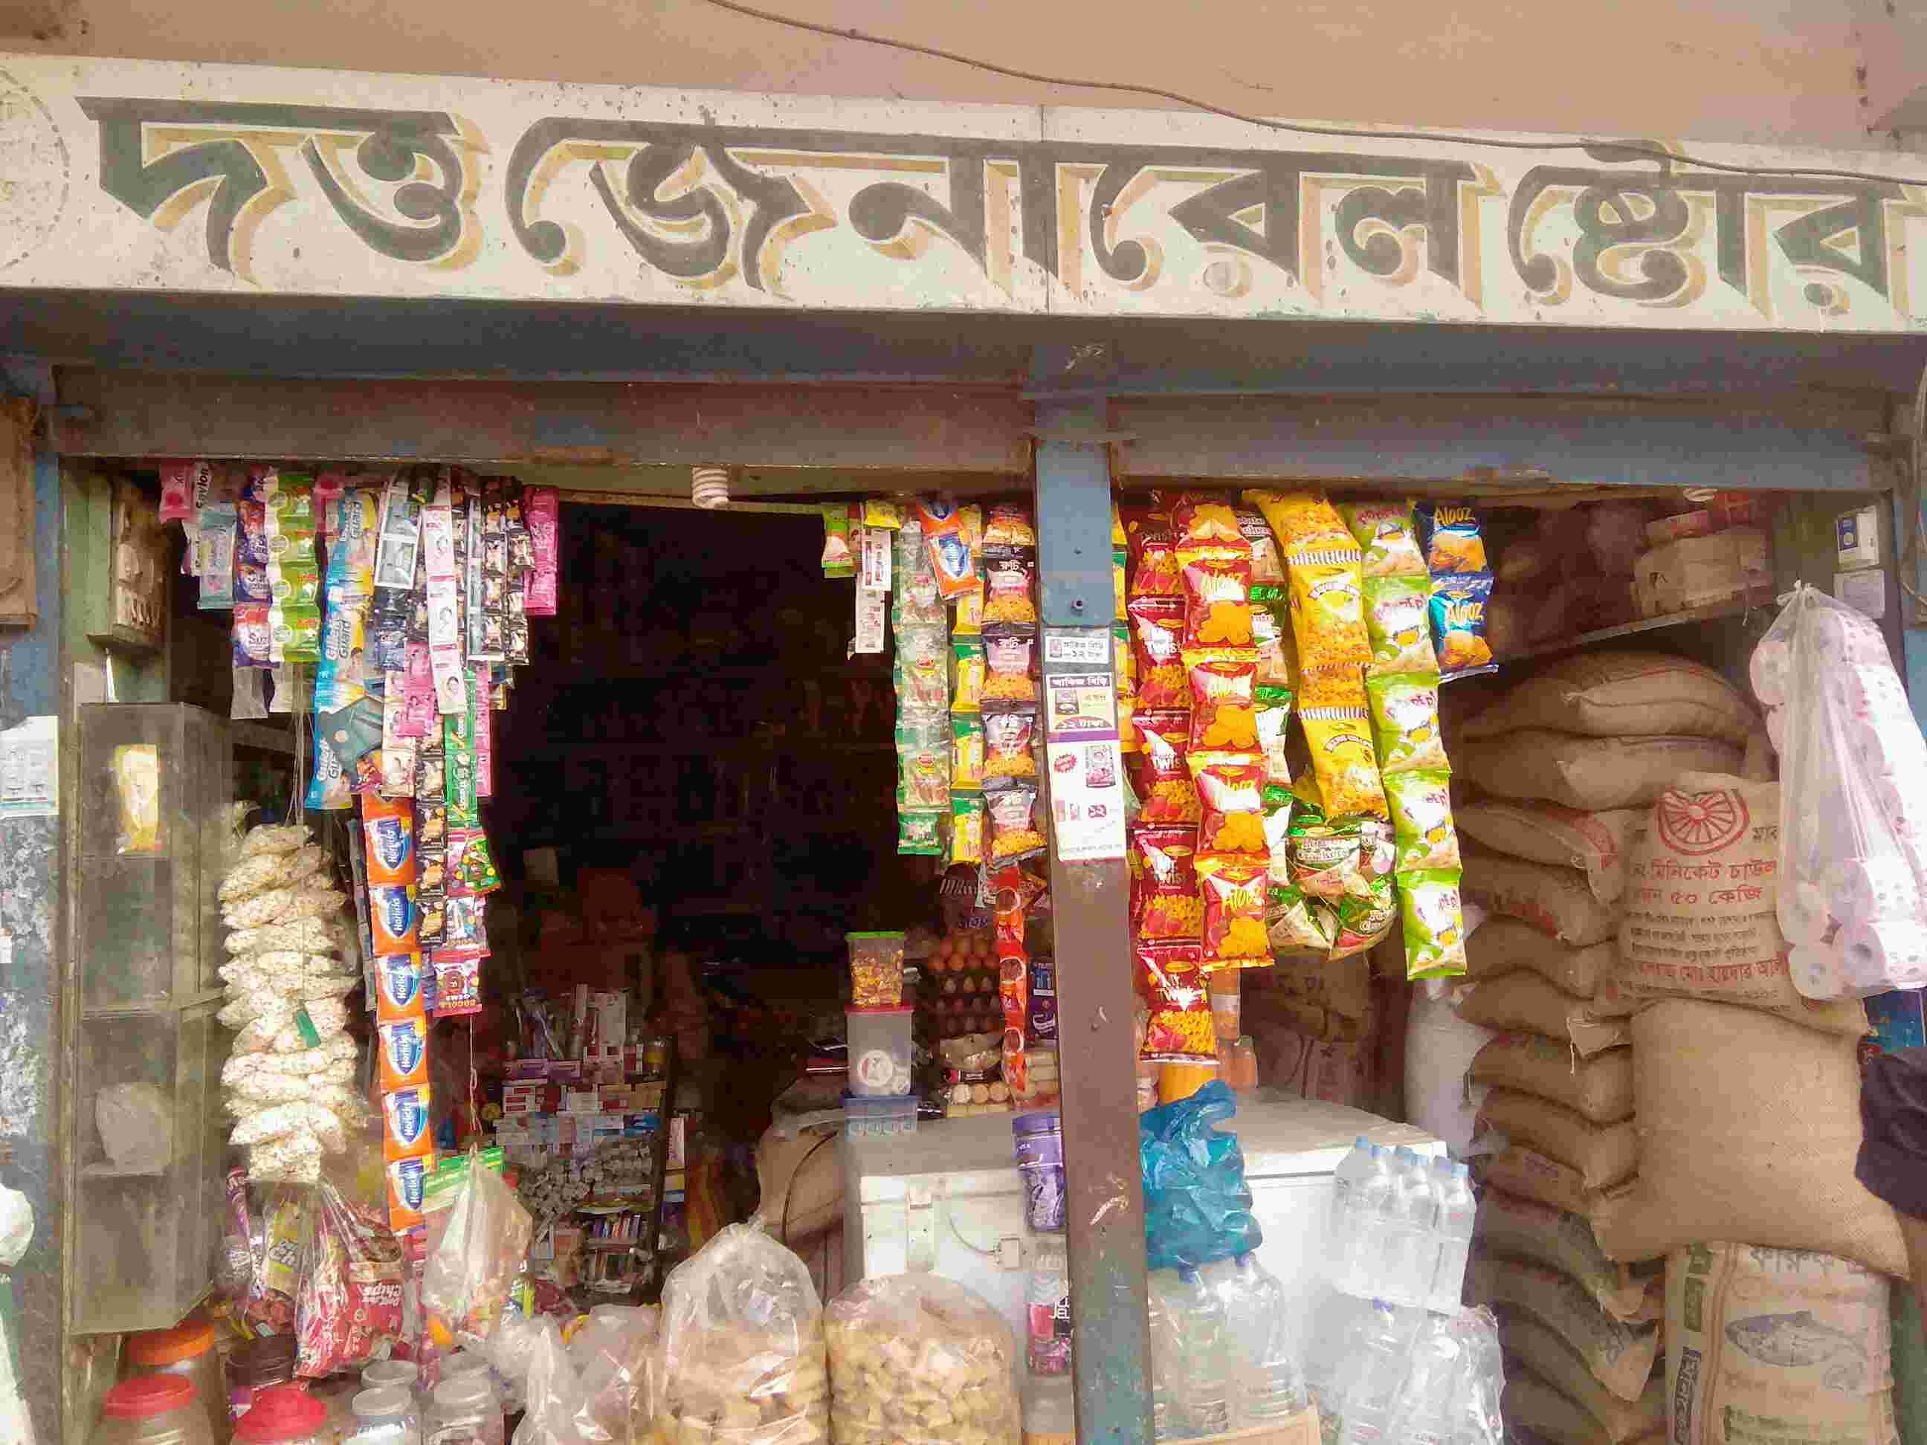
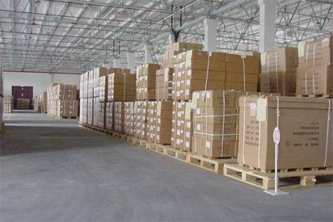
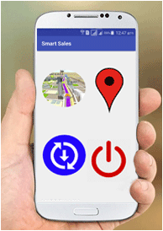
Introduction
Automation the order System
Real Time Order Information
Real Time Sales Representative Activity Details
Using Android OS
Development Platform Android Studio and Java
Network Operation with Sync Adapter And Content Provider
PHP On Web Application and Mobile API

Slide 5
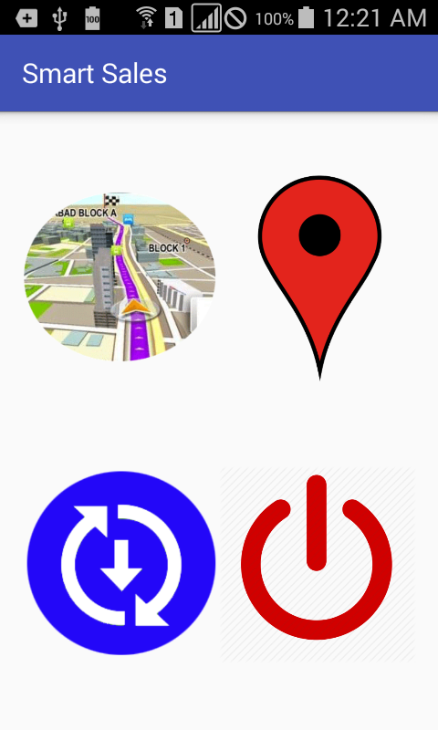
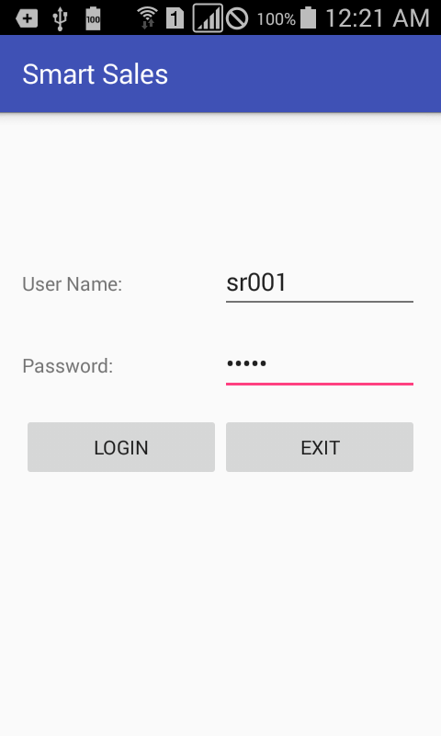
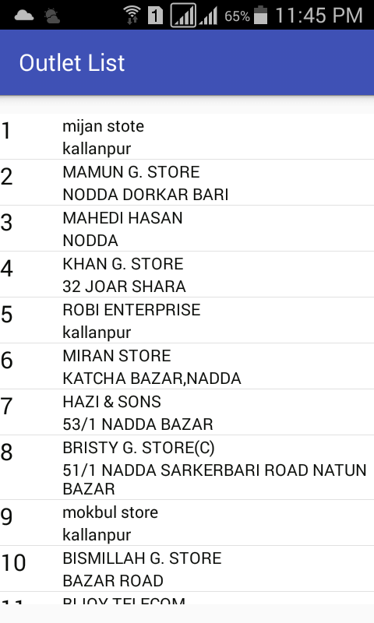
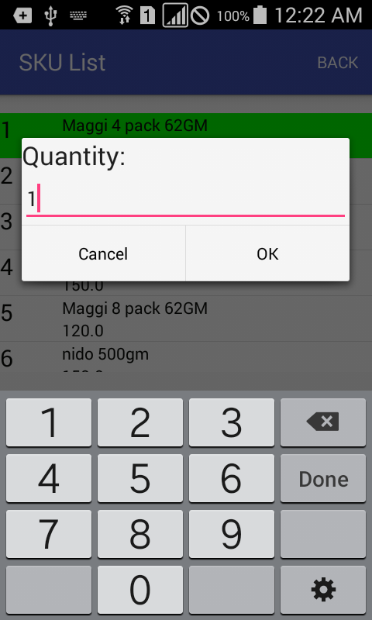
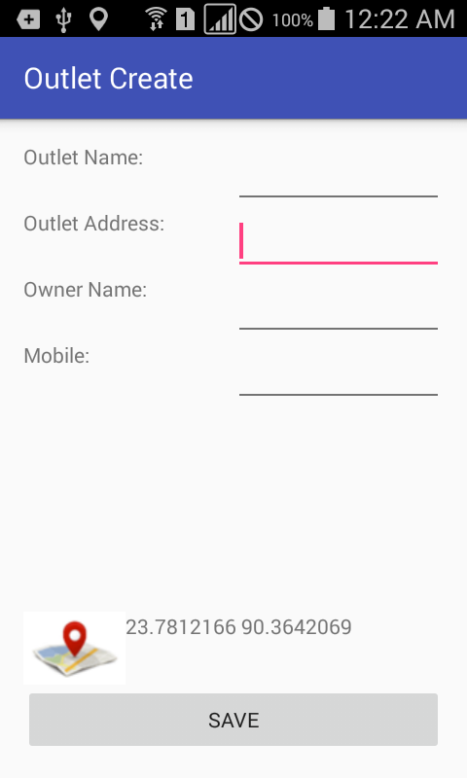
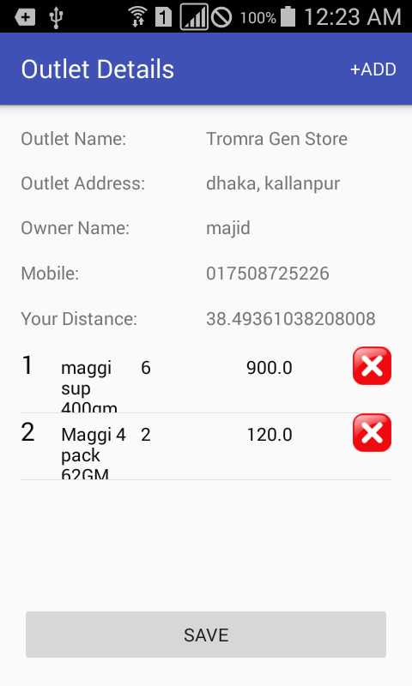
Overview of Android App

Slide 6
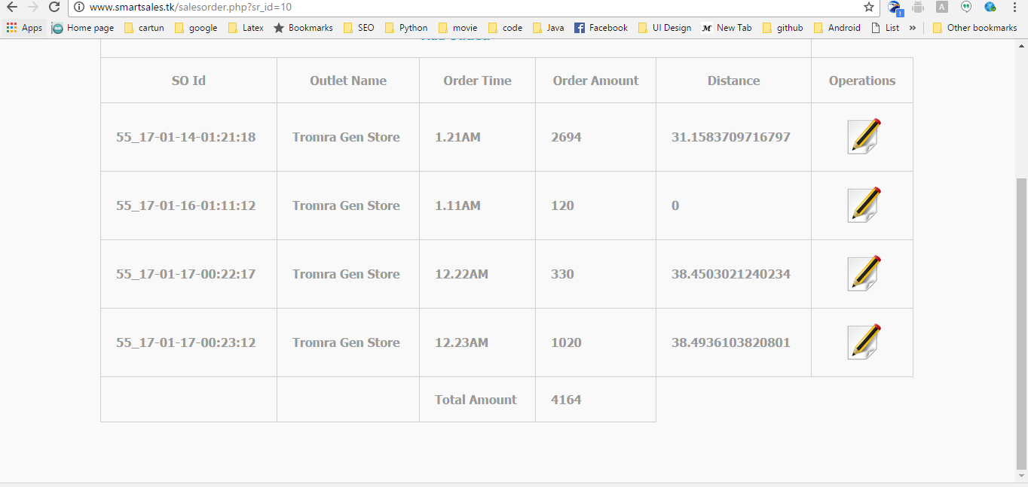
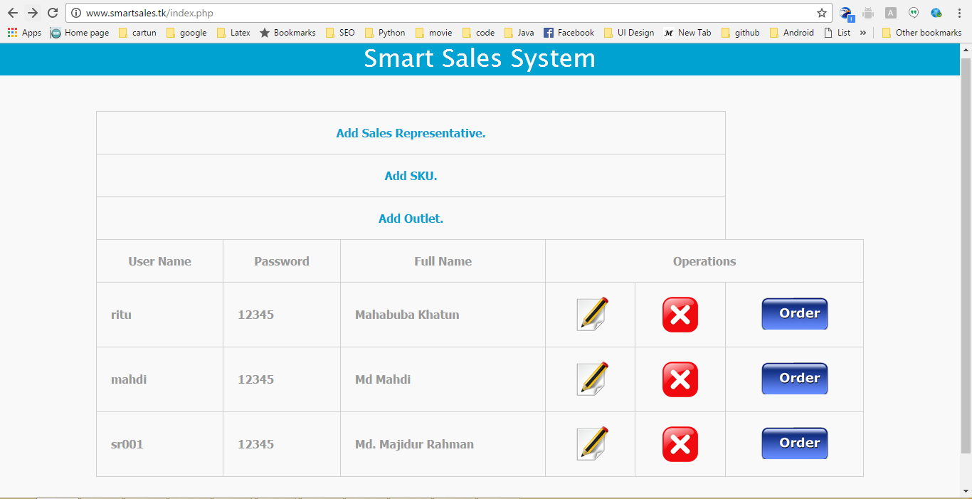
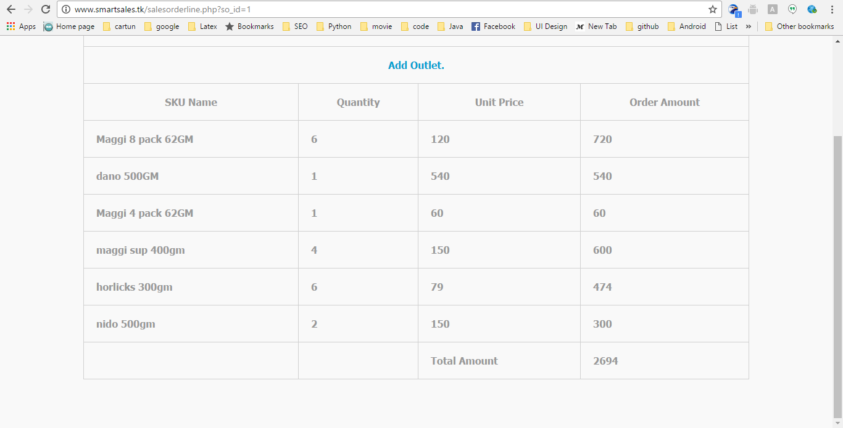

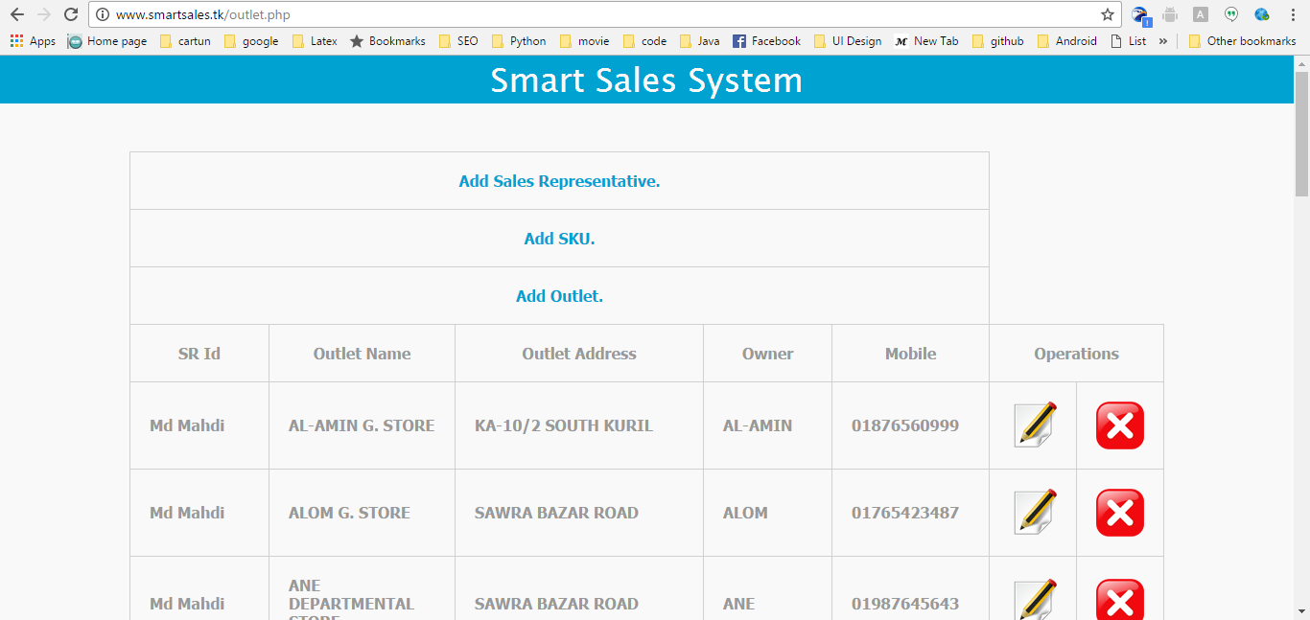
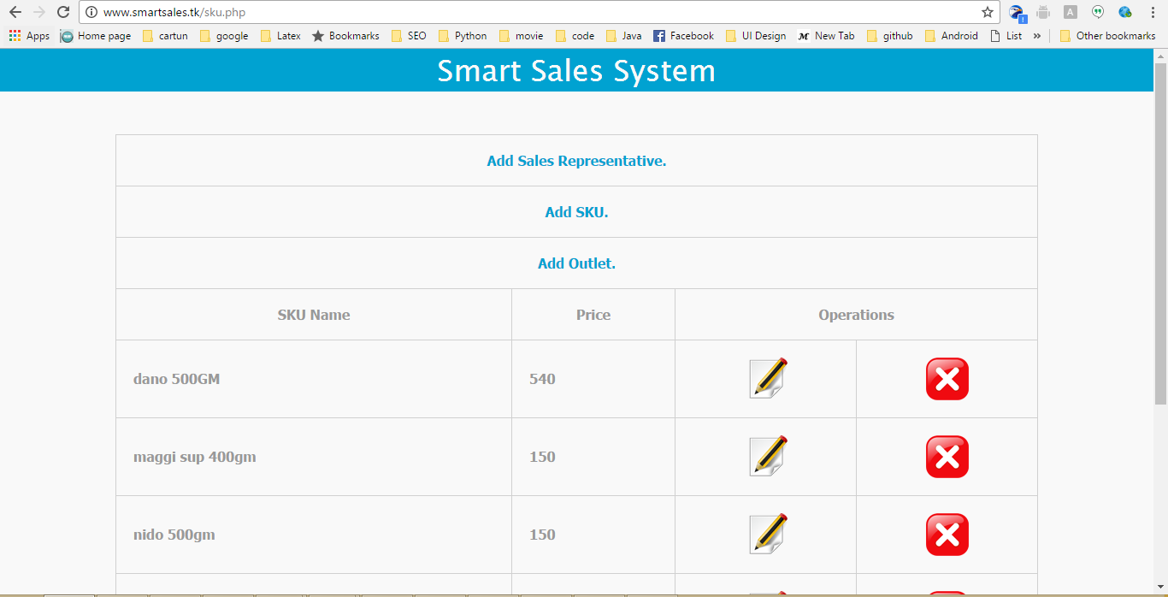
Overview of Web App

Slide 7
What we learnt?
Android Programming With Java
Web CRUD On PHP
Google Volley Library
Activity
Sync Adapter for Data Sync from server and send Data To Server
Content Provider for SQLite Data base CRUD

Slide 8
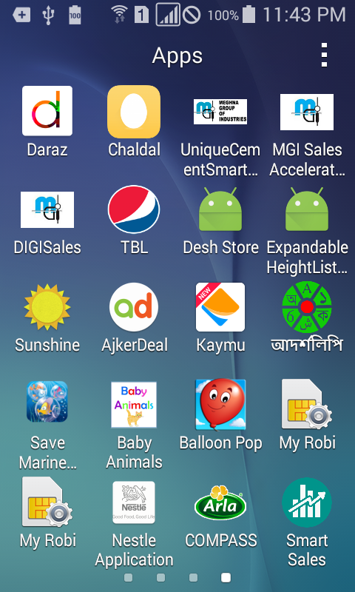
Project:
APP Name: Smart Sales
Android Package Name:
  com.mahabuba.smartsales
Dependencies
  minSdkVersion 10
  com.android.volley:volley:1.0.0
  play-services:9.4.0
  apache.http.client:4.1.2

Slide 9
Class:
Activity:
  LoginActivity
  MainActivity
  MainMenuActivity
  OutletCreateActivity
  OutletDetaileActivity
  OutletListActivity
  SKUListActivity
List Adapter:
  OrderedSKUListAdapter
  OutletListAdapter
  SKUListAdapter
Model:
  OutletModel
  SalesOrderModel
  SKUModel
Business Object:
  Outlet
  OutletList
  SalesOrder
  SalesOrderLine
  SalesOrderLineList
  SKU
  SKUList

Slide 10
Sync Adapter and Content Provider
DataContract.java
DataProvider.java
DBHandler.java
GenericAccountService.java
SyncAdapter.java
SyncService.java
SyncUtils.java

Slide 11
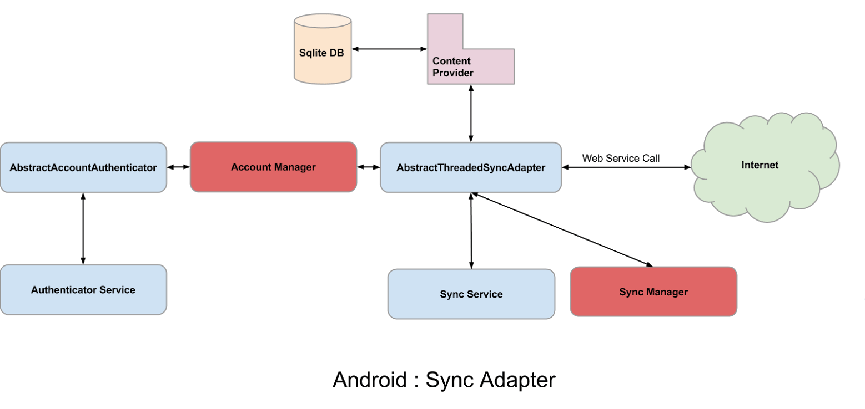
DBHandler.java
DataProvider.java
GenericAccountService.java
SyncAdapter.java
SyncService.java

Slide 12
Software Requirement
Android 2.3.3 API Level 10
Android Studio
Java Development kit(JDK)
Permission:
  Internet
  Manage Accounts
  Read Sync Settings
  Access Fine Location

Slide 13
Future Enhancement
Distribution House Manage
Inventory Management
Promotion
Damage
Route Manage
Sales Representative Target
Message Voice call with Distribution House
Sales And KPI Report Generation

Slide 14
Conclusion
The motivation of this thesis project is to build an Android based application And PHP for providing a simple. By using Android SDK and Android Studio IDE as the development environment the application is built keeping in mind about the design standards and maintainability of the code.
The main aim of my project work we have achieved that is Making a Automation System for Sales Representative Observe Sales Representative Activities

Slide 15
Reference
http://www.developer.android.com/
https://developer.android.com/training/volley/index.html
http://stackoverflow.com/
https://developer.android.com/guide/components/intents-common.html
https://developer.android.com/training/sync-adapters/index.html
https://udacity.com/

Slide 16
Thank You

