Slide 1
UFC-Dataset
Exploration and Machine Learning

Slide 2
Set of Questions
Which fighter has the most wins?
How many fighters have multiple, just one or no wins at all?
What does the density-distribution of the height-weight-ratio look like?
What is the percentage of rounds won by KO or TKO?
What is the maximum age a fighter has won a fight with?

Slide 3
Most Wins: Donald Cerrone at 23 wins total
Distribution of wins:
885 with more than one win
382 with one win
614 with no wins at all

Slide 4
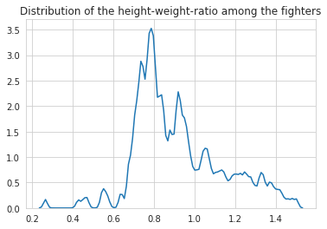
Peak of density is at around 0,78
Sharp drop of density towards lower values indicates a limit due to weight classes
The more shallow drop towards higher values indicate that being smaller isn‘t necessarily considered a disadvantage

Slide 5
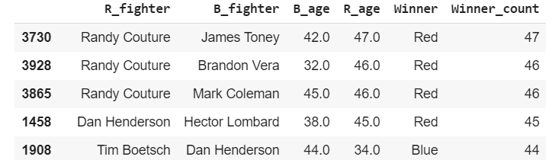
35% of the fights are won by KO/TKO
Randy Couture is the oldest to ever win a UFC-fight at 47 years old
Further analysis: he leads the chart of oldest winners with 3 fights he won at age 47 and 46 and is followed by Dan Henderson and Tim Boetsch

Slide 6
Machine Learning
predict the winner of a UFC-fight based on the available data from kaggle
Outcome:
Accuracy: 0,71
F1-score: 0,81
Recall: 0,92
Precision: 0,72
Assessment based on metrics: better than random ( = 0,5), decent f1-score

