Slide 2
PSMS
(Product Service Management System)

Slide 3
AIM
The system is a web based Manufacturing System that enables a Manufacturing company to schedule its manufacturing operations based on the daily update of sales from its dealers.
The system is modeled to be used by a Manufacturing company, whose main activity is manufacturing different products & then selling the finished goods through a network of Dealers.
To start with, the Stocks of all the Products manufactured by the company and held in the company ware-house are stored in a Database.
The details that are stored include the quantity of each product held with the company dealers who hold the stocks of finished products for sale.
Once the sales figures of Products sold in the past week are entered by the Dealers over the internet along with the Orders for the next delivery, the schedule for the next week’s production will be drawn up.

Slide 4
EXISTING SYSTEM
In the existing system all the information is placed based on paper based system.It will take more man power and it will take more time.
Disadvantages:
The redundancy of data is to be maintained. So the dealer details, order details and the manager Once Dealers place the Orders, a Production Schedule Report will be generated.
This report is based on the total Orders placed & the current Product Stocks held with the company. The final Production Schedule is generated by removing the Product Stocks above the re-order level present with the company in its warehouse, from the total Orders placed for the Products by the Dealers.

Slide 5
PROPOSED SYSTEM
The PSMS is to replace the existing system with a online software solution.
Merits of This System
Faster processing when compared to existing one.
Centralized system.
In this System all the information is to be maintained on the computer system So all the information can see very easily It can take the customer details and also the purchase details are to be maintained .
It can take product details and updated into the database . the customer can select the corresponding product .
whether the goods are to be placed on the customer side the order data is to be removed from the order table. The staff will check all the details of the product and dealer details and also the productstock details

Slide 6
MODULE DESCRIPTION
The system “PSMS” consists of 4 modules
Admin Module
Dealer Module
Staff Module
Supplier Module

Slide 7
FEATURES IMPLEMENTED
Session management
Connection pooling
Normalized database
Prevention of duplication login
Design patterns
Three-tier architecture
Maintainability
Easy deployment with Ant script
Exception handling
Client-side validations

Slide 8
TECHNOLOGIES USED
Web Presentation: HTML, CSS
Client – side Scripting: JavaScript
Programming Language: Java
Web based Technologies: JNDI, Servlets, JSP
Database Connectivity API: JDBC
Build Tool: ANT
Debug Tool: Log 4J
CASE tool: Rational Rose, Visual Paradigm, Enterprise Architect
Backend Database: Oracle/SQL Server/MY SQL/MS Access
Operating System: Windows XP/2000/2003, LINUX, Solaris
J2EE Web/Application Server: Tomcat/Web logic/Web sphere/JBoss/Glass Fish
IDEs: Eclipse with My Eclipse plug-ins/Net Beans/RAD
Browser: IE/Mozilla

Slide 9
HARDWARE REQUIREMENTS
Pentium processor ------- 233 MHZ or above
RAM Capacity ------- 128MB
Hard Disk ------- 20GB
Floppy disk ------- 1.44 MB
CD-ROM Drive ------- 32 HZ
Key Board ------- 108 Standard

Slide 10
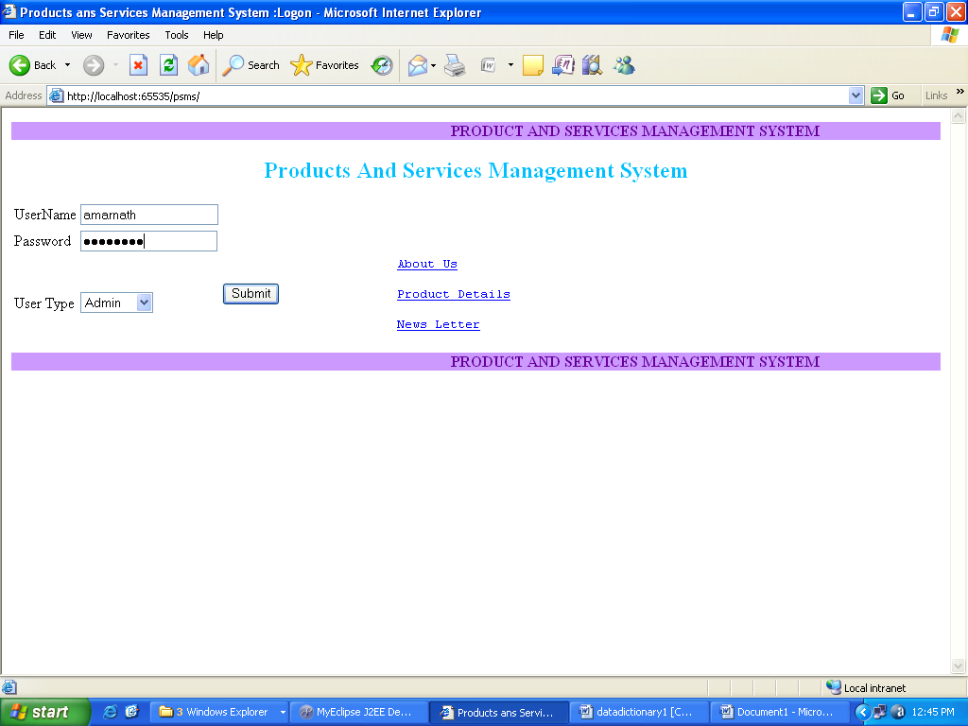

Slide 11
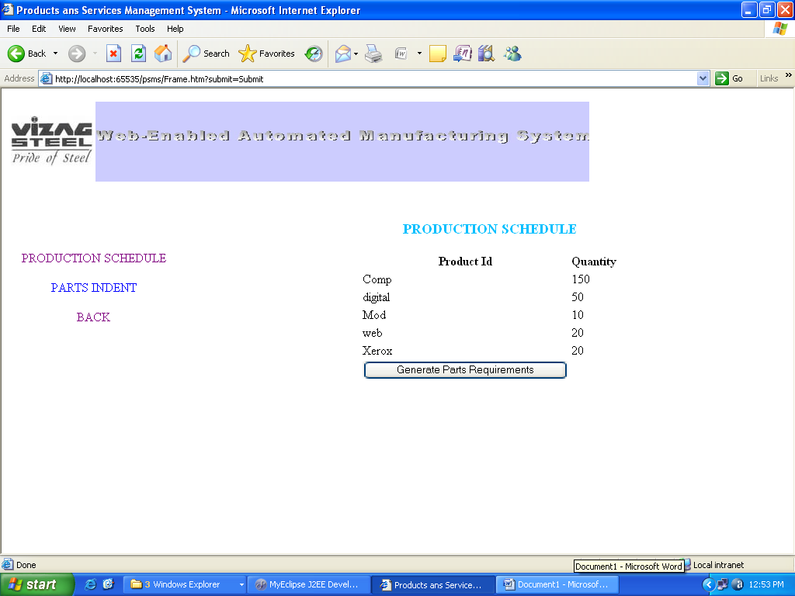

Slide 12
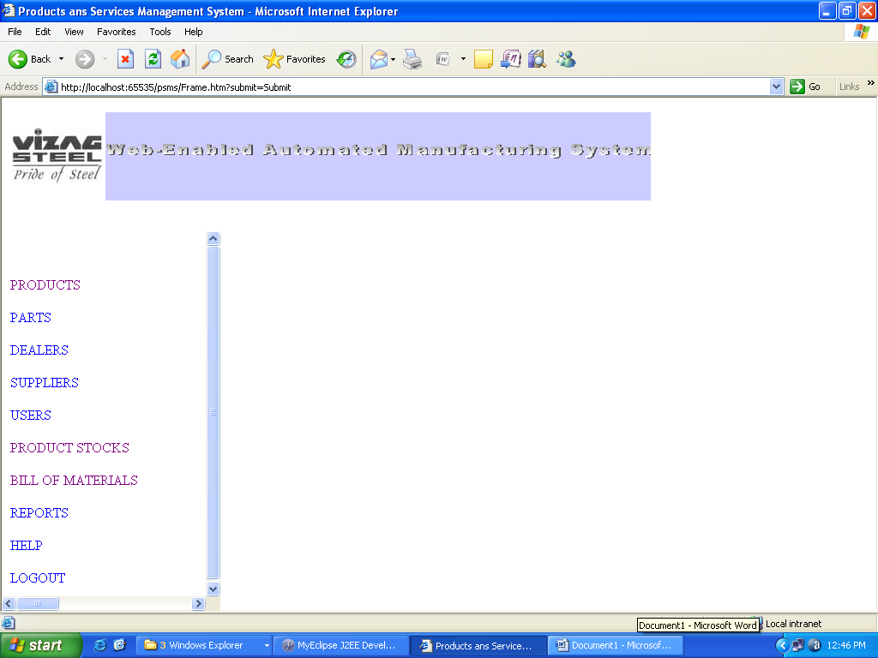

Slide 13
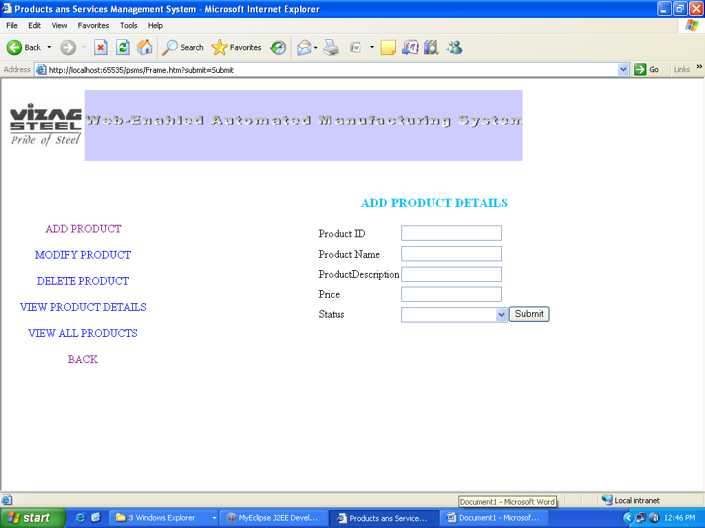

Slide 14
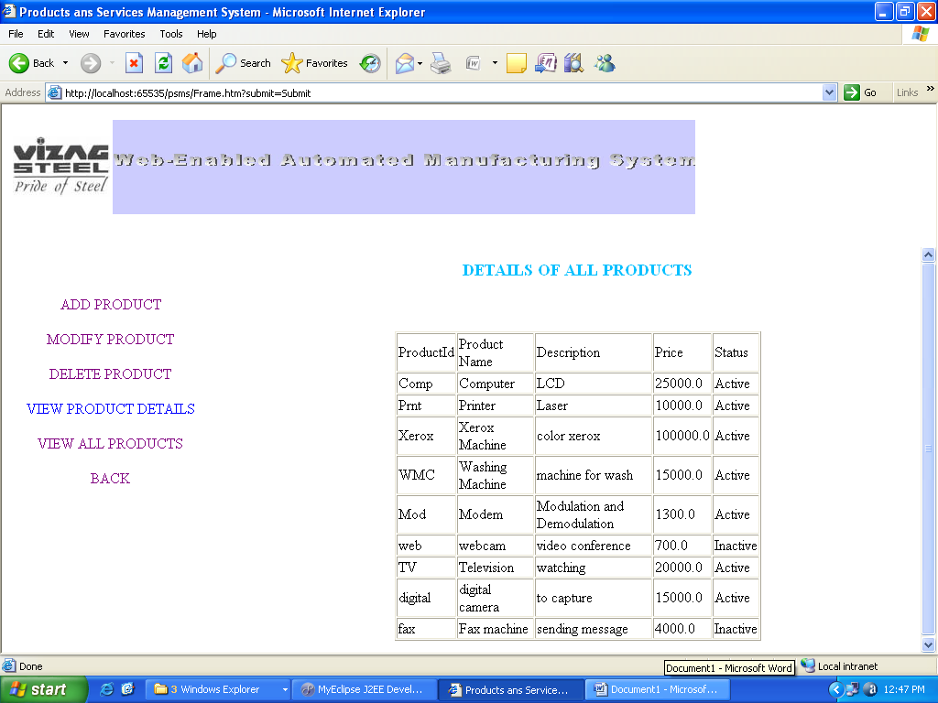

Slide 15
