Slide 1
Animism in Design
An analysis of animistic approaches in
the design of technological
products and processes

Slide 2
How we treat our things, we treat our fellow human beings, we treat our environment. These acts, this habitus, can be found again in our language, our thinking, our ideas. All these things are interlinked and interwoven.
Notes:
Hello everybody and thank you very much for being present at my short presentation on my research project. In the provided paper i focused mainly on the construction and justification of the the research question as well as the relevance. In this presentation I'll go into details of three areas I could only briefly touch: Animism, Narratives and the research setup.
I want to start where the paper ended. Let me give you some context.

Slide 3
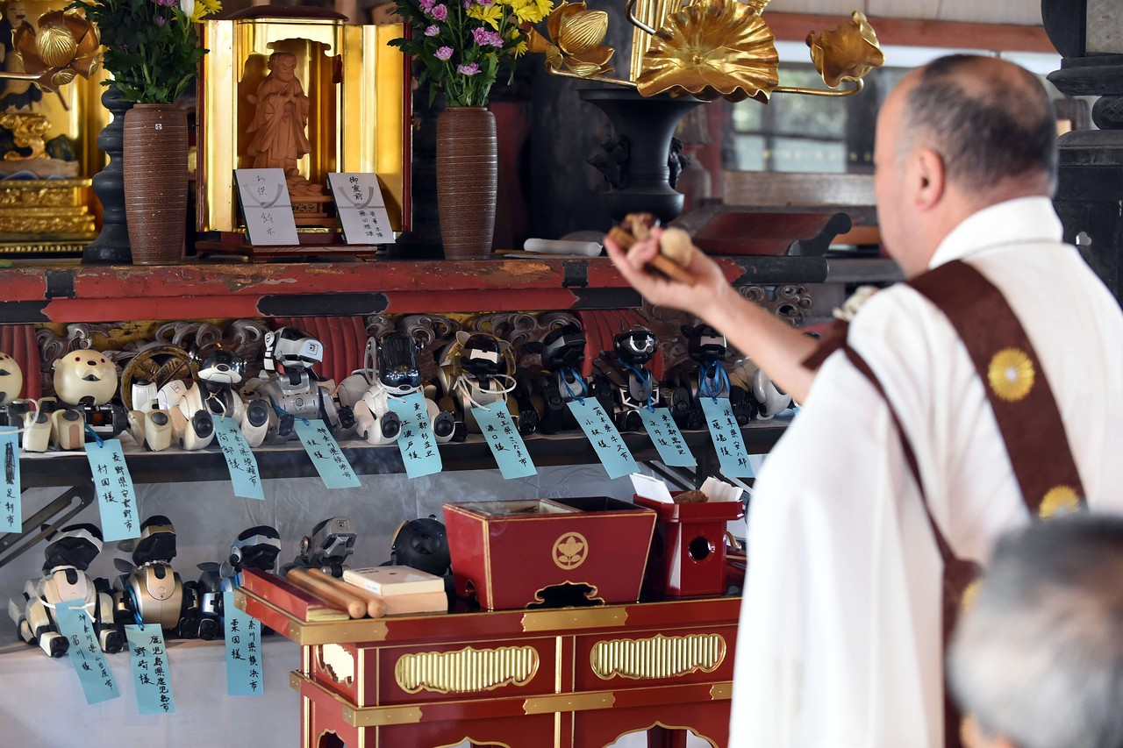
Kofukuji, wsj 2015

Slide 4
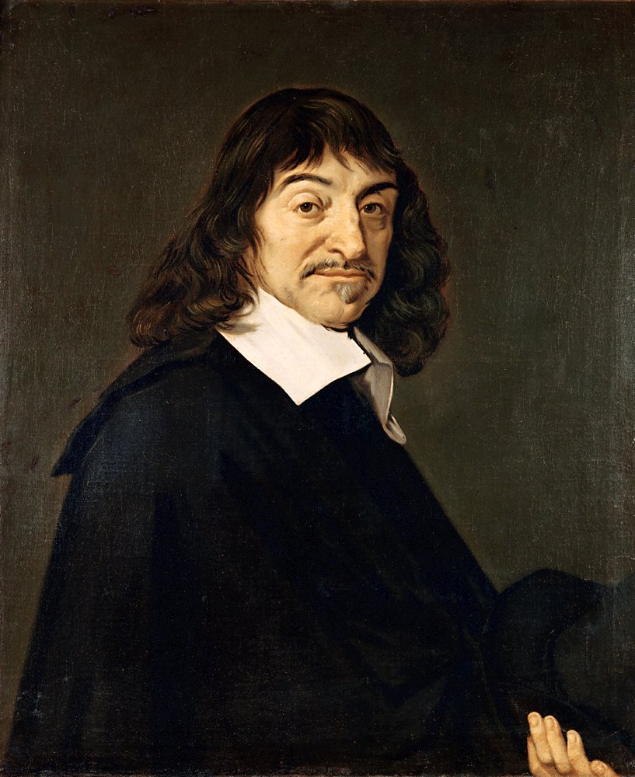
René Descartes, Wikipedia

Slide 5
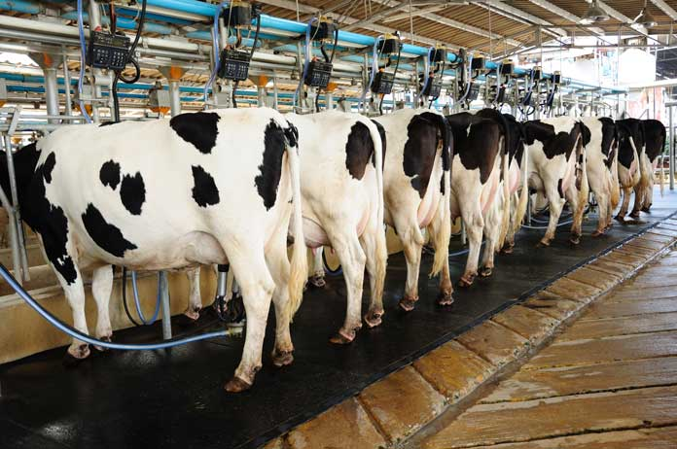
René Descartes, Wikipedia
Dairy cows, ESE Magazine 2019

Slide 6
“It matters what matters we use to think other matters with; it matters what stories we tell to tell other stories with; it matters what knots knot knots, what thoughts think thoughts, what descriptions describe descriptions, what ties tie ties. It matters what stories make worlds, what worlds make stories.”
- Donna J. Haraway, Staying with the Trouble

Slide 7
“If we pervade buildings, they also pervade us — entrances, corridors, stairs, lifts, large rooms, small rooms — all design our modes of spatial occupation and our movements through spaces, allowing some, not allowing others. While we as humans design buildings, they also design us.”
- Anne-Marie Willis, Ontological Designing

Slide 8
Animism

Slide 9
Shintoism

Slide 10
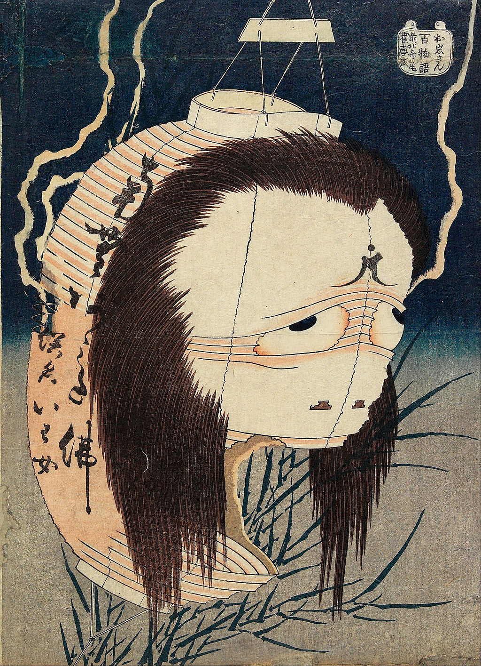
Hokusai, The Lantern Ghost, 1826/1837

Slide 11
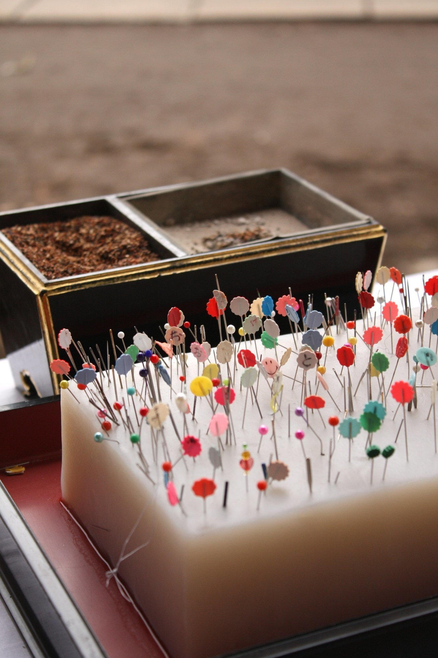
Hari-Kuyo, nanapi inc 2017

Slide 12
Relational Epistemology
1

Slide 13
“This epistemology is about knowing the world by focusing primarily on relatednesses, from a related point of view, within the shifting horizons of the related viewer. The knowing grows from and is the knower’s skills of maintaining relatedness with the known.”
- Nurit Bird-David, Animism Revisited

Slide 14
Aesthetics / Affordances
2

Slide 15
Entangled Practices
3

Slide 16
Relational Epistemology
1
Aesthetics / Affordances
2
Entangled Practices
3

Slide 17
a
b
c
Inputs
Design
Testing
Weak Signals
Fictions, Futures
Cultural Probes

Slide 18
a
b
c
Inputs
Design
Testing
Weak Signals
Fictions, Futures
Cultural Probes
Phone screen
is cleaned upon arrival at home

Slide 19
a
b
c
Inputs
Design
Testing
Weak Signals
Fictions, Futures
Cultural Probes
Phone screen
is cleaned upon arrival at home
Small shrine and story around phone is created

Slide 20
a
b
c
Inputs
Design
Testing
Weak Signals
Fictions, Futures
Cultural Probes
Phone screen
is cleaned upon arrival at home
Small shrine and story around phone is created
A-B-A as well as longitude
tests

Slide 21
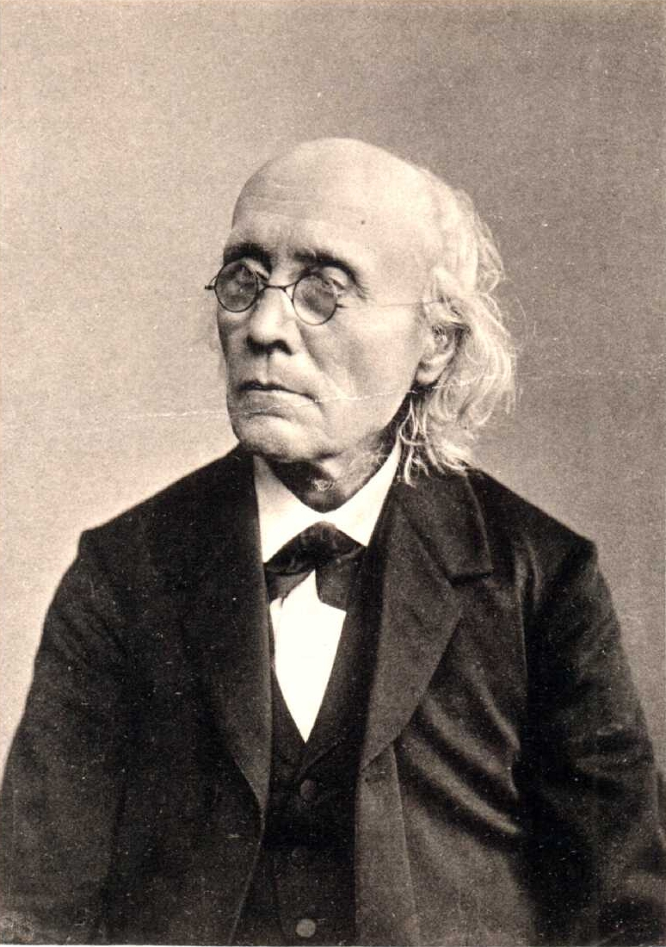
Gustav Fechner, Wikipedia

Slide 22

Nanna, Voss 1908

Slide 23


CC BY 4.0 2020
Adrian Demleitner
adrian@thgie.ch

