Slide 1

StudioLAB
Growth
SETUP GUIDE
01
02
Connect studio profiles without collecting passwords
Capture URLs
Owner login
03
04
A slide-through onboarding presentation for StudioLAB Growth profile connections.
OAuth access
StudioLAB verifies
Slide-through setup deck
01

Slide 2

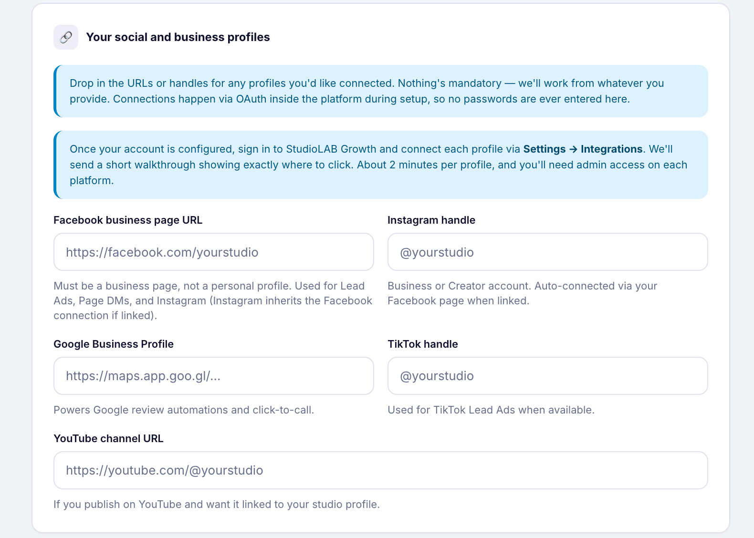
CORE MODEL
The form identifies public profiles; the owner authorises access later.
Capture first
URLs and handles tell StudioLAB which public profiles belong to the studio.
Connect second
The studio owner signs in directly and grants permission inside StudioLAB Growth.
Source: user-provided onboarding screenshot and StudioLAB Growth setup plan
02

Slide 3
SECURITY
No passwords are entered into the onboarding form.
1
2
3
4
Studio owner opens StudioLAB Growth
Platform login opens in their browser
OAuth grants the selected access
StudioLAB verifies the connection
StudioLAB receives authorised access only after the owner approves the platform permission screen.
Source: OAuth permission model and vendor setup documentation
03

Slide 4
BEFORE YOU START
Have the real account owner available before pressing Connect.
OK
StudioLAB Growth login
Ready
OK
Correct Facebook, Instagram, Google, TikTok or YouTube login
Ready
OK
Two-factor authentication device
Ready
OK
Admin or owner permissions
Ready
OK
Pop-ups allowed for the setup session
Ready
OK
Public profile URLs from the onboarding form
Ready
Most failed setup attempts are caused by using the wrong login or missing admin permissions.
Source: platform permission troubleshooting patterns across Meta, Google, TikTok and YouTube
04

Slide 5
PRODUCT MAP
Connections happen in three StudioLAB Growth areas.
1
2
3
Settings
Marketing
Reputation
Integrations for leads, inbox, reviews and connected apps.
Social Planner for publishing and scheduling profiles.
GBP optimisation, listings and review workflows.
Settings > Integrations
Marketing > Social Planner
Reputation
Source: StudioLAB Growth connection mapping from support documentation
05

Slide 6
SETUP SEQUENCE
Connect Meta first, then add Google, TikTok and YouTube as needed.
01
02
03
04
05
Facebook Page
Instagram
Google Profile
TikTok
YouTube
Page, lead ads and Messenger
Posting, DMs and Meta-linked access
Reviews, reputation and GBP posts
Posting, lead ads and automations
Only if publishing is included
Recommendation: connect only the platforms included in the client's Growth package
06

Slide 7
FACEBOOK ACCESS
Facebook needs Page control, and lead ads need extra lead access.
Facebook
1
Business Page, not a personal profile
2
Admin or full control Page access
3
Ad account access if lead ads are included
4
Lead Access Permission for lead form data
Source: Facebook integration and multi-page lead ads support articles, May 2026
07

Slide 8
FACEBOOK CLICK PATH
Leads, DMs and forms start in Settings > Integrations.
StudioLAB Growth
Dashboard
Integrations
Click target
Conversations
Integrations
Facebook & Instagram
Marketing
Facebook & Instagram
Google Business Profile
The owner signs in from their browser. StudioLAB does not see the password.
Lead Ads, Messenger, forms
Connect
Reviews and GBP sync
Connect
Reputation
Settings
TikTok
Connect
Connected Apps
Connect
Lead Ads and automations
Review permissions
Source: Settings > Integrations path from vendor support docs
08

Slide 9
FACEBOOK AUTHORISATION
Approve all requested permissions, then select the correct Page.
Authorise Facebook
StudioLAB Growth
Review permissions before continuing
Dashboard
StudioLAB Growth
OK
Manage Page connection
OK
Conversations
Integrations
OK
Access lead forms
OK
Marketing
OK
Read Page messages
OK
Facebook
Connect
Reputation
Start secure connection
OK
Sync selected Page data
OK
Settings
Selected asset: Your Studio Facebook Page
Allow access
If the Page is missing, check the Facebook profile and Page permissions.
Source: platform authorisation and connection support docs
09

Slide 10
FACEBOOK VERIFICATION
A green badge is not enough. Verify the capability you plan to use.
Page
Inbox
Lead Ads
OK
Correct Page connected
OK
OK
Messenger enabled
OK
OK
Forms mapped
OK
OK
Multiple Pages checked
Check
OK
Instagram messages checked
Check
OK
Test lead received
Check
Source: Facebook setup verification rules from researched support docs
10

Slide 11
INSTAGRAM ACCESS
Instagram must be Business or Creator before it can be connected.
Instagram
1
Business or Creator profile
2
Use Direct Integration for social posting
3
Facebook Page link needed for ads or DMs
4
Correct Instagram login available
Source: Instagram direct and Facebook-linked integration support article, May 2026
11

Slide 12
INSTAGRAM ROUTES
Posting and inbox workflows use different setup routes.
Route A
Route B
Social posting
Ads and DMs
Connect directly for posts, Stories and Reels where supported.
Use the Facebook and Instagram integration when inbox or ads are included.
Marketing > Social Planner
Settings > Integrations
Source: Instagram route mapping from vendor support docs
12

Slide 13
INSTAGRAM AUTHORISATION
Direct Instagram Integration is the simplest path for content scheduling.
Authorise Instagram
StudioLAB Growth
Review permissions before continuing
Dashboard
StudioLAB Growth
OK
Connect Business or Creator profile
OK
Conversations
Social Planner
OK
Publish eligible content
OK
Marketing
OK
View engagement metrics
OK
Instagram
Connect
Reputation
Start secure connection
OK
Reconnect if permissions expire
OK
Settings
Selected profile: @yourstudio
Allow access
Use Facebook-linked setup when the package includes ads, DMs or legacy Meta permissions.
Source: platform authorisation and connection support docs
13

Slide 14
INSTAGRAM VERIFICATION
Confirm the profile type, the Page link and the inbox status.
Profile
Publishing
DMs
OK
Business or Creator
OK
OK
Direct connection active
OK
OK
Facebook Page linked
OK
OK
Correct handle visible
Check
OK
Post types tested
Check
OK
Messages enabled
Check
Source: Instagram setup verification rules from researched support docs
14

Slide 15
GOOGLE ACCESS
Google Business Profile must be verified and managed by the connecting Google account.
Google Business Profile
1
Verified Google Business Profile
2
Owner or Manager access
3
Correct location selected
4
Call tracking decision ready
Source: Google Business Profile integration and Google owner role docs, May 2026
15

Slide 16
GOOGLE ROUTES
Reviews and reputation connect from Settings; GBP posts connect through Social Planner.
Route A
Route B
Reviews and reputation
GBP posts
Connect the verified location for review and reputation workflows.
Use the connected location for Google Business Profile scheduling.
Settings > Integrations
Marketing > Social Planner
Source: Google Business Profile route mapping from vendor support docs
16

Slide 17
GOOGLE AUTHORISATION
Select the exact location, then confirm call tracking.
Authorise Google Business Profile
StudioLAB Growth
Review permissions before continuing
Dashboard
StudioLAB Growth
OK
Access verified GBP locations
OK
Conversations
Integrations
OK
Read and respond to reviews
OK
Marketing
OK
Manage eligible GBP posts
OK
Google Business Profile
Connect
Reputation
Start secure connection
OK
Refresh profile data
OK
Settings
Selected location: Your Studio, Suburb
Allow access
Native Google Business Profile chat was deprecated in 2024. Use connected messaging channels where configured.
Source: platform authorisation and connection support docs
17

Slide 18
GOOGLE VERIFICATION
Check review sync separately from posting availability.
Location
Reputation
Posting
OK
Correct GBP connected
OK
OK
Reviews visible
OK
OK
GBP in Social Planner
OK
OK
Owner or Manager access
Check
OK
Reply path checked
Check
OK
Post type available
Check
Source: Google Business Profile setup verification rules from researched support docs
18

Slide 19
TIKTOK ACCESS
TikTok has three setup jobs: posting, lead ads and DM or comment automation.
TikTok
1
TikTok login for posting
2
Business Profile for comment management
3
Advertiser account for lead ads
4
At least one Instant Form for lead sync
Source: TikTok Social Planner, Lead Ads and DM automation docs, May 2026
19

Slide 20
TIKTOK ROUTES
Posting starts in Social Planner; lead ads and automations start in Integrations.
Route A
Route B
Posting
Lead ads and automations
Connect personal or business TikTok profiles for Social Planner publishing.
Connect TikTok Business Account and map forms for lead capture.
Marketing > Social Planner
Settings > Integrations
Source: TikTok route mapping from vendor support docs
20

Slide 21
TIKTOK AUTHORISATION
Lead ads require advertiser selection and form mapping.
Authorise TikTok
StudioLAB Growth
Review permissions before continuing
Dashboard
StudioLAB Growth
OK
Authorise TikTok Business Account
OK
Conversations
Integrations
OK
Select advertiser account
OK
Marketing
OK
Map Instant Form fields
OK
TikTok
Connect
Reputation
Start secure connection
OK
Test lead submission
OK
Settings
Selected advertiser: Your Studio Ads Account
Allow access
If no forms appear, create an Instant Form in TikTok Ads Manager first.
Source: platform authorisation and connection support docs
21

Slide 22
TIKTOK VERIFICATION
Test the workflow that matches the Growth package.
Posting
Lead Ads
Automations
OK
TikTok profile visible
OK
OK
Advertiser selected
OK
OK
Account available
OK
OK
Test draft created
Check
OK
Form mapping saved
Check
OK
Trigger tested
Check
Source: TikTok setup verification rules from researched support docs
22

Slide 23
YOUTUBE ACCESS
YouTube must be connected by the channel primary owner.
YouTube
1
Public channel URL captured
2
Primary owner available
3
Correct Google account selected
4
Only needed when publishing is included
Source: YouTube scheduling and Google channel permissions docs, May 2026
23

Slide 24
YOUTUBE CLICK PATH
Connect YouTube only when StudioLAB Growth will publish videos or Shorts.
StudioLAB Growth
Dashboard
Social Planner
Click target
Conversations
Social Planner
YouTube
Marketing
Facebook Page
Instagram
The owner signs in from their browser. StudioLAB does not see the password.
Posts and Page content
Connect
Posts, Reels, Stories
Connect
Reputation
Settings
TikTok
Connect
YouTube
Connect
Video posting
Videos and Shorts
Source: YouTube scheduling in Social Planner support article
24

Slide 25
YOUTUBE AUTHORISATION
Manager access cannot authorise third-party publishing.
Authorise YouTube
StudioLAB Growth
Review permissions before continuing
Dashboard
StudioLAB Growth
OK
Sign in as primary owner
OK
Conversations
Social Planner
OK
Select the correct channel
OK
Marketing
OK
Approve publishing permissions
OK
YouTube
Connect
Reputation
Start secure connection
OK
Confirm channel appears
OK
Settings
Selected channel: Your Studio Channel
Allow access
If the channel does not appear, the owner is probably logged into the wrong Google account.
Source: platform authorisation and connection support docs
25

Slide 26
YOUTUBE VERIFICATION
Confirm the channel appears before scheduling anything.
Owner
Channel
Publishing
OK
Primary owner connected
OK
OK
Correct channel visible
OK
OK
Video option tested
OK
OK
Manager-only avoided
Check
OK
Token active
Check
OK
Shorts option checked
Check
Source: YouTube setup verification rules from researched support docs
26

Slide 27
STUDIOLAB HANDOFF
Verify the intended workflow, not just the connected badge.
Meta
Google
TikTok
YouTube
OK
Page connected
OK
OK
GBP location connected
OK
OK
Profile connected
OK
OK
Primary owner used
OK
OK
IG linked if needed
Check
OK
Reviews visible
Check
OK
Advertiser selected
Check
OK
Channel visible
Check
OK
Lead forms mapped
Check
OK
Call tracking decision
Check
OK
Forms mapped
Check
OK
Publishing tested
Check
OK
Messenger enabled
Check
OK
GBP posts checked
Check
OK
Trigger tested
Check
OK
Optional if not in package
Check
Internal StudioLAB verification checklist
27

Slide 28
PRODUCTION MODEL
Use one master deck, then five short videos for the platform details.
Master deck
Five short videos
One client-facing click-through presentation for the full setup flow.
Facebook, Instagram, Google Business Profile, TikTok and YouTube, each under 3 minutes.
Setup checklist
Support fallback
Pre-flight owner permissions and profile URLs before the onboarding call.
15-minute assisted setup call when platform permissions are messy.
Recommended production model for StudioLAB Growth onboarding
28

Slide 29
StudioLAB
Growth
SOURCES
Access requirements are source-backed and ready for video production.
Facebook and Instagram
Google Business Profile
Official support on Facebook Page integration, lead ads, Messenger and Instagram direct integration.
Official support on GBP connection, owner or manager access, review sync and GBP post scheduling.
TikTok
YouTube
Official support on Social Planner, Lead Ads, Business Center permissions and DM or comment automations.
Official support on Social Planner scheduling and Google channel permission limits.
Detailed source links are saved with the deck workspace source notes and the research plan.
29

