Slide 1

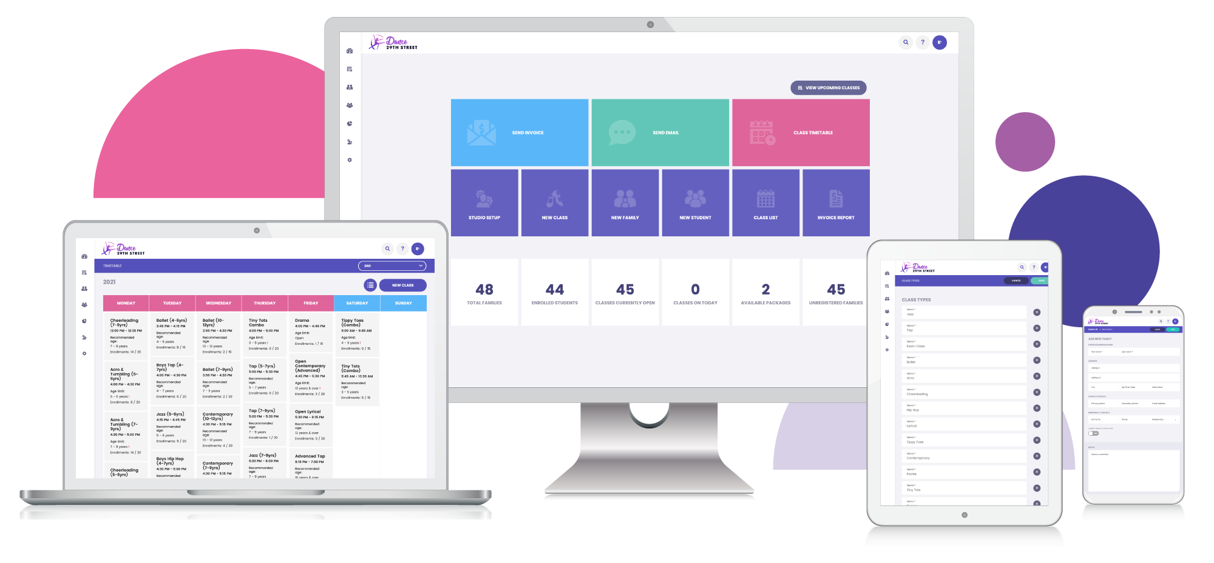

OWNER SETUP GUIDE
Connect your studio profiles to StudioLAB Growth
A simple walkthrough for authorising Facebook, Instagram, Google Business Profile, TikTok and YouTube.
You stay in control
StudioLAB Growth setup deck

Slide 2

THE WHOLE SETUP
You will connect each profile in three simple parts.
You do not send passwords to StudioLAB. You sign in through each platform from your own browser.
1
2
3
Add public links
Sign in as owner
Approve access
Enter the public URLs or handles for the profiles you want connected.
Open StudioLAB Growth and use your owner or setup login.
Choose the right account, review the permissions and click allow.
StudioLAB Growth setup guide
02

Slide 3
BEFORE YOU START
Have the right owner access open before you click Connect.
Most connection issues happen because the person signing in does not manage the correct Page, profile or location.
OK
Your StudioLAB Growth login is ready.
OK
You can receive any two-factor login code.
OK
You manage the Facebook Page or Business Portfolio.
OK
You manage the Google Business Profile location.
OK
You know which TikTok or YouTube account should connect.
OK
Pop-ups are allowed in your browser for the setup session.
StudioLAB Growth setup guide
03

Slide 4
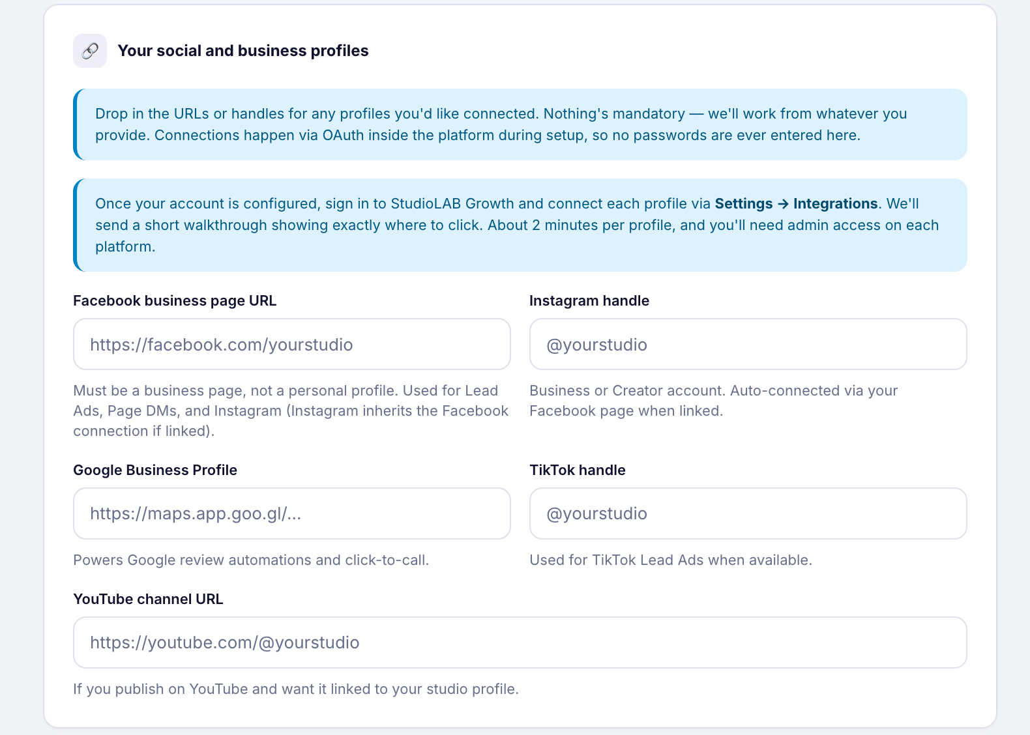
STEP 1
Fill in your public profiles first.
This tells StudioLAB which public profiles belong to your studio. It does not connect access by itself.
1
Paste profile URLs or handles
Add the platforms you want StudioLAB Growth to connect.
2
Skip anything not included
Leave a profile blank if it is not part of your Growth package.
3
Submit the form
Active connections happen after your account is created.
StudioLAB Growth setup guide
04

Slide 5
STEP 2
Open StudioLAB Growth integrations.
StudioLAB Growth
Dashboard
Integrations
Conversations
Start here for Facebook, Instagram, Google Business Profile and TikTok lead setup.
Most profiles connect from Settings. Some publishing profiles connect from Social Planner.
Marketing
Facebook
Google
Instagram, pages, messages and leads
Connect
Business Profile and reviews
Connect
Settings > Integrations
Reputation
Use this for account access, lead forms, messages, reviews and reputation tools.
Settings
TikTok
YouTube
Posting, leads or automations
Connect
Videos and Shorts
Connect
Marketing > Social Planner
Use this when you are connecting accounts for scheduled posts, videos or Shorts.
StudioLAB Growth setup guide
05

Slide 6
Facebook Page
FACEBOOK
Connect the Facebook Page first.
StudioLAB Growth
Use the Facebook profile that manages the studio Page. For lead ads, that person also needs access to the ad account and lead forms.
Dashboard
Facebook
1
Go to Settings > Integrations
Select Connect, then follow the platform sign-in window.
Choose Facebook and Instagram.
Conversations
2
Click Connect
Marketing
Facebook Page
Connect
A Facebook sign-in window will open.
Pages, DMs and lead forms
Reputation
Lead form mapping
Connect
3
Approve the permissions
Only when lead ads are included
Select the correct studio Page when asked.
Settings
4
Confirm the Page
Check that the right Page appears as connected.
StudioLAB Growth setup guide
06

Slide 7
Instagram
INSTAGRAM
Connect Instagram as a Business or Creator account.
If Instagram is linked to your Facebook Page, connect Facebook first. If you only need posting, use Social Planner.
For messages, lead ads or automations
For scheduled posts only
Start with Facebook and Instagram in Settings > Integrations. Make sure the correct Instagram account is linked to the Facebook Page.
Go to Marketing > Social Planner, add Instagram, then sign in and approve the connection from your own browser.
Check: the correct Instagram account appears in StudioLAB Growth
StudioLAB Growth setup guide
07

Slide 8
Google Business Profile
GOOGLE BUSINESS PROFILE
Connect the verified studio location.
StudioLAB Growth
Use the Google account that manages the studio Business Profile.
Dashboard
Google Profile
1
Go to Settings > Integrations
Choose the studio location after Google asks for permission.
Choose Google Business Profile.
Conversations
2
Sign in with Google
Marketing
Google Profile
Connect
Use the account with Owner or Manager access.
Reviews and local profile
Reputation
Reputation
Connect
3
Select the studio location
Review requests and reporting
Pick the verified location for this studio.
Settings
4
Confirm review access
Check that reviews and profile tools are available.
StudioLAB Growth setup guide
08

Slide 9
TikTok
TIKTOK
Choose the TikTok connection that matches your package.
Posting and lead ads use different paths. Connect only the TikTok features included in your StudioLAB Growth setup.
POSTING
LEAD ADS
If TikTok posting is included
If TikTok lead ads are included
Go to Marketing > Social Planner, add TikTok, sign in, then confirm the account appears as connected.
Go to Settings > Integrations, connect TikTok, choose the advertiser account, then map the lead form fields.
Check: the right account or advertiser is selected before you finish
StudioLAB Growth setup guide
09

Slide 10
YouTube
YOUTUBE
Connect YouTube for videos or Shorts.
StudioLAB Growth
The channel owner should sign in. Manager access may not be enough for third-party publishing.
Dashboard
Social Planner
1
Go to Marketing > Social Planner
Conversations
Add YouTube from the connected social accounts area.
Open the connected accounts area.
Marketing
Facebook Page
Connect
Choose YouTube
Connected
2
Instagram
Connect
A Google sign-in window will open.
Reputation
Connected
Sign in as channel owner
TikTok
Connect
3
Settings
Optional
Use the account that owns the channel.
YouTube
Connect
Videos and Shorts
4
Confirm the channel
Check the correct channel appears before scheduling.
StudioLAB Growth setup guide
10

Slide 11
FINAL CHECK
Check the right profile is connected.
OK
Facebook Page
Correct Page selected
Confirm the account name, Page, location or channel before you leave.
OK
Instagram
Business or Creator account connected
1
Read the account name
OK
Google Business Profile
Right studio location selected
Make sure it is your studio, not a personal or test account.
Check the feature area
OK
TikTok
Correct account or advertiser selected
2
Open Social Planner, Reputation or Integrations based on what you connected.
OK
YouTube
Channel appears in Social Planner
3
Tell StudioLAB Growth
Let the setup team know when the requested accounts are connected.
StudioLAB Growth setup guide
11

Slide 12
COMMON FIXES
If a profile does not appear, check access first.
These are the most common reasons a connection gets stuck.
Facebook Page missing
Use the Facebook profile with full Page control or Business Portfolio access.
Instagram missing
Confirm the account is Business or Creator and linked to the right Facebook Page.
Google location missing
Use a Google account with Owner or Manager access to the verified location.
TikTok forms missing
Check advertiser access and make sure at least one instant form exists.
YouTube channel missing
Ask the primary channel owner to sign in and authorise the connection.
Permission denied
Reconnect the platform and approve all requested permissions.
StudioLAB Growth setup guide
12

Slide 13
YOU ARE DONE
StudioLAB Growth can finish the setup.
Send the setup team a quick note confirming which platforms are connected. We will verify the connections and finish the remaining Growth configuration.
Keep your owner access active until setup is confirmed.
Facebook
Instagram
Google
StudioLAB will let you know when everything has been checked.
TikTok
YouTube
StudioLAB Growth setup guide

