Slide 1
Mayasari Bakery
Executive Management Review — 2025
Business performance and profitability overview
Customer value and opportunity analysis
Product mix and revenue performance
Management priorities for the next cycle

Slide 2
Executive Summary
Current business position
Rp 761.8M
Revenue
The business generated positive operating profit.
Gross margin remains above 40%, providing a meaningful contribution base.
Revenue performance shows meaningful month-to-month variation.
Customer and product concentration should be managed alongside growth.
Rp 334.3M
Gross Profit
43.88%
Gross Margin
Rp 166.8M
Operating Profit

Slide 3
Financial Performance
Profitability structure
Rp 761.8M
Revenue
Gross profit contribution: Rp 334.3M.
Operating expenses: Rp 167.5M.
Operating profit: Rp 166.8M.
Priority: protect margin while pursuing sustainable revenue growth.
Rp 334.3M
Gross Profit
Rp 167.5M
Operating Expense
21.89%
Operating Margin

Slide 4
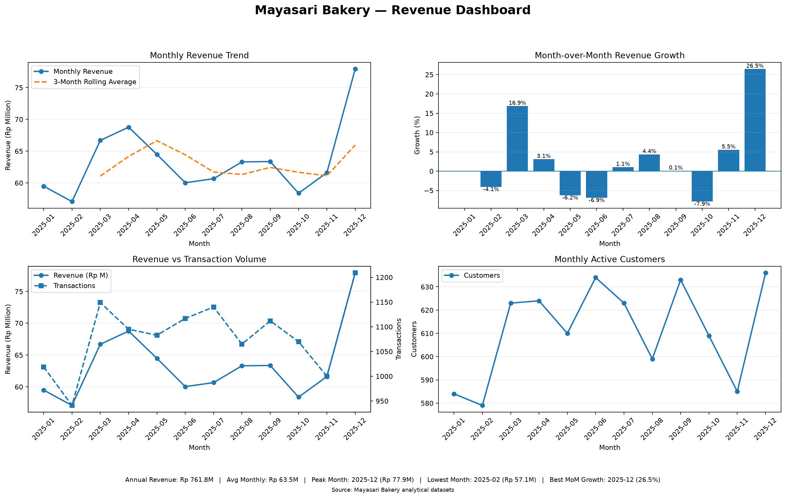
Revenue Performance
Monthly revenue trend and performance

Slide 5
Revenue Management Takeaways
What management should investigate
Peak revenue: 2025-12 at Rp 77.9M.
Lowest revenue: 2025-02 at Rp 57.1M.
December showed the strongest monthly growth at approximately +26.45%.
October recorded the weakest month-over-month movement at approximately -7.86%.
Investigate campaign, product availability, and customer activation drivers behind major movements.

Slide 6
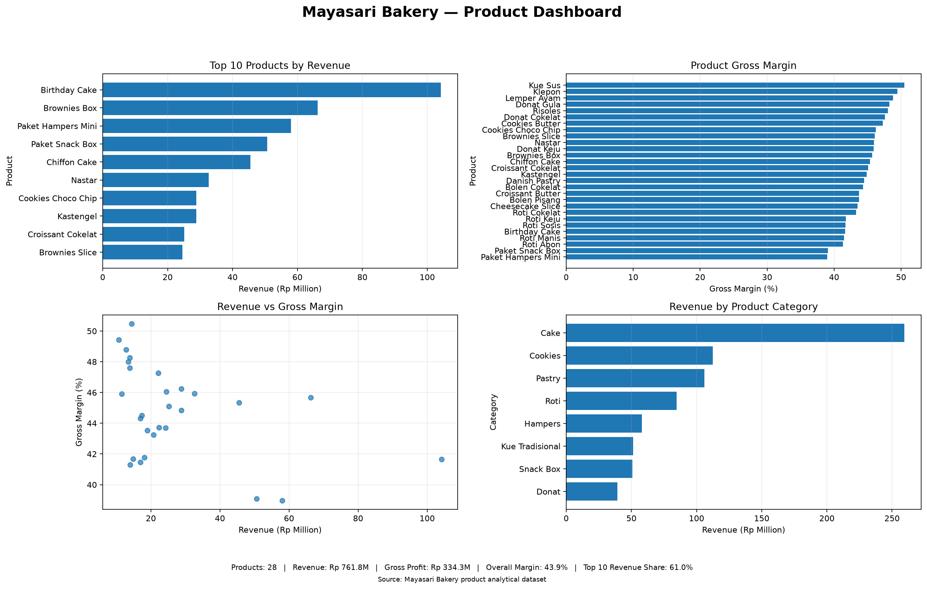
Product Performance
Revenue contribution and product mix

Slide 7
Product Management Takeaways
Revenue versus margin
Leading product: Birthday Cake with Rp 104.2M revenue.
High-revenue products should remain operational priorities.
Products with stronger margins should be evaluated for bundling and cross-selling.
Lower-margin products should be reviewed for pricing, cost, or product-mix opportunities.

Slide 8
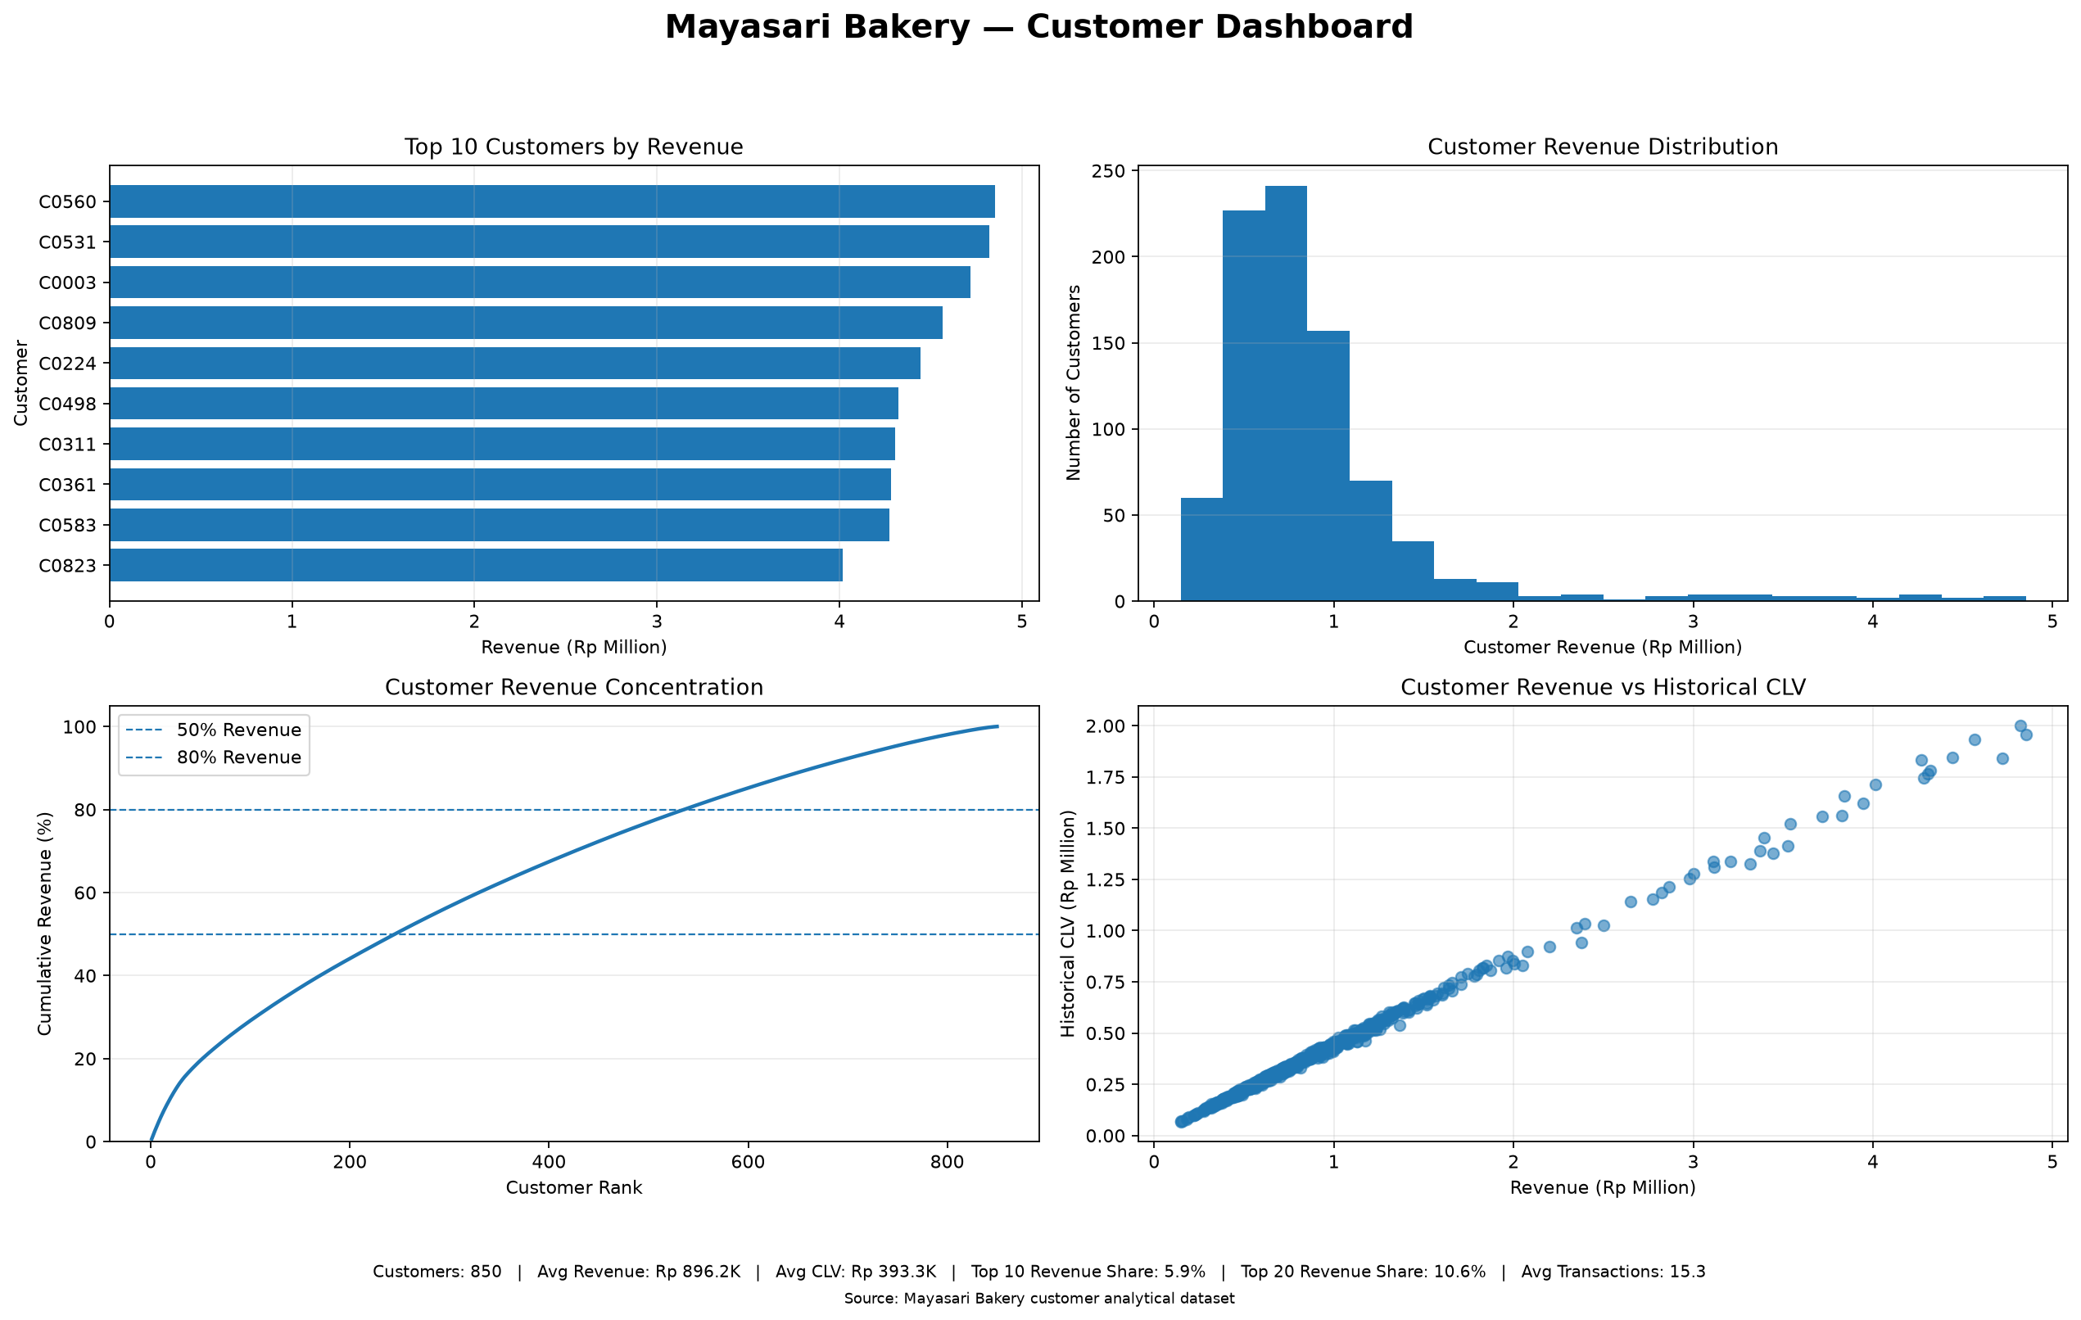
Customer Performance
Customer economics and value distribution

Slide 9
Customer Value Takeaways
CLV-based management priorities
Customer base: 850 customers.
Platinum customers contribute approximately 44.52% of annualized CLV.
Retention should prioritize economically important customers.
Customer value should be managed using CLV together with observed behavior.

Slide 10
Customer Opportunity
Opportunity prioritization

Slide 11
Opportunity Priorities
Where management attention should be concentrated
Review: 184 customers, 29.70% of annualized CLV.
Rescue: 147 customers, 24.51% of annualized CLV.
Develop: 169 customers, 17.36% of annualized CLV.
Rescue customers warrant economically targeted recovery actions.
Review customers require deeper diagnosis before intervention.
Develop customers provide a controlled growth opportunity.

Slide 12
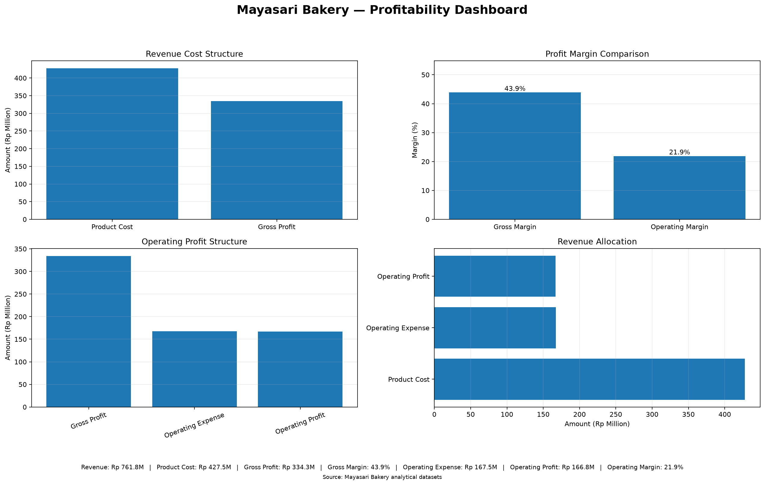
Profitability
Gross margin and operating profitability

Slide 13
Key Management Risks
Areas requiring continued monitoring
Revenue volatility across months can affect planning consistency.
Revenue concentration among leading products creates product-mix dependency.
High-value customer relationships require active retention management.
Margin differences across products can dilute profitability if mix is unmanaged.

Slide 14
Management Recommendations
Priority actions
1. Protect revenue momentum — identify repeatable drivers behind strong months.
2. Optimize product mix — balance revenue contribution with gross margin.
3. Protect high-value customers — prioritize Platinum and economically important relationships.
4. Prioritize Rescue and Review — allocate intervention based on customer economics.
5. Protect profitability — ensure revenue growth translates into sustainable operating profit.

Slide 15
Management Focus
Recommended decision framework
Grow revenue with discipline.
Protect gross margin.
Retain economically valuable customers.
Improve product-mix contribution.
Measure campaign and intervention outcomes.

