Slide 1
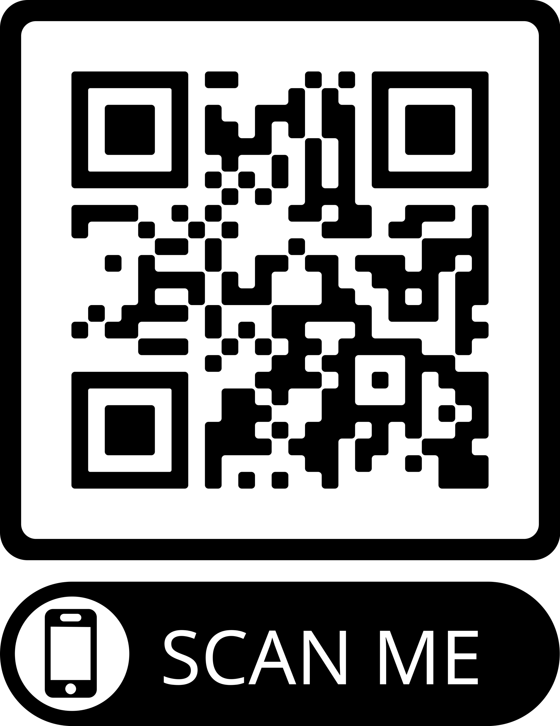
A Multidomain Relational Framework to Guide Institutional AI Research and Adoption
Vincent Straub, Deborah Morgan, Youmna Hashem, John Francis,
Saba Esnaashari and Jonathan Bright

Slide 2
How do we ensure that institutional AI research (on new metrics, technical standards, and governance mechanisms) better accounts for all the topics, issues, and methods potentially relevant to the institutional adoption of ethical AI?

Slide 3
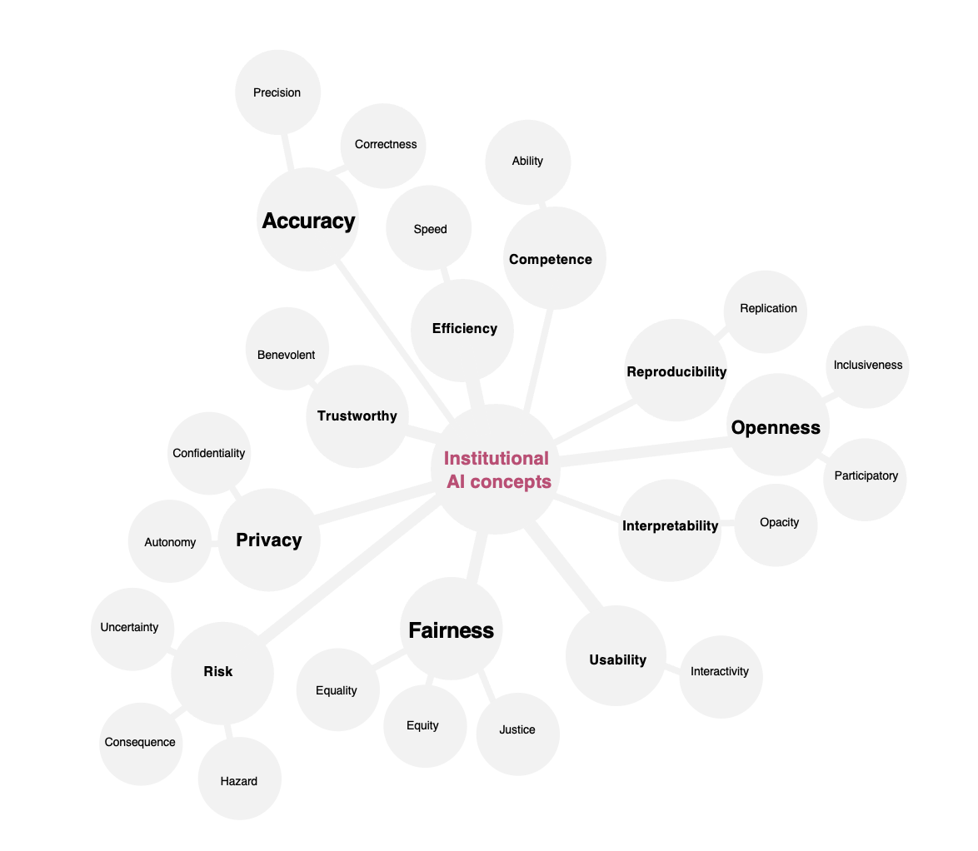

Slide 4
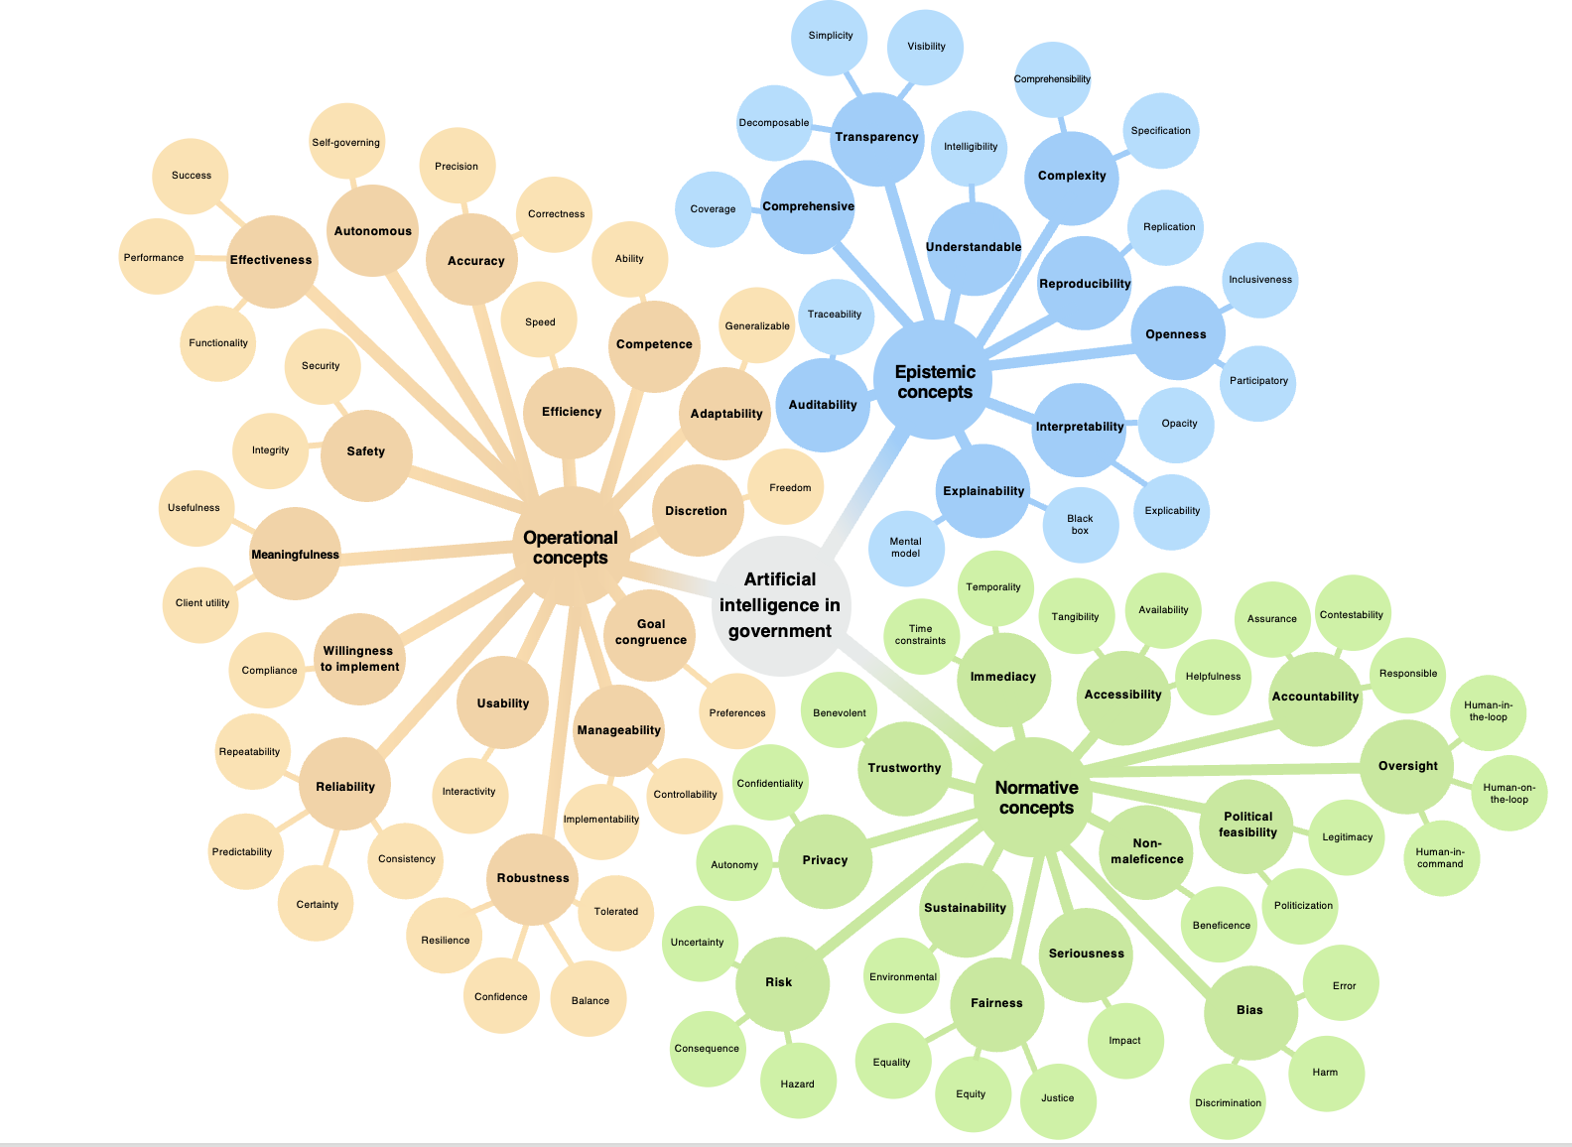



Knowledge-related issues
at human-machine interface
Epistemic
concepts
Operational
concepts
Normative
concepts
Routine machine activities and technical functionality
Moral entitlements, principles and values of affected groups

Slide 5
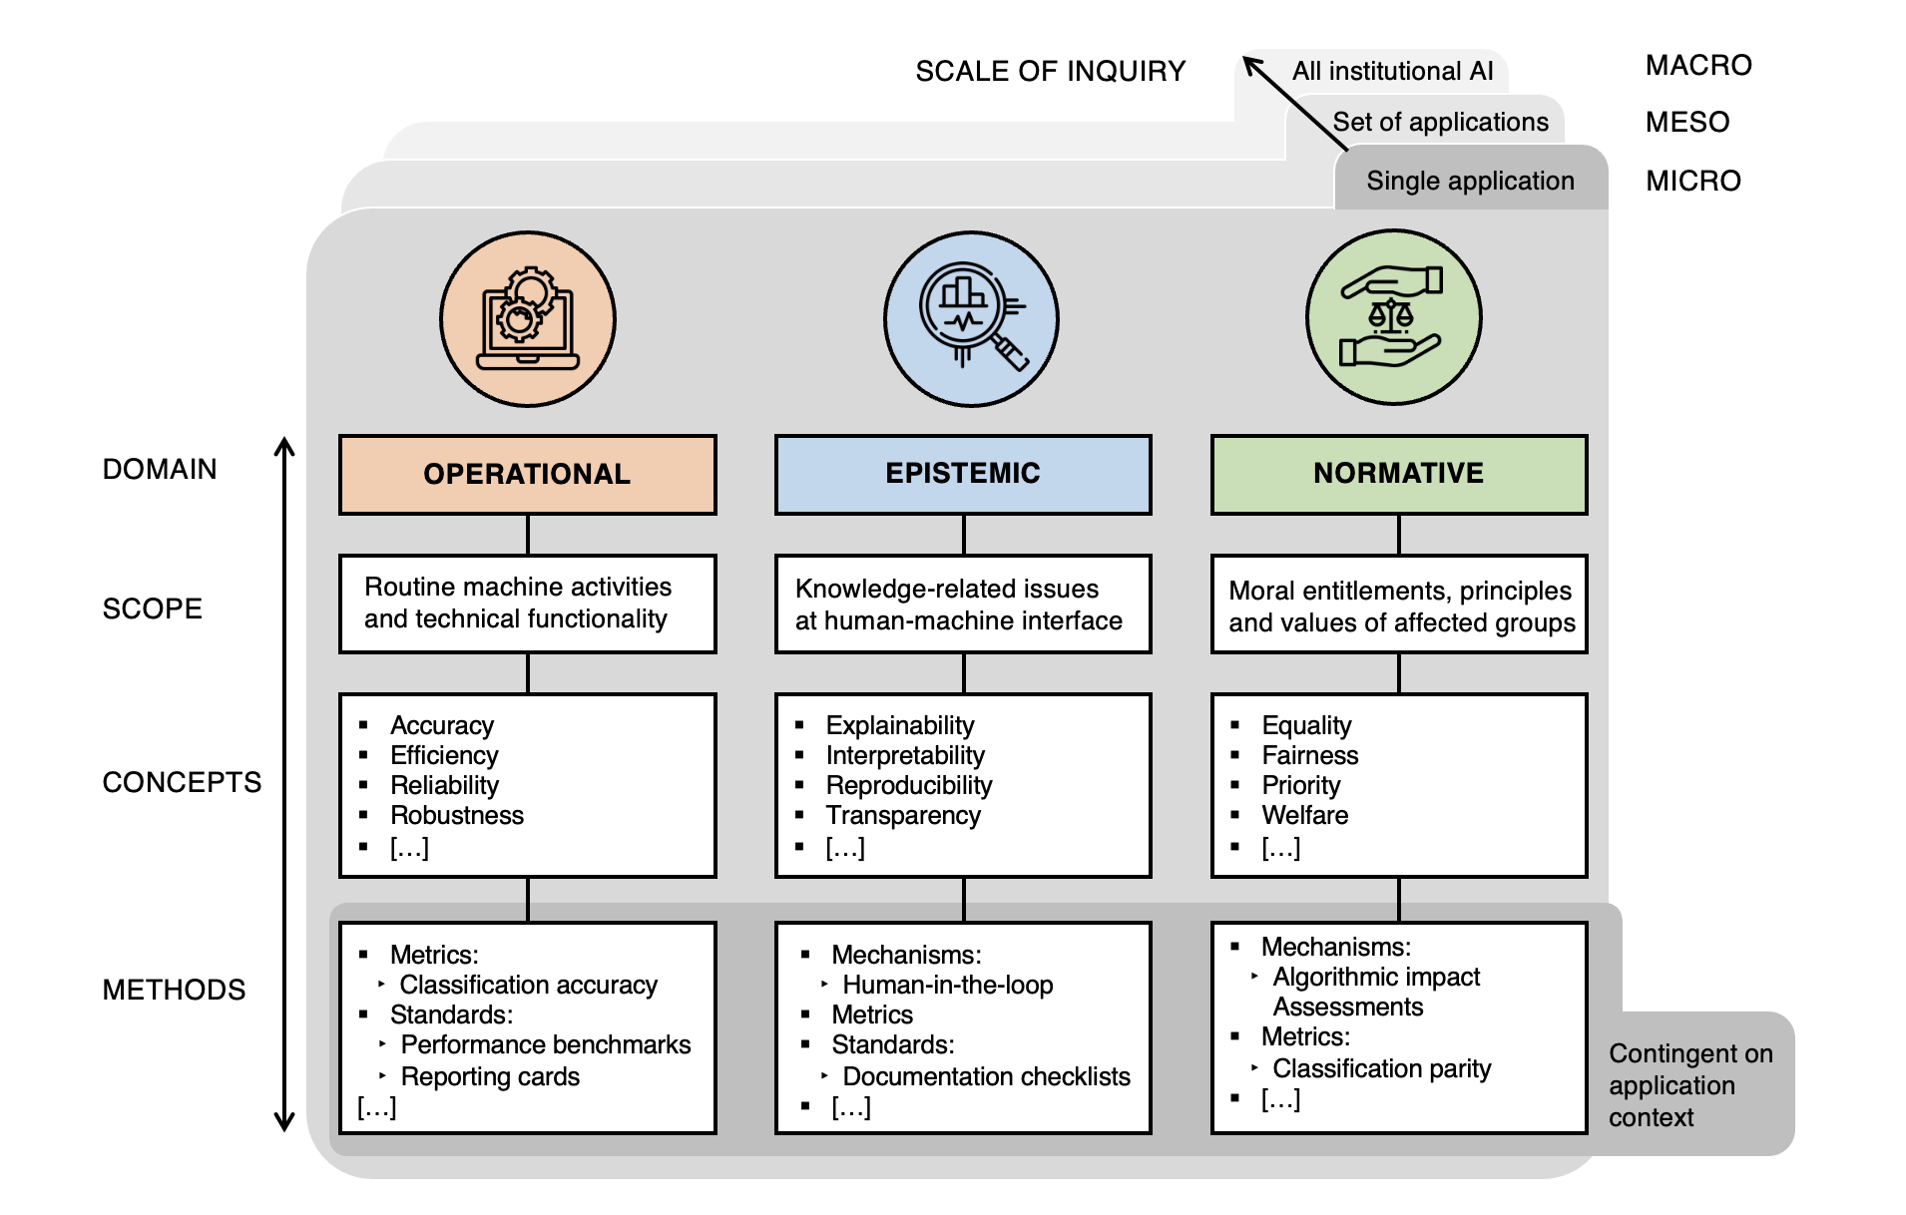

Slide 6
Thank you for listening
Vincent Straub
vstraub@turing.ac.uk

