Slide 1
A Multidomain Relational Framework to Guide Institutional AI Research and Adoption
Vincent J. Straub, Deborah Morgan, Youmna Hashem, John Francis,
Saba Esnaashari and Jonathan Bright
Straub, V. J., Morgan, D., Hashem, Y., Francis, J., Esnaashari, S., & Bright, J. (2023). A multidomain relational framework to guide institutional AI research and adoption. arXiv preprint arXiv:2303.10106.

Slide 2
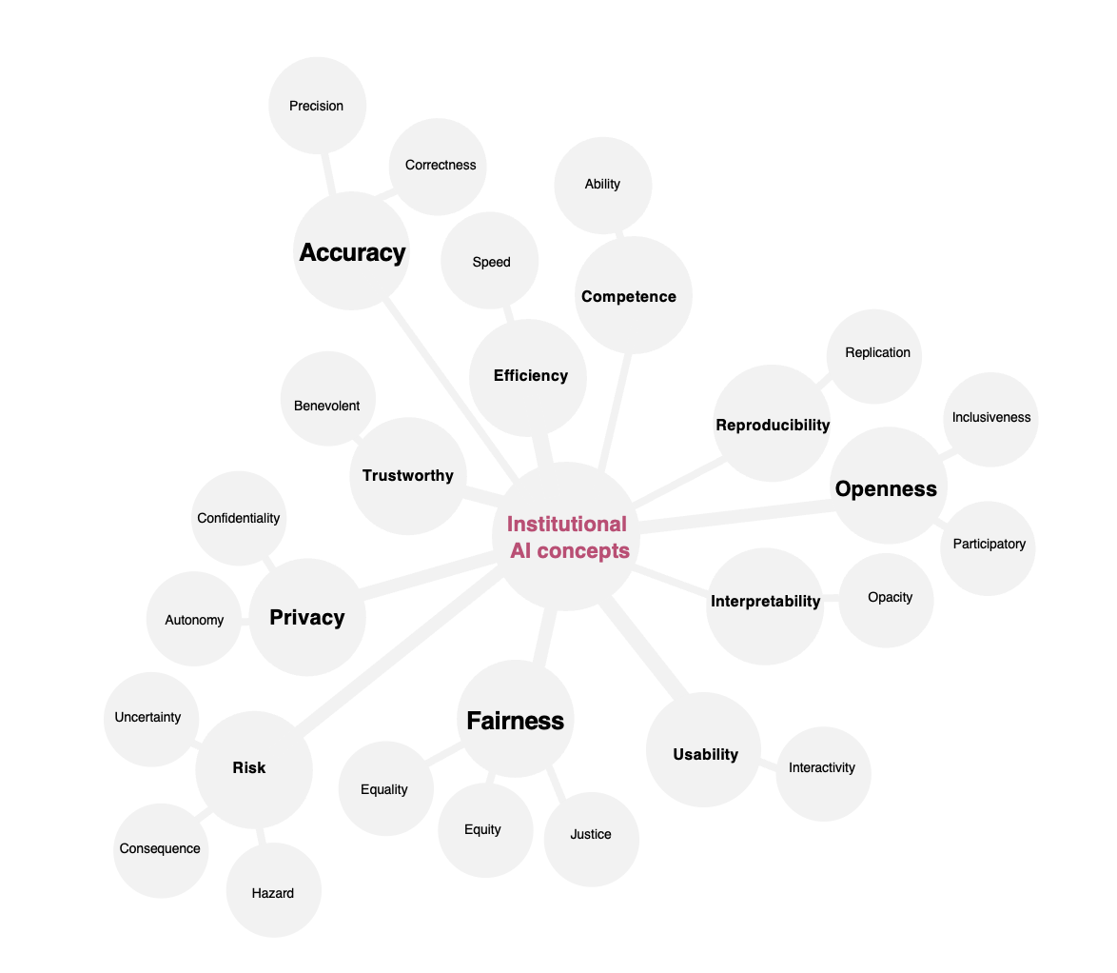
THE STATE OF SOCIO-TECHNICAL DISCOURSE
Disproportionate thematic focus (e.g., outcome fairness)
Semantic ambiguity
Differing terminologies
…

Slide 3
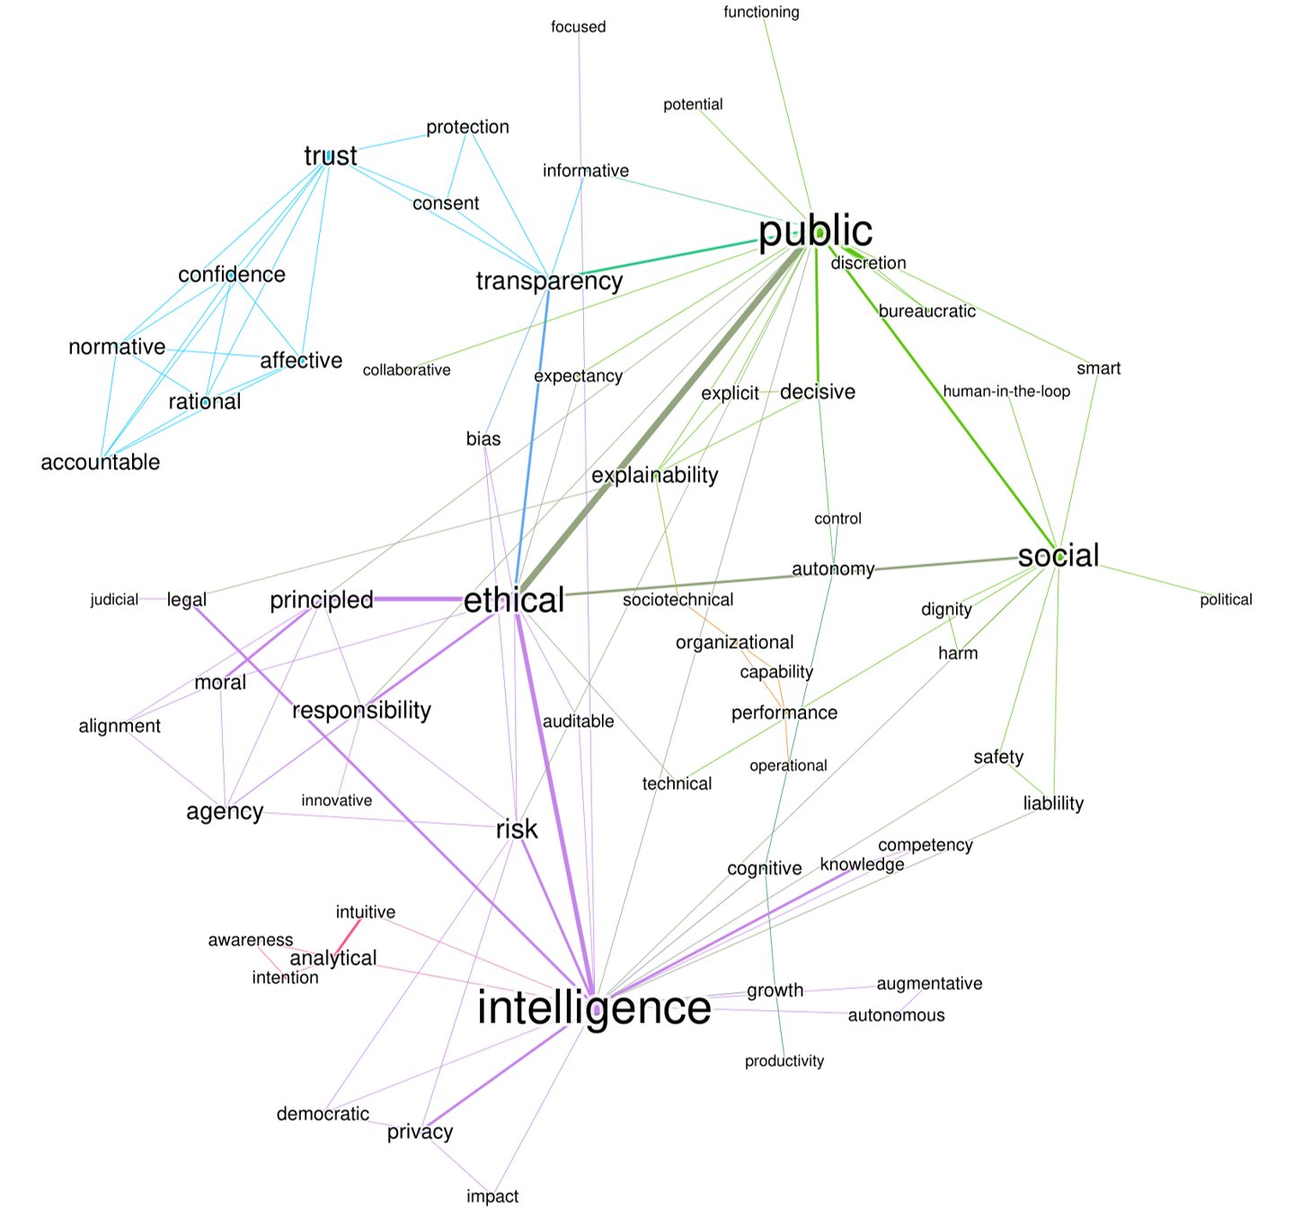
THE STATE OF SOCIO-TECHNICAL DISCOURSE
Disproportionate thematic focus (e.g., outcome fairness)
Semantic ambiguity
Differing terminologies
…
See: Straub, V. J., Morgan, Bright, J & Margetts, H. (2023). Artificial intelligence in government: Concepts, standards, and a unified framework. arXiv preprint arXiv:2210.17218

Slide 4
THE STATE OF SOCIO-TECHNICAL DISCOURSE
Disproportionate thematic focus (e.g., outcome fairness)
Semantic ambiguity
Differing terminologies
…
The 'relational problem’ is the ontological failure to explicitly connect terms and approaches with socio-technical discourse on institutional AI adoption … This results in rich-get-richer and echo-chamber system dynamics in institutional AI research as whole, whereby certain perspectives of important topics (i.e., mathematical definitions of outcome fairness) dominate discussion

Slide 5
How do we ensure that institutional AI research (on new metrics, technical standards, and governance mechanisms) better accounts for all the topics, issues, and methods potentially relevant to the institutional adoption of ethical AI?

Slide 6



Knowledge-related issues
at human-machine interface
Epistemic
concepts
A RELATIONAL MULTIDOMAIN FRAMEWORK TO GUIDE INSTITUTIONAL AI THEORIZING
Operational
concepts
Normative
concepts
Routine machine activities and technical functionality
Moral entitlements, principles and values of affected groups

Slide 7
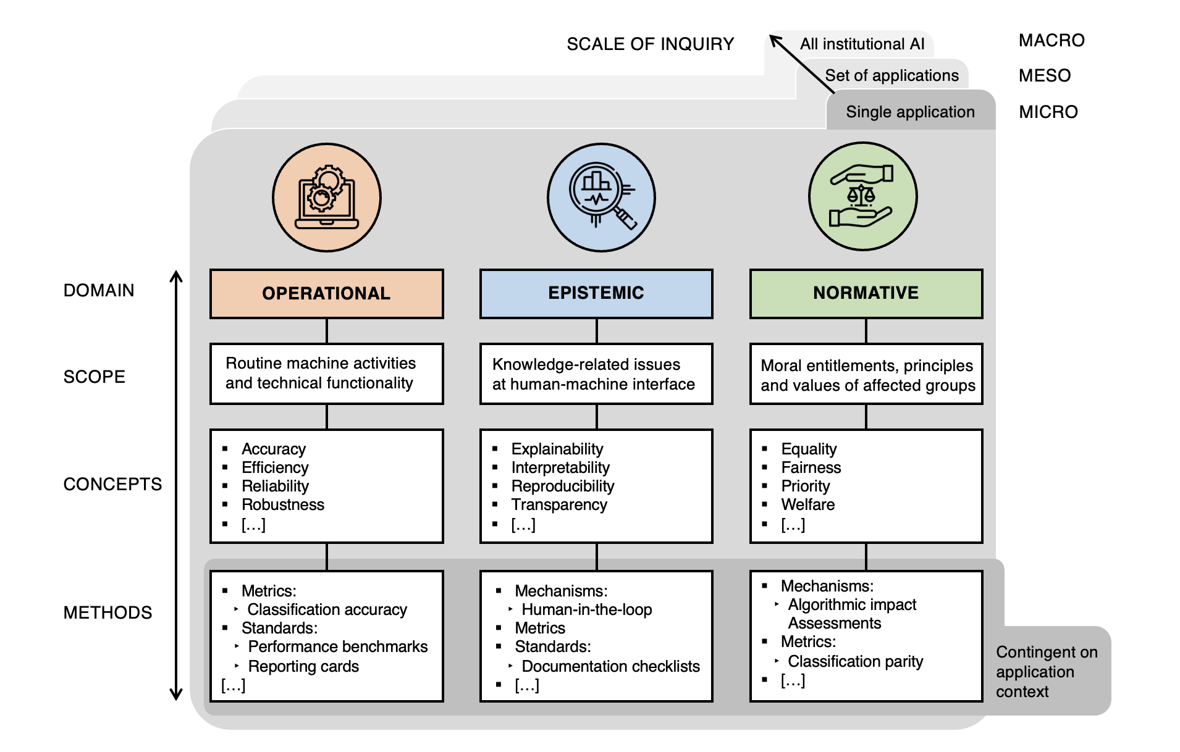
A RELATIONAL MULTIDOMAIN FRAMEWORK TO GUIDE INSTITUTIONAL AI THEORIZING
Domain
Scope
Concepts
Methods

Slide 8
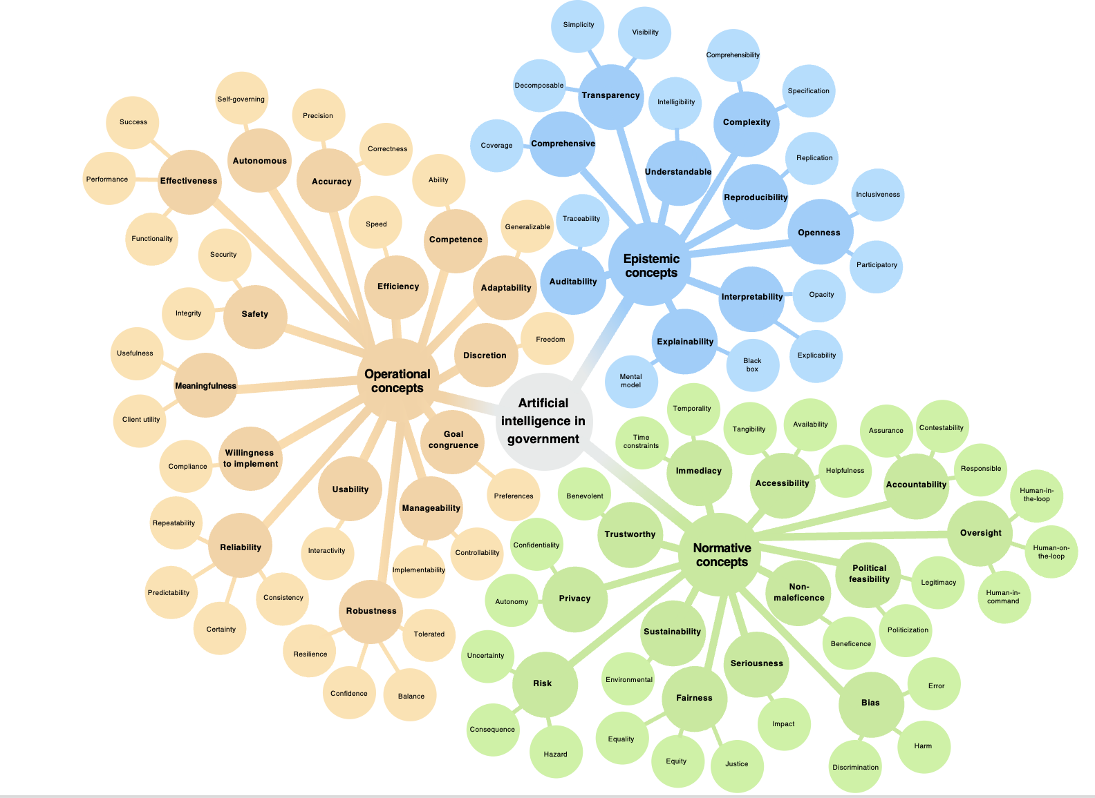
Knowledge-related issues
at human-machine interface
Epistemic
concepts
Operational
concepts
Normative
concepts
Routine machine activities and technical functionality
Moral entitlements, principles and values of affected groups

Slide 9
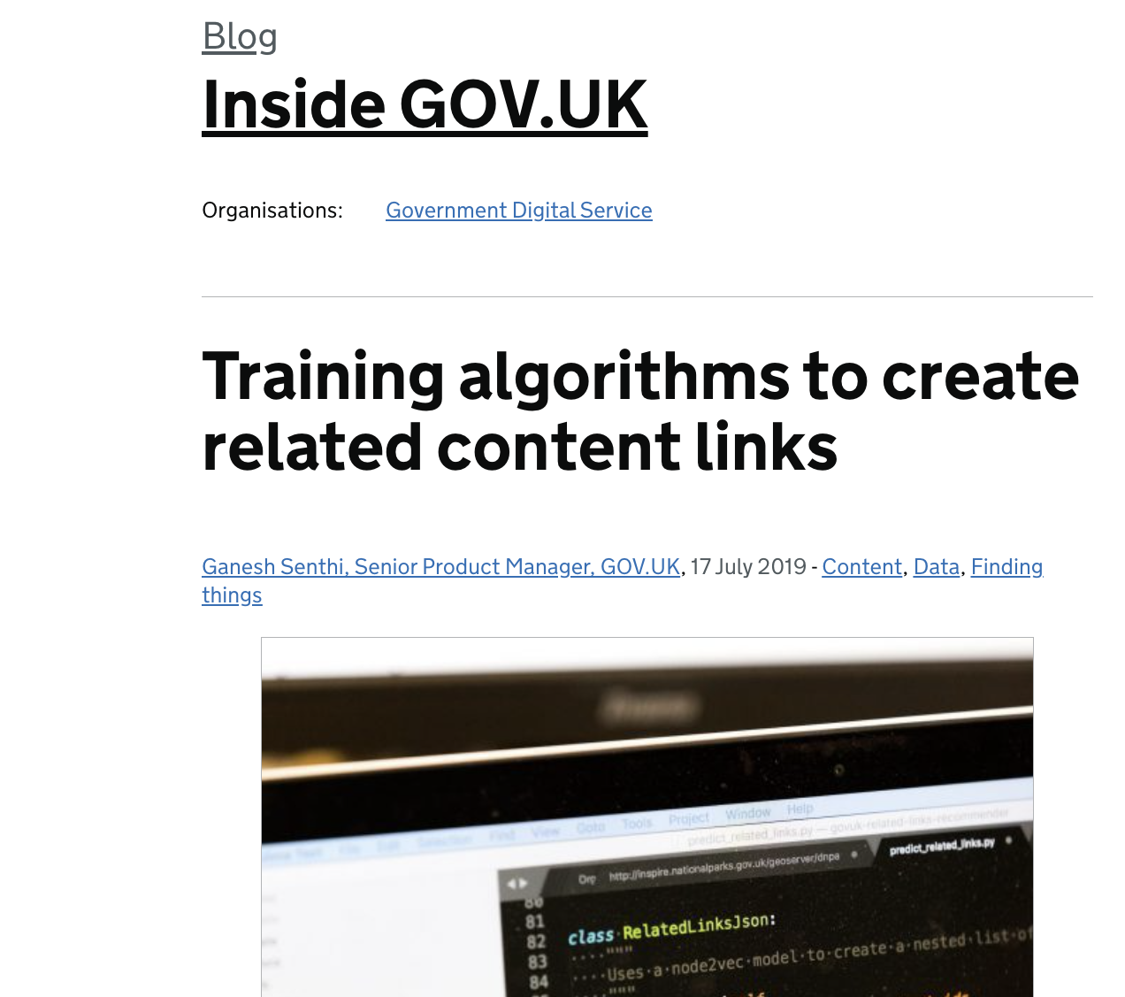
APPLYING THE FRAMEWORK
Four levels of abstraction (domain, scope, concepts, method) can be used to deductively guide the process of conceptualization (to decide what concepts and methods are most suitable to the application context)

Slide 10
MAPPING A RESEARCH AGENDA FOR A MULTIDOMAIN APPROACH TO INSTITUTIONAL AI
(1) Do we need to further delineate and operationalize the operational, epistemic, and normative domains as tangible concepts, or is it enough for these to act as abstract categories of analysis?
(2) To what extent does there need to be scholarly consensus on how we decide whether concepts fall into a particular domain and not into a different one?
(3) Should the importance of different concepts and metrics in a particular domain be considered? And if so, how?
(4) Is it of value to consider how we can move to unite each of the domains into a single category?
…

Slide 11
Key references
Selbst, A. D., Boyd, D., Friedler, S. A., Venkatasubramanian, S., & Vertesi, J. (2019, January). Fairness and abstraction in sociotechnical systems. In Proceedings of the conference on fairness, accountability, and transparency (pp. 59-68).
Green, B., & Viljoen, S. (2020, January). Algorithmic realism: expanding the boundaries of algorithmic thought. In Proceedings of the 2020 conference on fairness, accountability, and transparency (pp. 19-31).
Cooper, A. F., Abrams, E., & Na, N. (2021, July). Emergent unfairness in algorithmic fairness-accuracy trade-off research. In Proceedings of the 2021 AAAI/ACM Conference on AI, Ethics, and Society (pp. 46-54).
Birhane, A. (2021). Algorithmic injustice: a relational ethics approach. Patterns, 2(2).

Slide 12

Thank you for listening
dmorgan@turing.ac.uk
vstraub@turing.ac.uk

