Slide 1


Predictive Analytics for Workforce Stability: Identifying Attrition Factors
Michelle Zheng
Spring 2026 8W1
MSDS692

Slide 2


What is employee attrition?
Employee leaves & position not immediately replaced w/ new hire
Voluntary
Quitting
Retirement
Involuntary
Layoffs
Termination
employee attrition
team productivity
hiring cost
Motivation? Current role in department conducting new hire 5 wk basic training course, typically 20% stayed after 6 mths
Notes:
Employee attrition is when workers leave an organization and aren't immediately replaced.
Research shows that replacing a single employee can cost between one and a half to two times their annual salary.
For a large company, that can add up to millions of dollars every year just in turnover.
Also, when skilled people leave, organizations lose institutional knowledge, team morale drops and productivity suffers during the transition.
Most companies only react to attrition after it's already happened.
An opportunity could be in prediction where identifying which employees are at risk of leaving before they actually walk out the door.
My interest in this topic comes from my current role, where I am part of the department that conducts a 5-week basic training course for all new hires, and seeing only 20% still with us.

Slide 3



Employee Data & Ethical Concerns
1,470 records
35 features
Dataset: synthetic HR Employee Attrition & Performance dataset from IBM
Difficult to obtain real employee data
companies do not make personnel records public
accessing non-synthetic demographic data requires NDA making it inaccessible for open research
Anonymized personal data is vulnerable to re-identification
Netflix public dataset challenge: researchers were able to reverse-engineer anonymized customer records to identify individuals
Current Employees: 83.88%
Past Employees: 16.12%
Notes:
The dataset used is the IBM Watson HR Employee Attrition and Performance dataset, a synthetic dataset with 1,470 employee records and 35 features. It includes everything from compensation and job role to satisfaction ratings and years with the current manager.
Real employee data is difficult to obtain, companies do not make personnel records public and accessing non-synthetic demographic data typically requires an NDA making it inaccessible for open research. And anonymized personal data is vulnerable to re-identification. An example is the Netflix public dataset challenge where researchers were able to reverse-engineer anonymized customer records to identify individuals.
Back to the dataset, about 84% data makeup current employees and 16% of records are of employees who left.

Slide 4

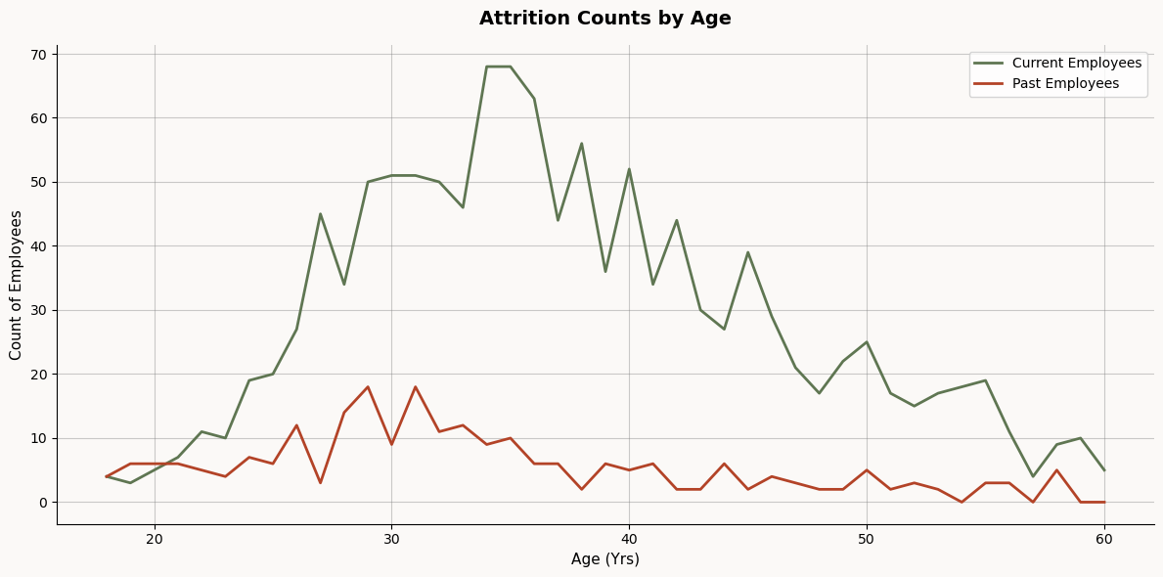
EDA & Preparation
(EDA) – Who had higher attrition rates?
Department: 1. Sales 2. HR 3. R&D
Monthly Income Group <$1,000-$4,000
Years w/ Current Manager: 0-2 years
18-20 Age Employees
Data Preparation:
Dropped constant/non-informative columns (EmployeeNumber, EmployeeCount)
Rating based columns → categorical types (JobSatisfaction)
Numerical column skewness >0.75 → log transformed
Independent t-test:
H₀: Average income by month of past employees is the same as employees still present.
p < 0.0001 → Average income by month of past employees is different as employees still present
Notes:
Before building any models, I explored the data visually across several dimensions.
Department, Sales had the highest attrition rate, followed by Human Resources. Research and Development had the lowest.
Age, younger employees in their mid-to-late twenties and early thirties accounted for the most departures. Attrition dropped noticeably after age 35, consistent with early-career job mobility patterns.
Income, employees who left were heavily concentrated in the lower monthly income brackets, between one thousand and four thousand dollars, while current employees were spread more evenly into higher ranges.
Manager tenure, employees who left were most concentrated among those with zero to two years with their current manager, suggesting that early manager-employee relationships are more fragile.
To prepare the data, I dropped four constant columns that added no information, converted rating-based columns to categorical types, and log-transformed nine skewed numeric features to bring their distributions closer to normal.
I also ran an independent t-test on monthly income, which confirmed that employees who left earned significantly less than those who stayed, with a p-value effectively at zero.

Slide 5
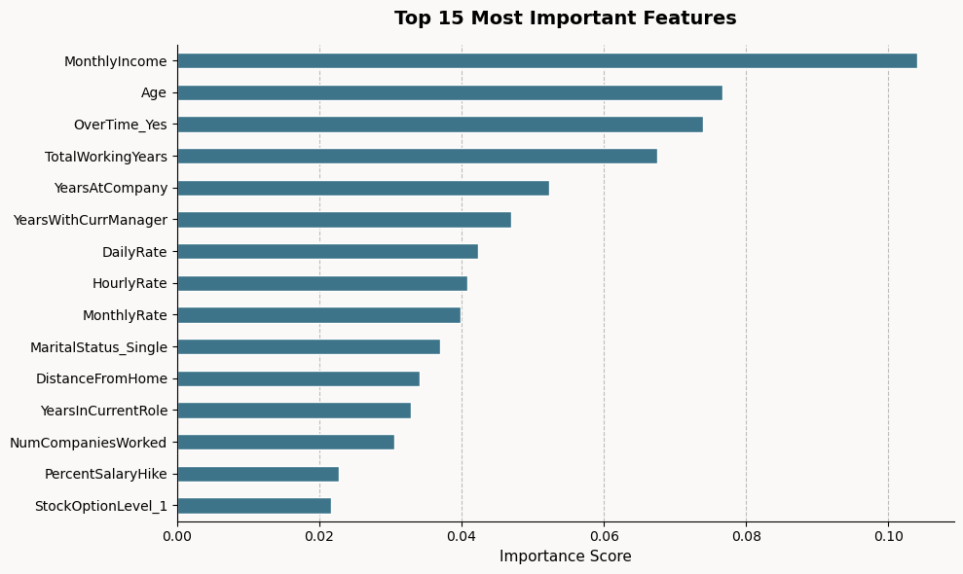
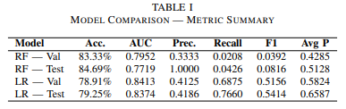
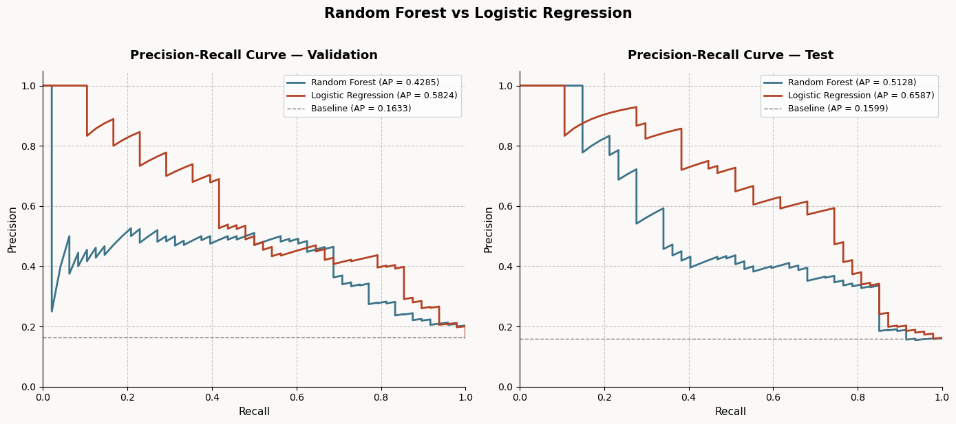
Models: Logistic Regression vs Random Forest
Correctly identified how many employees left in the test set
Metrics:
AUC & Recall > Acc.
Notes:
I trained and evaluated two models: Logistic Regression and Random Forest.
The Random Forest model showed feature importance scores. The top driver was monthly income, and then followed by age, overtime, total working years, years at the company and years with the current manager.
This confirms what the EDA suggested: compensation and tenure are some of the biggest predictors of whether someone stays or goes.
Random Forest achieved the higher accuracy, 84.69% on the test set. But it only correctly identified 4% of the employees who had actually left. It was essentially ignoring the past employee category entirely, which makes it not as useful for the actual purpose of tool.
Logistic Regression achieved a lower accuracy of 79.25%, but it correctly identified 77% of employees who had left. Its AUC score was also stronger at 0.8374, compared to 0.7719 for Random Forest.
The precision-recall curves tell the same story. Logistic Regression maintained a much stronger balance between precision and recall across thresholds, with an average precision of 0.6587 on the test set versus 0.5128 for Random Forest.
A key point is that accuracy is not the best metric for this situation and what the purpose of the model is, recall and AUC are better metrics.

Slide 6




Findings
Money (income) matters!!
Younger people (18-20) tend to leave the company
Logistic Regression > Random Forest
Future Directions
Real anonymized employee data
Real time system for continuous monitoring and flagging
Notes:
To summarize:
The top drivers of attrition are monthly income and then followed by age. Logistic Regression is the right model for this problem. It correctly flags three out of every four at-risk employees, giving HR teams the lead time to intervene with targeted retention efforts, it could be a compensation review or some sort of check-in conversation with a manager.
There are limitations. The dataset is synthetic, so models would need to be retrained on real organizational data before deployment. It also reflects a single point in time, not ongoing changes.
Future directions include integrating real anonymized employee data, and potentially building a real-time scoring system that continuously monitors and flags at-risk employees as conditions evolve.

Slide 7
References
Alqahtani, H., Almagrabi, H., & Alharbi, A. (2025). Dataset for predictive modelling and analysis of employee attrition and retention. Data in Brief, 63, 112242. https://doi-org.dml.regis.edu/10.1016/j.dib.2025.112242
Cooper, A. K., & Coetzee, S. (2020). On the ethics of using publicly-available data. Lecture Notes in Computer Science, 159–171. https://doi.org/10.1007/978-3-030-45002-1_14
Couronné, R., Probst, P., & Boulesteix, A.-L. (2018). Random Forest versus logistic regression: A large-scale benchmark experiment. BMC Bioinformatics, 19(1). https://doi-org.dml.regis.edu/10.1186/s12859-018-2264-5
Govindarajan, R., Kumar, N. K., P, S. R., E, S. P., B, D., & G, P. K. (2025). Predicting employee attrition: A comparative analysis of machine learning models using the IBM Human Resource Analytics Dataset. Procedia Computer Science, 258, 4084–4093. https://doi-org.dml.regis.edu/10.1016/j.procs.2025.04.659
Hoffman, M., & Tadelis, S. (2021). People Management Skills, employee attrition, and manager rewards: An empirical analysis. Journal of Political Economy, 129(1), 243–285. https://doi.org/10.1086/711409
Kim, J. (2025). The effect of mismanagement of poor performers on their coworkers’ turnover intentions. Public Personnel Management, 55(1), 118–144. https://doi-org.dml.regis.edu/10.1177/00910260251360823
Kirasich, K., Smith, T., & Sadler, B. (2018). Random Forest vs Logistic Regression: Binary Classification for Heterogeneous. SMU Data Science Review, 1(3). https://scholar.smu.edu/datasciencereview/vol1/iss3/9
Lee, F., & Algarra, A. (2025). Leveraging topic modeling to predict and prevent employee attrition. Information Systems Education Journal, 23(4), 59–84. https://doi.org/10.62273/mqnf1140
Manafi Varkiani, S., Pattarin, F., Fabbri, T., & Fantoni, G. (2025). Predicting employee attrition and explaining its determinants. Expert Systems with Applications, 272, 126575. https://doi-org.dml.regis.edu/10.1016/j.eswa.2025.126575
Narayanan, A., & Shmatikov, V. (2006). How to break anonymity of the Netflix Prize dataset. arXiv. https://doi.org/10.48550/arXiv.cs/0610105
Srivastava, G. N., Sharma, H., Agarwal, R. N., & Jain, A. K. (2025). Analyzing employee attrition of research and development firms using mixed methods. Cogent Business &amp; Management, 12(1). https://doi-org.dml.regis.edu/10.1080/23311975.2025.2565439
Susser, D., Schiff, D. S., Gerke, S., Cabrera, L. Y., Cohen, I. G., Doerr, M., Harrod, J., Kostick‐Quenet, K., McNealy, J., Meyer, M. N., Price, W. N., & Wagner, J. K. (2024). Synthetic Health Data: Real ethical promise and peril. Hastings Center Report, 54(5), 8–13. https://doi.org/10.1002/hast.4911

