Slide 1
Neighborhood-Aware Recidivism Prediction
An Open-Source, Socio-Economically Informed Model
Trained on the Wisconsin Circuit Court Dataset
MSDS 696 | Regis University | Data Science Practicum
1

Slide 2
Why Build a New Model When COMPAS Already Exists?
COMPAS is proprietary: defendants, lawyers, and judges cannot inspect how scores are generated or challenge them in court.
COMPAS is racially biased: it is talked about how it incorrectly flagged Black defendants as high risk at nearly twice the rate of white defendants.
COMPAS ignores place: no deployed tool incorporates neighborhood-level socioeconomic context, despite decades of criminological evidence that where you live could predict recidivism.
Fully open-source, auditable recidivism model on WCLD that quantifies how neighborhood deprivation shapes risk and publishes every fairness metric alongside predictions.
Interactive Dashboard: https://recidivismpredictionwcc-kfyajwz7quye87vxkogsah.streamlit.app/
2

Slide 3
DATASET OVERVIEW
Wisconsin Circuit Court Longitudinal Data (WCLD)
Dataset at a Glance
Key Missing Value Structure
1,357,746 model-ready cases after cleaning
54 original columns; 2000 to 2018 coverage across Wisconsin
Target: recid_180d (new offense within 180 days of disposition)
42.2% recidivism rate (573,131 cases); 57.8% no recidivism (784,624 cases)
8.1% excluded: sentences over 180 days cannot be observed for re-offense (structural, not random missingness)
jail: 56.6% missing — no jail sentence imposed probation: 30.1% missing — no probation imposed
hist_jail columns: 19.1% missing — imputed to 0; binary has_prior_jail flag created
zip: 2.7% missing — address unavailable
4

Slide 4
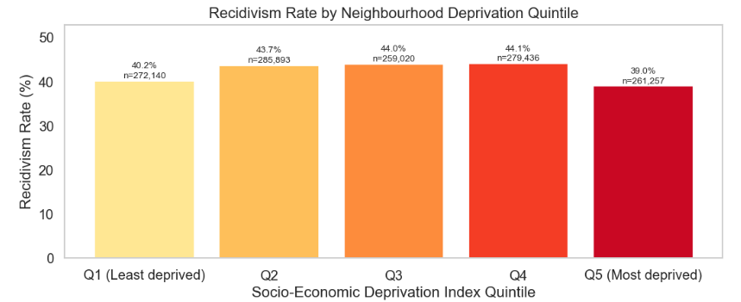
FEATURE ENGINEERING
Building the Socio-Economic Deprivation Index (SEDI)
SEDI Formula
SEDI = mean Z-score ( food stamps, pct Black, pct Hispanic )
minus mean Z-score ( median household income, pct college degree )
Higher score = more deprived neighborhood
5

Slide 5
ANALYSIS METHODS
Modeling Pipeline: Five Key Decisions
01 — Stratified 80/20 split: preserves 42.21% recidivism rate in both training and test partitions; unstratified splits produce incomparable evaluation metrics.
02 — SMOTE on training set only (k=5 neighbors, 50/50 balance, 1.26M rows): applied after the split to prevent synthetic samples from contaminating the held-out test set.
03 — StandardScaler on Logistic Regression only: tree-based models are scale-invariant; scaling Random Forest or XGBoost adds computation with no benefit.
04 — Three models benchmarked: Logistic Regression (C=0.01, strongly regularized baseline), Random Forest (300 trees, max_depth=10, min 20 samples per leaf), XGBoost (400 estimators, learning rate 0.05, 80% subsampling per Chen and Guestrin 2016).
05 — SHAP TreeExplainer for attribution: game-theoretically grounded, instance-level, and globally comparable; SHAP values sum to the model output and decompose cleanly by feature category.
6

Slide 6
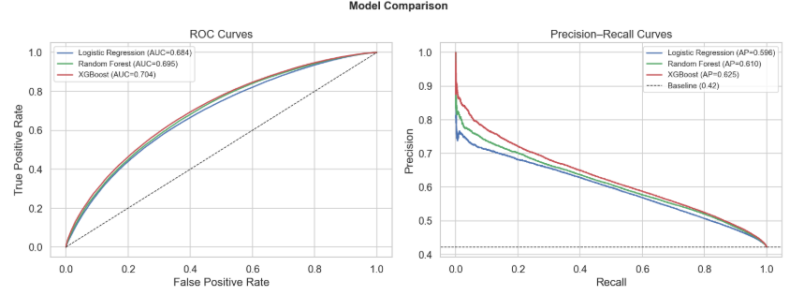
RESULTS
Three Classifiers
No Recidivism: precision 0.69, recall 0.74, F1 0.71
Recidivism: precision 0.60, recall 0.55, F1 0.57
Overall accuracy: 66%
Model is better at identifying who will NOT reoffend (recall 0.74) than who will (recall 0.55)
Model | AUC-ROC | AUC-PR
Logistic Regression | 0.6839 | 0.5963
Random Forest | 0.6954 | 0.6096
XGBoost (best) | 0.7043 | 0.6247
7

Slide 7
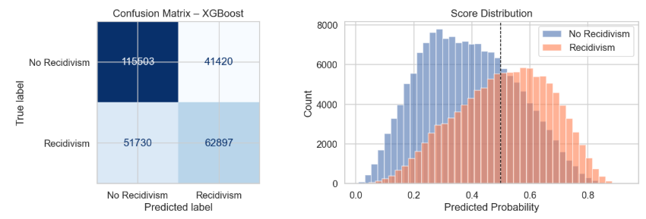
XGBoost Prediction Behavior
8

Slide 8
SHAP Analysis: Individual vs. Neighborhood Effects
81.3%
18.7%
of SHAP explanation mass from
individual features (age, priors, severity)
of SHAP explanation mass from
neighborhood features (SEDI, income, education)
Nearly one-fifth of the model's explanatory power comes from where a defendant lives a contribution that COMPAS and every other deployed risk tool ignores entirely.
Top individual predictors: prior misdemeanor count, prior record score, prior felony count, and age at offense.
Top neighborhood predictors: SEDI composite, median household income, and pct_food_stamps.
The SHAP dependence plot for SEDI (Figure 9) shows a non-linear curve: moderate deprivation raises predicted recidivism, but extreme deprivation plateaus and reverses, consistent with the ceiling effect observed in the quintile analysis.
9

Slide 9
Fairness Audit by Race and Ethnicity
Group | N | Actual Rate | TPR | FPR
Am. Indian / AK Native | 11,897 | 55.8% | 0.680 | 0.429
African American | 58,470 | 46.4% | 0.573 | 0.282
Asian / Pacific Isl. | 2,546 | 39.7% | 0.634 | 0.295
Caucasian | 179,717 | 40.2% | 0.534 | 0.253
Hispanic | 18,920 | 39.6% | 0.470 | 0.232
Key Findings
TPR gap: 21 points (Am. Indian 0.680 vs Hispanic 0.470)
FPR gap: 20 points (Am. Indian 0.429 vs Hispanic 0.232)
Gaps are mathematically unavoidable when base rates differ across groups (Chouldechova 2017)
Calibration is strong: predicted rates track actual rates within 2 percentage points across all SEDI quintiles
Responsible deployment requires disclosing these figures to defendants and courts
10

Slide 10
CONCLUSIONS AND FUTURE WORK
Key Findings
Future Work
Neighborhood features account for 18.7% of SHAP explanation mass
SEDI-recidivism relationship is non-linear; tree models required
TPR and FPR gaps exceed 20 points across racial groups
Individual features dominate (81.3%) but neighborhood adds critical context
Interactive Dashboard
Longer windows: 365-day or 3-year recidivism outcomes
Threshold optimization: multi-objective accuracy vs. fairness parity tradeoff
External validation: Illinois or Minnesota court data for generalizability
https://recidivismpredictionwcc-kfyajwz7quye87vxkogsah.streamlit.app/
11

Slide 11
REFERENCES
Angwin et al. (2016). Machine Bias. ProPublica.
Ash et al. (2021). Wisconsin Circuit Court Longitudinal Data. ETH Zurich / Oxford.
Barocas, Hardt and Narayanan (2023). Fairness and Machine Learning. MIT Press.
Chawla et al. (2002). SMOTE: Synthetic Minority Over-sampling Technique. JAIR, 16.
Chen and Guestrin (2016). XGBoost: A Scalable Tree Boosting System. KDD 2016.
Chouldechova (2017). Fair Prediction with Disparate Impact. Big Data, 5(2).
Dressel and Farid (2018). The Accuracy, Fairness, and Limits of Predicting Recidivism. Science Advances.
Hardt, Price and Srebro (2016). Equality of Opportunity in Supervised Learning. NeurIPS.
Kind et al. (2014). Neighborhood Socioeconomic Disadvantage and Rehospitalization. Ann. Int. Med.
Lundberg and Lee (2017). A Unified Approach to Interpreting Model Predictions. NeurIPS.
Pedregosa et al. (2011). Scikit-learn: Machine Learning in Python. JMLR, 12.
Sampson, Raudenbush and Earls (1997). Neighborhoods and Violent Crime. Science, 277.
12

