Slide 1
MSDS 640: Week 4 Organizational Policies and Compliance
Ksenia Polson, Ph.D.
kpolson@regis.edu
Notes:
Talk about chat GTP
This week you will explore organizational cultures, norms and policies, professional codes of conducts, and how compliance can provide challenges that affect individuals, organizations, and professional groups.
When discussing policy and compliance, this could be compliance at the individual level or compliance at an organizational level. The question is are there policies, ethical codes in place to guide individuals on what to do when issues arise. What is appropriate and who defines these rules? What are the ramifications of someone not following rules. There are numerous examples of this.

Slide 2
Last Week
Six Ethics Lenses
Government Regulations Overview
Value of privacy
Privacy regulatory models
Fundamental Principles in Privacy Regulation
Notes:
Ethics lenses: utilitarian lens, care lens, common good lens, rights lens, justice lens, virtue lens

Slide 3
Week 4 Outline
A Data Science Code of Ethics?
Several Codes of Conduct
Discuss Ethics and Employment issues
Learn about Organizational Policies and Compliance
Discuss ethical issues in workplace algorithms.

Slide 4
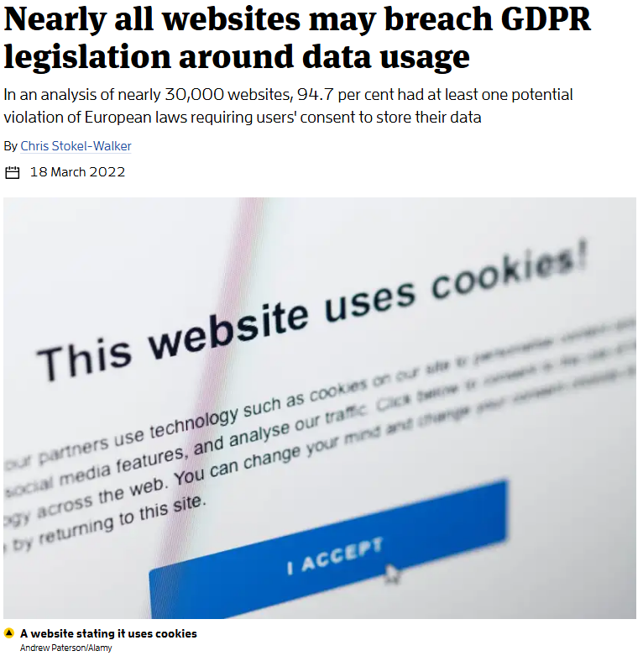
A Code of Ethics for Big Data?
Tradeoff between government regulations and capitalism
Some companies have vague terms of agreement and use
Using the data from 30,000 companies about 94.7% of them had at least one potential violation of GDPR rules regarding use of consumer data. Link
Standards take a long time to develop
https://www.newscientist.com/article/2312820-nearly-all-websites-may-breach-gdpr-legislation-around-data-usage/
Notes:
Within data science we don’t have a single code of ethics.
COO of data analytics provider First Rain argues against an overly burdensome standard. Struggle between companies providing customized products to consumers while maintaining consumer privacy
Ninety-five per cent of websites may breach General Data Protection Regulation (GDPR) rules around user cookie storage.
How should companies balance ethics with data use?

Slide 5
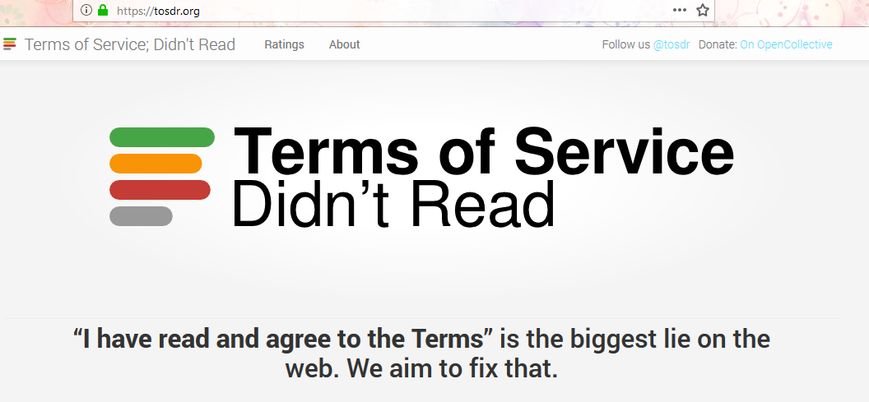
Making Terms of Service clearer?
Notes:
Analyzes terms of service and provides a grade in terms of fairness with regards to consumer rights and privacy
Users often struggle with complex terms of service.
Clear terms help build trust and ensure informed consent
How can we make terms more transparent for users?

Slide 6
Other Data Science Ethical Codes
Royal Statistical Society: A Guide for Ethical Data Science
The Royal Statistical Society (RSS) and the Institute and Faculty of Actuaries
Data Science Association
The Data Science Association
DrivenData Checklist: Steps to maintain ethical data practices
DrivenData Ethics checklist for Data Science Projects
Organizations have their own ethics regulations
Notes:
The codes refer to best practices for using and collecting data ethically.
For example, if we decide to clean the data in a certain way (e.g. by replacing missing values with zeros), then we should document who made that decision, when, and why. There are also some dataset version control systems out there and more being developed, such as DVC.

Slide 7
Ethical Issues in Data investigations
Misuse
Prejudice
Discrimination
Mortgage
Access to schools
Job
Health insurance
Notes:
Often the purpose of investigations into people is intended to make judgements about individuals. What are the ramifications of getting information that is wrong?
Employers can use a data broker’s profile of a job candidate to infer their medical information, conditions or disabilities; then a hiring algorithm can factor in the cost of an inferred medical condition(even if the inference is inaccurate), and label a job candidate with a low overall score if they are identified as likely to be high-cost, without revealing that the specific health factor that resulted in an adverse impact for a job candidate

Slide 8

Ethical Issues in Employment Settings
42% of companies use AI for screening job applicants, another 40% are considering using it (early 2024). Link
Sandra Wachter et al., University of Oxford’s Internet Institute, identifies bias through the Conditional Demographic Disparity test. Link
U.S Equal Employment Opportunity Commission (EEOC)
sued iTutorGroup, Inc, online English-language tutoring service, who screened out applicants over 55 years of age. The company has agreed to pay $365K in damages. Link
Some tech companies (Google) share payroll data with Equifax
Work Number has collected and stored data for millions of Americans. Link
https://www.oii.ox.ac.uk/news-events/ai-modelling-tool-developed-by-oxford-academics-incorporated-into-amazon-anti-bias-software-2/
Notes:
Human resources managers and employers sifting through job applicant pools by applying hiring algorithms. The products are quantitative but may not be fair.
AI Modeling Tool: developed by Oxford Academics incorporated into Amazon anti-bias software. The test aligns with approaches used by courts across Europe in an anti-discrimination law. She calls for establishing ethical decision-making in algos
Equifax data sharing: Workers then don’t have to rely on their former employer to directly confirm the points on their résumé each time they’re looking for a new job, or need a loan or mortgage. But the workers at Google worried that it’s risky to house such sensitive data in one central database controlled by a company that has faced data security challenges in the past.

Slide 9
Ethical Issues in Workplace algorithms
Often hiring algorithms are based on data collected historically to create predictions regarding an applicant’s job performance
What could be the problem?
Entelo, developed an anti-discrimination, diversity-hiring algorithm to sort candidates by protected class characteristics. Link
Entelo removes features like name, gender, ethnicity, career gaps etc.
How can we reduce bias in algorithms without sacrificing utility?
Notes:
One group could be over represented over another- leading to inaccurate results
Entelo: infers skills for candidates based on information pooled by their peers; introducing inclusive language in recruiting emails

Slide 10
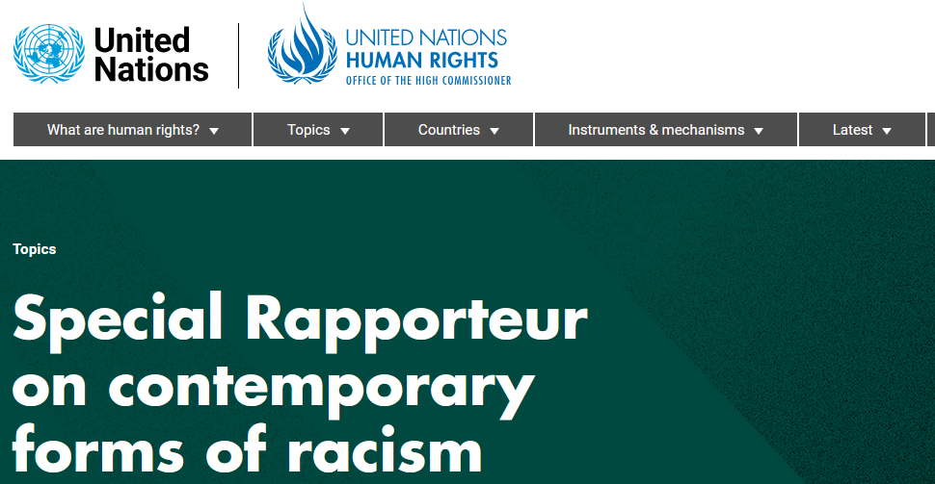
Ethical Issues: What to do?
What policies could be put in place to monitor AI biases?
Policies in the U.S.
Executive Order 14110 on the Safe, Secure, and Trustworthy Development of and Use of Artificial Intelligence
Voluntary AI Bill of Rights, link
EU Artificial Intelligence Act, link
https://documents.un.org/doc/undoc/gen/g24/084/20/pdf/g2408420.pdf

Slide 11
Data Analytics companies “talking the talk”
Retention Science (acquired by Constant contact)
Does not share data across clients
Data scientists must sign confidentiality agreements
Third-parties ask customers’ consent for the use of their data
BlueKai- acquired by Oracle
Online portal with customers’ cookies based on browsing history
Acxiom
https://isapps.acxiom.com/optout/optout.aspx
Option to opt out or update preferences
Notes:
use consumer data to gain insights and maintain consumer’s rights and privacy.
Retention science, a data analytics firm uses algorithms to predict customer’s purchase probability and build retention marketing campaigns to create targeted campaigns while protecting consumer privacy
Confidentiality agreements- data stays within the confines of company- not allowed to be used elsewhere for publication.
BluKai- a vendor offering data management platforms allows customers a way to view data collected about them

Slide 12
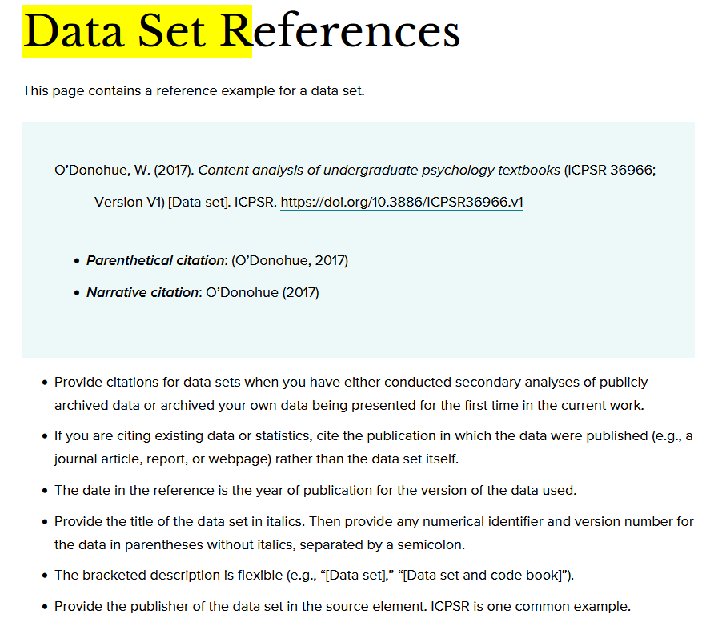
APA. (2020). How to Cite a Data Set in APA Style. Retrieved from APA Style. https://apastyle.apa.org/style-grammar-guidelines/references/examples/data-set-references

Slide 13
Assignment
Work on your Ethics Grand Rounds presentations to commence next week!

Slide 14
Government Regulations Presentations
Notes:
Amazon Sidewalk: echo devices that extends as wifi that makes it like a publc internet wifi. It sounds like a breach in security and privacy. Back in may of 2021, this setting was enabled automatically. No direct knowledge of this happening which users can easily skip over.

