Slide 1
RISK MANAGEMENT

Slide 2
Software Risks
No proper definition for software risk
Risk always involves two characteristics:
  Uncertainty: risk may or may not happen; there are no 100% probable risks
  Loss: if the risk becomes a reality, unwanted consequences or losses will occur

Slide 3
Risk Categorization
There are three (3) different categories of risk:
  Project risk
  Technical risk
  Business risk

Slide 4
Project risk
Threaten the project plan
If project risk becomes real, it is likely that project schedule will slip and that costs will increase
Project risk identify:
  Potential budgetary
  Schedule
  Personnel
  Resource
  Customer
  Requirements problems and their impact on software project.

Slide 5
Technical risk
Threaten the quality and timeliness of the software to be produced
If technical risks becomes a reality, implementation may become difficult or impossible
Technical risks identify:
  Potential design
  Implementation
  Interface
  Verification
  Maintenance problem

Slide 6
Business risk
Threaten the viability the software to be built.
Often jeopardize the project or product
Top FIVE business risk:
  Building an excellent product or system that no one really wants
  Building a product that no longer fits into the overall business strategy for the company
  Building a product that the sales force doesn’t understand how to sell
  Losing the support of senior management
  Losing budgetary or personnel commitment

Slide 7
Another general categorization of risks has been proposed by Charette:
  Known risks
  Predictable risk
  Unpredictable risk

Slide 8
Known risk
Those that can be uncovered after careful evaluation of the project plan, the business and technical environment in which the project is being developed, and other reliable information sources (unrealistic delivery date, lack of documented requirements or software scope, poor development environment)

Slide 9
Predictable risk
Extrapolated from past project experience
Example:
  Staff turnover
  Poor communication with the customer
  Dilution of staff effort as ongoing maintenance request are serviced

Slide 10
Unpredictable risk
Risk that can occur but they are extremely difficult to identify in advance.

Slide 11
Risk identification
A systematic attempt to specify threats to the project plan
Two distinct types of risks for each of the categories:
  Generic risk: potential threat to every software project
  Product-specific risk: can be identified only by those with a clear understanding of the technology, the people and the environment that is specific to the project at hand

Slide 12
One method for identifying risks is to create a risk item checklist
The checklist can be used for risk identification and focuses on some subset if known and predictable risks in the following generic subcategories:
  Product size
  Business impact
  Customer characteristics
  Process definition
  Development environment
  Technology to be built
  Staff size and experience

Slide 13
Assessing overall project risk
The following questions have derived from risk data obtained by surveying experienced software project managers in different part of the world:
  Have top software and customer managers formally committed to support the project?
  Are end users enthusiastically committed to the project and the system to be built?
  Are requirements fully understood by the software engineering team and their customers?
  Have customers been involved fully in the definition of requirements?
  Do end users have realistic expectation?
  Is project scope stable?
If any one of these questions is answered negatively, mitigation, monitoring and management steps should be instituted without fail.

Slide 14
Risk components and drivers
Risk components are defined in the following manner:
  Performance risk: the degree of uncertainty that the product will meet its requirements and be fit for its intended use
  Cost risk: the degree of uncertainty that the project budget will be maintained
  Support risk: the degree of uncertainty that the resultant software will be easy to correct, adapt and enhance
  Schedule risk: the degree of uncertainty that the project schedule will be maintained and that the product will be delivered on time

Slide 15
The impact of each risk driver on the risk component is divided into one of four impact categories:
  Negligible
  Marginal
  Critical
  Catastrophic
The impact category is chosen based on the characterization that best fits the description in the table.

Slide 16
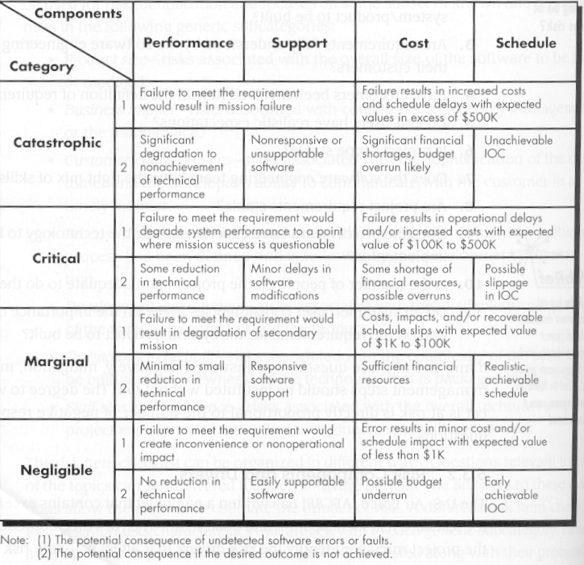

Slide 17
Risk Estimation
Attempts to rate each risk in two ways:
  The likelihood or probability that the risk is real
  The consequences of the problems associated with the risk, should it occur
Four Risk estimation activities are performed:
  Establish the risk table
  Delineate the consequences of the risk
  Estimate the impact of the risk on the project and the product
  Note the overall accuracy of the risk estimation so that there will be no misunderstanding

Slide 18
Developing a risk table
Provide a project manager with a simple technique for risk projection
Begins by listing all risks in the first column of the table
Each risk is categorized in the second column
The probability of occurrence of each risk is entered in the next column
Next the impact of each risk is assessed
Once the first four columns of the risk table has been completed, the table is sorted by probability and by impact
The project manager studies the resultant sorted table and defines a cut-off line (implies that only risks that lie above the line will be given further attention)
The column labeled RMMM contains a pointer to a Risk Mitigation, Monitoring and Management Plan

Slide 19
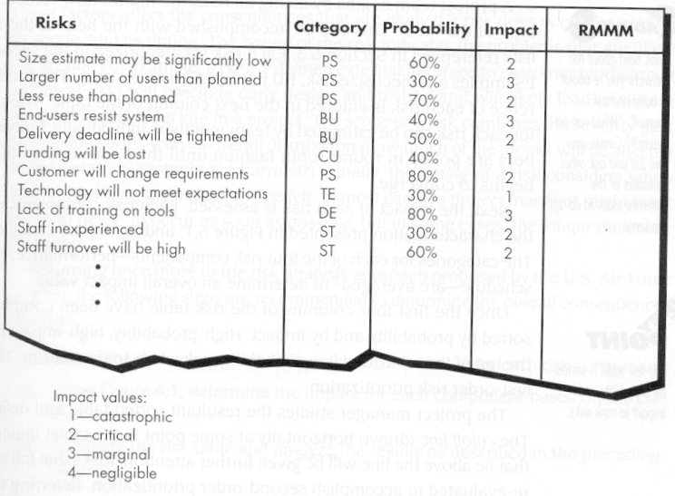

Slide 20
Risk mitigation, monitoring and management
All the risk analysis activities presented have a single goal – to assist the project team in developing a strategy for dealing with risk. An effective strategy must consider three issues:
  Risk avoidance
  Risk monitoring
  Risk management and contingency plan

Slide 21
Risk mitigation
Example:
  Assume that high staff turnover is noted as a project risk
To mitigate the risk, project management must develop a strategy for reducing turnover. Among the possible steps:
  Meet with current staff to determine causes for turnover
  Mitigate those causes that are under our control before the project starts
  Once the project commences, assume turnover will occur and develop techniques to ensure continuity when people leave
  Etc…

Slide 22
Risk monitoring
As the project proceeds, risk monitoring activities commence.
Project manager monitors factors that may provide an indication of whether the risk is becoming more or less likely
In the case of high staff turnover, the following factors can be monitored:
  General attitude of team members based on project pressures
  The degree to which the team has jelled
  Interpersonal relationships among team member
  Potential problems with compensation and benefits
Project manager should also monitor the effectiveness of risk mitigation steps

Slide 23
Risk management and contingency planning
Assumes that mitigation efforts have failed and that the risk has become a reality
Continuing the example, the project is well underway and a number of people announce that they will be leaving
If the mitigation strategy has been followed, backup is available, information is documented and knowledge has been dispersed across the team

Slide 24
The RMMM plan
Risk management strategy can be included in the software project plan OR
It can be organized into a separate RMMM Plan
RMMM Plan documents all work performed as part of risk analysis and is used by the PM as part of the overall project plan
Once the RMMM has been documented and the project has begun, risk mitigation and monitoring steps commence.

