Slide 1
Android pro tips trilogy

Slide 2


Slide 3


Slide 4



Always up to date
Users don't like to wait.
  Location updated.
  Data downloaded from web.

Slide 5
Find the location fast.
Loop through all providers->getLastKnownLoc.
  If there is one or more location which is recent enough – return the most accurate one
  If not – Return the latest one.
In case of #2 – look for “fastest” provider:
  Coarse Accuracy && low power consumption.
Register for location update.

Slide 6
Use passive location
>Gingerbread.
Passive location – Receive location update when other app is using location provider.
Requires ACCESS_FINE_LOCATION permission.
Location.getProvider.

Slide 7
Intents for location monitoring
Specify pending intent to BCAST Receiver when the location changes.
Location is stored as an extra
  KEY_LOCATION_CHNAGE
Useful for multiple activities / services that tracks location.

Slide 8
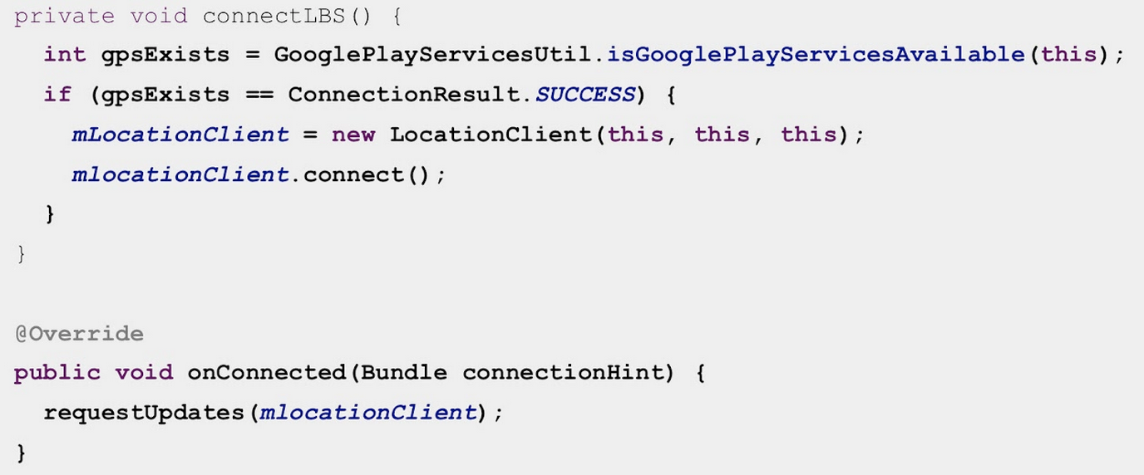
Fuse Location
Define your priorities
Let Google play services do the heavy lifting.

Slide 9
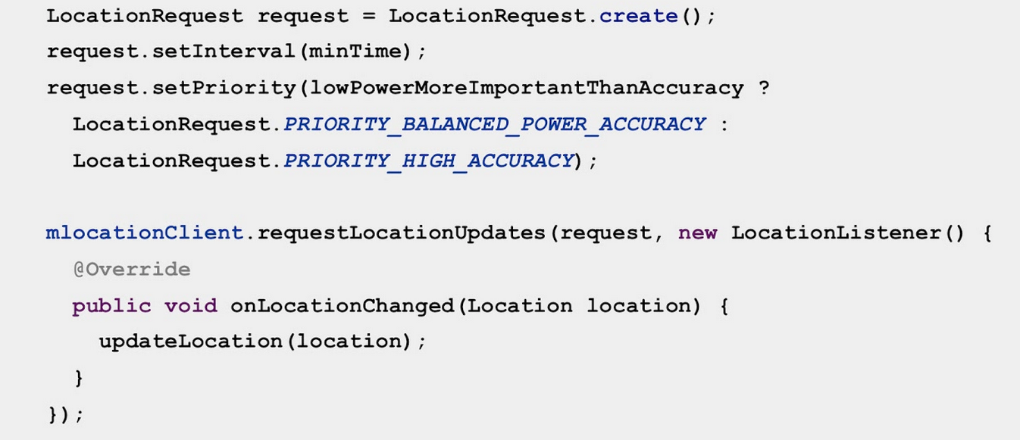
Using fuse location

Slide 10

When to update my App?
Right before the user launches it
  Assuming I have battery.
  Assuming I have BW.

Slide 11
Updating Data.
Server updates – use GCM.
  Here is why

Slide 12
Updating Data from 3rd party servers
Monitor the device
  Use Variable alarms.
  Use conditional services and receivers.
Monitor the user

Slide 13
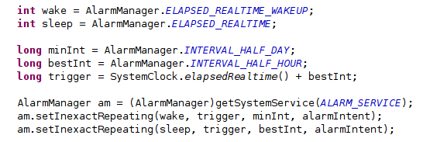
Is it worth waking up?
Set wake alarm for min update freq.
Set non-wake alarm from optimal update freq.

Slide 14
Monitor device State
Change the refresh rate based on device state:
Update without connectivity?
Update more on WiFi?
Update more when charging?
Suspend updates on low battery?
Update more when docked?
Don't update in car dock?

Slide 15

Monitor connectivity

Slide 16

Monitor Battery

Slide 17
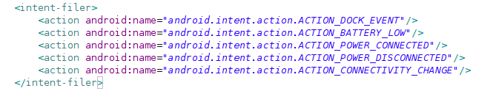
Monitor State canged BCAST

Slide 18
Monitor the user
Change your behavior based on the user's acitivty
Update more when driving?
Update more when walking?
Pause updates while cycling?

Slide 19
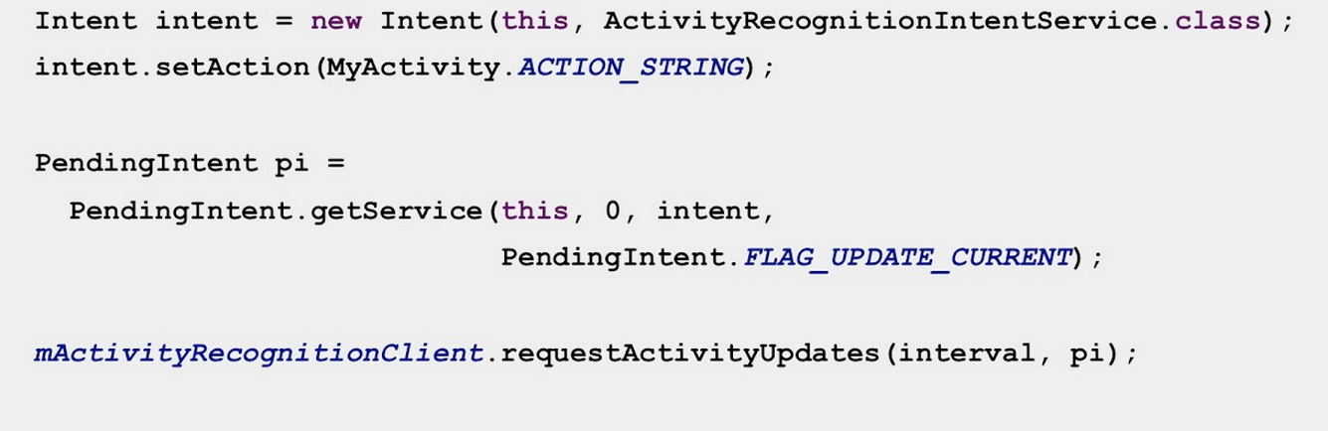
Activity recognition

Slide 20
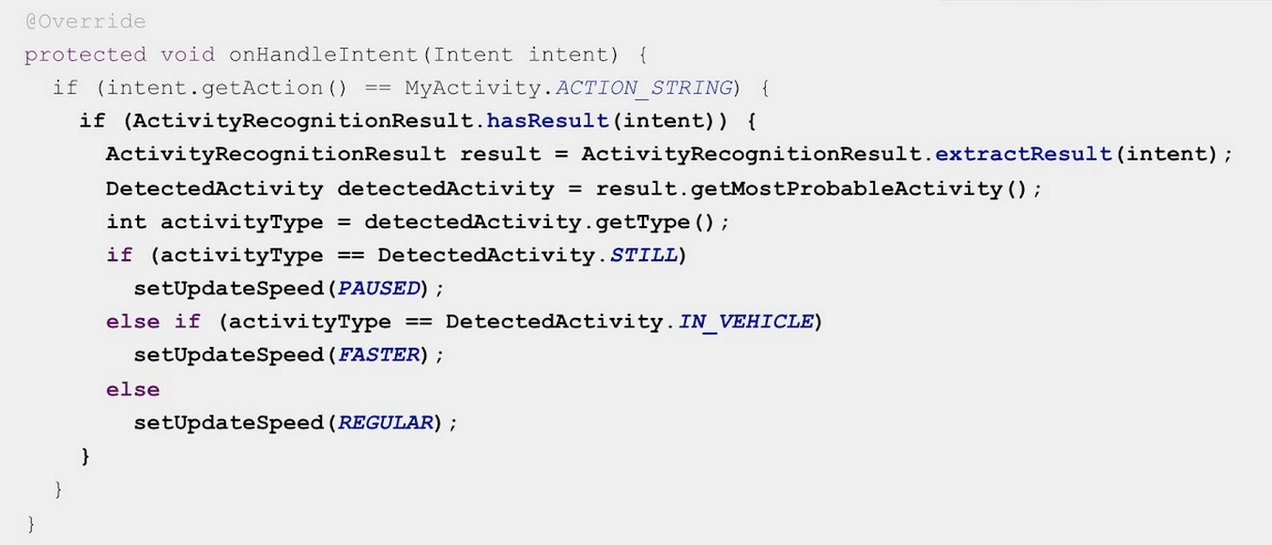
Activity recognition

Slide 21
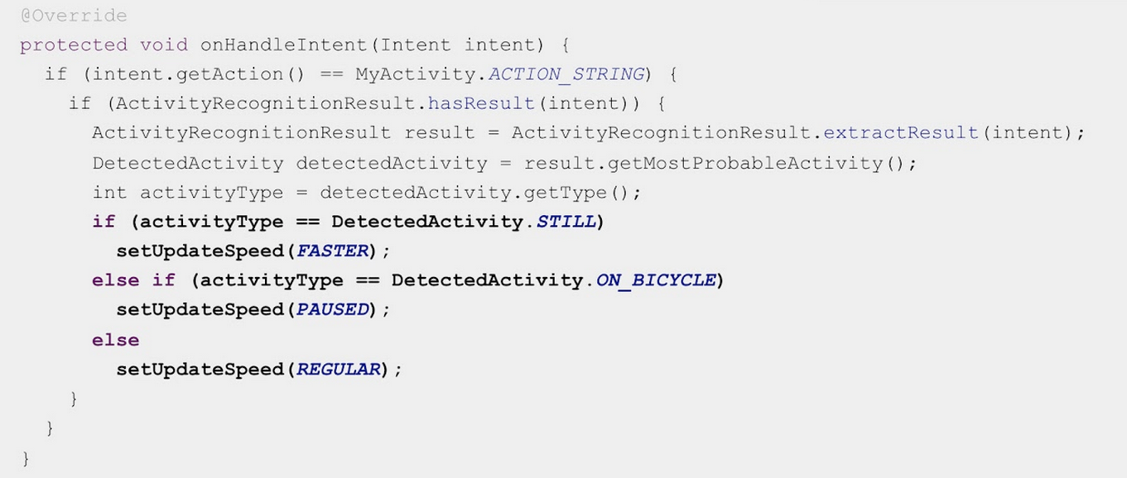
Activity recognition

Slide 22


Slide 23
Being Invisible
I don't need to think how the app works.
I never notice the app's work.
I am never being bothered by the app.

Slide 24
Work Offline
Queue and Send transactions.
  Use persistence layer.
  Tape From Square.

Slide 25
Work Semi-Offline
Be resilient to poor networks.
  Prioritize your transactions.
  Be able to cancel transaction on the fly, or clear the Queue.
  Adjust your apps behavior and timeouts accordingly.
Use Volley

Slide 26
Use sync adapter to... sync
Sync adapter is great for sending data from the device to your server
Has a system wide POV.
Poor documentation, Hard to implement.

Slide 27
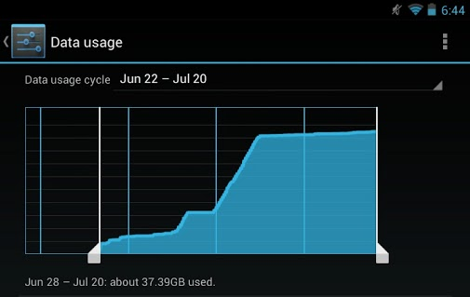
Be efficient

Slide 28
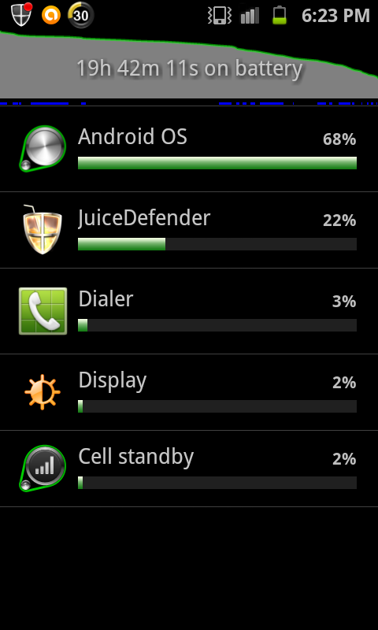
Be efficient

Slide 29
Radio Resource
Frequency is expensive.
Cell tower can not service 100% of its clients 100% of the time.
Frequency is dynamically allocated to clients.
  Cellular cells uses various multiplexing methods (OFDM/OFDMA, FTDMA).

Slide 30
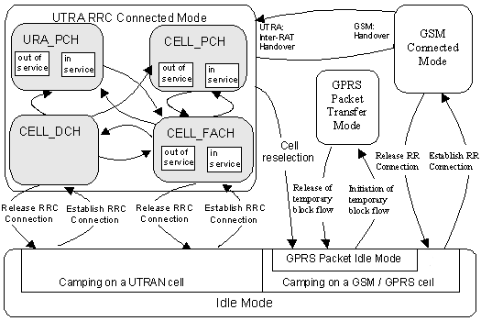
UMTS RRC States. (source: 3gpp)

Slide 31
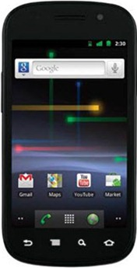
Radio State Machine
Power
DCH
~10Sec tail time
FACH
~12-75 Sec tail time
IDLE
Bandwidth

Slide 32
Radio State Machine
Power
~2 Sec
DCH
~10Sec tail time
FACH
~12-75 Sec tail time
IDLE
Bandwidth

Slide 33
Avoid bursty traffic
Transmit data “together”.
  Piggyback if needed.
  Pre-fetch data for the next 2-5 minutes.
Don't ping just to keep TCP connection alive
  RRC != TCP Connection.
  TCP connection is kept even in IDLE mode

Slide 34
Don't be HTTP rookie
Don't download what you already have.
Take care of server headers
  Max-age, expires.
Use conditional GET when cache expires
  Use “last modified” header.
  Server return 304, with no body.

Slide 35
Don't be lazy
Read AT&T research:
  Top Radio Resources Issues in Mobile Applications
  AT&T Lab Research – call for more efficient apps
Watch my latest reversim talk (video / slides )
Use ARO.
  Developed by AT&T.
  Monitors and analyze network activity.
  http://developer.att.com/

Slide 36


Slide 37
Adaptive App
Optimized for different User Experience.
  User has more than one device.
Be predictable.
Behave as expected

Slide 38
Text Input
Specify the Edit Text input to show the right keyboard type.
  use android:inputType attribute
Four classes of keyboards:
  Plain text
  Decimal Number
  Phone Number
  Date or Time

Slide 39
Text Input
Plain text types:
  URIs
  Email address
  People's names
  Postal address
  Passwords

Slide 40


Slide 41
Context is critical
Activity recognition
Location

Slide 42
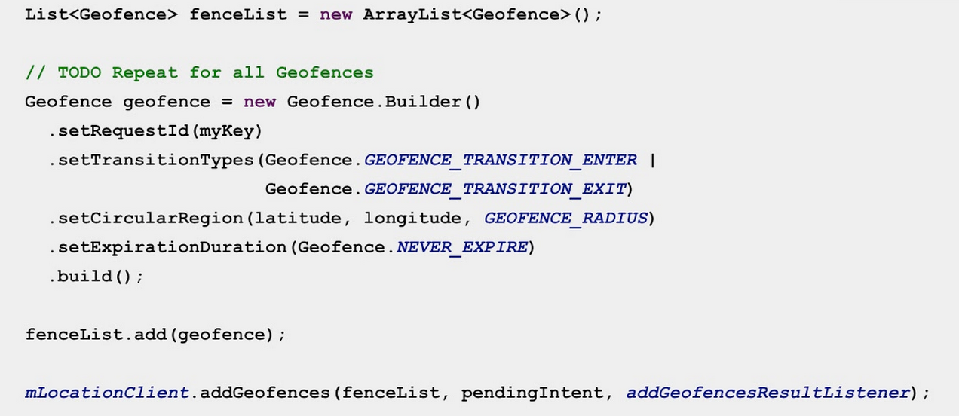
GeoFencing

Slide 43
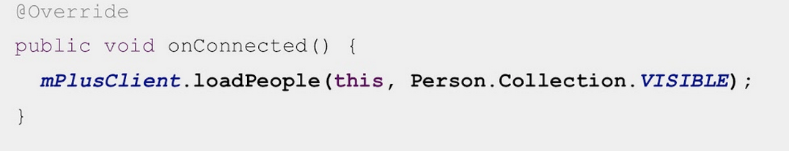
Personal
G+ SSO
  Login once – on all of your devices.
What friends are doing?

Slide 44
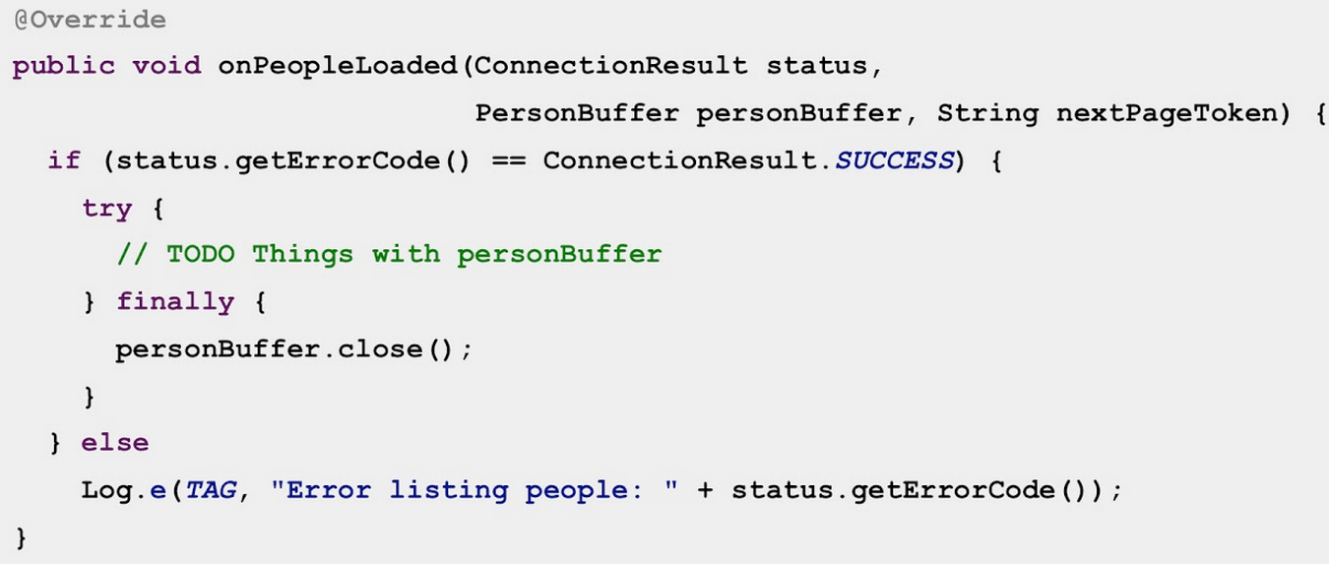
What my friends are doing?

Slide 45
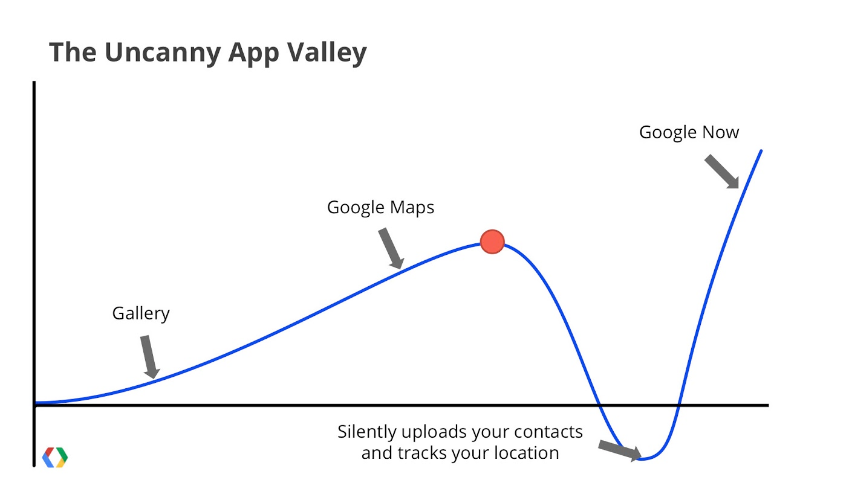

Slide 46
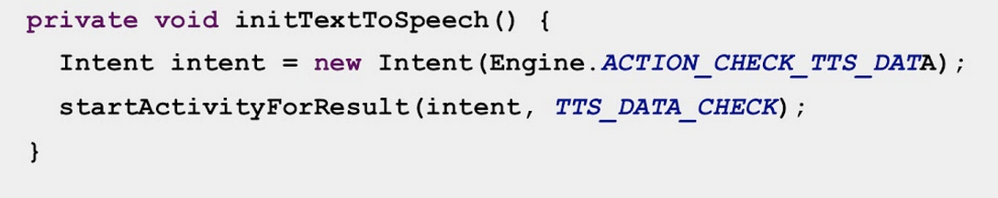
Geek Magic – Text to Speech

Slide 47
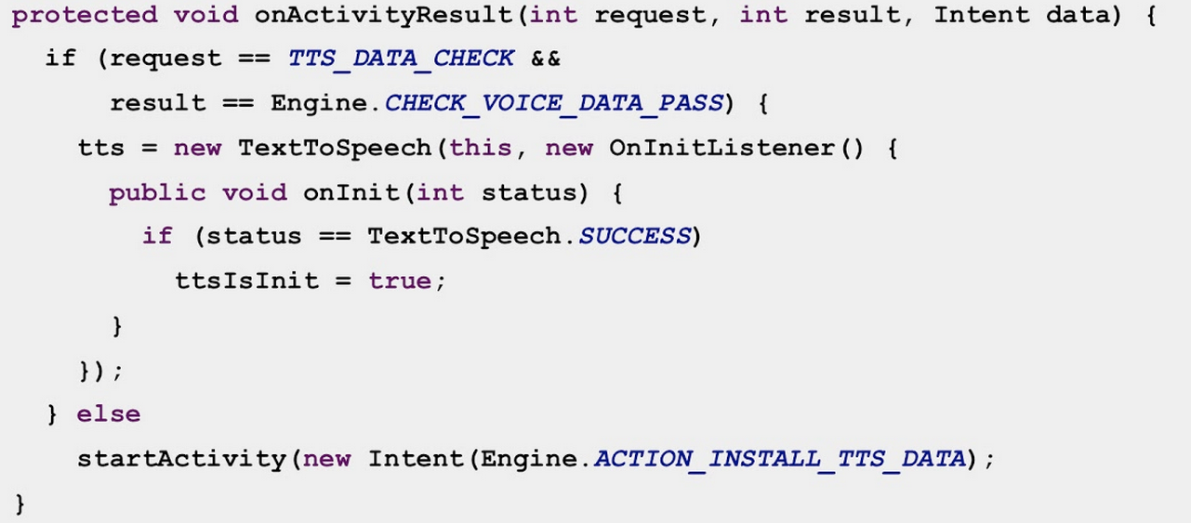
Geek Magic – Text to Speech

Slide 48
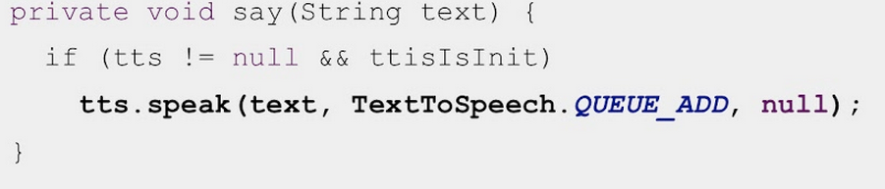
Geek Magic – Text to Speech

Slide 49
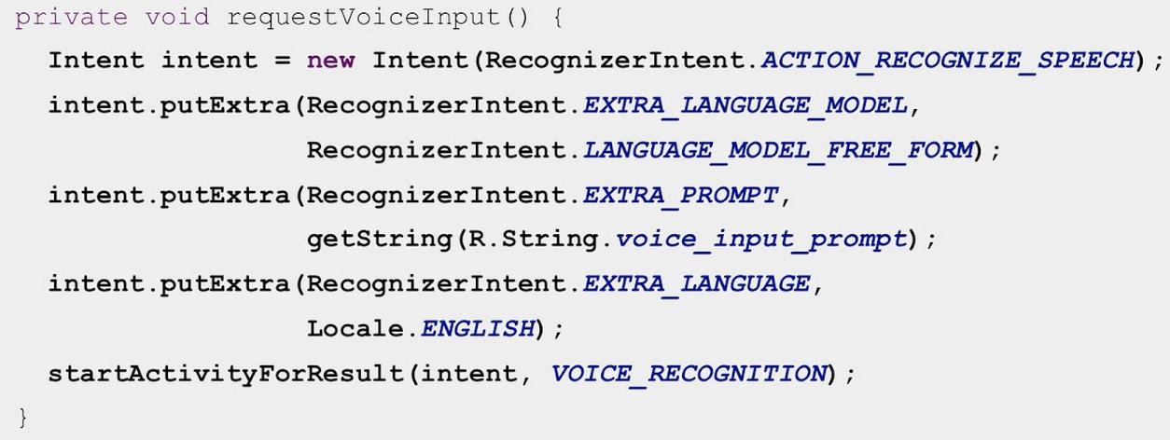
Geek Magic – Speech Recognition

Slide 50
Geek Magic – Speech Recognition
More than one result is returned.
Loop through all results, taking context in mind.

Slide 51
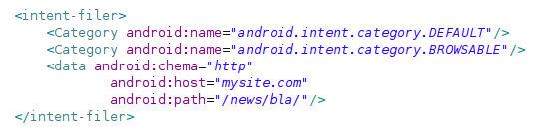
Intercept links
Use Intent Receiver
similar to maps / youtube

Slide 52
Summary

Slide 53

Thank You
ran@mobiliup.com
+Ran Nachmany

