Slide 1
PREDICTING STOCK PRICES WITH LLM AND LSTM
Team H: Kodanda Rama Naidu Gullipalli, Rami Reddy Kancharla, Hannah Boyd

Slide 2


INTRODUCTION AND OBJECTIVE
The primary goal of this project is to conduct sentiment analysis on financial news data and subsequently employ this sentiment data, along with historical stock prices of TSLA, to construct and assess LSTM models for predicting higher stock prices.
Through this project, we intend to gain a better understanding of how sentiment relates to stock price changes and evaluate the models' predictive performance.

Slide 3
PROBLEM SOLVING
FUTURE SCOPE
IDENTIFY
A Real-time Application
Identify the problem
MODEL EVALUATION
PROBLEM
SOLVING
CYCLE
DATA COLLECTION
Evaluate the solution
Data collection from different sources
MODEL BUILDING
DATA PRE-PROCESSING
Different steps involved in Model Building
Data pre-processing techniques to convert data into a format suitable for input to the model

Slide 4
DATA
1. Financial News Sentiment Data:
The data originates from the AlphaVantage API and pertains to news articles associated with the stock symbol "TSLA" (representing Tesla).
Sentiment analysis is conducted on the news article summaries using a pre-existing model called "finbert" to categorize the sentiment of each article into one of three categories: "Negative," "Neutral," or "Positive.”
2. Historical Stock Price Data:
This data is obtained from Yahoo Finance through the utilization of the "yfinance" library, and it pertains to the stock symbol "TSLA".
Key components of the historical stock price data include open, high, low close prices, timestamps.

Slide 5
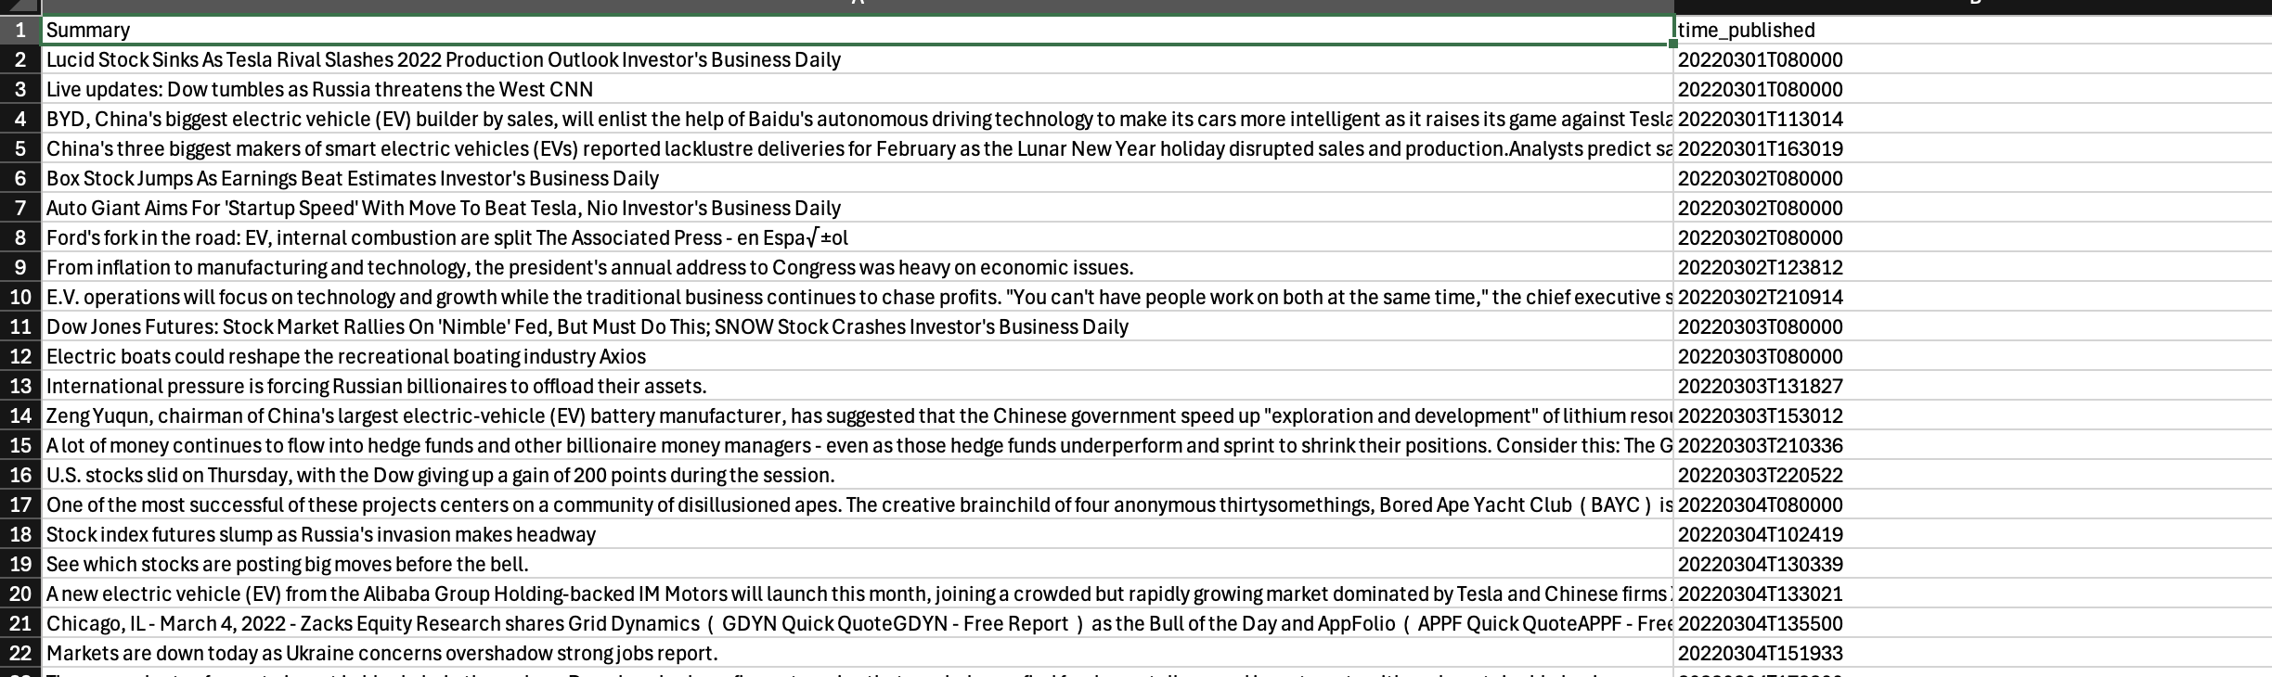
DATA (CONTD)
Since, we are using free API we can able to fetch 100 records for that stock. As per now, we just extracted 1 year data.
Here’s the sample data looks like and the Link to access that csv file.
https://tinyurl.com/7x3bzzwp

Slide 6
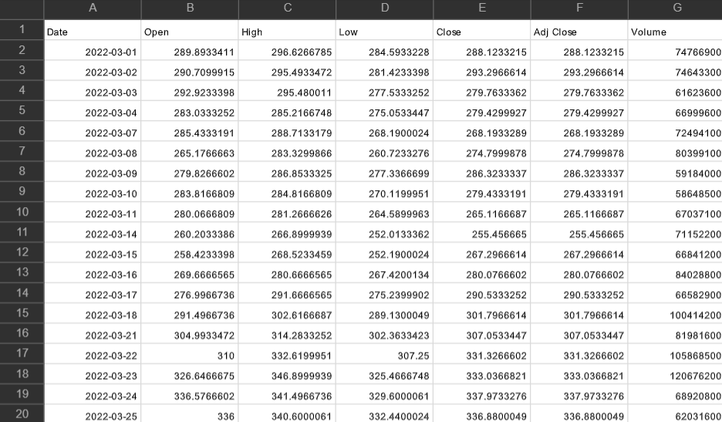
TESLA STOCK DATA

Slide 7
GITHUB
https://github.com/studyingstudent101/StockPricePrediction

Slide 8
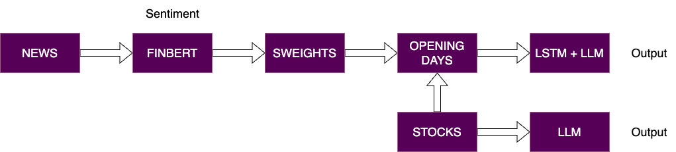
ARCHITECTURE

Slide 9
SENTIMENT ANALYSIS WITH FINBERT
Model & Tokenizer: Utilizes ProsusAI/finbert, a BERT model pre-trained on financial texts, coupled with BertTokenizer for efficient text processing.
Sentiment Prediction Function:
Tokenizes input text and prepares it for the model.
Employs the model to predict sentiment class (Negative, Neutral, Positive) based on the logits.
Data Application:
Demonstrated on the new dataset which we collected from AlphaVantage.
Provides insights into sentiment trends within financial texts.

Slide 10
WHY FINBERT?
Financial Text Specialization: Unlike generic NLP models, FinBERT is fine-tuned specifically on financial corpora, making it exceptionally effective for understanding the intricacies of financial language, including terms, jargon, and financial context.
Accurate Sentiment Classification: It consistently delivers high accuracy for sentiment prediction, which is critical for making informed decisions based on textual data in financial markets.
Scalability: The model can process large volumes of data efficiently, making it suitable for analyzing multiple sources of financial data in real time, enabling firms to stay ahead of market trends.

Slide 11
SENTIMENT PREDICTION FUNCTION
Tokenization Process: The sentiment prediction pipeline begins by tokenizing the input text using the BertTokenizer. This tokenizer prepares the text by splitting it into tokens compatible with the FinBERT model. Special tokens (e.g., [CLS], [SEP]) are added to mark the beginning and end of sequences for proper model comprehension.
Model Application:
The tokenized input is then passed through the FinBERT model, which leverages its pre-trained knowledge to analyze financial contexts.
The model generates logits (raw output scores) for each sentiment class -- Negative, Neutral, or Positive.
These logits are processed by applying the softmax function, converting them into probabilities, and the highest probability determines the sentiment class of the input text.
Confidence Scores: Alongside the predicted sentiment, the model outputs the confidence score for each class, allowing for a more nuanced understanding of sentiment distribution, especially in ambiguous cases.

Slide 12
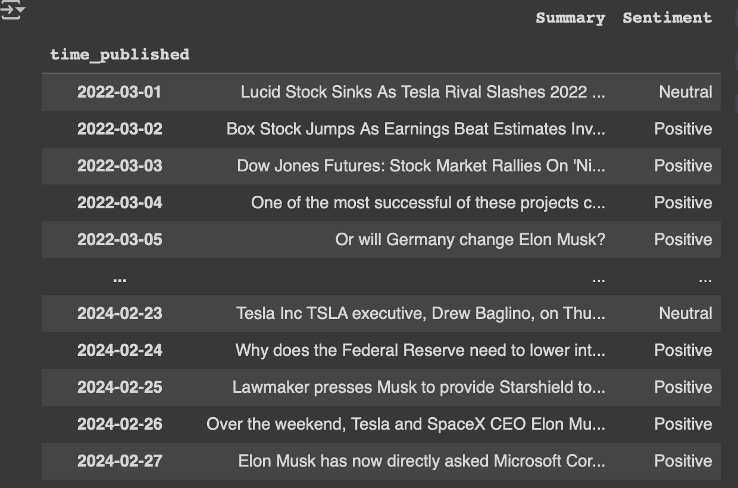
SAMPLE DATA WITH FINBERT SENTIMENTS

Slide 13
LSTM STOCK PREDICTION MODEL OVERVIEW
LSTM Networks: Highly effective in capturing long-term dependencies and trends in time-series data, making them ideal for forecasting complex patterns in stock market movements.
Rolling Window Approach: Utilizing a window size of 101 to capture temporal dependencies in stock data.
Model Architecture:
Multiple LSTM layers with varying units (e.g., 100, 512, 256, 128) for deep learning.
A final Dense layer for output prediction.
Training Parameters:
Loss Function: Mean Squared Error (MSE).
Optimizer: Adam.
Epochs and Batch Size: 10 epochs, 64 batch size for training efficiency.
Model Training:
Validation on test data during training for performance monitoring.
Shuffle enabled to ensure model generalization.

Slide 14
RESULTS
Train Loss (MSE): 0.0006855614483356476
Test Loss (MSE): 0.006768424063920975

Slide 15
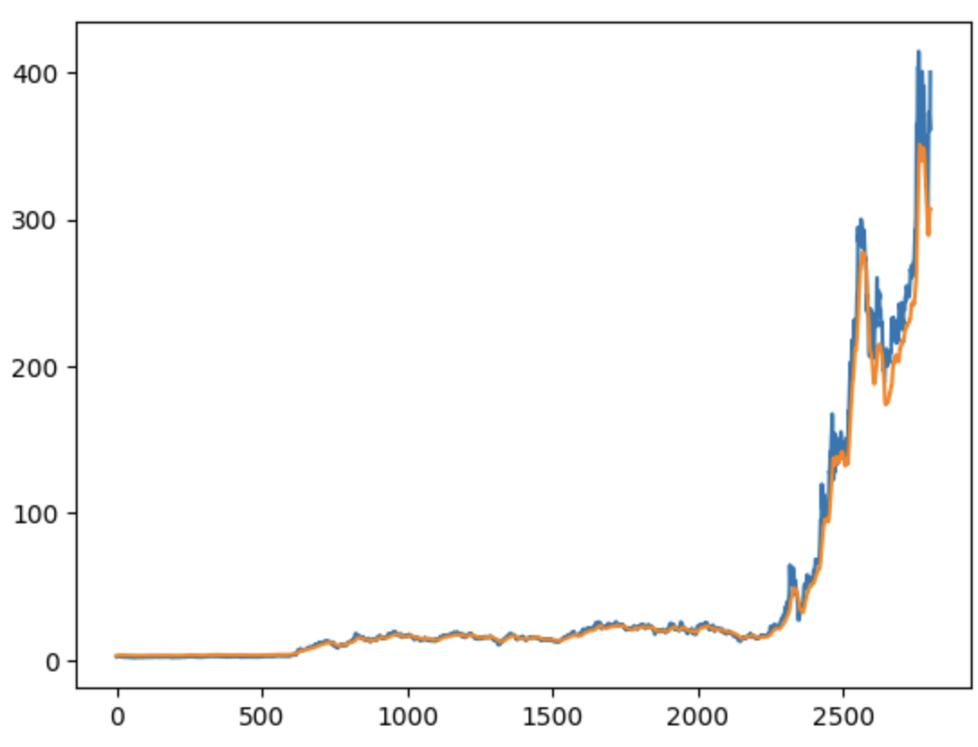
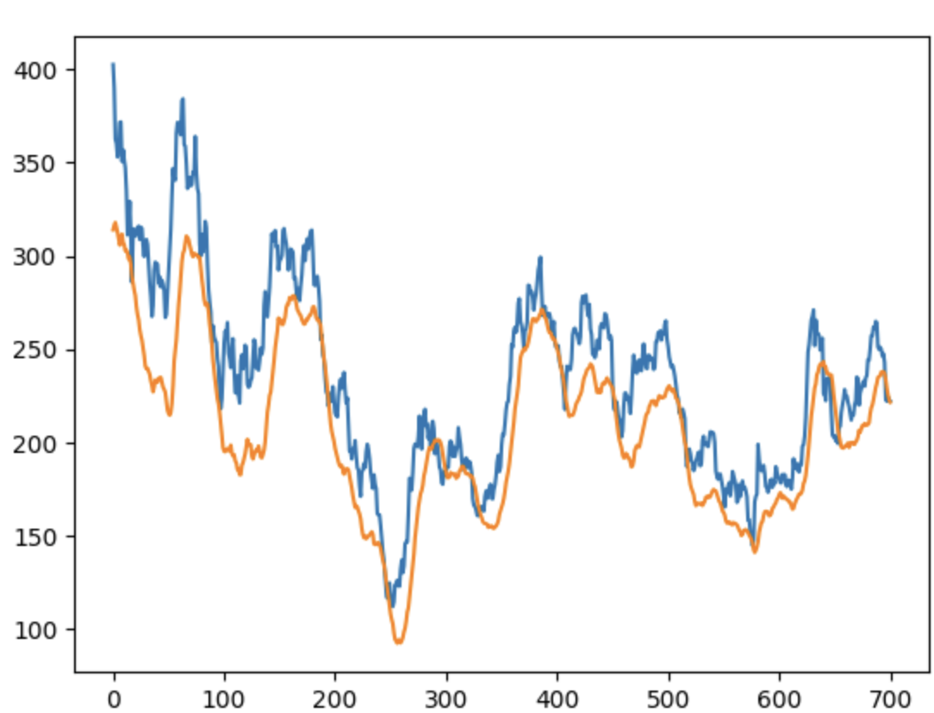
LSTM PREDICTIONS
LSTM Stock High price on Training Data
LSTM Stock High price on Testing Data

Slide 16
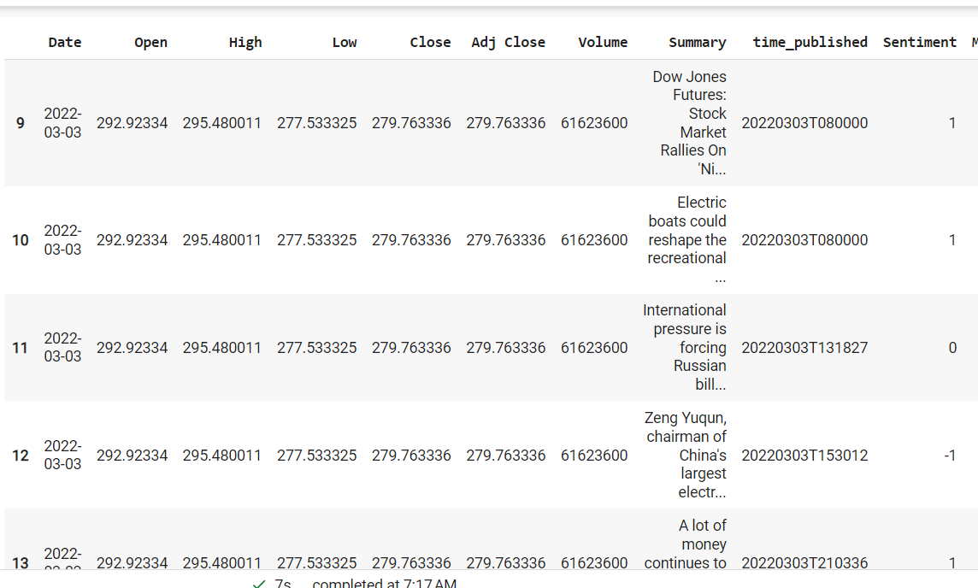
COMBINED DATASET

Slide 17
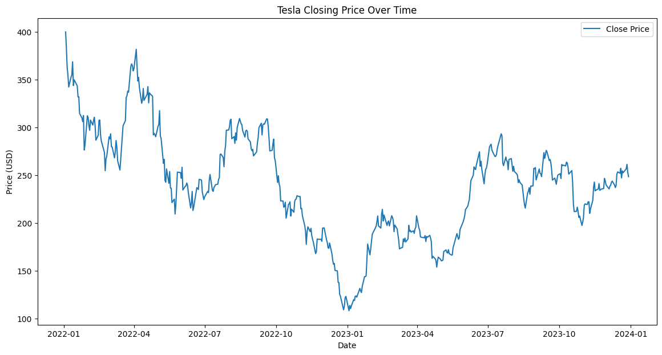
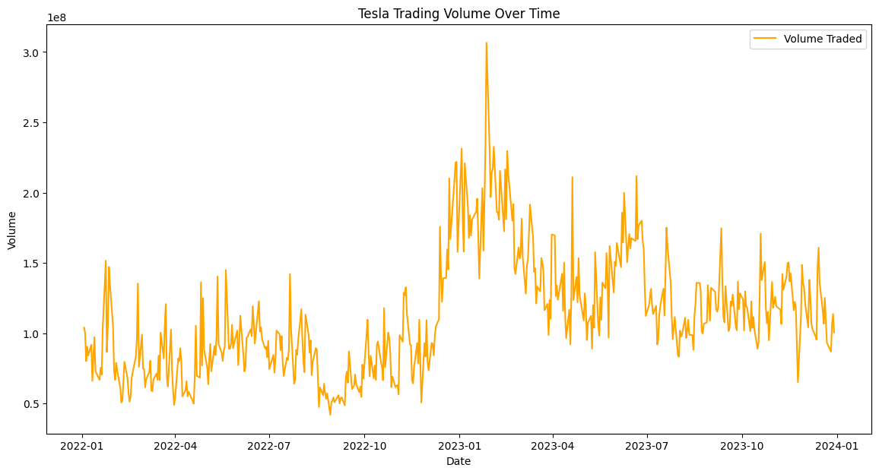
EDA

Slide 18
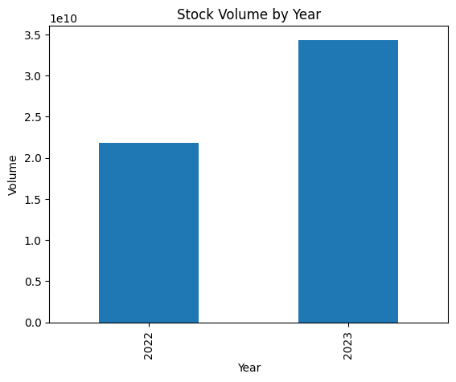
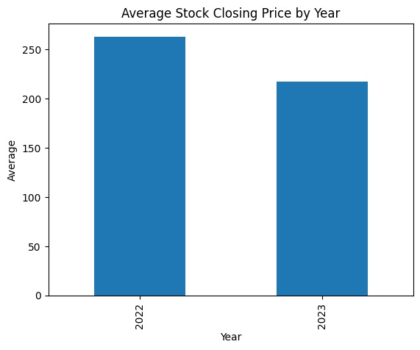
EDA (CONTD)

Slide 19
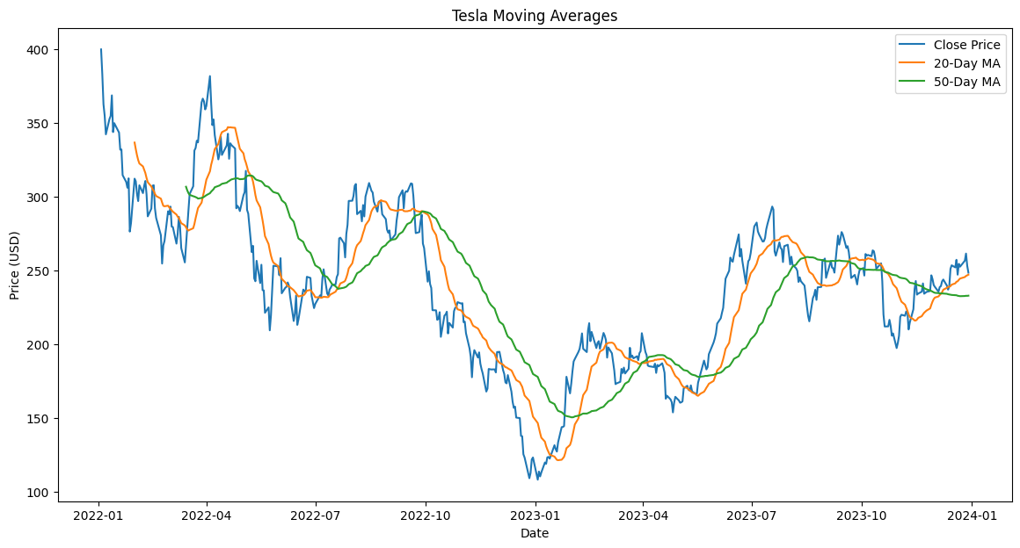
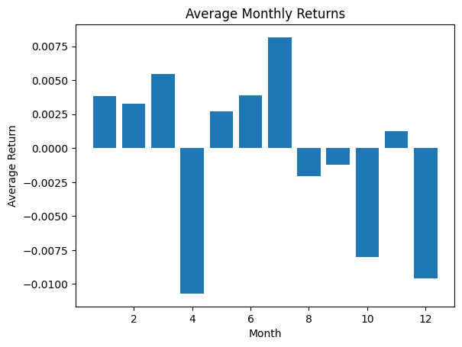
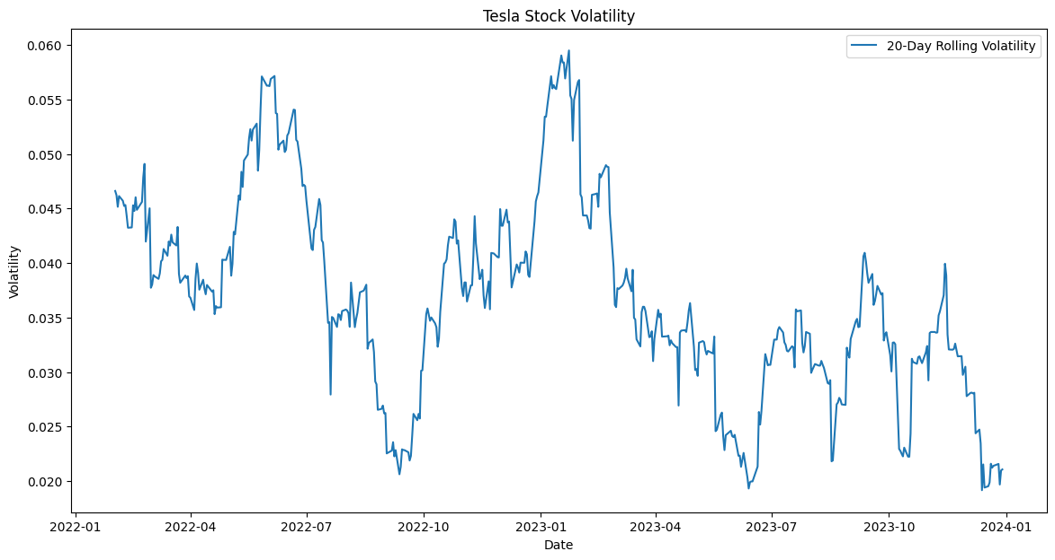

Slide 20
NEXT STEPS
Doing LSTM with LLM with normal data and sentiment which we will get it from ’yfinance’ Library and LLM.

Slide 21

THANK YOU

