Slide 1
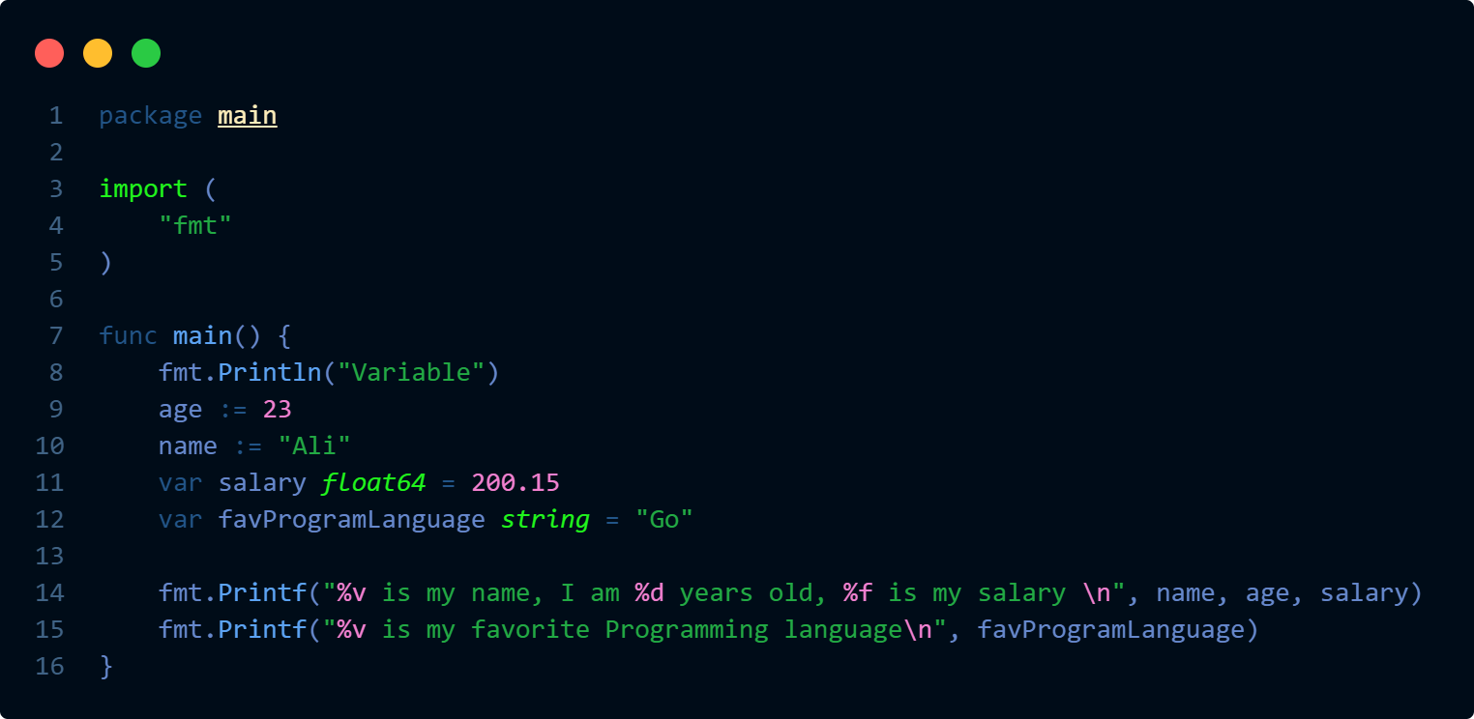
Special package
Import format package

Slide 2


Special package
Import format package

Slide 3



Special package
Import format package
Variables

Slide 4
Special package
Import format package
Variables

Slide 5
Variables

Slide 6

Variable
A variable is a named placeholder in a computer's memory that stores a value which can be changed during program execution
Can call them repeatedly during program execution
Values stored are of different data types and sizes
Values can change during the program execution

Slide 7
Variable
A variable is a named placeholder in a computer's memory that stores a value which can be changed during program execution
Can call them repeatedly during program execution
Values stored are of different data types and sizes
Values can change during the program execution

Slide 8
Variable Data Types
A variable is a named placeholder in a computer's memory that stores a value which can be changed during program execution

