Slide 1
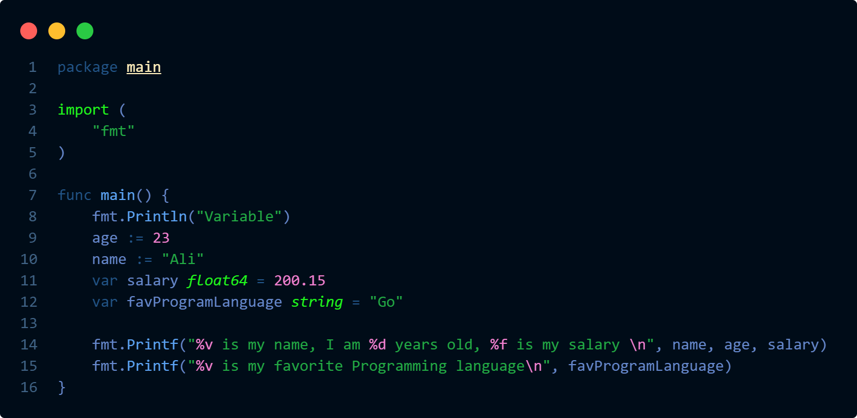
Variable Data Types
A variable is a named placeholder in a computer's memory that stores a value which can be changed during program execution
Notes:
Now variable data types are an important concept to understand.
Some of the important factors why data types are required

Slide 2
Variable Data Types
A variable is a named placeholder in a computer's memory that stores a value which can be changed during program execution
Basic Data Types
Strings
Numbers
Boolean
Integers
“Go”
true
123
-50
false
“is a Programming”
Float
500.19
“language”
-50.25

Slide 3
Variable Data Types
A variable is a named placeholder in a computer's memory that stores a value which can be changed during program execution
Basic Data Types

Slide 4
Variable Data Types
A variable is a named placeholder in a computer's memory that stores a value which can be changed during program execution
Why Data Types Are Required
Memory Allocation
Data Integrity
Performance Optimization
Code Clarity
Function Signatures
Notes:
Memory Allocation , by the type it can be determined how much memory is required to store the value
Data Integrity , Ensures that the value conform to expected format and ranges like int8 can save from -128 to 127
Performance Optimization , Declaring data type also helps to generate efficient machine code
Code Clarity , improves code readability and maintainability by clearly defining the kind of data being used.
Function Signatures , data types are also used in function signatures defining the kind of data being used , more on this later

Slide 5
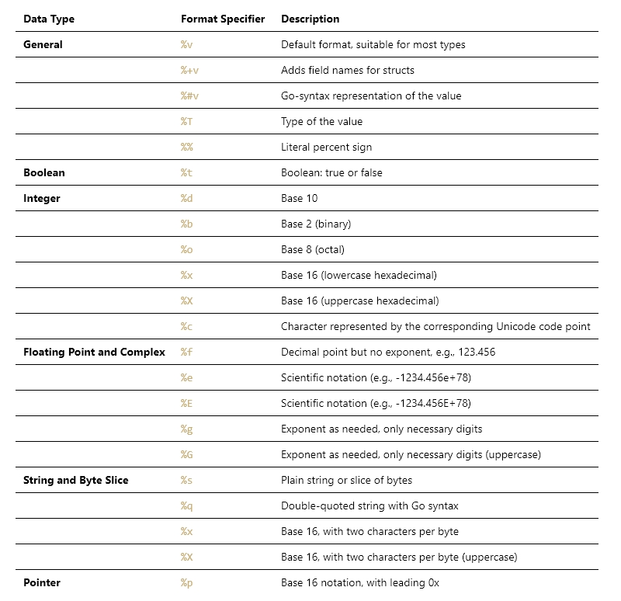
Variable Data Types
A variable is a named placeholder in a computer's memory that stores a value which can be changed during program execution

