Slide 1
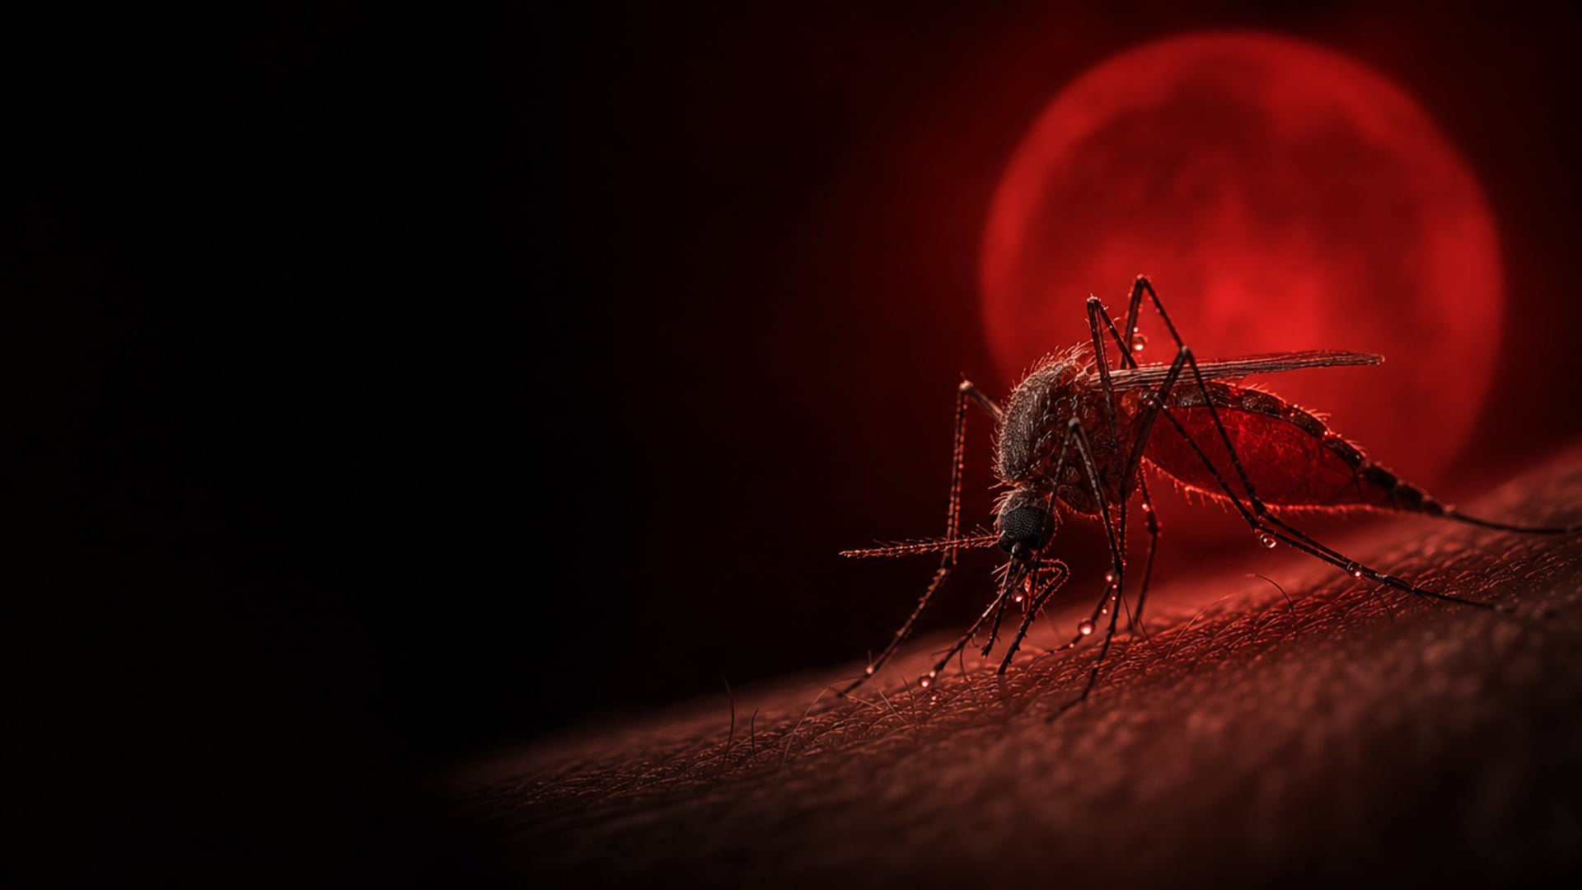




GROUP ORAL PRESENTATION
◆ ◆ ◆
AZAMOV JAVOHIR
ASATULLAYEV MUHAMMADRIZO
BAKIYEV RAMAZAN
ABDURAIMOV AKMALBEK
Latipovich
Anvarjon o'g'li
Sherzodovich
Jamshit o'g'li
b2600910
b2603096
b2605509
b2606469
Notes:
[Javohir Azamov]
Good afternoon, dear teacher and dear audience. Today our group will present one of the oldest and deadliest diseases in human history: malaria. Before we start, let us introduce ourselves. My name is Azamov Javohir Latipovich, and my ID number is b2600910.
[Muhammadrizo Asatullayev]
Good afternoon. My name is Asatullayev Muhammadrizo Anvarjon o'g'li, and my ID number is b2603096.
[Ramazan Bakiyev]
Good afternoon. My name is Bakiyev Ramazan Sherzodovich, and my ID number is b2605509.
[Akmalbek Abduraimov]
Good afternoon. My name is Abduraimov Akmalbek Jamshit o'g'li, and my ID number is b2606469.

Slide 2








PLAN OF THE TALK
WHAT IS MALARIA
HISTORY
MALARIA TODAY
FIGHTING BACK
CONCLUSION
Definition, cause and fatality rate
First records, discoveries, major outbreaks
Statistics on cases, deaths and damage
Vaccine, prevention and treatment
Key takeaways
◆ ◆ ◆
◆ ◆ ◆
◆ ◆ ◆
◆ ◆ ◆
◆ ◆ ◆
Javohir
Azamov
Muhammadrizo
Asatullayev
Ramazan
Bakiyev
Akmalbek
Abduraimov
Javohir
Azamov
JAVOHIR AZAMOV · 02 / 16
Notes:
[Javohir Azamov]
Thank you. First, I will explain what malaria is and how deadly it is. Then Muhammadrizo will talk about its history and the biggest outbreaks, Ramazan about the numbers today, and Akmalbek about how we fight back: vaccines, prevention and treatment. Finally, I will conclude.

Slide 3
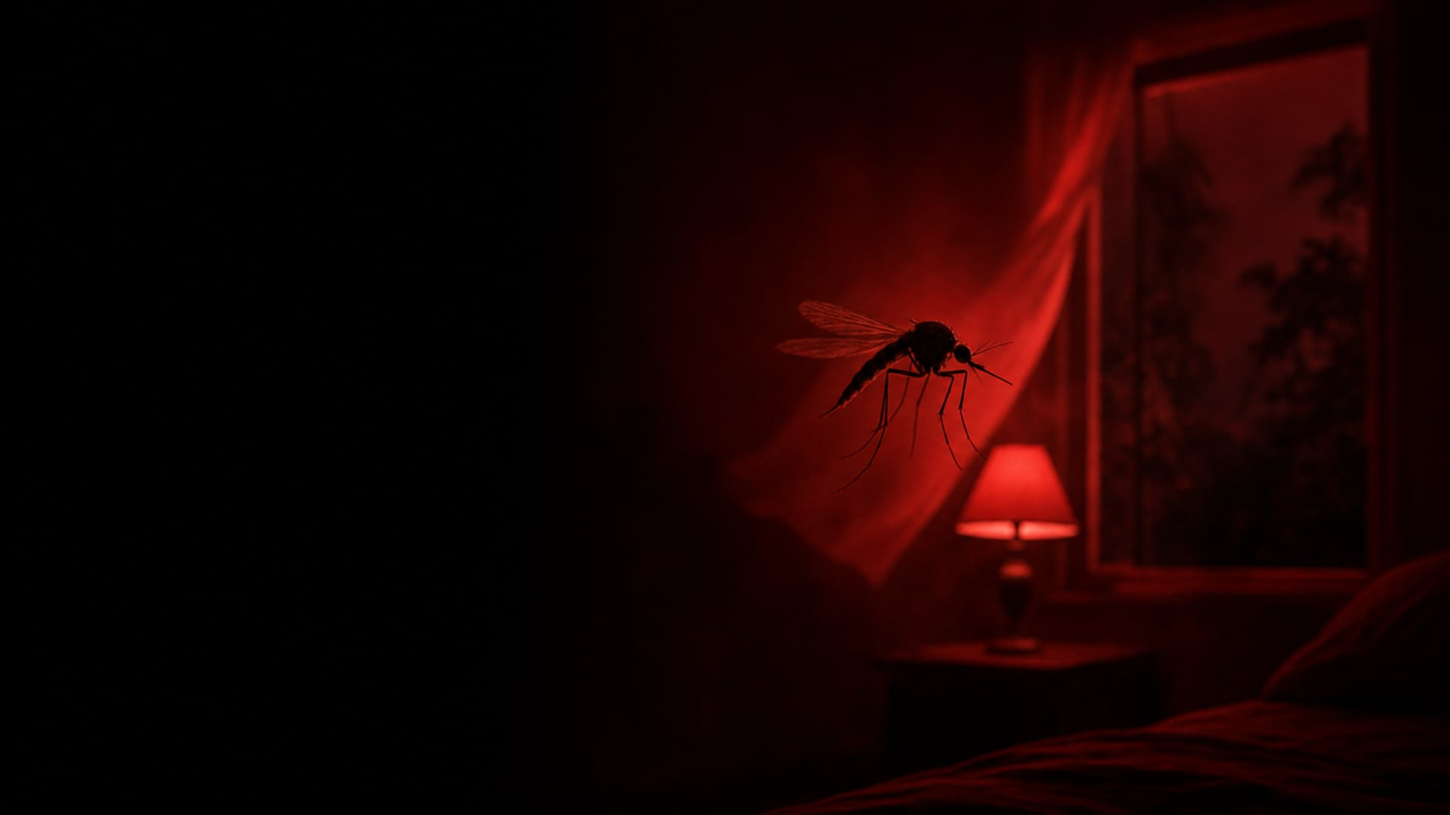


01 · WHAT IS MALARIA
“A life-threatening disease spread to humans by some types of mosquitoes. The infection is caused by a parasite and does not spread from person to person.”
WORLD HEALTH ORGANIZATION
CAUSE
CARRIER
SPECIES
A parasite
Female Anopheles
5 infect humans
Plasmodium, a single-celled organism. Not a virus, not a bacterium.
The mosquito bites mostly at night. Parasites go to the liver, then to red blood cells.
P. falciparum is the deadliest. P. vivax is the most common outside Africa.
Source: World Health Organization (2025a)
JAVOHIR AZAMOV · 03 / 16
Notes:
[Javohir Azamov]
So, what is malaria? According to the World Health Organization, it is a life-threatening disease spread to humans by mosquitoes. Our task asks if it is viral or bacterial. The answer is: neither. Malaria is caused by a parasite, a tiny single-celled organism called Plasmodium.
The parasite travels inside the female Anopheles mosquito, which bites mostly at night. After the bite, the parasites hide in the liver, and then they attack the red blood cells. Malaria does not spread from person to person.
Five species of Plasmodium infect humans. The most dangerous are vivax, the most common outside Africa, and falciparum, the deadliest one.

Slide 4





01 · WHAT IS MALARIA
until the first symptoms: fever, chills and headache. It looks like the flu.
DAYS
Left untreated, P. falciparum malaria can progress to severe illness and death.
HOURS
Severe malaria without treatment: deaths approach 100%. With treatment: 10–20%.
UNTREATED
The key word is TIME: fast diagnosis saves lives.
Source: World Health Organization (2025a); World Health Organization (2015)
JAVOHIR AZAMOV · 04 / 16
Notes:
[Javohir Azamov]
And how deadly is it? The first symptoms usually start ten to fifteen days after the bite: fever, chills and headache. It looks like the flu, and that is exactly the danger. Left untreated, falciparum malaria can progress to severe illness and death within twenty-four hours.
When severe malaria is not treated, the death rate approaches one hundred percent. Even with good hospital treatment, ten to twenty percent of these patients still die. So the key word is time: fast diagnosis saves lives.
But how long has this parasite been with us? Muhammadrizo will tell you.

Slide 5






02 · HISTORY
c. 2700 BC
1570 BC
c. 400 BC
THE NAME
Fevers that keep coming back
Papyri and a pharaoh
Hippocrates and the marshes
Mal aria = “bad air”
A Chinese medical text describes repeating fevers and an enlarged spleen.
Egyptian papyri describe fevers. In 2010, parasite DNA was found in Tutankhamun’s mummy.
He links the fevers to life near marshes and stagnant water.
People blamed the air of the swamps, and the disease got its name.
Source: Cox (2010); Hawass et al. (2010)
MUHAMMADRIZO ASATULLAYEV · 05 / 16
Notes:
[Muhammadrizo Asatullayev]
Thank you, Javohir. As Javohir said, malaria is a very old enemy. In fact, it is one of the oldest diseases known to humanity.
The first records come from China. A Chinese medical text from about 2700 BC describes fevers that return again and again, together with an enlarged spleen. These are the classic signs of malaria.
In Egypt, medical papyri from 1570 BC describe similar fevers. And modern science found real proof: in 2010, researchers found the DNA of the malaria parasite in the mummy of the pharaoh Tutankhamun. So even a king could not escape it.
In ancient Greece, Hippocrates noticed that people who lived near marshes often suffered from these fevers. And the name itself is Italian: mal aria means bad air, because people believed that the disease came from the air of the swamps.

Slide 6

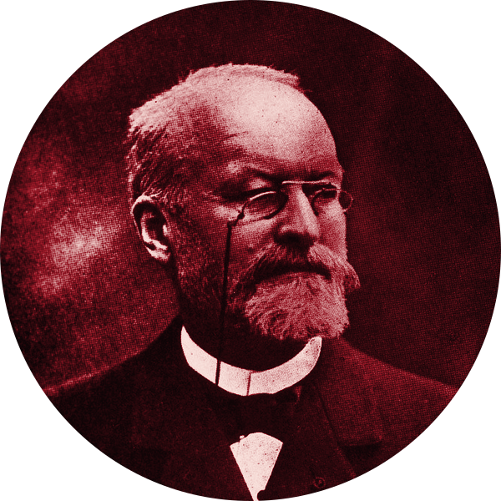
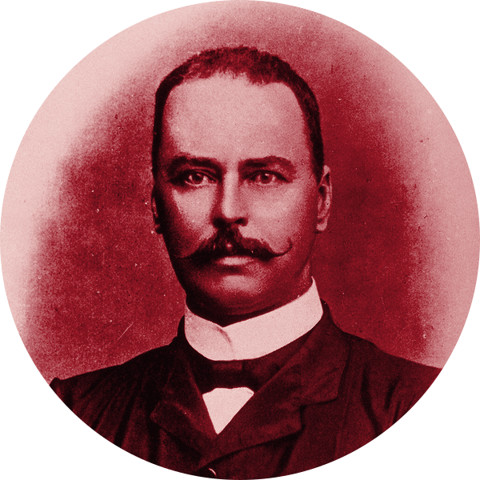
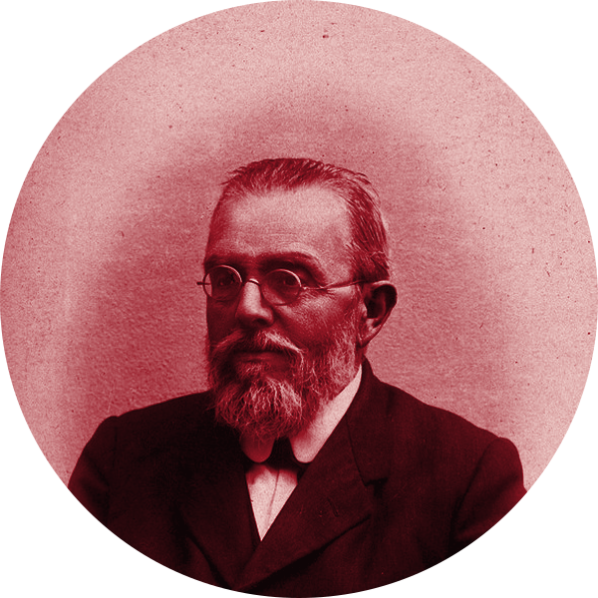

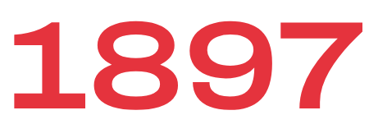

02 · HISTORY
ALPHONSE LAVERAN
RONALD ROSS
GIOVANNI BATTISTA GRASSI
A French army doctor in Algeria sees the parasite in the blood of a sick soldier.
In India, he finds the parasite inside a mosquito: 20 August, “Mosquito Day”.
His Italian team proves that Anopheles mosquitoes carry human malaria.
NOBEL PRIZE 1907
NOBEL PRIZE 1902
ITALY · 1898
Source: Cox (2010); Nobel Prize Outreach (2026). Portraits: Wellcome Collection, public domain
MUHAMMADRIZO ASATULLAYEV · 06 / 16
Notes:
[Muhammadrizo Asatullayev]
For thousands of years, nobody knew the real cause. The answer came only at the end of the nineteenth century.
In 1880, a French army doctor in Algeria, Alphonse Laveran, looked through his microscope at the blood of a sick soldier and saw the parasite. Later he received the Nobel Prize for this work.
On the twentieth of August 1897, the British doctor Ronald Ross, working in India, found the parasite inside a mosquito. He called this day Mosquito Day, and in 1902 he received the Nobel Prize. A year later, in 1898, the Italian scientist Giovanni Grassi and his team proved that human malaria is carried by Anopheles mosquitoes.
Now, for the first time, people knew exactly who the enemy was: a parasite, and its carrier, the mosquito.

Slide 7
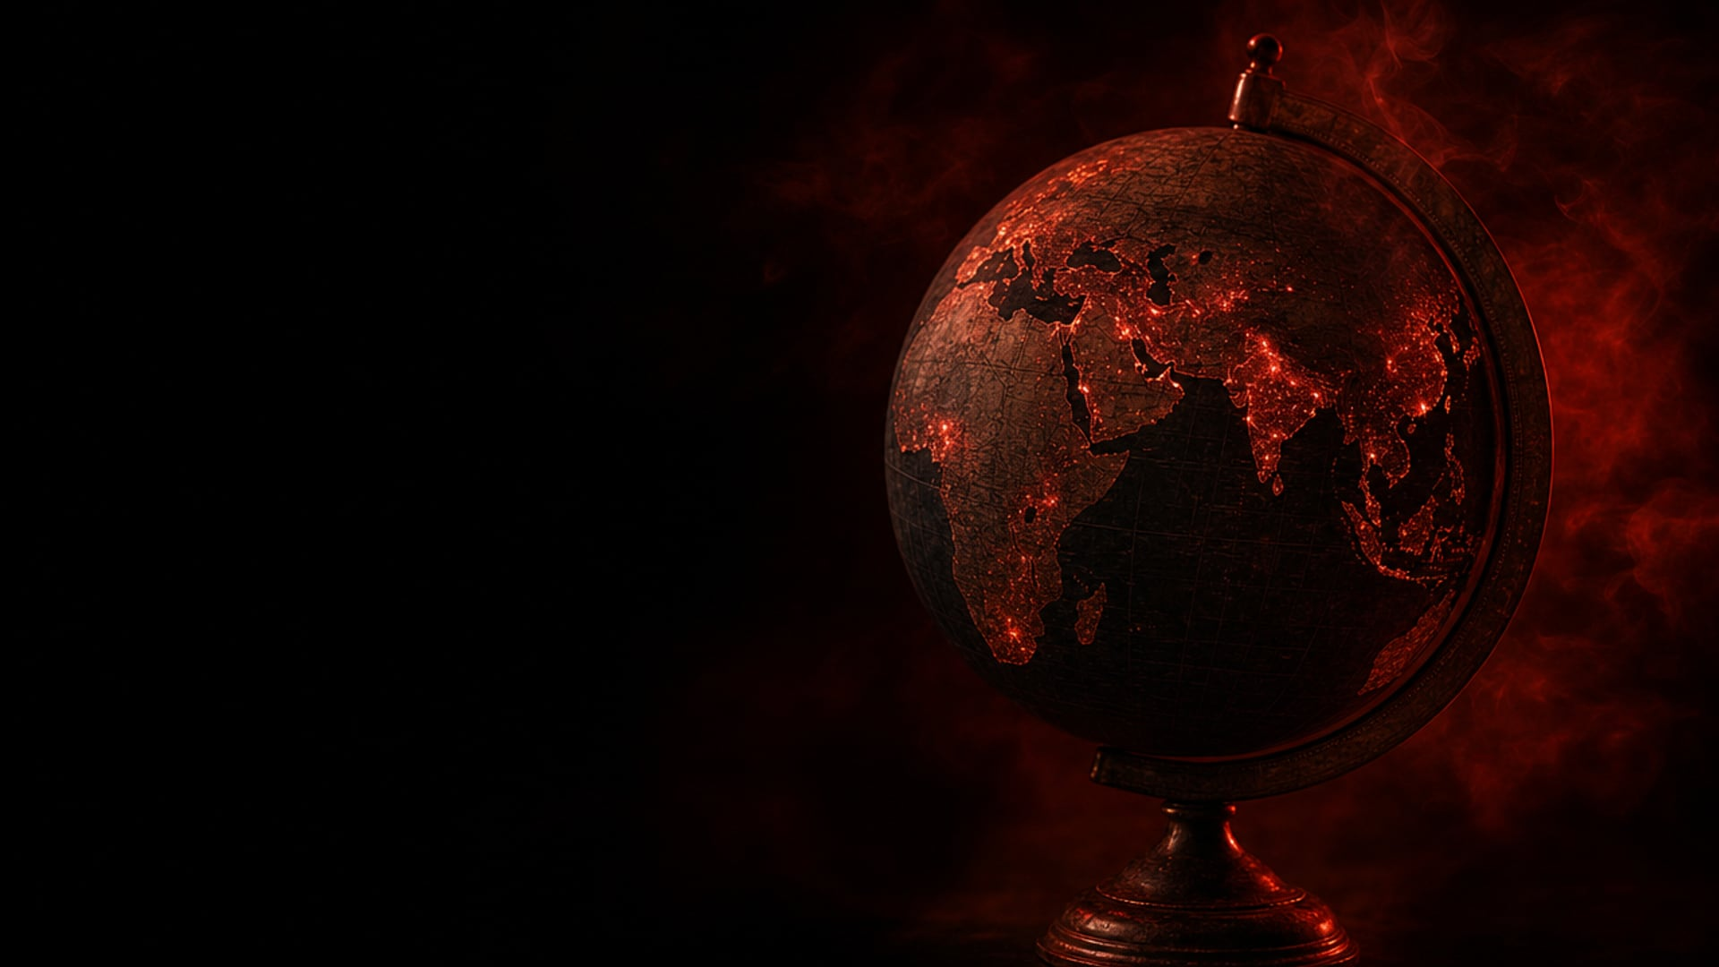




02 · HISTORY
DEATHS
DEATHS
CEYLON (SRI LANKA) · 1934–35
ETHIOPIA · 1958
After a drought, about 1.5 million people fell ill.
About 3 million cases in one epidemic.
CASES
NEW CASES
PAKISTAN · 2022
3 COUNTRIES · 2024
After the floods: 400,000 cases (2021) → 1.6 million+ (2022).
Ethiopia, Madagascar and Yemen added them in one year.
Source: Gill (1935); Fontaine, Najjar and Prince (1961); World Health Organization (2023a; 2025b)
MUHAMMADRIZO ASATULLAYEV · 07 / 16
Notes:
[Muhammadrizo Asatullayev]
Once people knew the enemy, they could fight it. But malaria still caused terrible epidemics.
In 1934 and 1935, in Sri Lanka, which was then called Ceylon, a drought created perfect breeding places for mosquitoes. About one and a half million people fell ill, and about eighty thousand died.
In 1958, Ethiopia suffered one of the worst epidemics in history: about three million cases and one hundred and fifty thousand deaths.
And this is not only history. After the terrible floods of 2022 in Pakistan, malaria cases grew at least four times. And in 2024, Ethiopia, Madagascar and Yemen together added about five million new cases in just one year.
So what does malaria cost the world today? Ramazan will show you the numbers.

Slide 8






03 · MALARIA TODAY
malaria cases in 2024, in 80 countries
DEATHS IN 2024
AFRICA
CHILDREN UNDER 5
almost 1,700 people every day
of all cases · of all deaths
of all malaria deaths in Africa
5 countries have more than half of all cases: Nigeria · DR Congo · Uganda · Ethiopia · Mozambique
Source: World Health Organization (2025b), World malaria report 2025
RAMAZAN BAKIYEV · 08 / 16
Notes:
[Ramazan Bakiyev]
Thank you, Muhammadrizo. As Muhammadrizo showed, malaria is not only a disease of the past. Let me show you the latest numbers from the World Malaria Report, published by WHO in December 2025.
In 2024, there were about two hundred and eighty-two million cases of malaria in eighty countries. Six hundred and ten thousand people died. That is almost one thousand seven hundred people every single day.
The burden is very unequal. Africa carries ninety-four percent of all cases and ninety-five percent of all deaths. Just five countries, Nigeria, the Democratic Republic of the Congo, Uganda, Ethiopia and Mozambique, have more than half of all cases in the world.
And the most painful number: in Africa, three out of four people who die from malaria are children under five years old. That is more than one thousand small children every day.

Slide 9




03 · MALARIA TODAY
DEATHS · 2015 → 2024
The death rate per person fell, but the population keeps growing.
FUNDING IN 2024
US$ 3.9 bn
invested
US$ 9.3 bn
needed every year
Source: World Health Organization (2025b)
RAMAZAN BAKIYEV · 09 / 16
Notes:
[Ramazan Bakiyev]
And here is the worrying part: the number of cases is going up. In 2015, there were two hundred and thirty million cases. In 2023, two hundred and seventy-three million. And in 2024, two hundred and eighty-two million. Deaths also grew, from five hundred and seventy-eight thousand to six hundred and ten thousand. The death rate per person is lower than ten years ago, but the population keeps growing.
One big reason is money. The global strategy needs about nine point three billion dollars a year. In 2024, the world invested only three point nine billion dollars. That is just forty-two percent of what is needed. And without money, there are fewer nets, fewer tests and fewer medicines.

Slide 10









03 · MALARIA TODAY
CASES PREVENTED
DEATHS PREVENTED
MALARIA-FREE
since 2000
since 2000
countries + territory, WHO-certified
UZBEKISTAN: OUR OWN SUCCESS STORY
First elimination
Tashkent Declaration
Last local cases
WHO certificate, 7 Dec
Surkhandarya, the most affected province: 81 cases in 2007 → 0
Source: World Health Organization (2018); World Health Organization (2025b)
RAMAZAN BAKIYEV · 10 / 16
Notes:
[Ramazan Bakiyev]
But there is also good news. Since the year 2000, malaria control has prevented two point three billion cases and fourteen million deaths. Today, forty-seven countries and one territory are officially certified as malaria-free.
And one of them is our own country. Uzbekistan first stopped malaria in 1961, but the disease came back. In 2005, the countries of our region signed the Tashkent Declaration and promised to eliminate malaria. In Surkhandarya, the most affected province, cases fell from eighty-one in 2007 to zero. The last local cases were found in 2010, and in December 2018, WHO officially certified Uzbekistan as malaria-free. According to WHO, the key was early diagnosis and treatment, free of charge for everyone.
So malaria can be defeated. But with which tools? Akmalbek will explain.

Slide 11
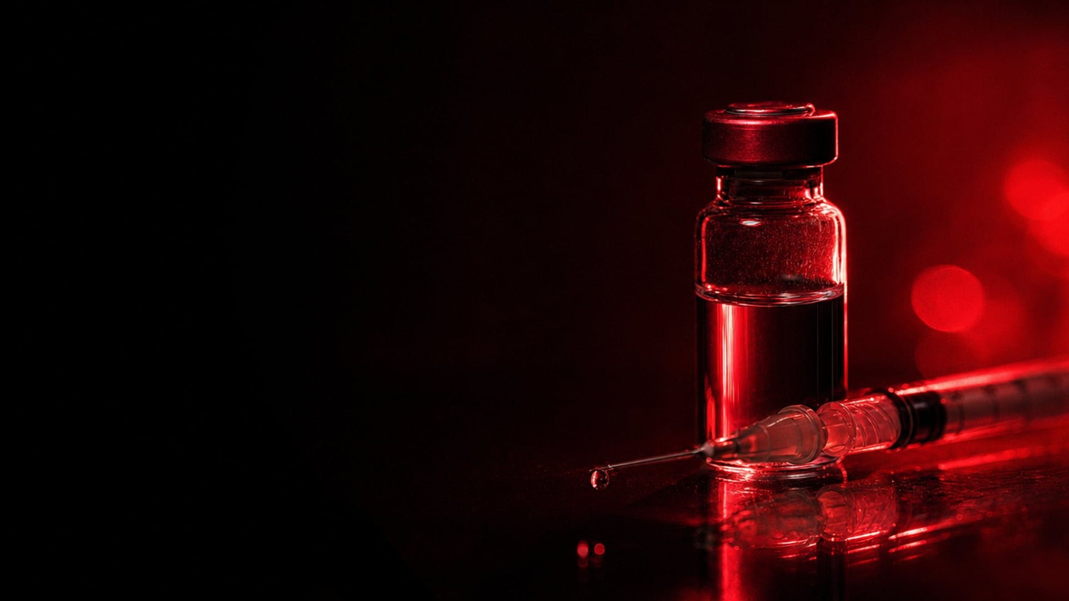





04 · FIGHTING BACK
FIRST · WHO 2021
SECOND · WHO 2023
AS01 · GSK
MATRIX-M · OXFORD
30 years of research. Recommended for children in October 2021: “a historic moment”.
−75% cases where malaria is seasonal. Cost-effective at US$ 2–4 per dose.
child deaths from all causes in the pilot: Ghana, Kenya, Malawi
countries using malaria vaccines by October 2025
Source: World Health Organization (2021; 2023b; 2025b); University of Oxford (2023)
AKMALBEK ABDURAIMOV · 11 / 16
Notes:
[Akmalbek Abduraimov]
Thank you, Ramazan. As Ramazan said, malaria can be defeated, and today we have a new weapon: a vaccine. For a long time it seemed impossible, because a parasite is much more complex than a virus or a bacterium.
The first vaccine, RTS,S, is the result of thirty years of research by the company GSK. In October 2021, WHO recommended it for children, and called it a historic moment. In October 2023, WHO recommended a second vaccine, R21, developed by the University of Oxford. In areas where malaria is seasonal, it reduced cases by seventy-five percent. And it is affordable: according to WHO, it is cost-effective at only two to four dollars per dose.
In the pilot programme in Ghana, Kenya and Malawi, child deaths from all causes fell by thirteen percent. And by October 2025, twenty-four countries were using malaria vaccines.

Slide 12
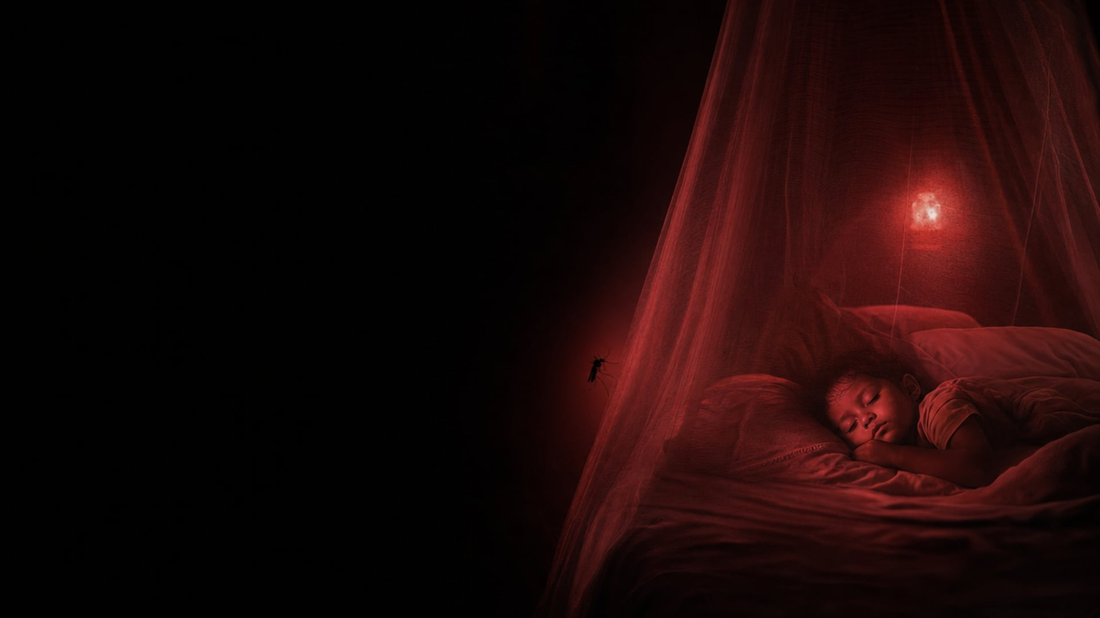





04 · FIGHTING BACK
1 · INSECTICIDE-TREATED BED NETS
68% of all cases prevented in Africa, 2000–2015. Sleep under it every night.
2 · INDOOR SPRAYING
Insecticide on the inside walls, where mosquitoes rest after they bite.
3 · SEASONAL MEDICINES FOR CHILDREN
About 54 million African children in each round, 2024.
4 · PERSONAL PROTECTION
Repellent, long sleeves, no standing water. Preventive tablets for travellers.
Source: Bhatt et al. (2015); World Health Organization (2025a; 2025b)
AKMALBEK ABDURAIMOV · 12 / 16
Notes:
[Akmalbek Abduraimov]
But a vaccine alone is not enough. Prevention is still our main shield.
The most important tool is very simple: a bed net treated with insecticide. Between 2000 and 2015, these nets were responsible for sixty-eight percent of all malaria cases prevented in Africa. But a net works only if people sleep under it every night.
Second, spraying insecticide on the inside walls of houses, where mosquitoes rest after they bite.
Third, preventive medicines for children during the rainy season. In 2024, about fifty-four million African children received them in each round.
And finally, personal protection: repellents, long sleeves, and no standing water near the house. Travellers to risk areas should also take preventive tablets.

Slide 13








04 · FIGHTING BACK
STEP 1 · TEST FIRST microscope or rapid diagnostic test
Cinchona bark from South America is used against fever.
Scientists extract quinine from the bark.
Tu Youyou finds artemisinin in sweet wormwood. Nobel Prize 2015.
NEW THREAT: DRUG RESISTANCE
ACT: artemisinin-based combination therapy. Severe malaria: artesunate injection.
Partial resistance to artemisinin is confirmed in Eritrea, Rwanda, Uganda and Tanzania.
Source: Achan et al. (2011); World Health Organization (2015; 2025b); Nobel Prize Outreach (2026)
AKMALBEK ABDURAIMOV · 13 / 16
Notes:
[Akmalbek Abduraimov]
And if a person is already sick? Malaria is curable, but the first step is always a test: a blood test under the microscope, or a rapid test.
The history of treatment is fascinating. In the 1600s, people used the bark of the South American cinchona tree against fever, and in 1820 scientists extracted quinine from it. In the 1970s, the Chinese scientist Tu Youyou found artemisinin in an ancient herbal medicine, sweet wormwood. In 2015, she received the Nobel Prize.
Today, the most effective treatment is artemisinin-based combination therapy, or ACT. For severe malaria, doctors give artesunate by injection. But there is a new danger: in Eritrea, Rwanda, Uganda and Tanzania, the parasite is becoming partially resistant to artemisinin.
Now Javohir will sum up our presentation.

Slide 14






05 · CONCLUSION
A parasite, not a virus or a bacterium. Without treatment it can kill within 24 hours.
Almost 5,000 years with humanity, from ancient China to Tutankhamun.
282 million cases, 610,000 deaths in 2024, mostly young children in Africa.
We know how to win: vaccines, bed nets and fast treatment. Uzbekistan is the proof.
◆ ◆ ◆
Malaria is preventable and curable.
JAVOHIR AZAMOV · 14 / 16
Notes:
[Javohir Azamov]
Thank you, Akmalbek. To conclude, here are our four main ideas.
First, malaria is caused by a parasite, and without treatment it can kill within one day.
Second, it has been with humanity for almost five thousand years.
Third, it is still a huge problem: two hundred and eighty-two million cases and six hundred and ten thousand deaths in 2024, mostly young children in Africa.
And fourth, we know how to win: vaccines, bed nets and fast treatment. Uzbekistan is the proof.
So our message is simple: malaria is preventable and curable. Block the bite, test early, treat fast.

Slide 15

◆ ◆ ◆
QUESTIONS ARE WELCOME
Javohir Azamov · Muhammadrizo Asatullayev · Ramazan Bakiyev · Akmalbek Abduraimov
Notes:
[Javohir Azamov]
Thank you for your attention. We will be happy to answer your questions.

Slide 16

SOURCES · HARVARD STYLE
Achan, J. et al. (2011) ‘Quinine, an old anti-malarial drug in a modern world: role in the treatment of malaria’, Malaria Journal, 10, 144. Available at: https://doi.org/10.1186/1475-2875-10-144
Bhatt, S. et al. (2015) ‘The effect of malaria control on Plasmodium falciparum in Africa between 2000 and 2015’, Nature, 526(7572), pp. 207–211. Available at: https://doi.org/10.1038/nature15535
Cox, F.E.G. (2010) ‘History of the discovery of the malaria parasites and their vectors’, Parasites & Vectors, 3, 5. Available at: https://doi.org/10.1186/1756-3305-3-5
Fontaine, R.E., Najjar, A.E. and Prince, J.S. (1961) ‘The 1958 malaria epidemic in Ethiopia’, American Journal of Tropical Medicine and Hygiene, 10, pp. 795–803. Available at: https://doi.org/10.4269/ajtmh.1961.10.795
Gill, C.A. (1935) Report on the malaria epidemic in Ceylon in 1934–35. Sessional Paper XXIII. Colombo: Ceylon Government Press.
Hawass, Z. et al. (2010) ‘Ancestry and pathology in King Tutankhamun’s family’, JAMA, 303(7), pp. 638–647. Available at: https://doi.org/10.1001/jama.2010.121
Nobel Prize Outreach (2026) All Nobel Prizes in Physiology or Medicine. Available at: https://www.nobelprize.org/prizes/lists/all-nobel-laureates-in-physiology-or-medicine/ (Accessed: 27 October 2026).
University of Oxford (2023) Highly effective R21/Matrix-M malaria vaccine developed by University of Oxford and Serum Institute of India receives WHO prequalification, 21 December. Available at: https://www.ox.ac.uk/news/2023-12-21-highly-effective-r21matrix-m-malaria-vaccine-developed-university-oxford-and-serum (Accessed: 27 October 2026).
World Health Organization (2015) Guidelines for the treatment of malaria. 3rd edn. Geneva: WHO. Available at: https://www.ncbi.nlm.nih.gov/books/NBK294445/ (Accessed: 27 October 2026).
World Health Organization (2018) WHO certifies that Uzbekistan has eliminated malaria, 7 December. Available at: https://www.who.int/news/item/07-12-2018-who-certifies-that-uzbekistan-has-eliminated-malaria (Accessed: 27 October 2026).
World Health Organization (2021) WHO recommends groundbreaking malaria vaccine for children at risk, 6 October. Available at: https://www.who.int/news/item/06-10-2021-who-recommends-groundbreaking-malaria-vaccine-for-children-at-risk (Accessed: 27 October 2026).
World Health Organization (2023a) ‘It was just the perfect storm for malaria’: Pakistan responds to surge in cases following the 2022 floods. Available at: https://www.who.int/news-room/feature-stories/detail/It-was-just-the-perfect-storm-for-malaria-pakistan-responds-to-surge-in-cases-following-the-2022-floods (Accessed: 27 October 2026).
World Health Organization (2023b) WHO recommends R21/Matrix-M vaccine for malaria prevention in updated advice on immunization, 2 October. Available at: https://www.who.int/news/item/02-10-2023-who-recommends-r21-matrix-m-vaccine-for-malaria-prevention-in-updated-advice-on-immunization (Accessed: 27 October 2026).
World Health Organization (2025a) Malaria: fact sheet. Available at: https://www.who.int/news-room/fact-sheets/detail/malaria (Accessed: 27 October 2026).
World Health Organization (2025b) World malaria report 2025. Geneva: WHO. Available at: https://www.who.int/teams/global-malaria-programme/reports/world-malaria-report-2025 (Accessed: 27 October 2026).
16 / 16
Notes:
(Show this slide after "thank you" and leave it on the screen during questions. No speech needed. If asked: "Here are the sources we used, in Harvard style.")

