Slide 1
An Open-Source MVP Data Lake
A self-hosted, offline platform built almost entirely from open source
Executive overview · for technology leadership

Slide 2
The idea in one line
Store all your data cheaply in one place, and decide how to use it later
A data lake is a single, low-cost place to store and analyse all of the organisation's data — running on our own hardware, fully offline, with no cloud dependency and no per-terabyte fees.
1
2
3
Open source
Runs offline
Low cost, low risk
No licensing cost for the core. Inspect, extend, or swap any part — no vendor lock-in.
On our own infrastructure. Full control of our data; nothing leaves the building.
Cheap object storage, proven parts. Prove the pattern fast, grow it later.

Slide 3
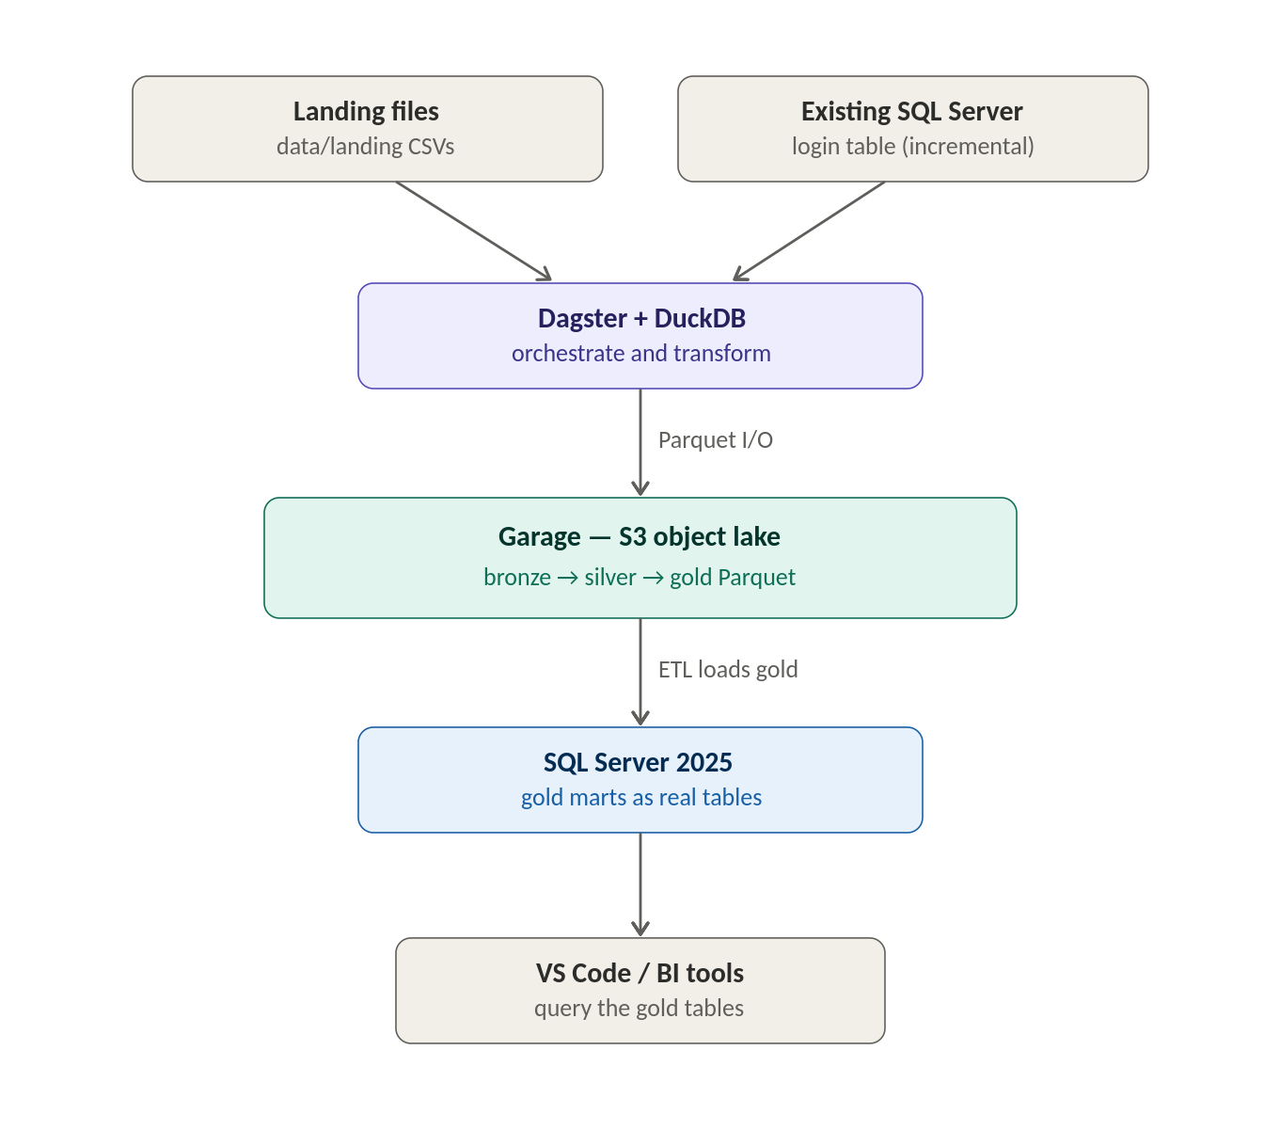
How it works
Land raw data, refine it in stages, serve the result
1
Land
Raw data arrives from files and databases into the lake — untouched.
2
Refine
Cleaned and shaped in stages (bronze → silver → gold).
3
Serve
Business-ready tables for staff, dashboards, and BI tools.
Figure — the core platform

Slide 4
The technologies — and what they do
Every core component is open source
1
Garage
2
Dagster + DuckDB
The lake — S3 object storage holding all data on your own hardware.
The engine — runs the pipeline and transforms data through each layer.
3
Apache Parquet
4
SQL Server 2025
The format — efficient open files any analytics tool can read.
The serving layer — finished results as tables staff already know.

Slide 5
No lock-in — an enterprise path for each part
The technology we would scale toward as data and users grow
Garage
→
Ceph — petabyte-scale on-prem object storage
Dagster
→
Apache Airflow — the enterprise-standard orchestrator
DuckDB
→
Apache Spark — large-scale distributed processing
Parquet
→
Apache Iceberg — transactions & versioning at scale
SQL Server
→
PostgreSQL — leading open-source database

Slide 6
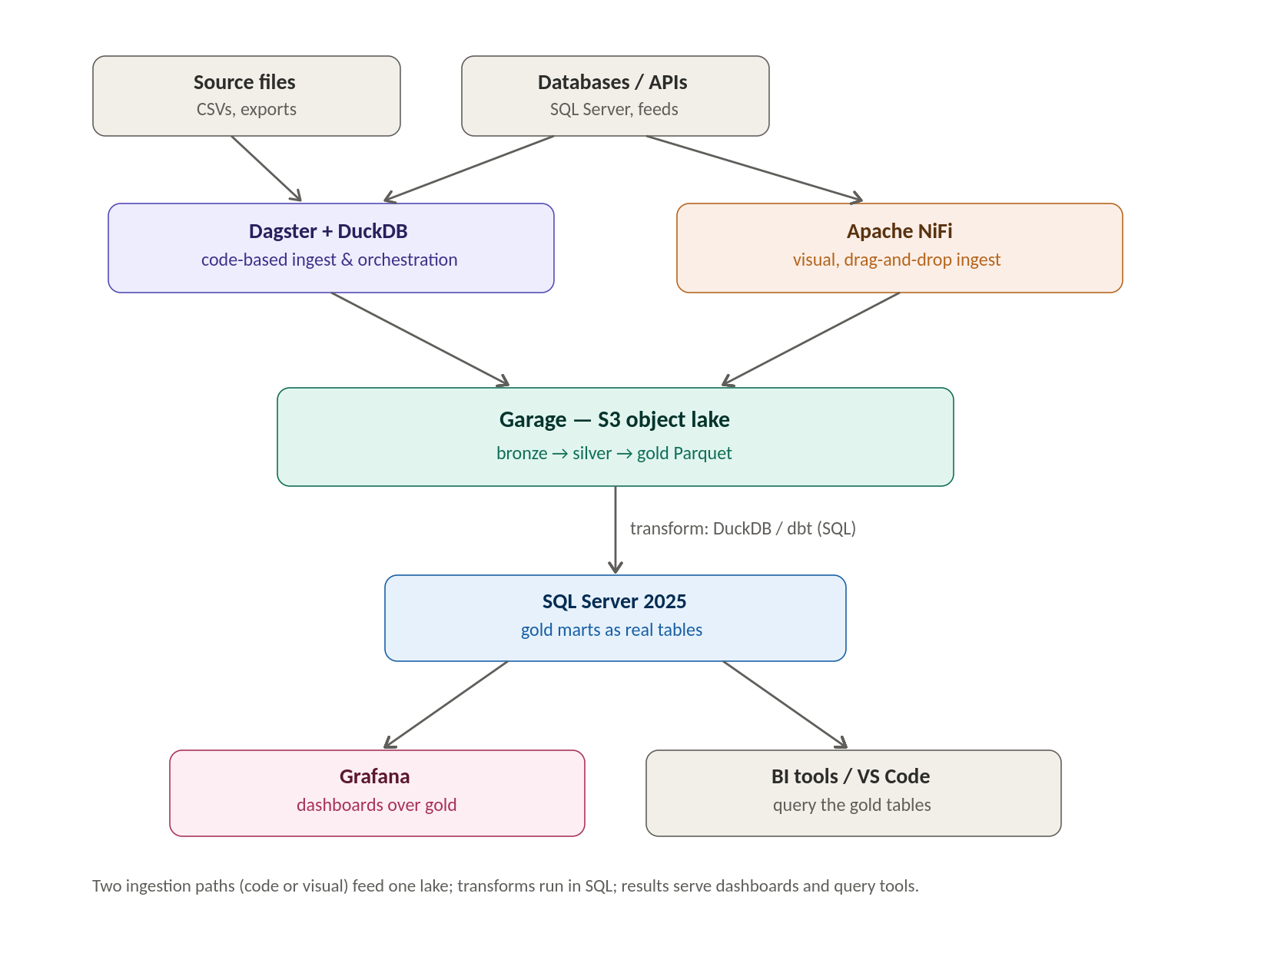
Low-code & visual tooling
Reducing hand-written code — for engineers who prefer it
Apache NiFi
Drag-and-drop visual ingestion — no code.
dbt
Transforms written in plain SQL, with testing & lineage built in.
Grafana
Point-and-click dashboards over the gold data.
Figure — the extended stack

Slide 7
Open source & security — the honest note
Lower cost, but a responsibility that must be resourced
Open source removes licensing cost, but it shifts the security burden onto us. With no vendor, we own vulnerability tracking, patching, hardening, and monitoring. Manageable and normal — but a real, ongoing commitment, not a one-time setup.
Practical mitigations
Standardise on well-supported enterprise projects (fast security response).
Consider commercial support for the critical components.
Fold the platform into our existing patching and monitoring.

Slide 8
Who runs it — three key roles
The platform is only as valuable as the people who run it
Platform / infra engineer
Data engineer
Reporting / dashboard engineer
Monitor platform health
Security & patching
Access & backups
Check pipeline runs
Build & extend pipelines
Safeguard data quality
Build & maintain dashboards
Partner with the business
Assure what's reported
Why the dashboard role matters: a lake no one can see delivers no value. Fund the reporting role alongside the engineering — not after.

Slide 9
Build vs buy — our stack vs a platform (Iomete)
Both are open-format and self-hosted — it's a build-vs-buy call
Build (our DIY stack)
Buy (Iomete)
No licensing; pay in team time
Light — a few containers a DBA can run
Full control; swap any part
Right-sized for a small MVP
Licensing cost; less labour, vendor support
Heavier — runs on Kubernetes
Enterprise features & governance built in
Built for large scale & compliance
Prove the pattern cheaply now; re-evaluate a platform when scale, governance, or team-capacity limits bite.

Slide 10
Why this is an MVP data lake
Stores anything — structured today, documents & more later
Keeps full raw history cheaply; reprocess as questions change
Breaks down silos in one governed place
Runs on our own hardware, offline, on open standards
From platform to practice: this is the foundation for data-driven leadership — one trusted source of truth, made visible. The technology is proven; the next step is the habit of asking questions of the data and acting on the answers.

