Slide 1
Object Pool Pattern
Tyler Ellsworth -- Stuart Harley -- Joseph Skubal

Slide 2
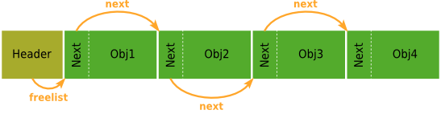
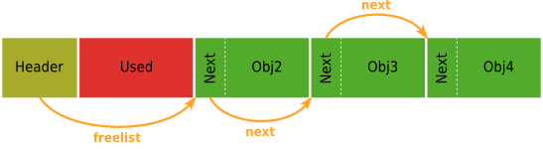
About Object Pool
Very efficient when instantiating many particularly expensive objects instead of creating and deleting them over and over
Users “check out” the object while they use it and then return it to the pool when they are finished using it
The size of the pool is determined by who runs the program, thus setting the max possible size/number of objects available at any given time

Slide 3
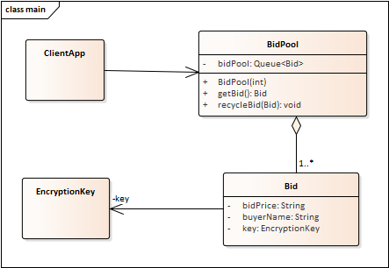
UML

Slide 4
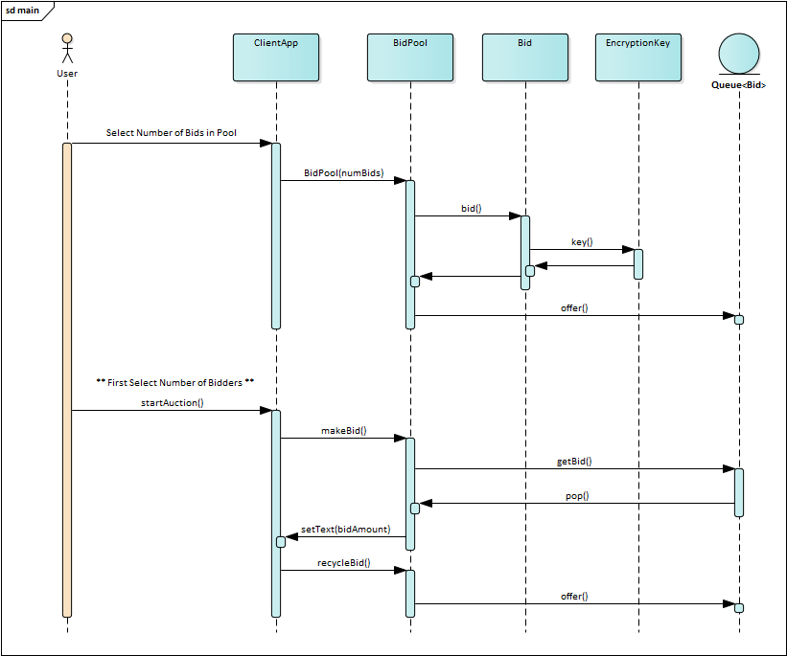
Simplified Sequence Diagrams

Slide 5

Pros of Object Pool
Greatly boosts the performance of an application as objects are not constantly being created and deleted
Connections are managed and can be reused and shared
A limit on the maximum number of objects can be created so only a set amount of space is taken up at most

Slide 6
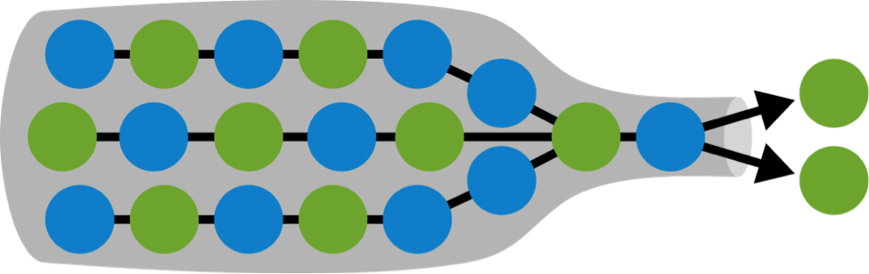

Cons of Object Pool
Since the max number of objects is limited, if too many objects are trying to be created bottlenecking could occur
A user may not return the object after using it, taking up an object slot and taking up space
Methods used by different threads need to be
synchronized and as such may run out of sync

Slide 7

When To Use Object Pool
Object pool pattern is most efficient when the rate of initializing an instance of the class is very high
Able to be used if your application is constantly creating and destroying expensive objects
Useful for setting a max number of objects able to be created at any given time to avoid clutter

Slide 8
Summary of Object Pool
Primary Use: Improve an applications performance
Advantages: Objects are not being created or destroyed
Max number of objects that can be created
Disadvantages: Bottlenecking may occur
Threads may run out of sync

