Slide 2
Pre-processing the image
1. Convert the image to grayscale
Create a mask of the image
Using a custom threshold that separates by color intensity
Manual intervention
Drawing the trimap on the image
2. Reduce noise in image
Using Closed Form proposed in past studies
Extract the alpha matte, foreground and background

Slide 3
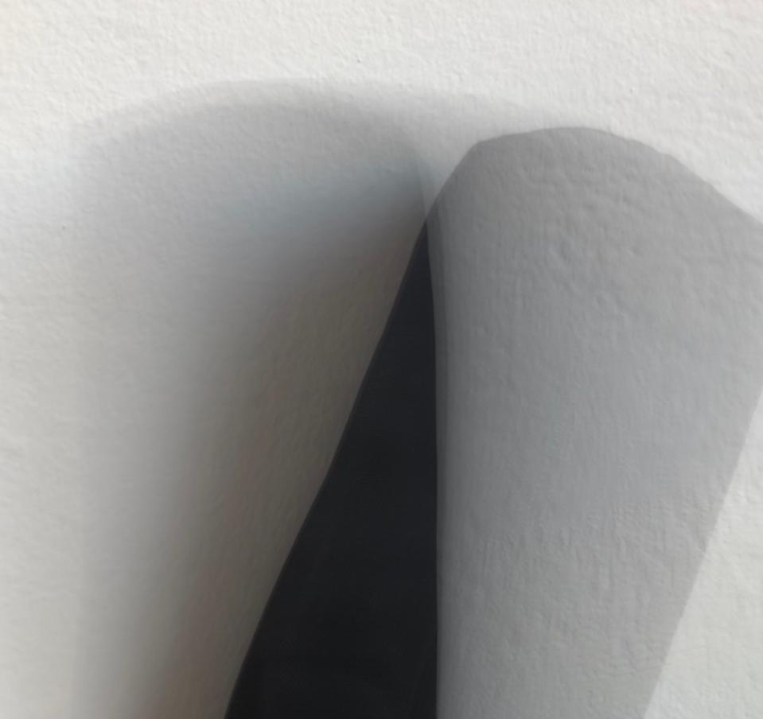
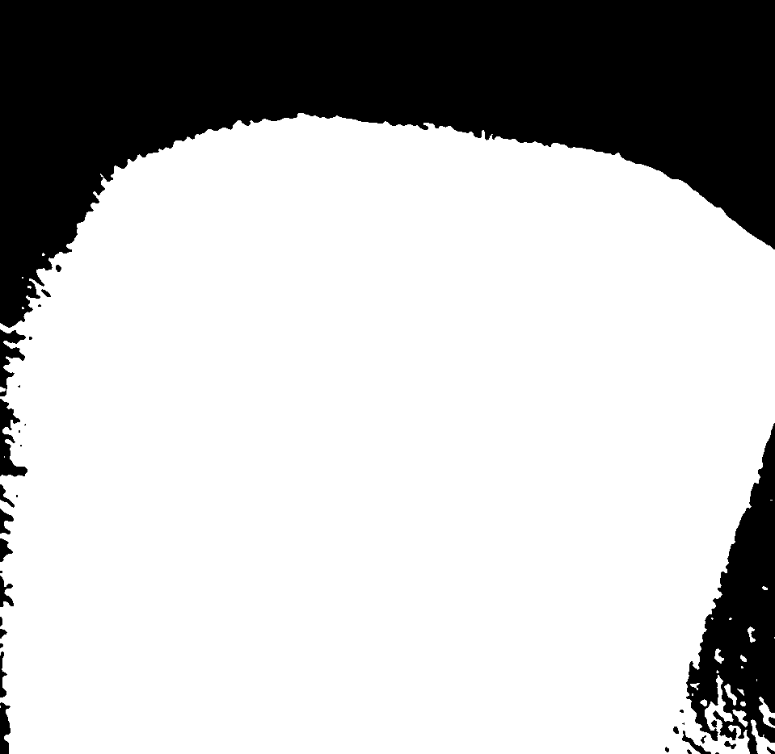
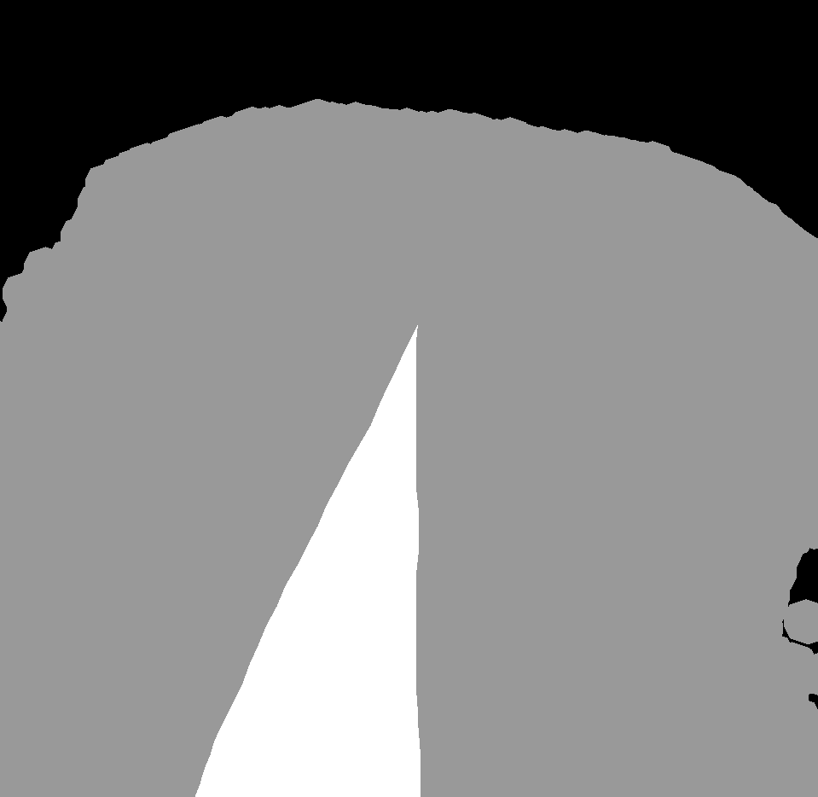
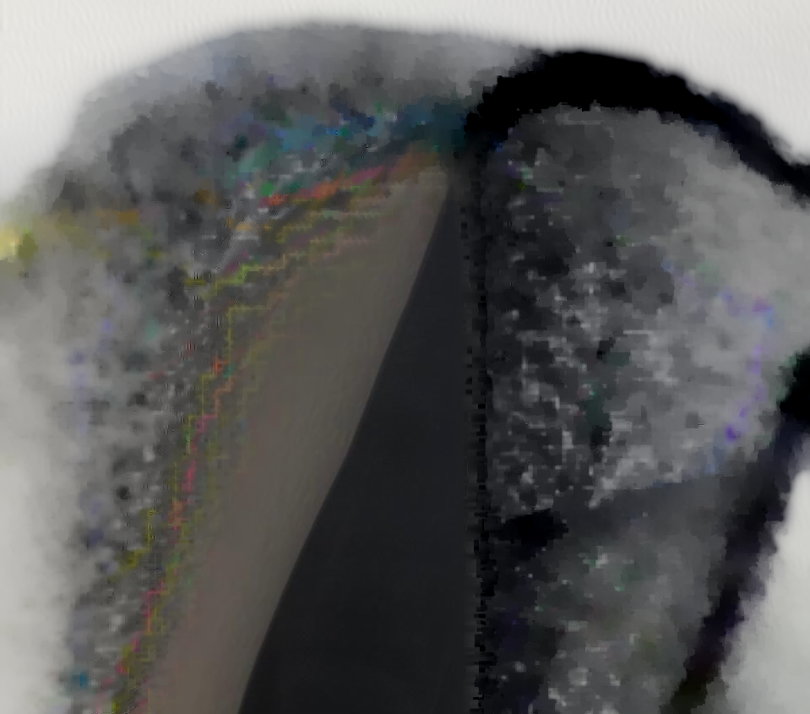
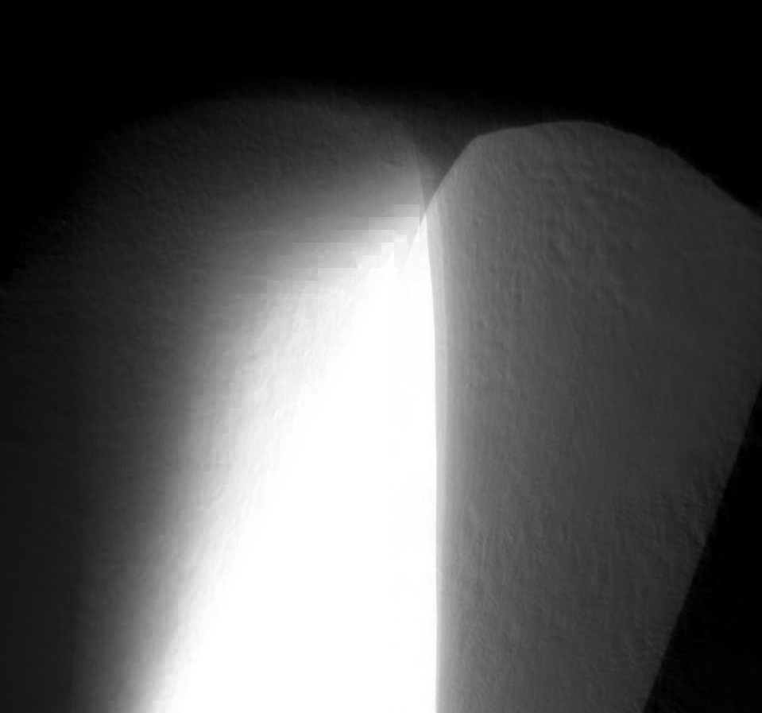
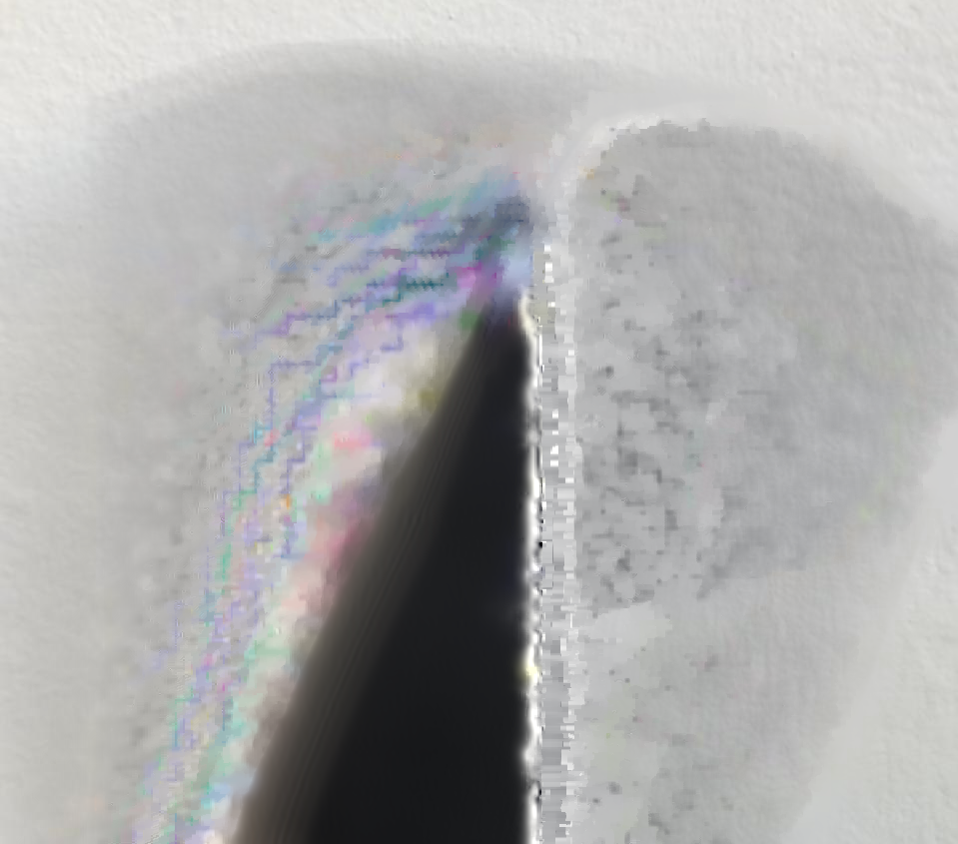
Pre-processing the image
1. Convert the image to grayscale
Create a mask of the image
Using a custom threshold that separates by color intensity
Manual intervention
Drawing the trimap on the image
2. Reduce noise in image
Using Closed Form proposed in past studies
Extract the alpha matte, foreground and background

Slide 4
Pre-processing the image
1. Convert the image to grayscale
Calculate Gradient
Using the Sobel operator on axis X and Y
2. Reduce noise in image
Apply a Gaussian adaptive threshold
Extract object contours with outlined borders
With the Gradient found before to get well defined features
Equalizing the histogram of the image

