Slide 1
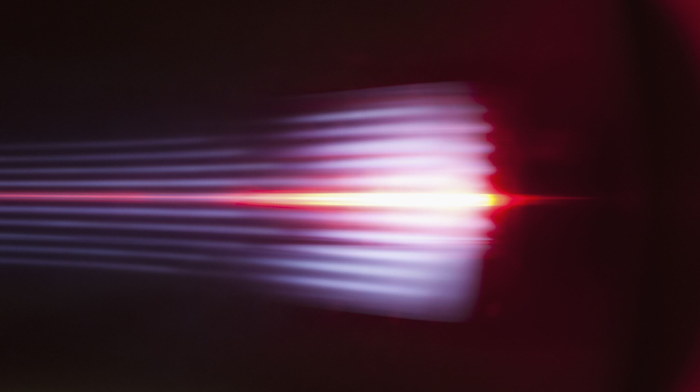
Object contours detection in motion-blurred image
Presented by:
Angela Remolina and Semjon Tukmatsov
IACV project 2023-2024

Slide 2
Agenda

Slide 3
Pre-processing the image
1. Convert the image to grayscale
Create a 2 masks of the image (strict and broad)
Using a custom threshold that separates by color intensity
Calculate the trimap
Using the intersection of the 2 masks found before
2. Reduce noise in image
Using Closed Form proposed in past studies
Extract the alpha matte, foreground and background

Slide 4
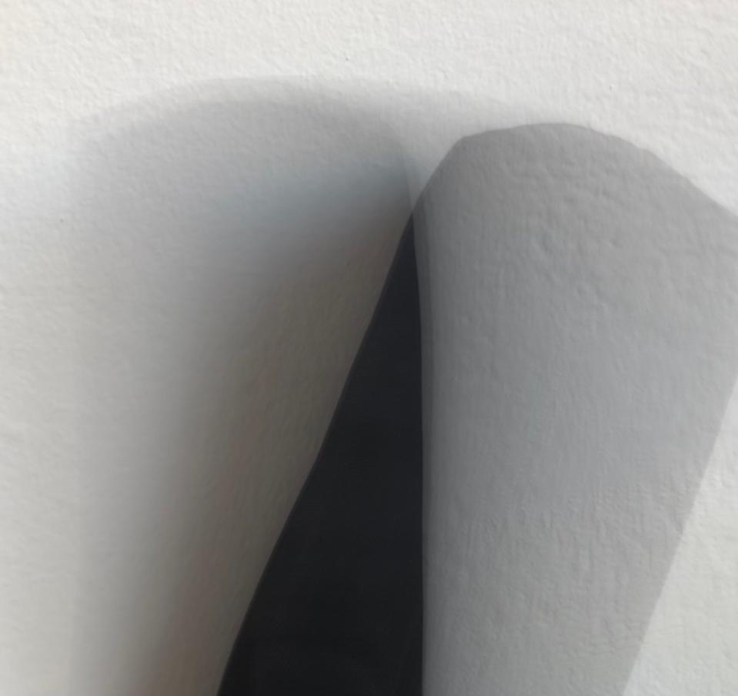
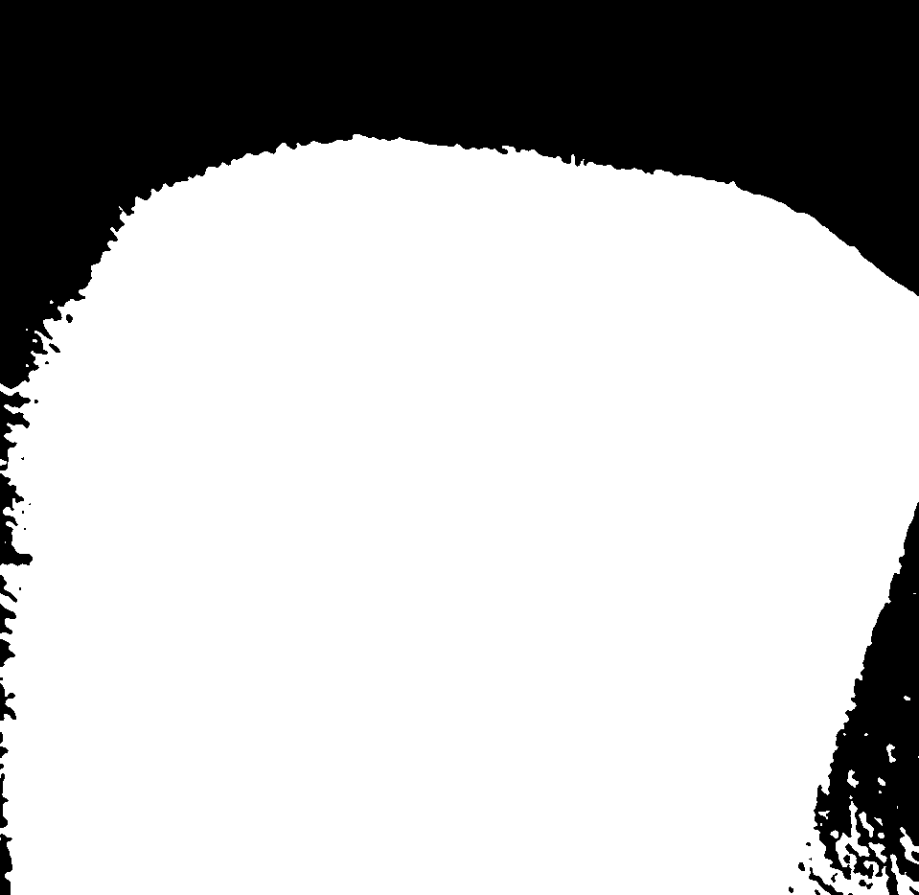
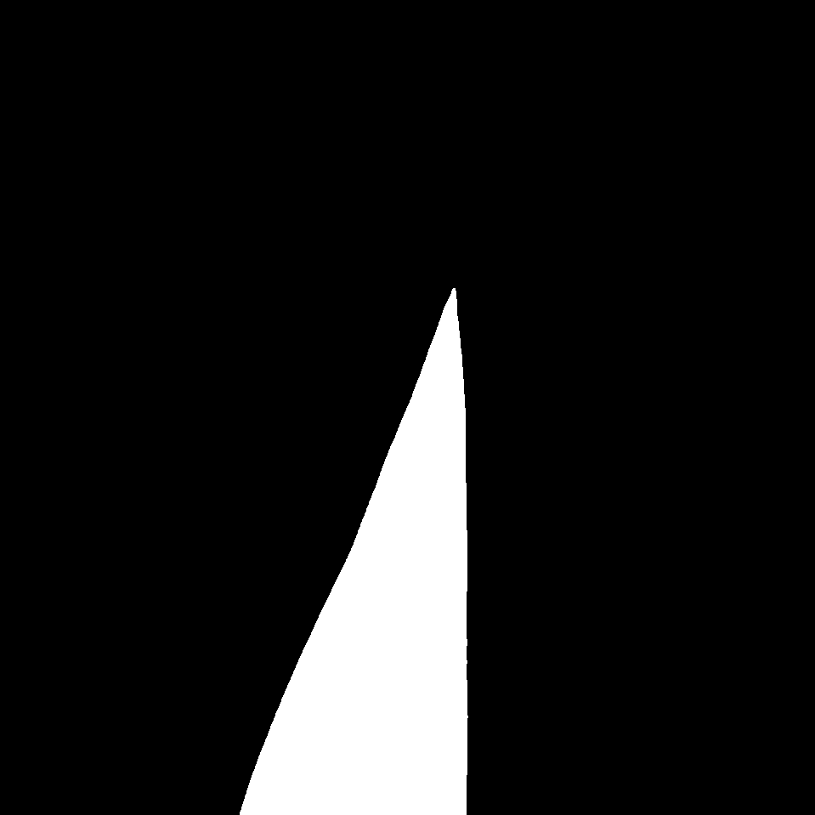
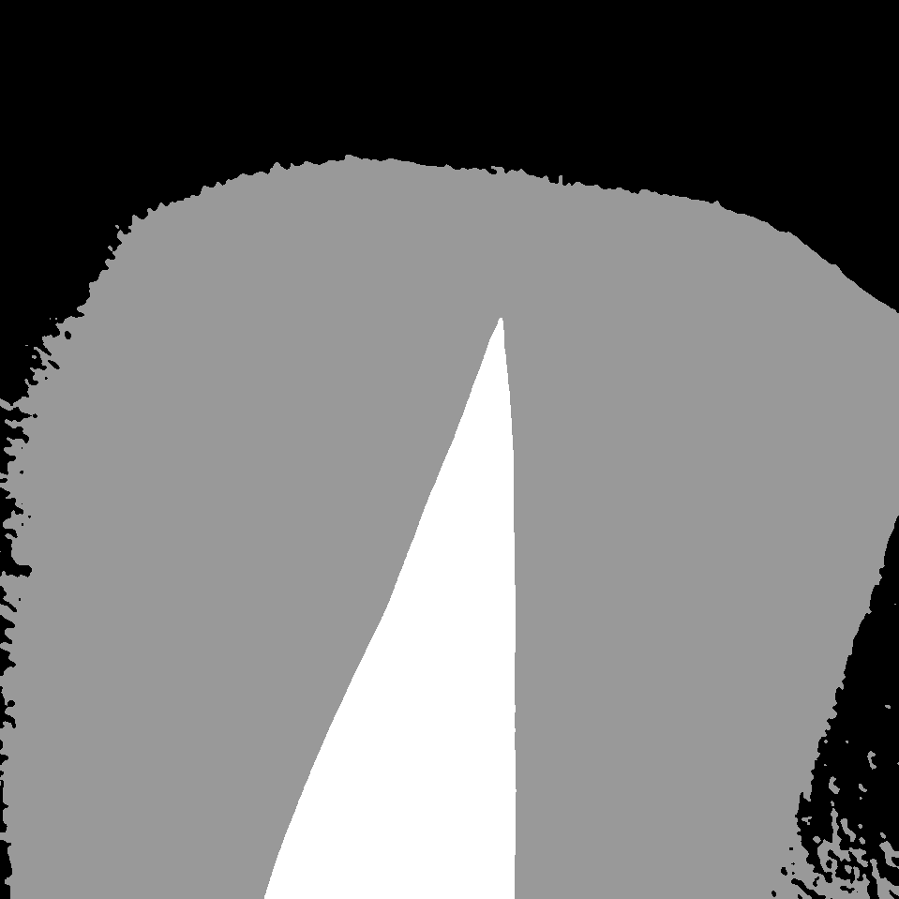
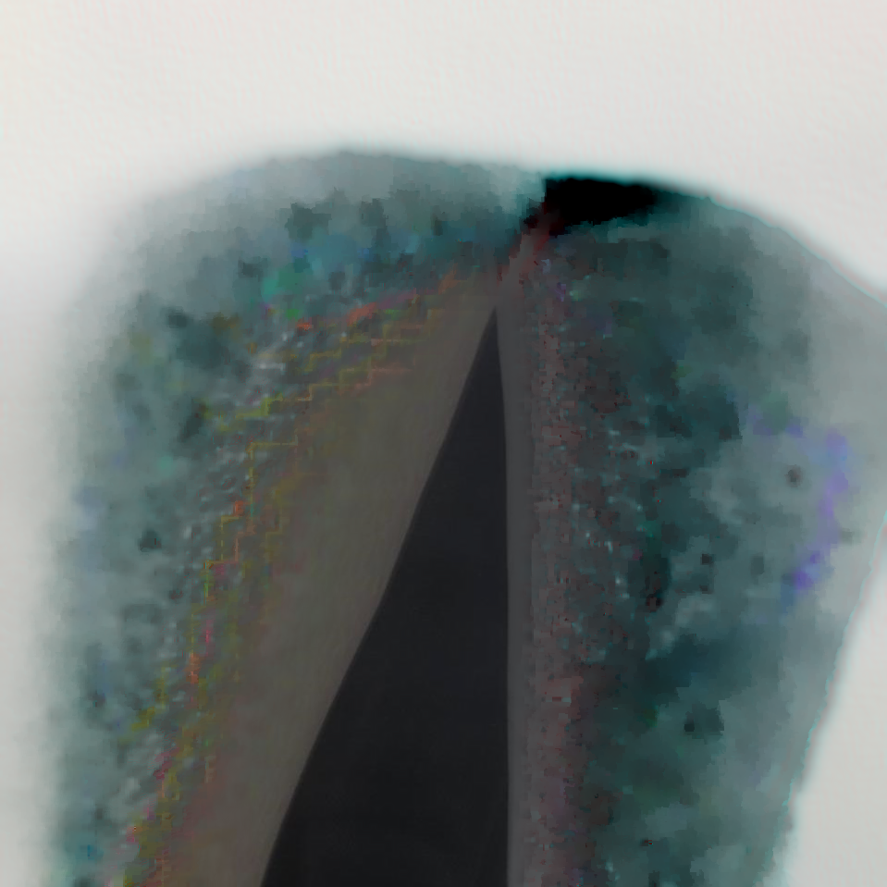
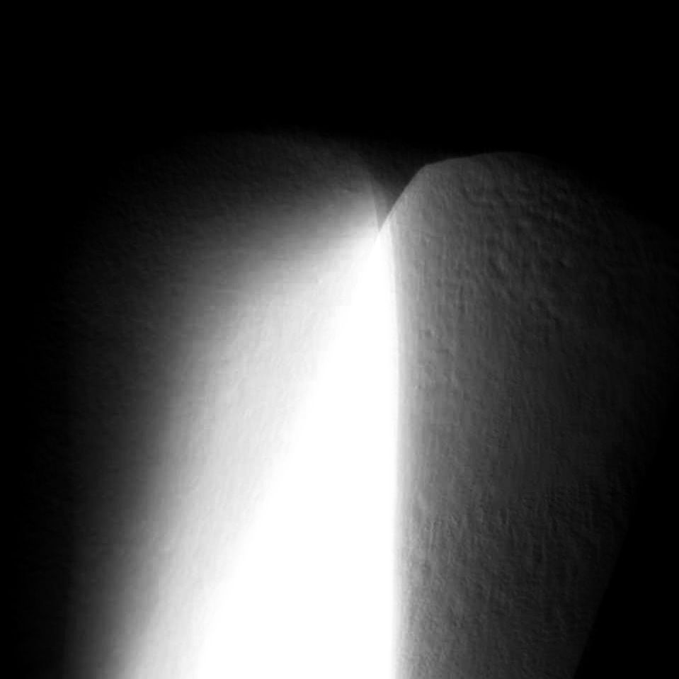
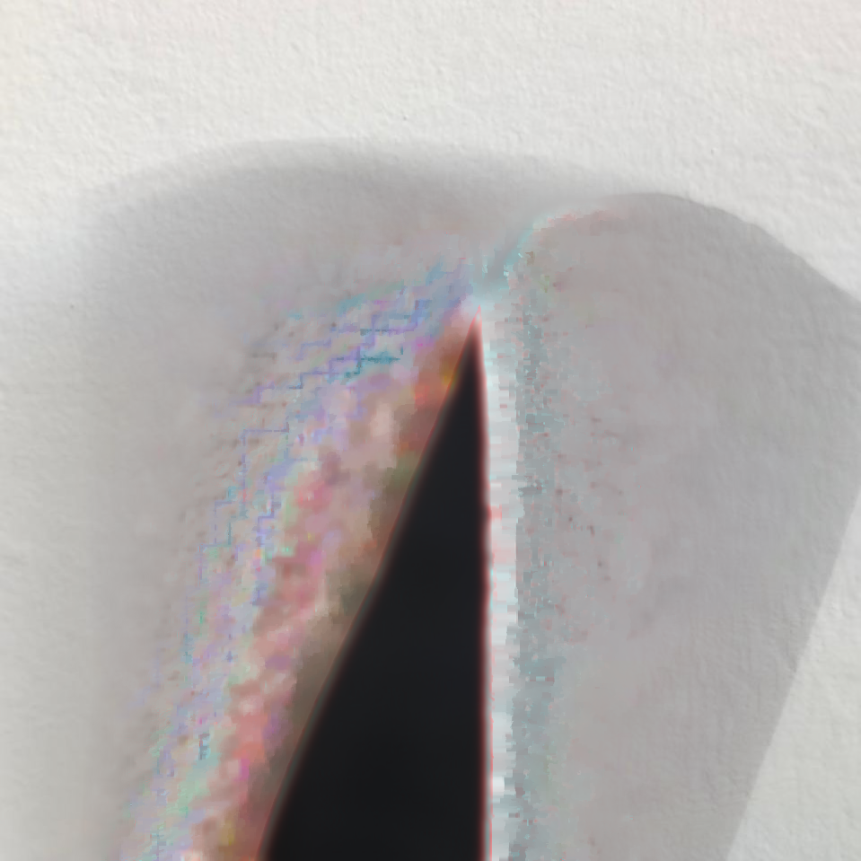
Pre-processing the image
1. Convert the image to grayscale
Create a 2 masks of the image (broad and strict)
Using a custom threshold that separates by color intensity
Calculate the trimap
Using the intersection of the 2 masks found before
2. Reduce noise in image
Using Closed Form proposed in past studies
Extract the alpha matte, foreground and background

Slide 5
Pre-processing the image
1. Convert the image to grayscale
Calculate Gradient
Using the Sobel operator on axis X and Y
2. Reduce noise in image
Apply a Gaussian adaptive threshold
Extract object contours with outlined borders
With the Gradient found before to get well defined features
Equalizing the histogram of the image

