Slide 1
bonobono

Slide 2


Photo

Slide 3
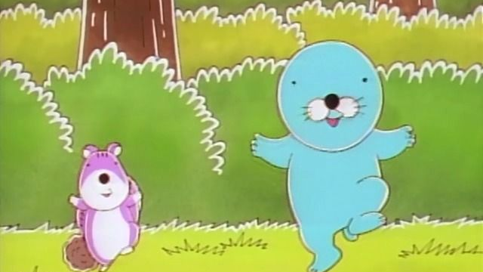
Hello world

