Slide 1
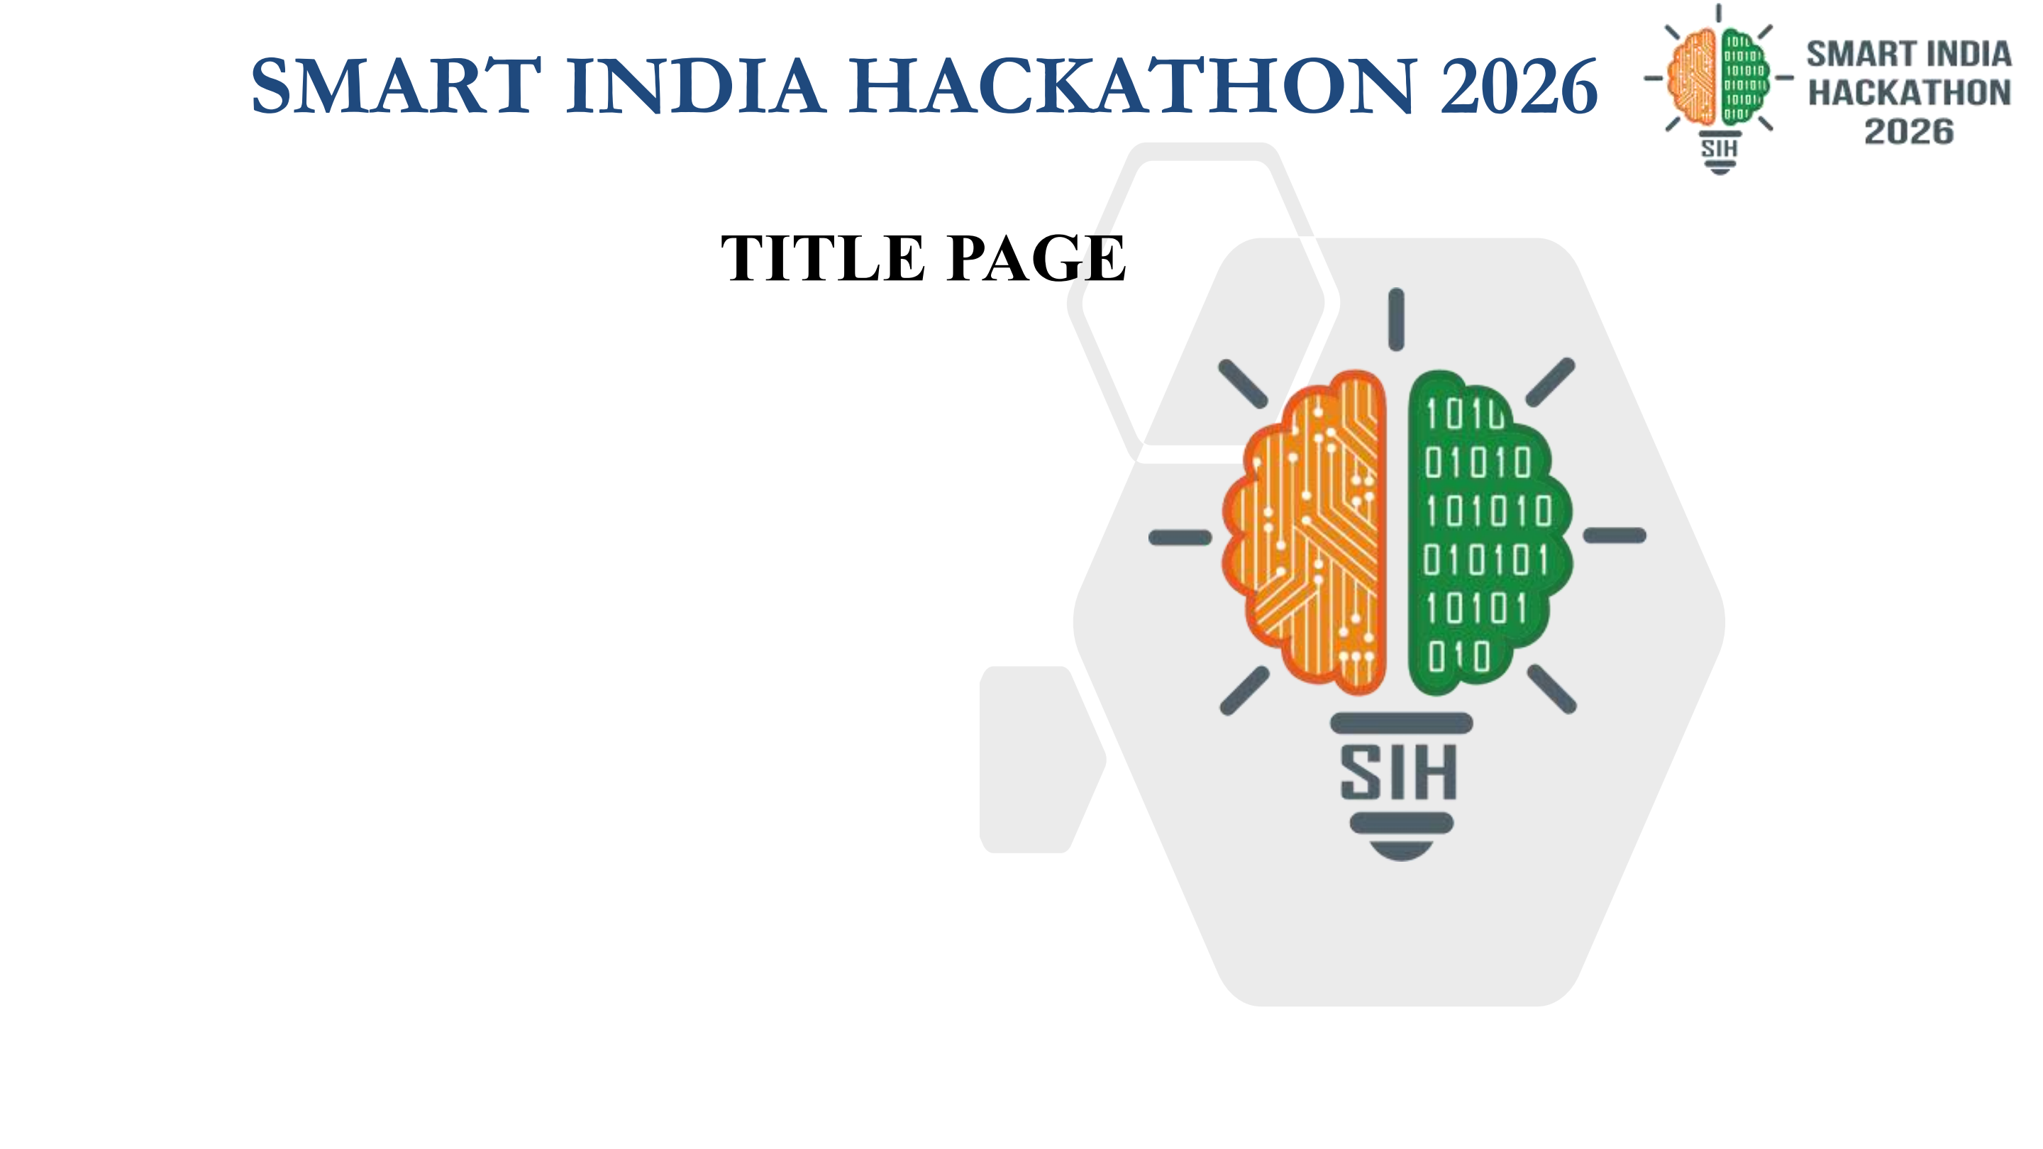
BhoomiSetu-AI (भूमिसेतु / ଭୂମିସେତୁ)
Predictive Analytics & Visual Governance System for Early Detection of Land Acquisition Delays
Shifting Acquisition from Reactive Firefighting to Proactive Early Intervention
OFFICIAL SUBMISSION DETAILS
• Problem Statement ID – 26017
• Problem Statement Title – Predictive Analytics of Land Acquisition Delay
• Theme – Smart Automation
• PS Category – Software Edition
• Team ID – SIH2026-TEAM-BHOOMOBYTES
• Team Name (Registered on portal) – BHOOMOBYTES
★ WORKING PROTOTYPE VALIDATED: React GIS + FastAPI + Scikit-Learn (92.8% Acc, MAE 20.6d)

Slide 2
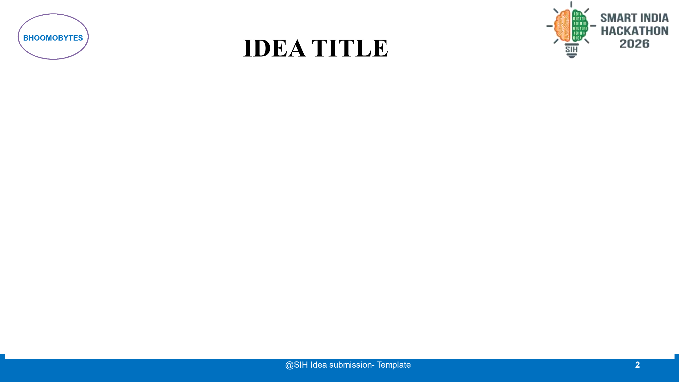
Proposed Solution (Describe your Idea/Solution/Prototype)
Shift from Reactive Delay Handling to Predictive, Visual, and Proactive Intervention
1. ADDRESSING THE PROBLEM
2. DETAILED PROPOSED SOLUTION
3. INNOVATION & UNIQUENESS
TRADITIONAL REACTIVE PROCESS
• Late Detection: Bottlenecks discovered only after statutory milestones lapse (>180 days lost).
• Dense Paperwork: Field staff manually decode 40-page Khatians and paper title deeds.
• Departmental Silos: LAO, Surveyors, and Compensation lack shared real-time status.
• Landowner Distrust: Lack of tracking creates disputes and prolonged court stays.
👤 Land Acquisition Officer (LAO)
Executive Triage & Task Dispatch
Monitors corridor delay probability, triages high-risk villages, assigns field survey tasks, sanctions awards.
Total Land Parcel: 1.00 Acre (Plot #142/A)
▶ Required for Corridor: 0.50 Acre
⚠ DISPUTED SLICE (0.18 Acre): Partition stay
👤 Survey Officer (SO)
Cadastral Verification & Demarcation
Verifies boundaries via GIS demarcation, inspects disputed plot slices, logs physical field reports.
Transforms dense Khatians into interactive boundary demarcation with real-time risk alerts.
BHOOMISETU PREDICTIVE SHIFT
✔ Day-0 Early Detection: ML risk engine scores cases at initial project registration.
✔ Root-Cause Identification: Identifies exact drivers (disputes, missing papers).
✔ Dynamic Recalculation Loop: Officer action immediately drops risk (84% ➔ 45%).
✔ Cadastral Geo-Visualization: Slices plots to highlight disputed portions in red.
✔ Transparent Citizen Bridge: Multilingual SMS + portal updates for farmers.
👤 Compensation Officer (CO)
9-Stage Disbursement Pipeline
Maintains escrow accounts, verifies Aadhaar/bank passbook OCR scans, tracks RTGS payouts with zero leakage.
KEY DIFFERENTIATORS:
• Micro-Demarcation: Isolates disputed 0.18 Ac so uncontested 0.32 Ac proceeds immediately.
• RapidFuzz OCR Discrepancy Engine: Scans deeds and flags name/khatian typos before submission.
• Actionable Recommendations: Generates specific legal task queues, not just abstract probability.
👤 Landowner / Citizen
Empowerment & Instant Grievance
Trilingual portal (EN/HI/OR) to track case progress, upload RoR deeds, and file instant grievance tickets.

Slide 3
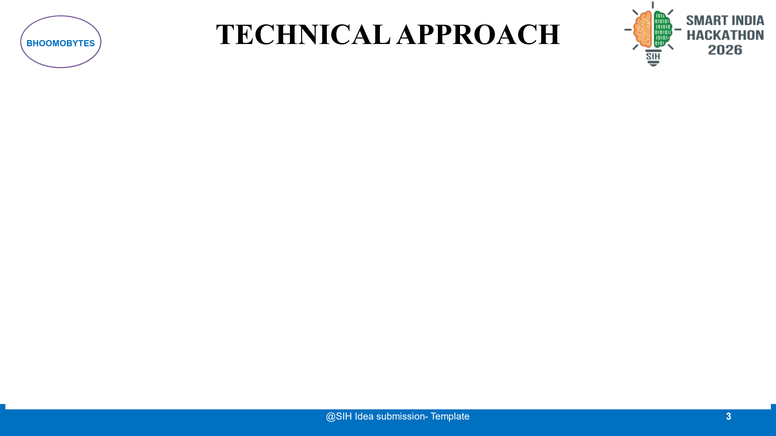
Technologies to be Used & Methodology for Implementation
Production-Ready Architecture, 6-Stage Process Flow, and Validated Machine Learning Benchmarks
TECHNOLOGIES TO BE USED
METHODOLOGY & PROCESS FLOW
ML PREDICTION ENGINE
⚙ Frontend Layer
React 18 + Vite + Tailwind CSS
Leaflet GIS maps, Recharts analytics, Lucide icons, i18next multilingual engine (English, Hindi, Odia).
Step 1: Case Registration & Deed Upload
Project corridor initialized; RoR deeds ingested.
VALIDATED TEST BENCHMARKS:
• Random Forest Classifier (150 Trees):
- Test Accuracy: 92.8% | ROC-AUC: 0.970
- Precision: 95.8% | Recall: 95.8% | F1: 95.8%
• Random Forest Regressor (150 Trees):
- Mean Absolute Error (MAE): 20.65 Days
- Root Mean Sq Error (RMSE): 28.03 Days | R²: 0.814
Step 2: RapidFuzz OCR Discrepancy Scan
Fuzzy string match catches name/khatian typos.
⚙ Backend API Layer
FastAPI (Python 3.11) + Pydantic v2
Asynchronous REST endpoints (<45ms latency), JWT role authorization, RapidFuzz OCR string discrepancy engine.
Step 3: 17-Factor Statutory Feature Ingestion
Ingests dispute counts, survey %, and clearances.
⚙ Database & Geospatial
PostGIS / PostgreSQL + SQLite
Cadastral GeoJSON polygon layers, spatial coordinate indexing, relational schema for 80+ seed parcels.
Step 4: Dual ML Inference & SHAP Explain
Calculates delay probability, days, and root causes.
SHAP EXPLAINABILITY BREAKDOWN:
• 1. Active Title / Co-Sharer Disputes: +38% Risk impact
• 2. Cadastral Field Survey Pending (<70%): +28% Risk impact
• 3. Missing / Discrepant RoR Deeds: +22% Risk impact
• 4. Delayed Compensation Pipeline (<50%): +18% Risk impact
• 5. Overdue Statutory Milestone: +16% Risk impact
⚖ Note: Advisory intelligence; statutory awards require human sign-off.
Step 5: Visual Survey Cadastral Demarcation
Surveyor verifies boundaries on interactive GIS map.
⚙ ML Decision Engine
Scikit-Learn + SHAP + Joblib
Random Forest Classifier & Regressor, TreeExplainer for feature attribution, dynamic recalculation service.
Step 6: Dynamic Risk Recalculation Loop
Officer action drops case risk immediately (84% ➔ 45%).

Slide 4
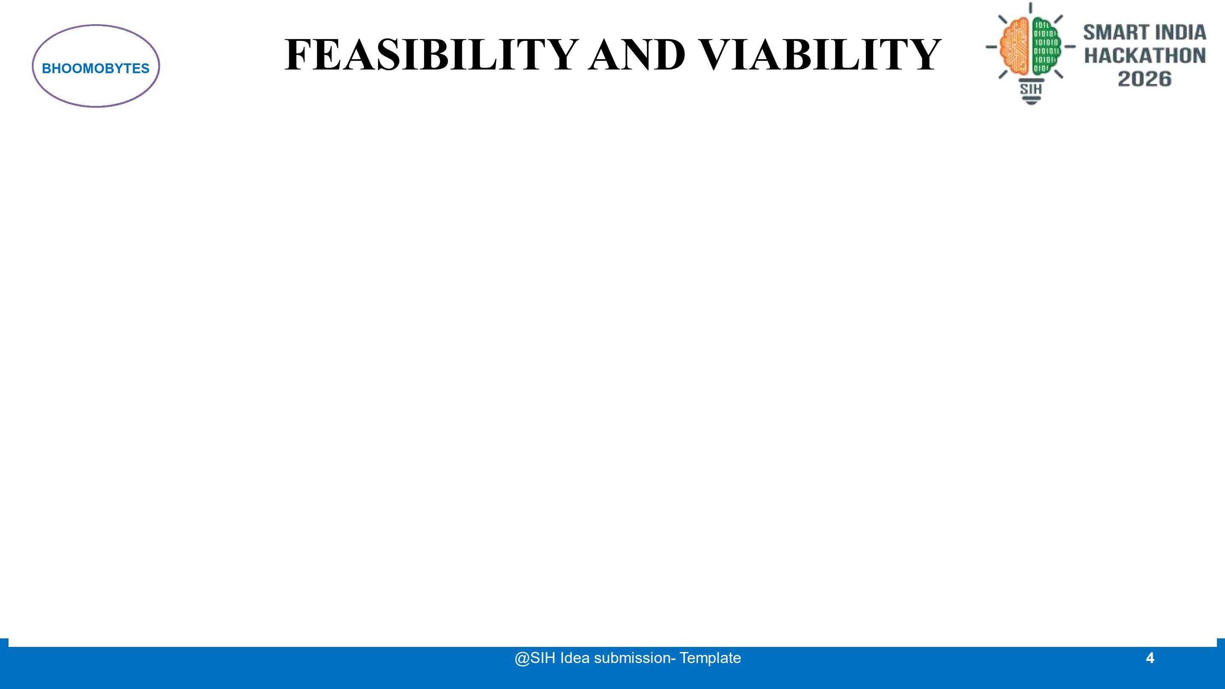
Analysis of Feasibility, Potential Challenges, and Practical Mitigation Strategies
Systematic 4-Pillar Evaluation & Production Risk Control Framework
✔ Technical Feasibility
Low-Overhead Stack
• REST API response time <45ms.
• Runs on standard commodity servers or state cloud (NIC / MeghRaj).
• Zero proprietary GIS vendor lock-in (uses Leaflet & GeoJSON).
✔ Operational Feasibility
Role-Tailored Workflows
• Fits directly into daily duties of LAO, Survey, and Compensation Officers.
• Zero workflow disruption: pairs alongside existing e-Office steps.
• Trilingual citizen portal (EN/HI/OR) ensures easy farmer adoption.
✔ Legal Feasibility
RFCTLARR Act 2013
• Strict statutory mapping to Sec 11, 19, and 25 award deadlines.
• Role-based immutable audit trail preserves evidentiary court integrity.
• Human-in-the-loop: AI remains strictly advisory.
✔ Financial Viability
Cost Avoidance
• Avoids 15-30% capital cost escalations on highway/rail corridors.
• 100% open-source core stack cuts recurring proprietary licensing fees.
• Low compute footprint cuts server CapEx.
POTENTIAL CHALLENGES, RISKS & STRATEGIC MITIGATIONS
⚠ CHALLENGE: Data Incompleteness & Cold-Start Scarcity
Risk: Newly digitized tehsils or revenue divisions may lack historical project performance records. ➔ Mitigation: Hybrid architecture combining statutory milestone clocks with ML, bootstrapping confidence as survey data accumulates.
⚠ CHALLENGE: Legacy Record Discrepancies & Name Variations
Risk: Spelling variations between handwritten RoR deeds, voter IDs, and bank passes stall compensation. ➔ Mitigation: RapidFuzz Levenshtein string-similarity OCR discrepancy pipeline flags mismatches for proactive review before bank submission.
⚠ CHALLENGE: Field Resistance & Officer AI Skepticism
Risk: Revenue staff may distrust automated 'black-box' delay predictions or fear administrative surveillance. ➔ Mitigation: White-Box SHAP Explainability shows exact legal reasons (+38% dispute, +28% survey lag), acting as a helpful paperwork assistant.

Slide 5
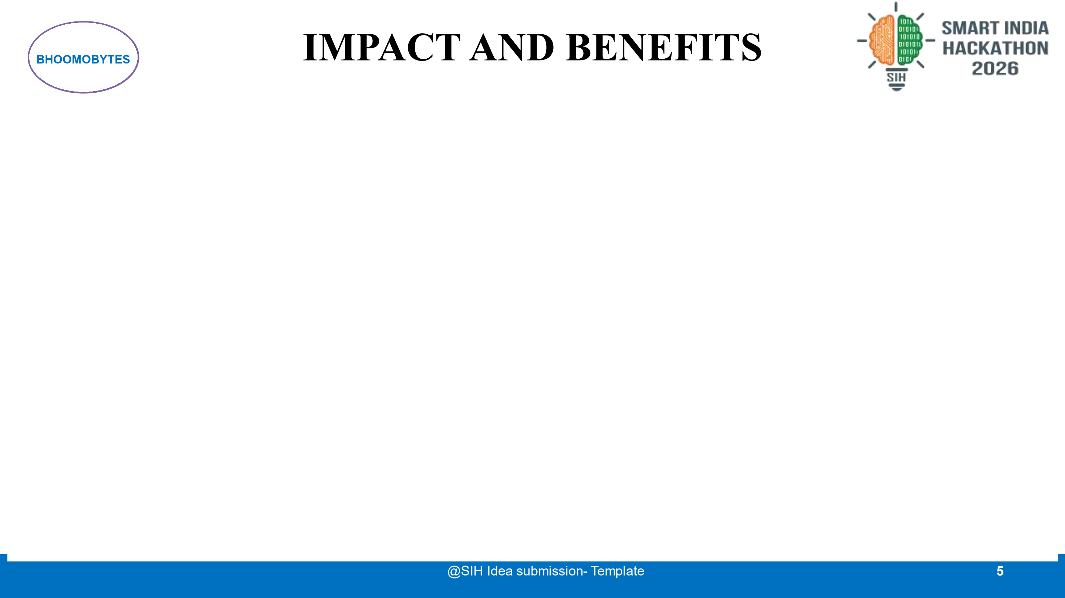
Potential Impact on Target Audience & Multi-Dimensional Benefits
Social, Economic, and Governance Value Proposition with Simulation Targets
POTENTIAL IMPACT ON TARGET AUDIENCE
MULTI-DIMENSIONAL BENEFITS & BENCHMARKS
👤 Land Acquisition Officer (LAO) — Strategic Executive Visibility
• Corridor-Wide View: Instantly filters cases by risk tiers across tehsils.
• Proactive Bottleneck Elimination: Reallocates survey teams to high-risk zones 3-6 months before deadlines lapse.
• Automated Reporting: Eliminates weeks of manual progress compilation.
★ ECONOMIC BENEFITS (National Capital Efficiency)
• Drastic Reduction in Capital Idling: National Highway projects incur crores per month in financing costs during delay stays.
• Faster Monetization: Accelerates PM GatiShakti multi-modal logistics corridors.
👤 Survey Officer (SO) — Precision Cadastral Field Guidance
• Visual Demarcation: Clearly isolates 0.5-acre required plot from 1-acre parcel.
• Conflict Spotting: Problematic / disputed co-sharer strips are pre-flagged in red.
• Rapid Survey Sign-off: Closes verification cycles in days instead of months.
★ SOCIAL & COMMUNITY BENEFITS (Farmer Welfare)
• Eliminates Intermediaries: Direct DBT compensation tracking protects rural titleholders.
• Accelerated Rehabilitation & Resettlement (R&R) package disbursement.
★ GOVERNANCE & ADMINISTRATIVE INTEGRITY
• Statutory Compliance: Enforces RFCTLARR Act 2013 legal milestones (Sec 25 lapse prevention).
• Data-Driven Accountability: Quantifiable officer performance audit logs.
👤 Compensation Officer (CO) — Leakage-Proof Disbursement
• 9-Stage Milestone Pipeline: Transparent tracking from award sanction to RTGS.
• Zero Fraud: Cross-checks RoR title records against bank passbook OCR scans.
• Reduced Audit Queries: Complete tamper-evident transaction logs.
PROTOTYPE OBJECTIVE TARGETS (SIMULATION BENCHMARKS):
• Early Risk Visibility: Day 0 vs Day 180+ — Flags high delay probability upon initial case registration.
• Survey Demarcation Speed: 60% Faster Triage — Isolates disputed land slices so undisputed plots proceed.
• Grievance Redressal Cycle: <72 Hr SLA — Direct digital tracking avoids physical tehsil visits.
👤 Landowners & Farmers — Dignity, Transparency & Timely Payouts
• Multilingual Access: Farmers view parcel status in English, Hindi, or Odia.
• Grievance Transparency: Digital ticket tracking eliminates repeated office visits.
• Fairness: Early conflict identification enables mediated settlement.

Slide 6
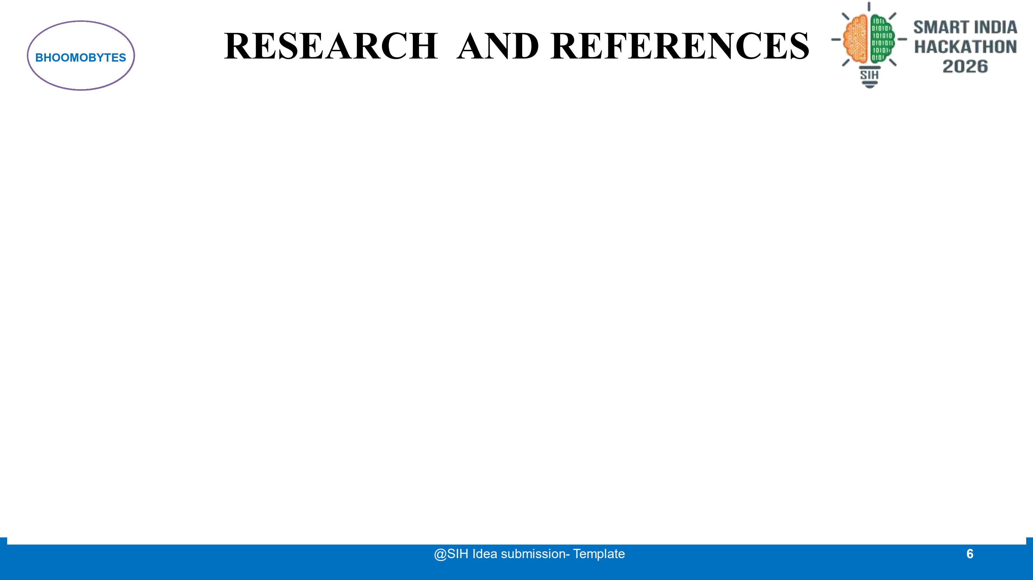
Details and Links of Reference and Research Work
Statutory Frameworks, Empirical Audit Studies, Peer-Reviewed AI Research & Implementation Integrity
1. STATUTORY & POLICY FRAMEWORKS
• Right to Fair Compensation & Transparency in Land Acquisition (RFCTLARR Act, 2013): Ministry of Rural Development, GoI. Statutory milestones: Sec 11 (Preliminary Notification), Sec 19 (Declaration), Sec 25 (Lapsing of award period if delayed >12 months).
• Digital India Land Records Modernization Programme (DILRMP): Department of Land Resources (DoLR), GoI. Guidelines for cadastral parcel digitization, computerized RoR maintenance, and integration with registration authorities.
• PM GatiShakti National Master Plan: Logistics Division, DPIIT. Multi-modal infrastructure coordination principles to eliminate departmental silos and accelerate project clearance pipelines.
2. EMPIRICAL STUDIES & AUDIT REPORTS
• CAG Audit Report on National Highway Corridors (Report No. 19 of 2020): Comptroller & Auditor General of India. Documented that 68% of highway delays stem from delayed land handover, pending joint cadastral surveys, and stalled compensation.
• MoSPI Monthly Flash Reports on Infrastructure Projects: Ministry of Statistics & Programme Implementation (MoSPI). Consistent analysis identifying land acquisition litigation and disputed titles as the primary driver of cost overruns.
• NITI Aayog Research Paper on Land Governance & Titling: Highlighting land dispute resolution mechanisms and conclusive titling reforms across Indian States (State Bhulekh & Bhoomi portals).
3. AI/ML & GEOSPATIAL RESEARCH
• Explainable Artificial Intelligence (SHAP Framework): Lundberg, S. M., & Lee, S. I. (NeurIPS 2017). 'A Unified Approach to Interpreting Model Predictions.' Applied via TreeExplainer for legally accountable feature attribution in public administration.
• Ensemble Modeling for Tabular Delay Prediction: Breiman, L. (2001). 'Random Forests.' Applied for high-dimensional tabular risk estimation across 17 statutory case features with robust noise resilience.
• OGC Geospatial & GeoJSON Standards: Open Geospatial Consortium (OGC) specifications for Cadastral Boundary Models, DGPS coordinates, and parcel topology partitioning.
4. IMPLEMENTATION HONESTY & ROADMAP
✔ PROTOTYPE IMPLEMENTATION (Fully Built in Repository):
• End-to-end working software: FastAPI backend, React 18 frontend, SQLite/PostGIS.
• Dual ML models: Classifier (92.8% Acc) + Regressor (MAE 20.6d) trained on 2,000+ records.
• Cadastral plot visualization prototype with 1-acre to 0.5-acre parcel slicing & dispute alerts.
• 4-Role RBAC authentication, RapidFuzz OCR discrepancy engine, dynamic risk loop.
✔ FUTURE INTEGRATION ROADMAP (Production Scaling):
• Direct API federation with State Land Portals (e.g. Odisha Bhulekh, Karnataka Bhoomi).
• Drone/LiDAR orthomosaic imagery overlay for automated physical encroachment detection.
• Tamper-proof hyperledger audit trail for immutable award disbursement records.

